Slide 1
Start the change-
First steps to reducing emissions
June Davenport, Sustainability Team Manager,
Groundwork

Slide 2
What are your drivers for reducing your business carbon footprint?
Energy costs?
Climate Change Ask / Procurement Tenders?
Environmental Policy?
Staff interested?
Everyone else is setting Net Zero Targets?
Notes:
All or any of the above – mean change is essential but where to start?

Slide 3
Whatever they are remember you can’t change what you don’t measure….

Slide 4
STEP 1: Where are emissions coming from?
Premises – space/water heating, lighting etc (gas, oil, LPG, electricity, air con)
Equipment/production
Transport
Waste disposal
Value chain – products & services procured, your own products & services

Slide 5
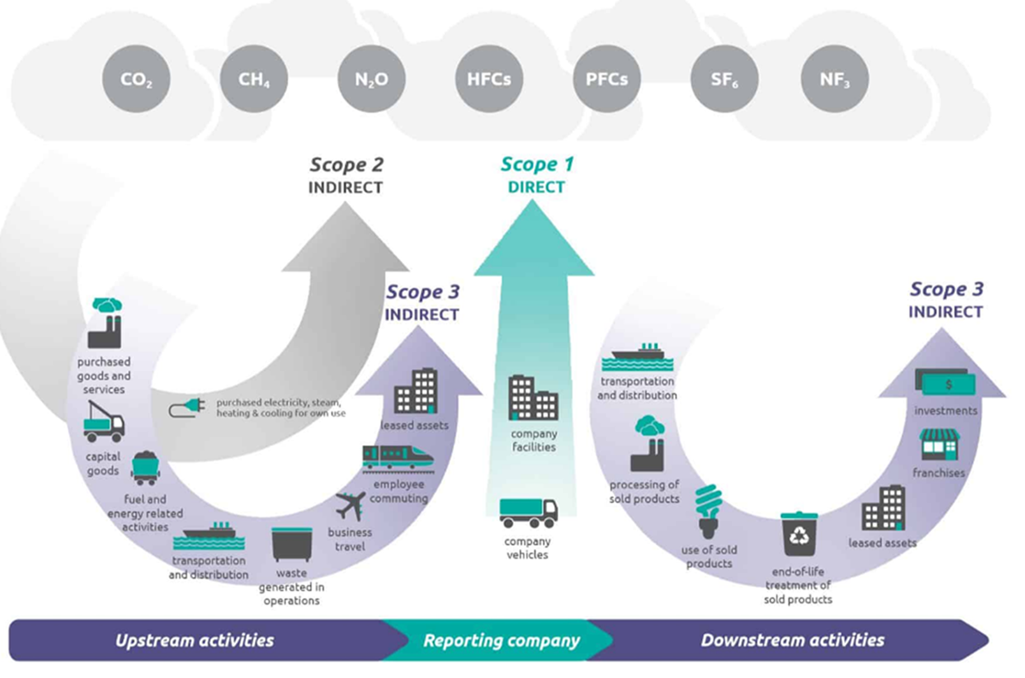
Notes:
Scope 1 emissions - relate to direct use of emissions sources – such as burning gas or other heating fuels, and vehicle use, as well as leakages from refrigerants.
Scope 2 emissions - involves indirect use – principally electricity, which is generated off-site but used on-site.
Scope 3 emissions - include anything up or downstream of your operations – this includes business travel, purchased goods and services, water and waste
Talk about what goes into each one (pictured)

Slide 6
STEP 2: Getting to grips with the numbers
Scope 1 & 2
Recent 12 months (calendar year or FY)
Gas/oil/LPG consumption (meter reads or delivery invoices) in kWh, m3, litres, kg
Business vehicle fuel consumption (preferable) or mileage (fuel card data, invoices, miles travelled and type of vehicle) in litres or miles
Electricity consumption at your premises (meter reads, supplier bills, landlord charges) in kWh
Notes:
Starting with Scope 1 and 2, data needs to cover a recent 12 month period and should be in units of consumption.
So, oil, gas, LPG etc from meter readings or delivery invoices
Fuel consumption in litres from fuel cards, you can also use miles travelled but this is generally less accurate.
And also electricity consumption which is always in kWh hours and can come from meter reads, supplier bills or sometimes landlord charges.

Slide 7
Value chain emissions-Scope 3
Employee business travel (expenses claims) in miles
Employee commuting in miles
Waste production (including volume recycled) in kg or tonnes
Transport and distribution in litres of fuel or miles
Working from home in working hours
Water (bills, meter reads)

Slide 8
STEP 3: Use a simple carbon calculator tool
Free Carbon Calculator Tool - www.carboncharter.org/footprint
UK carbon conversion factors - www.gov.uk/government/collections/government-conversion-factors-for-company-reporting
Join the Carbon Charter use your member support to calculate your carbon footprint – www.carboncharter.org/contact-us/

Slide 9
STEP 4: What can be improved and how?
Buildings Efficiency improvements?
  Quick Wins
  Mid Term Investments
Transport Efficiency improvements?
  Quick Wins
  Mid Term Investments

Slide 10
BUILDINGS Efficiency = quick wins
Ensure your premises are well insulated and heated efficiently
Service regularly (boiler/heating system/cooling system)
Turn down your thermostat and use smart controls
Choose low energy appliances - look for A+ ratings, LED lights
Turn off appliances rather than leaving them on standby

Slide 11
BUILDINGS Efficiency- Mid term investment
LED lighting
Renewable energy generation (onsite)
Offsite investment in renewable technology
Consolidate or move to low/zero carbon building

Slide 12
TRANSPORT Efficiency = quick wins
Become more efficient – route planning; consolidation of deliveries and orders; good maintenance and efficient driving, car sharing
Encourage the use of public transport and active travel
Avoid physical movements - use virtual meetings where possible; work from home.

Slide 13
TRANSPORT -Mid term investment
Upgrade to more efficient ICE vehicles (Adblue etc) and hybrid
Switch to alternative fuels – electric vehicles, HVO, hydrogen
Support electrification through charging infrastructure
Encourage staff to switch through salary schemes

Slide 14
Real example – Precision Marketing
First steps process working with Carbon Charter/Groundwork
Started reviewing energy bills and calculated emissions
Calculated current carbon footprint and action plan
Established a Green Champion to implement actions
Advised on how waste and recycling is dealt with
Switched to Electric vehicles and Solar PV
Notes:
Nick Pryke - Becoming carbon neutral is something we have been striving towards for the past 6 years, for our customers, for our employees and for the planet. Since the beginning of 2020 we have officially been operating a carbon neutral business model, but our journey won’t stop there, we will continue to introduce new sustainable initiatives, new ways of working to improve our carbon footprint and reduce our impact on the environment as part of our carbon neutral company commitment."

Slide 15
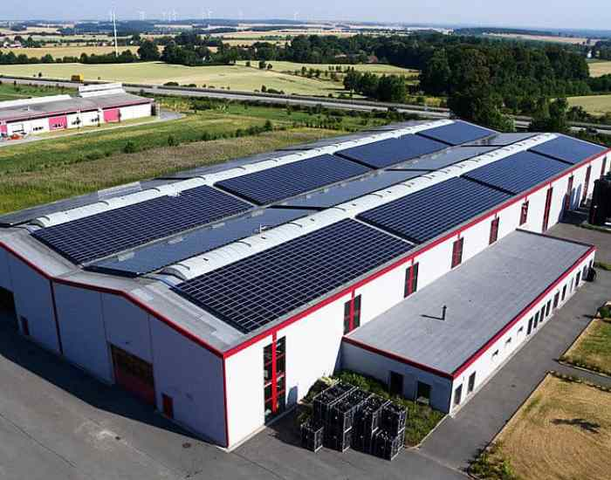
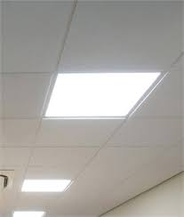
Real example – Box-It East
First Steps – Measured their emissions and implemented measures to reduce by switching to LED lighting and solar photovoltaics on the roof
Notes:
Suggested upgrading their lighting to LED which saved 13,910Wh/year (£1,682 and 8.0tCO2e).
Recommended installing a 46.9kWp solar PV system to suitable roof space which can generate 44,906kWh annually, equating to around 50% of the site’s total estimated annual consumption
Suggested the enrolment into the Carbon Charter to help continue to make improvements towards net zero.

Slide 16
Real example - Lignacite
First steps process working with Groundwork
Started reviewing energy bills and calculated emissions
Suggested equipment change to more energy efficient models
Recommended the use of LEDs
Advised on how waste and recycling is dealt with
Gave advise for staff to act more sustainably
Advised on better ways to run energy intensive equipment
Notes:
Lignacite, formed in 1947, manufactures concrete blocks for the construction industry from manufacturing plants located in Suffolk and Essex, this certification covers their Suffolk, Brandon site. Lignacite has continually developed innovative mixes and designs for their building blocks; more recently testing and successfully utilising many recycled materials to produce more sustainable products. They are committed to an extensive R & D programme ensuring they stay at the cutting edge of the construction industry

Slide 17
What next?
Talk about it – get your staff onboard, share with stakeholders
Start tracking your emissions, check bills and record data
Prioritise action
Set reduction targets
Measure progress
Review and refine reporting process

Slide 18
First steps –help available https://carboncharter.org/first-steps/
Useful guides available covering all of these to help any business
Calculate a carbon footprint
Develop a carbon reduction policy and action plan
Get your staff onboard
Make buildings more efficient
Consider renewable energy
Dealing with transport, waste, carbon offsetting

Slide 19

The future- Carbon Charter www.carboncharter.org
Supporting businesses to reduce carbon and reach Net Zero.
An environmental award scheme and sustainable business network for SMEs in Suffolk and Norfolk.
Key to certification - carbon emissions reductions and communication (internally and externally).
Employees are key to businesses meeting their environmental objectives and enhancing their reputation.

Slide 20
Groundwork Carbon Management Services
Establishing a pathway to net zero
Carbon Literacy training
Green House Gas inventory and reporting
External assurance of company reporting
Prioritisation of carbon reduction actions
Resource efficiency, energy efficiency and carbon management assessments –funded programmes still available!

Slide 21
Q&As
Any questions?
June.davenport@groundwork.org.uk
www.groundworksbs.org.uk

