Slide 1
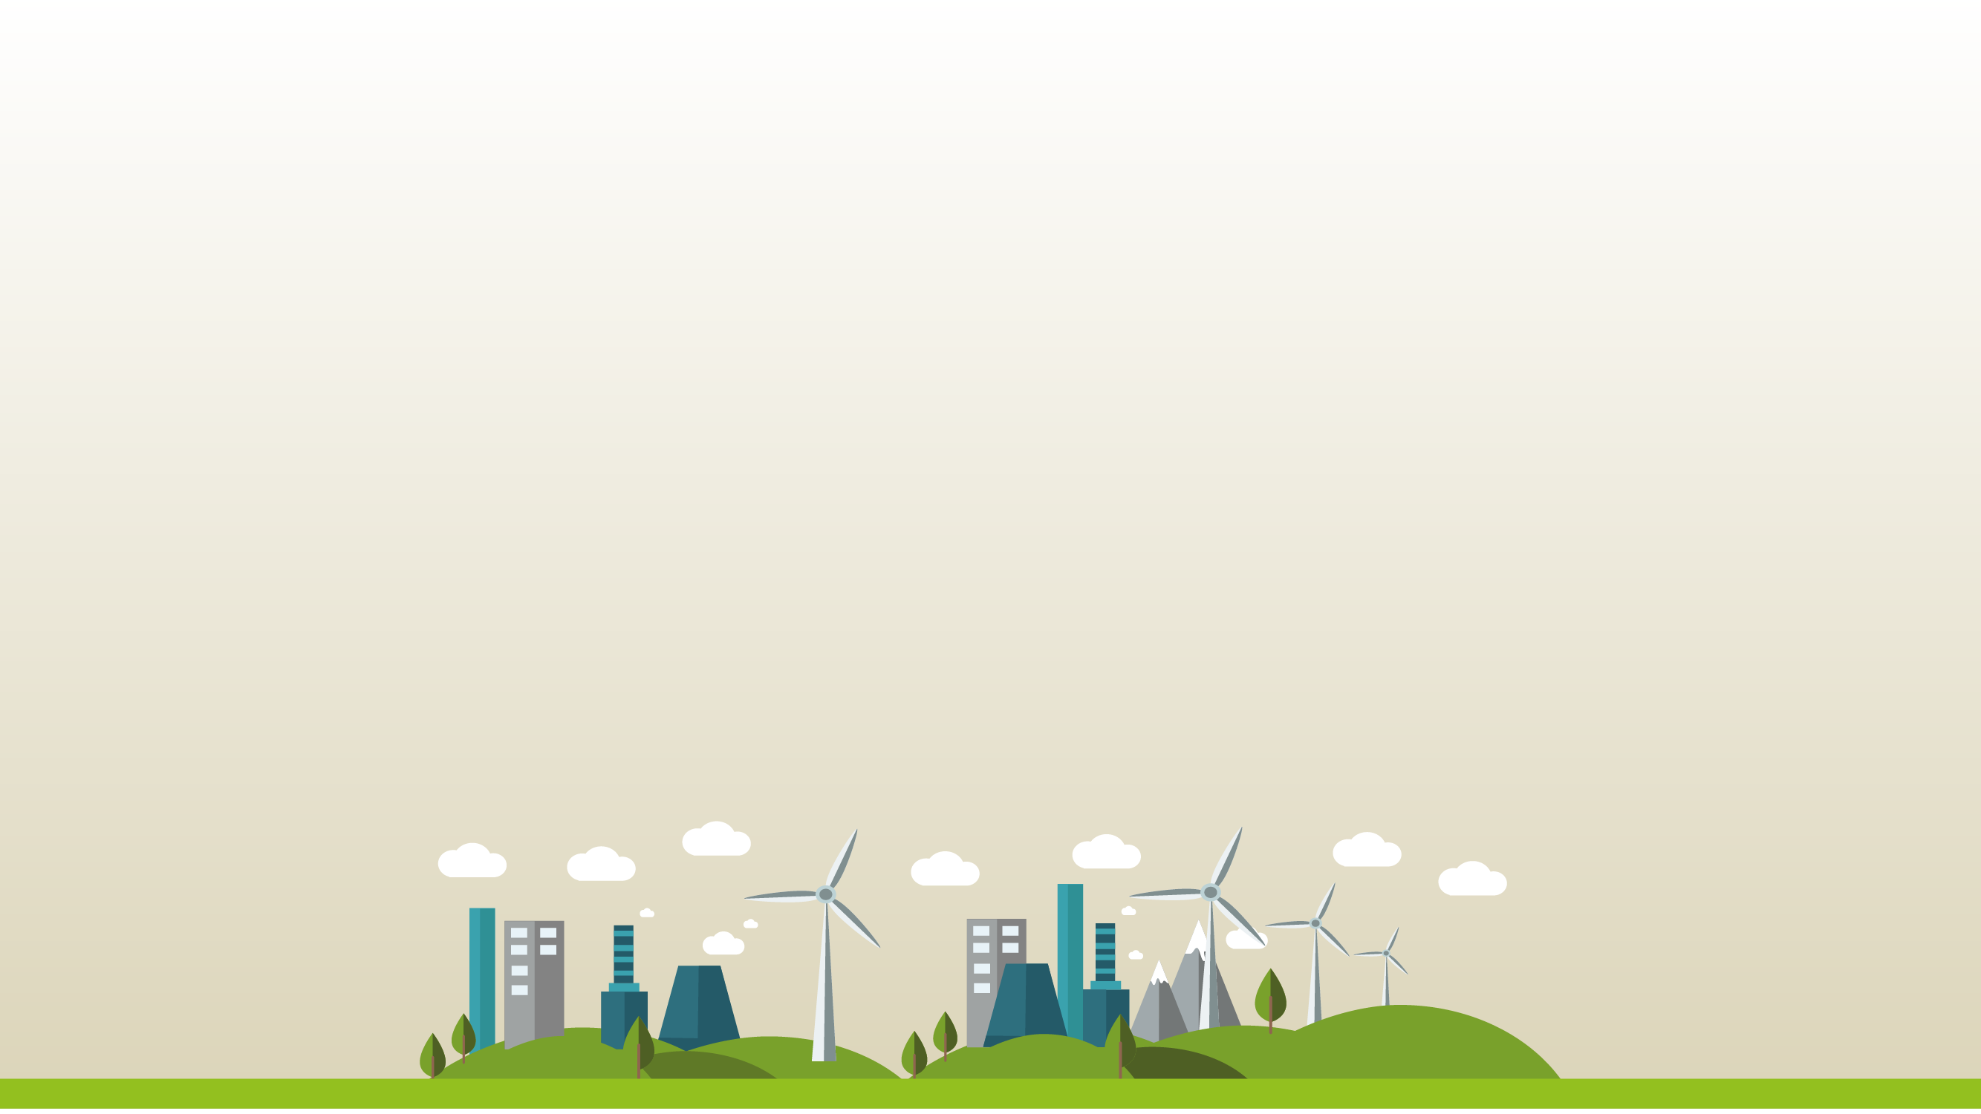
An Introduction to Carbon Literacy Amy Coulter, Groundwork
7th November 2022
Notes:
Intro Amy Coulter, Lead Sustainability Consultant Gwk East.
Gwk East is an environmental charity working across the EoE and we deliver the Carbon Charter in partnership with SCC.

Slide 2
Carbon Charter - www.carboncharter.org
Supporting businesses to reduce carbon and reach Net Zero.
An environmental award scheme and sustainable business network for SMEs in Suffolk and Norfolk.
Key to certification - carbon emissions reductions and communication (internally and externally).
Employees are key to businesses meeting their environmental objectives and enhancing their reputation.
Notes:
Quick background to the Carbon Charter.
Hopefully there will be some of you out there who area already members of the Charter and who have worked with us over the years.
13+ years
500+ organisations
Last year we developed a Carbon Literacy course for SMEs which we deliver to our members and the wider business community.
Key to certification - carbon emissions reductions and communication and we realised that training would be a benefit to our members. To date we have run 6 courses and trained around 70 individuals from a range of different businesses.

Slide 3
What is Carbon Literacy?
“An awareness of the carbon dioxide costs and impacts of everyday activities, and the ability and motivation to reduce emissions, on an individual, community and organisational basis.”
Carbon Literacy Project www.carbonliteracy.com
Notes:
CL = quite a common term these days. Used in different ways.
So, the definition of CL by the Carb Lit Project is …
Carbon Literacy Project was established in Manchester, it is an independent educational charity which was recognised at COP21 in Paris in 2015 and has been certifying individuals and organisations since then.

Slide 4
Carbon Literacy Action Day
7th November 2022
40,000+ individuals certified as Carbon Literate
Courses running simultaneously around the world
Carbon Literacy Project: www.carbonliteracy.com
Notes:
Why is this important?
Particularly relevant as day 1 of COP 27.
40,000+ indivs now certified.
The way the process works is that organisations develop their own courses which are signed off by the Carb Lit Project and which can then lead to formal certifications for individuals .
ILOs- Bronze, Silver, Gold and Platinum.

Slide 5
Why Carbon Literacy?
Carbon savings 5-15%
Communication
Shared responsibility
Tools
Motivation
Notes:
Why is carb lit beneficial to individuals and organisations?
Why do you or your employees need to be carbon literate?
Research shows that it supports people to make significant carbon savings. Pledges.
Communication is key to the Carbon Charter – particularly when you get to the Gold level - it is vital that each of us are equipped to communicate on these topics, be that in conversation, in the board room or on social media.
Tools - The aim is to support people to be able to be confident in the decisions that they make with regards to their impact on the climate, and to encourage us all to start talking about climate change and give people the tools, the knowledge to talk about these issues and communicate to people within their organisations and externally, about what they are doing and why.
Motivation – the people attending my courses often want to let me know how motivated they feel to make changes within the organisation and also their home life.
CL at Gwk East – lead to lots of changes, asking why do we do things the way we do?

Slide 6
Carbon Literacy course outline
The science and effects of climate change
Understanding how this relates to your business or organisation
Carbon footprints and why these are important
How our actions at home and at work can have an impact
Carbon reduction targets
Developing a carbon reduction plan and getting to Net Zero
Notes:
The Cab Lit courses I’m talking about are approved by the CLP and there are several key aspects which must be covered in order for delegates to be certified as CL.
Core topics include:

Slide 7
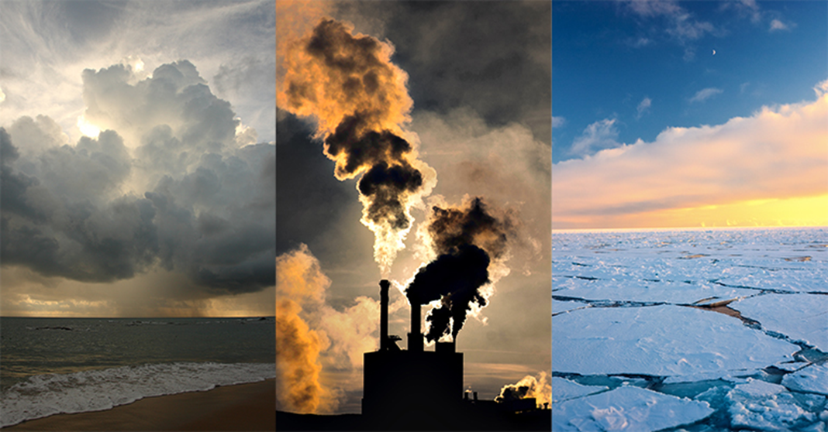
Jargon Busting:
Weather & climate
Global warming & climate change
Greenhouse effect & greenhouse gases
Global warming potential (GWP)
Carbon dioxide equivalent (CO₂e)
Carbon footprint
Carbon neutral & Net Zero
Notes:
Today I just want to give you a feel of what is included in the course and also to give you some useful take-aways from the webinar.
So. I’ve picked 3 key terms to explore in this introductory session:
Greenhouse gases
Carbon footprint
Net Zero
Then wrap up with some actions to reduce emissions and start the journey to net zero
Lots of what I talk about will be familiar to you but one key aspect of the CL training is to ensure that everyone has confidence in using terminology and phrases in conversation. And it might be that you have been away of these words and concepts for so long that actually you would benefit from a reminder of what it’s all about.

Slide 8
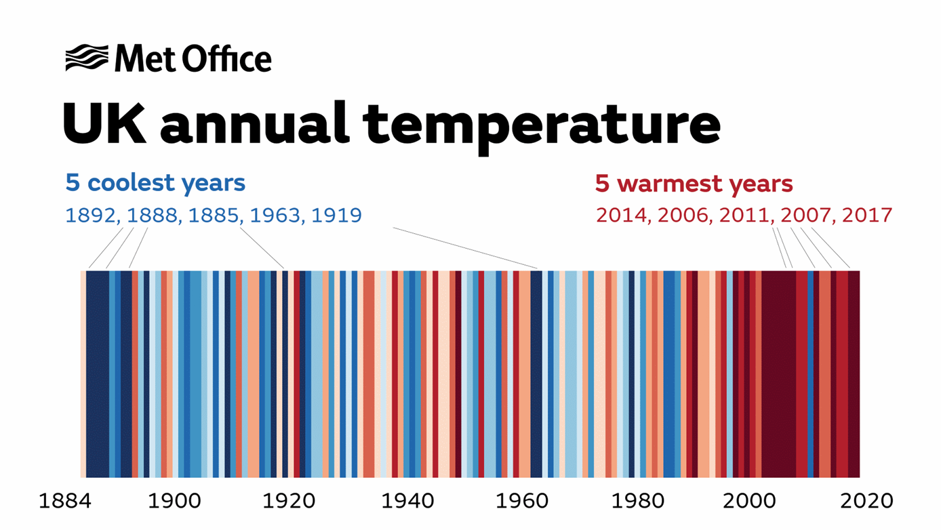
Notes:
Let’s start by thinking about the science behind climate change and the evidence we are seeing of this changing climate.
This image represents the change in average annual temperatures in the UK, using colour. Each year has been given a colour – dark blue being the coolest and dark red the warmest.
And what is blindingly obvious from this is the way that the reds are on the right of the illustration and the cooler blues are on the left, corresponding to the earlier years from 1884.
And we can see that some of you may remember the hot summer of 1976 – or have heard about it, there was a drought and very high temperatures. You can see in this illustration that it was a pink year, and more recently 2017 was also a very hot year in the UK – which is dark red here.

Slide 9
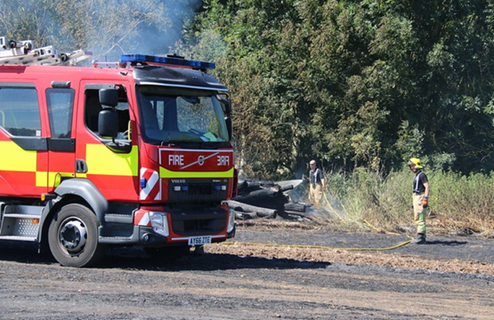
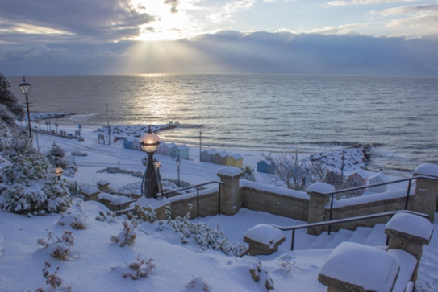
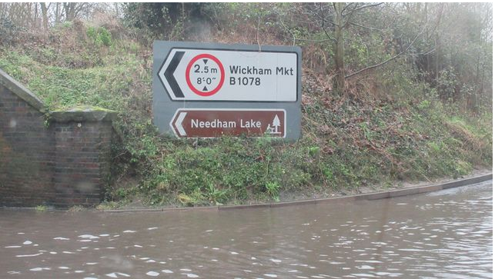
Climate change is happening …
Notes:
So this change in temperature is leading to changes in our weather patterns and climate.
We’re seeing increased outbreaks of wildfires, unusual cold events (Texas in 2021) and of course flooding.
So, for example with the flooding – warmer air means it can hold more moisture which leads to more heavy rain events, built up areas have little ground available for water to permeate and drain away and this leads to flooding events.

Slide 10
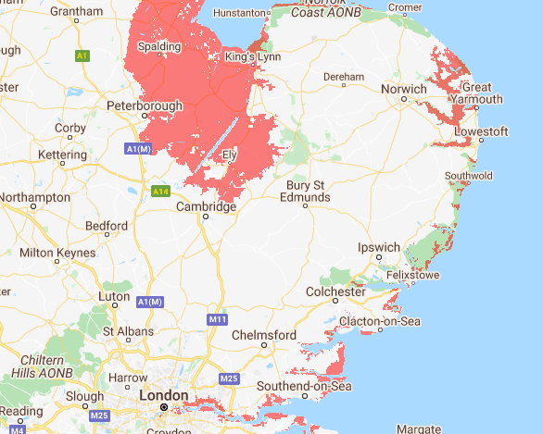
Notes:
One of the other key risks arising from global warming is the potential for sea levels to rise.
Recent studies from climate researchers from the University of Copenhagen’s Niels Bohr Institute show levels could rise as much as 1.35 metres by 2100, under a worst-case warming scenario.
This may shows areas at risk from sea level rise – this is based on a rise of 1.3m – you can model different scenarios with the costal risk screening tool www.coastal.climatecentral.org

Slide 11
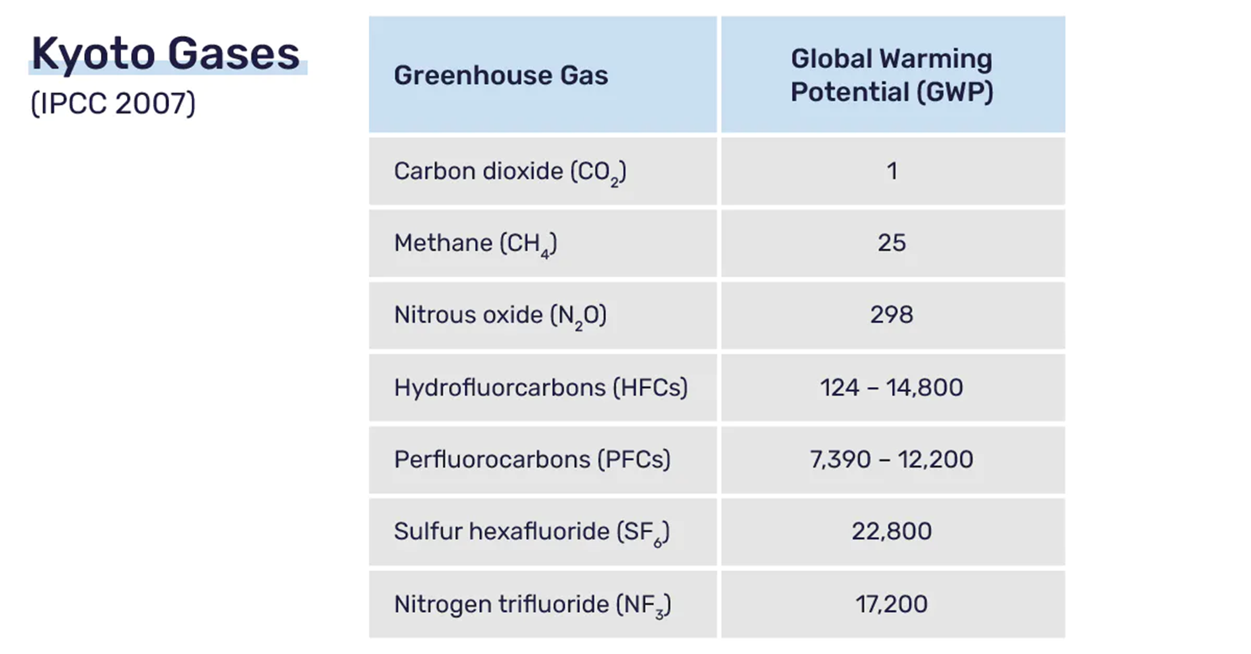
Greenhouse gases (GHG) contribute to the greenhouse effect
Global warming potential (GWP) - The GWP of a greenhouse gas is its ability to trap extra heat in the atmosphere over time (relative to carbon dioxide).
Carbon dioxide equivalent (CO₂e) takes into account the different GWP and puts it into an equivalent unit
Notes:
So, what’s causing this change in temperature?
GHGs contribute to the greenhouse effect. The greenhouse effect is the natural process through which gases in Easrth’s atmosphere trap heat. As I say, this is a natural process but what is occurring now is that our activities are generating much higher levels of these GHGs than in previous years (prior to the Indust Rev).
So each of the main GHGs – can see them in this table – has a GWP.
Global warming potential - The GWP of a greenhouse gas is its ability to trap extra heat in the atmosphere over time relative to carbon dioxide. See from the table CO2 has a GWP of 1.
CO2e – unit of measurement that takes account of the GWP of the different GHGs, allowing emissions to reported as a single figure.
These Greenhouse gases all have different global warming potentials. This means that they are more less potent.
Water vapour
We often use an equivalent – CO2e carbon dioxide equivalent in order to be able to calculate a ‘carbon footprint’ – this takes into account the different GWP and puts it into an equivalent unit which is what bodies such as the UN use to report on GHGs. Methane has a shorter lifetime
Company reporting is also in CO2e – carbon dioxide equivalent

Slide 12
Carbon Footprint
A measure of the GHGs you emit – tCO₂e
Important tool Carbon Charter and Carbon Literacy
Online calculators use carbon conversion factors
To consider: boundaries, timeframe, activities.
www.carboncharter.org/footprint
Notes:
We’re now going to look at carbon footprints, what the process is and what carbon footprints can show us.
A carbon footprint is defined as the ‘total amount of greenhouse gases produced directly or indirectly by a person, organisation, event or product and is usually expressed in equivalent tonnes of carbon dioxide (CO₂e). ‘
tCO2e – bundles all those GHGs together into a single unit of measurement.
Everyone done this? Key part of the Carbon Charter assessment process – should be calculating it annually in business.
Why is this useful?
It is an important tool to understand the impact of personal or organisational behaviour on global climate change and key to managing and reporting on carbon emissions.
Can’t manage what you don’t measure.
Carbon Charter has a tool and our advisors also help our businesses to calculate their emissions.
Key elements to consider:
Boundaries (of the business)
Timeframe – 12 months
Activities – what to include?

Slide 13
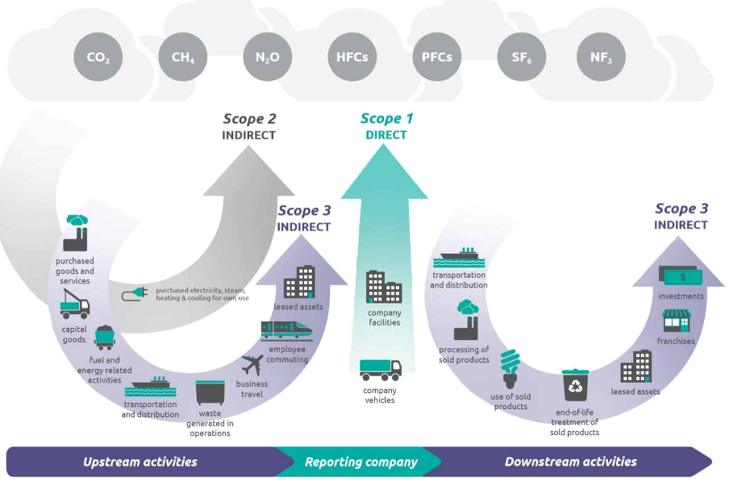
Notes:
What should a business include in its carbon footprint?
Lots of guidance available to business now and it tends to classify emissions into 3 categories or scopes.
Image from GHG Protocol – Scope 1 , Scope 2, Scope 3.
Always include Scope1 and Scope 2.
Government procurement requires Scope1, Scope 2 and 5 categories from Scope 3 – business travel, waste, commuting, transport & distribution (upstream & downstream).
PPN 06/21

Slide 14
Scope 1 and Scope 2 Emissions
1. Gas/oil/LPG consumption (meter reads or delivery invoices for oil and LPG) in kWh, m3, litres, kg
1. Business vehicle fuel consumption (preferable) or mileage (fuel card data, invoices, miles travelled and type of vehicle) in litres or miles
2. Electricity consumption at your premises (meter reads, supplier bills, landlord charges) in kWh

Slide 15
Scope 3 Emissions
3. Employee business travel (mileage from expenses claims, public transport) in miles
3. Employee commuting in miles
3. Water consumption (supplier bills, meter reads) in litres or m3.
3. Waste production (including volume recycled) in kg or tonnes
3. Working from home in working hours
3. Transport and distribution (upstream = you pay for) in litres of fuel or miles

Slide 16
‘Net Zero’ vs Carbon Neutral ‘Net zero’ - balance between the amount of greenhouse gas emissions (GHGs) produced and the amount removed from the atmosphere. Move to consensus on credible definition (UN Race to Zero, Science Based Targets Initiative). Accepts the need for ‘offsetting’ or carbon capture, use or storage (CCUS) Carbon Neutral – can be all done through offsetting, often just covers carbon dioxide emissions

Slide 17
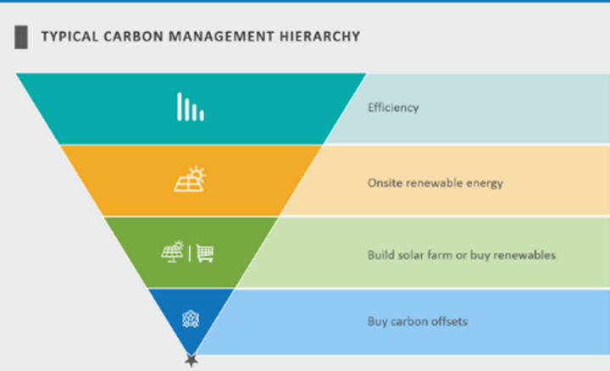
Notes:
Ensure your premises is well insulated and heated efficiently
Service regularly (boiler/heating system/cooling system)
Turn down your thermostat and use smart controls
Choose low energy appliances - look for A+ ratings, LED lights
Turn off appliances rather than leaving them on standby
Switch to renewable energy, install solar PV.
Offset.

Slide 18
Carbon Offsetting good practice
Start offsetting now, whilst simultaneously making emissions reductions
‘Net Zero’ – can use offsets but based on 90% reductions in actual emissions
Only use certified offset schemes – e.g. Gold Standard, VCS (Verified Carbon Standard), Woodland Carbon Code credits
Offset more than your carbon footprint – carbon positive
Notes:
A Carbon offset is a way to compensate for your emissions by funding an equivalent carbon dioxide saving elsewhere – usually through tree planting or land restoration but it can also be through investment in renewable energy.
Often hear the phrase carbon credit – so carbon offsetting is the process of purchasing and cancelling, carbon emissions credits equivalent to the carbon footprint of your activity.
May have happened anyway (not truly additional)
Projects must permanently lock away emissions (fires, pests etc)
Mustn’t lead to emissions happening elsewhere
Must drawdown more carbon than is being emitted
Mustn’t lead to delays (‘the promise of future offsets can delay action’, Lancaster University)
Must not buy up land and prevent access for indigenous groups.
The Carbon Trust only recognises Gold Standard, VCS and UK Woodland Carbon Code credits for offsetting.

Slide 19
Carbon Literacy Training
Carbon savings
Improve communication and staff engagement
Motivate you and your team
Provide tools to make better decisions
Delivered online or in person via range of learning methods, exercises, group discussions, external resources.
Next course Nov 2022 – email to reserve your space
Total 8 hours learning leading to Carbon Literacy certification.
Sign up now!
Notes:
A handful of places left on our course starting on 15th November
Cost is £165 but Charter members get a third off.

Slide 20
Case Study - Suffolk Building Society Carbon Charter members since 2018 Support to identify ways staff from different teams can reduce their emissions Carbon Literacy Training delivered 2021 2 x 1 day training courses - face to face session ‘in house’ and via Zoom Other key personnel attending Open Access courses

Slide 21
Case Study – Urban & Civic Bespoke Carbon Literacy course for employees Aim of our support was to identify ways staff from different teams can reduce their emissions The course covered a wide range of topics, from climate science, to the specific challenges of reducing carbon emissions in the built environment as well as the opportunities for reductions within Urban&Civic’s operations. Delivered over 5 courses to staff from all teams
Notes:
UK’s leading Master Developer

Slide 22
Carbon Literacy – Groundwork East All employees required to attend training Aim to become Carbon Literate Organisation To identify ways staff from different teams can reduce their emissions Delivered over 5 courses to staff from all teams
Notes:
Examples of pledges
Develop new ways of measure emissions from our project work and reducing these.

Slide 23
Feedback from previous courses:
‘The content was really rich and was a great mix of climate change science and practical application at a global and local level‘
[The course] ‘explained the big picture but also how to make a difference in practical ways.’
‘As a complete novice to the climate crisis (I know its happening but wasn’t aware to what extent) I really enjoyed the whole course as it opened my eyes to this and has given me the education in a subject I knew basically nothing about.’

Slide 24
Q&A
amy.coulter@groundwork.org.uk
www.carboncharter.org
www.carbonliteracy.com
Notes:
Q&As
Hope that you have picked up some useful pieces of information, as well as finding out a bit more about the certified Carbon Literacy training.
My colleague June Davenport will be looking at some of the quick wins and first steps to net zero tomorrow at the same time.
Happy to take any questions.

