Slide 1
Decarbonising Transport
How can we respond to shifting trends?
BZ1341-RHD-ZZ-XX-PP-Z-0001
Sarah Simpson
15 November 2022

Slide 2
Introduction
Travel trends in industrialised nations have confounded expectations
Long term travel trends are primarily influenced by broader society and lifestyles, than by any internal changes to the transport system
Typical predict & provide methodologies have consistently been found wanting:
Fails to capture uncertainty of travel demand
Unsuitable for supporting new decision making methods
Its use results in cyclical reinforcement of undesirable trends
In 2000, DfT’s traffic forecasts were for 22% increased traffic by 2010. The reality:
+7% by 2007 compared with 2000
+5% by 2010 compared with 2000
The digital age means we can forecast traffic with very little confidence

Slide 3
Historic Travel Trends
Notes:
Car use has been slowing in cities in Australia, Canada, Europe and the USA in each decade since the 1960s. Studies have found that half of this slow down can be attributed to socio economic changes (e.g. inflation, decreasing wages, higher family start age, increased urbanites) but this reduces to one third in the UK.
The majority of our slow down is therefore not for socio economic reasons and it has been clearly identified that the link between earnings / GDP and car ownership levels has been eroded.
In depth work by the DfT has found that, by comparing data across English cities, the slow down in car use across cities suggests that the transport system in these cities themselves plays an under-recognised role in shaping travel behaviour.
While transport is a means to an end, it is important that we recognise that how the transport system actually functions can also shape society.

Slide 4
Decide and Provide
Moving towards a “Decide and Provide” approach which takes account of:
Physical mobility
Spatial proximity
Digital connectivity
Allows for uncertainty and charts a path to achieving a preferred future
Focus on plausibility rather than precision

Slide 5
Travel Futures in England
Half of all journeys in towns or cities by walking or cycling by 2030 (currently 8% of journeys to work)
World class walking and cycling network by 2040
Deliver a zero emission freight and logistics sector
Embed transport decarbonization principles in spatial planning and transport policy (Decide and Provide

Slide 6
What does this mean for business?
Digitalisation and personalisation | Climate Change and Resource Efficiency | Sharing instead of Owning | Operational Enablement
Increasingly customised services and products. Leads to individualised and flexible travel behaviours | Trends for stricter regulations to reduce GHG emissions. Stronger pricing mechanisms. Incentivised sustainable travel behaviours. | New models of ownership – sharing economy and collaborative consumption supported by digital services. | Recognising that transport can shape business. Scan market place for changing trends and look to future proof business operations by increasing flexibility
Notes:
Are the most useful measures being used? What is salient for your business? Is it staff churn and recruitment? Logistical efficiency? Short trips vs long trips?

Slide 7
Case Study – Micro Mobility in the UK
Study for the Dutch Embassy in the UK. Key findings:
Micro logistics are held back by lack of infrastructure at premises.
Passenger micro mobility increases footfall and per person spend vs. car drivers/ status quo.
High management of schemes minimises frontage impact.
Women, older people and disabled people are less engaged with micro mobility schemes
Disconnect between national policy and the funding to enable the required modal shift
Little similarity between businesses’ logistics systems which leads to a lack of interface
Better and safer shared infrastructure is needed urgently

Slide 8
Case Study – Removing Barriers in Horsford
Addressing safety concerns to increase walking and cycling, and to decrease severance in the village
Testing new road safety protocols to identify how intrinsically safe the roads are.
Master plan developed to improve road safety outcomes in the village.
Approach can be applied to:
Single sections of roads
Operational private networks
Larger towns and cities

Slide 9
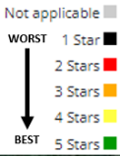
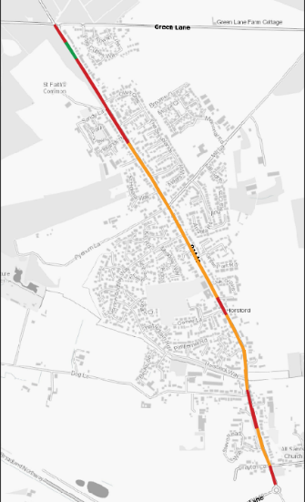
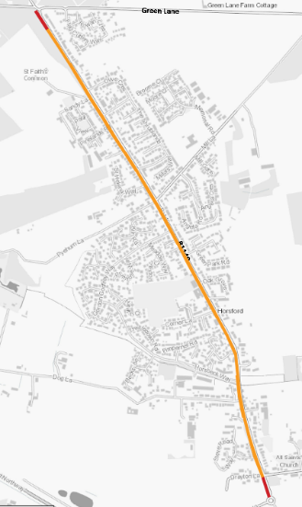
iRAP Assessment – Holt Road Star Ratings

Slide 10
References and Further Reading
National Government’s Decarbonising Transport plan: https://assets.publishing.service.gov.uk/government/uploads/system/uploads/attachment_data/file/1009448/decarbonising-transport-a-better-greener-britain.pdf
On global travel trends and dealing with uncertainty: Travel Transitions: How Transport Planners and Policy Makers Can Respond to Shifting Mobility Trends | ITF (itf-oecd.org)
Guidance on the Decide and Provide methodology in transport planning http://www.trics.org/img/trics%20dp%20guidance_web.pdf
For more information on the iRAP protocols on safety and risk in road environments Star Ratings – iRAP

