Slide 1
Changing the way we think about mobility
REDUCING DEMAND,
ALTENATIVE FUELS,
MODE SHIFT
Ali Clabburn, Chairman, Mobilityways
Helping employers measure, reduce
and report commuter emissions.

Slide 2
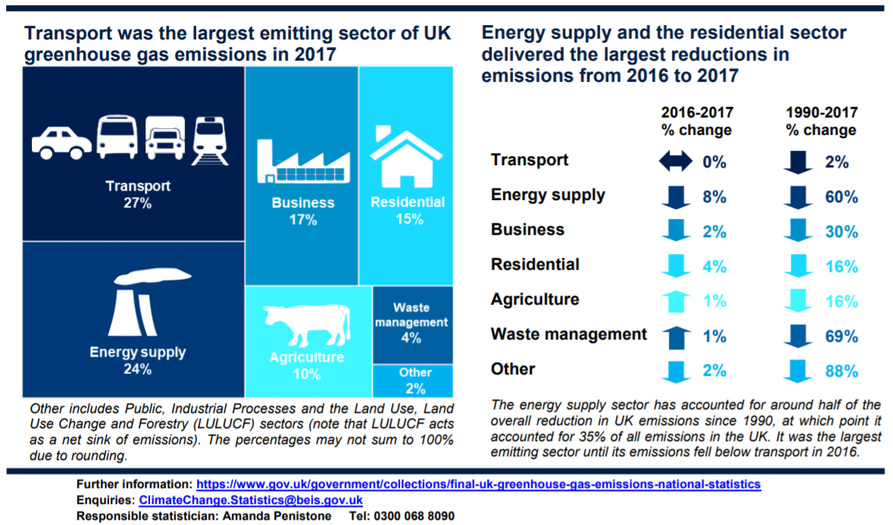
The transport sector and air quality

Slide 3
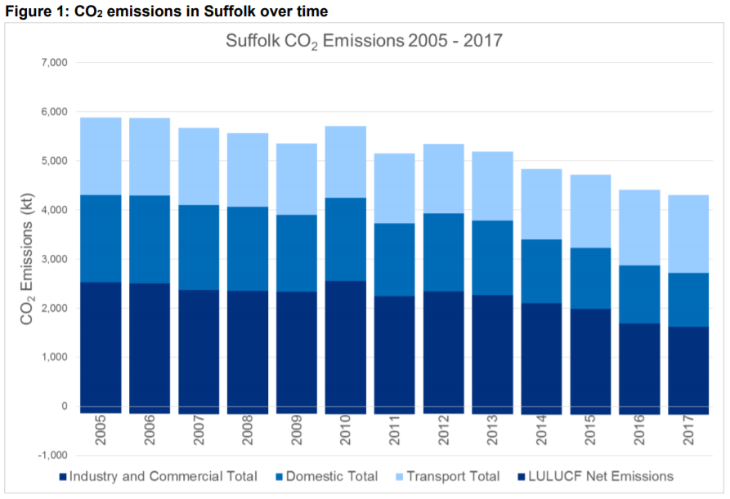

Slide 4
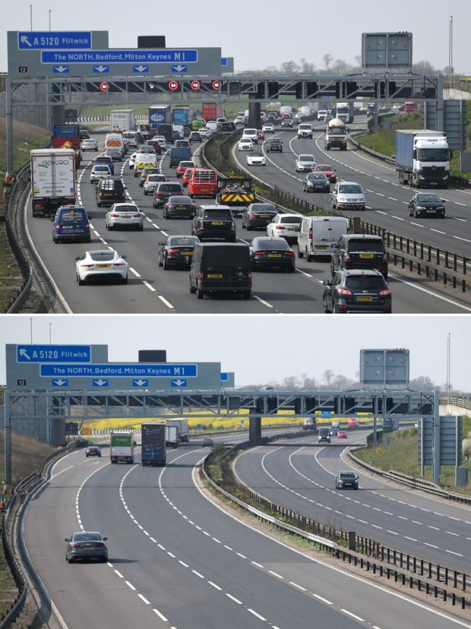
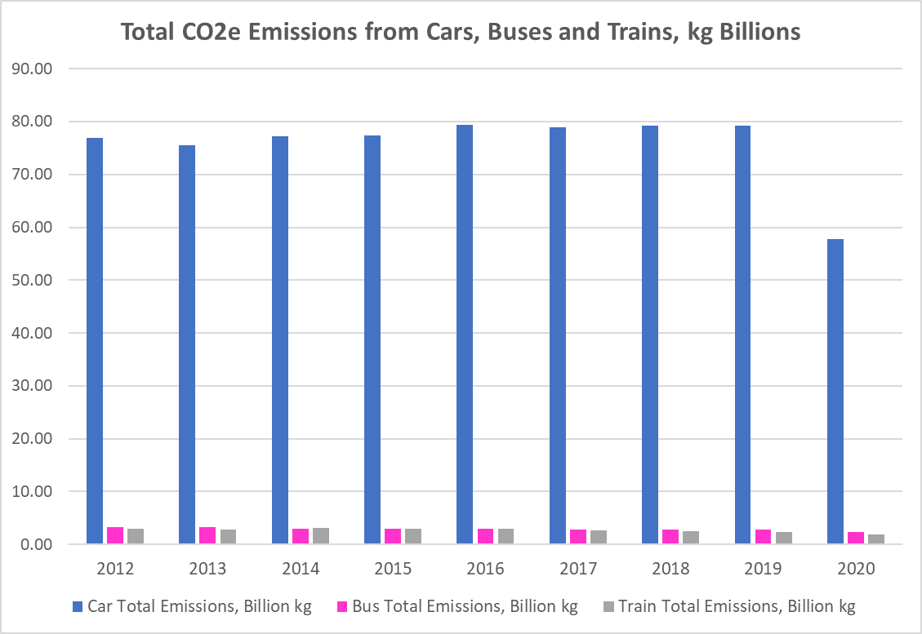
CO2 by mode

Slide 5
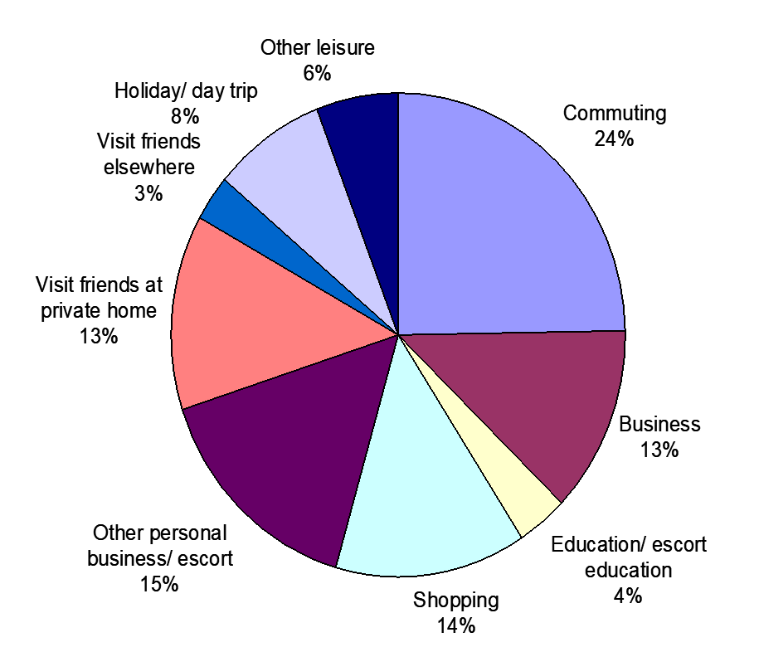
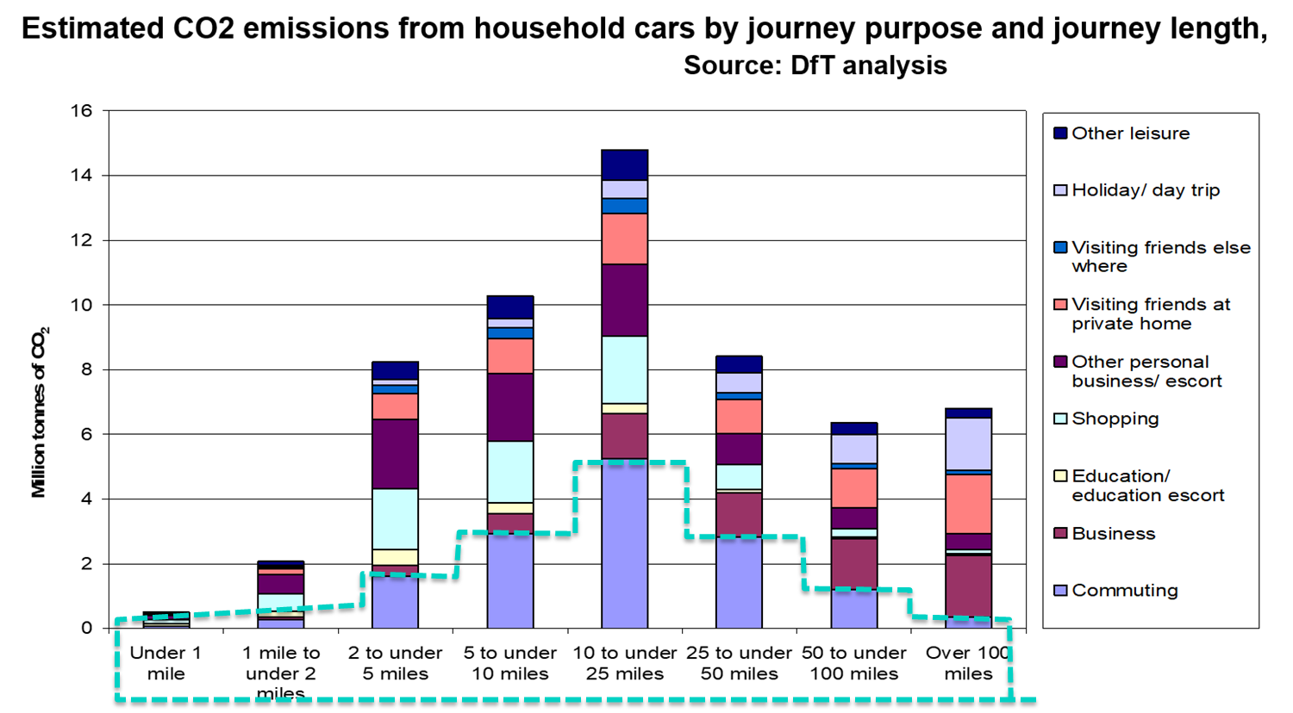
27% of UK CO2 from transport
18 Million tonnes CO2 from commuting
Our aim is for Zero
We believe it is possible

Slide 6
50% of commuters drive alone
82% of the emissions come from them!

Slide 7
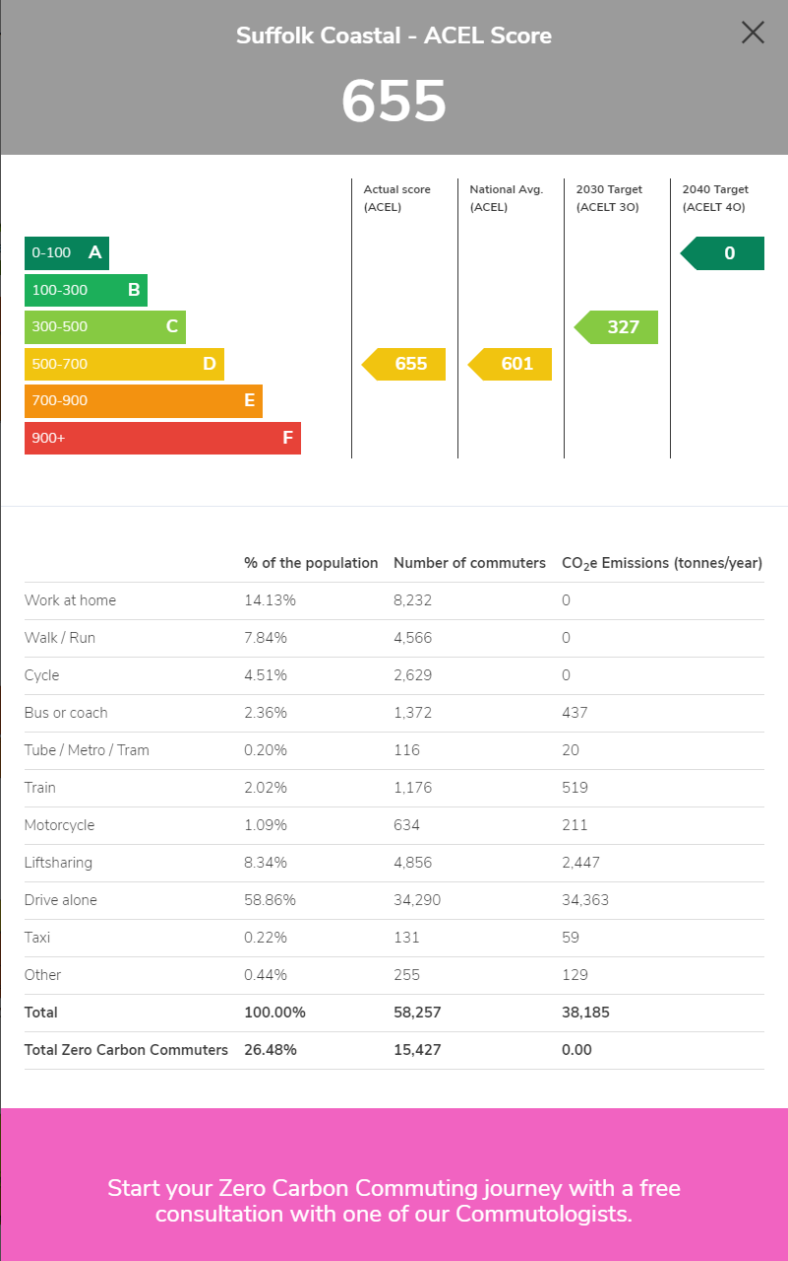

Slide 8
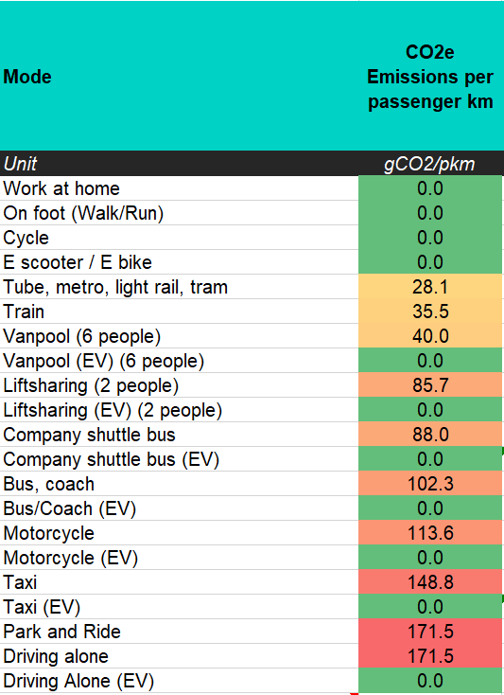
How to cut CO2?
1) Reduce Demand
WFH, move closer, do less
2) Shift to lower emission vehicles
Active travel, EVs
3) Increase occupancy & utilisation
Lift-sharing, van-pooling, buses
Notes:
The minister is right that a full double decker bus could take 75 cars off the road however the average bus occupancy pre covid was just 10. Making it no more efficient than the average car with 1.6 people in it.
I think it is wrong to set bus travel against car travel. Both can be very efficient or not. It all depends on their occupancy. A passenger on a full bus emits ~30g/km. A passenger in a full car emits ~30g/km.
Increasing average car occupancy to 1.7 people per car would save 3Mtonnes CO2 – the same as the total emissions from buses.

Slide 9
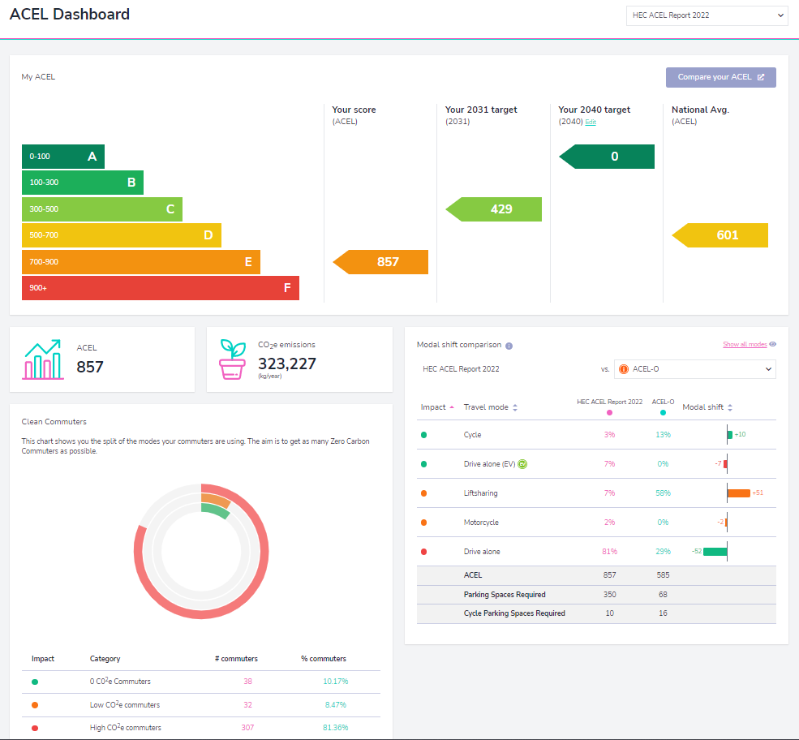
Commutology
The science of achieving Zero Carbon Commuting
Measure
Travel Survey (How, why, why not) & ACEL Calculation
Scope the opportunity
MW scoping will identify all the current options and ACELO
Create a simple user centric mobility strategy
Set target (Reduce ACEL by 5%/year)
Use data to inform budget (should be cost neutral based on proj. savings)
Use data to decide marketing and activity focus for next 3 years.
Take action.

Slide 12
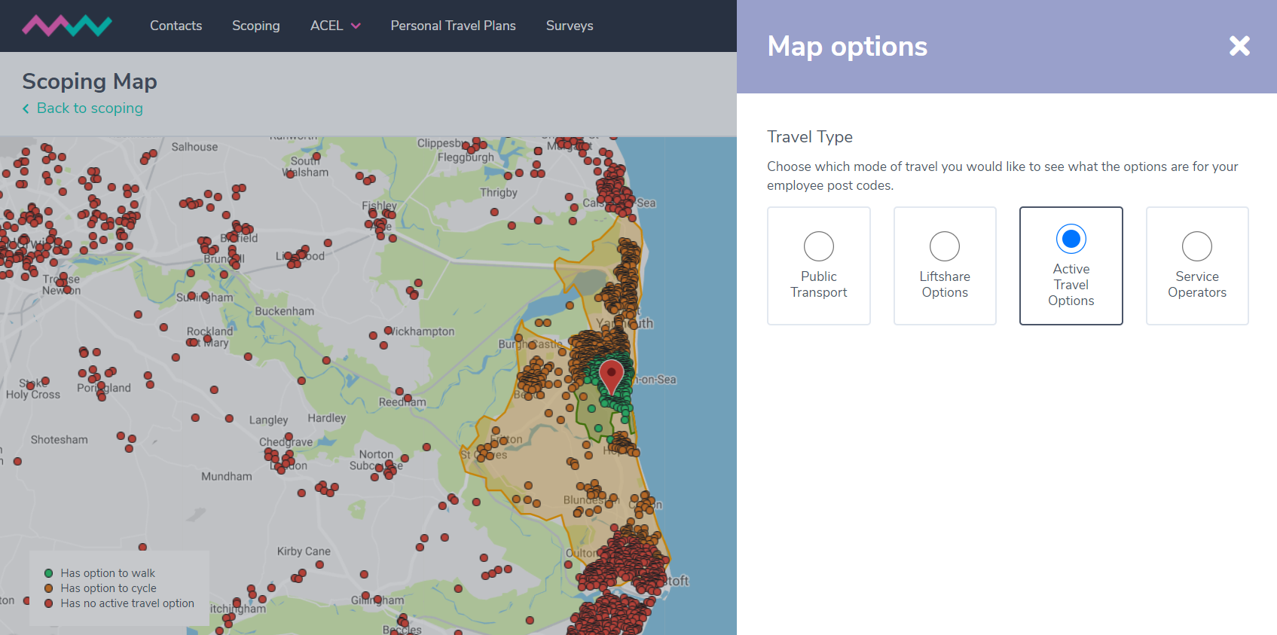
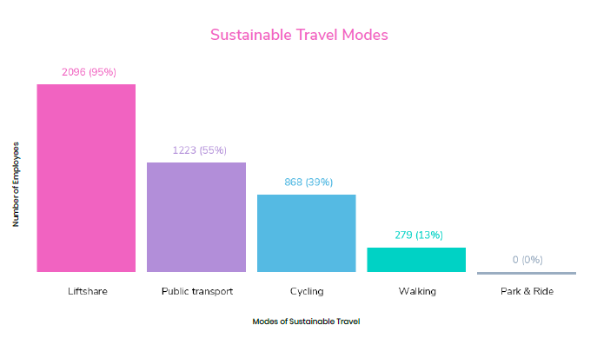
Scoping Analysis - Employer & Employee

Slide 13
Mode | Survey (Are doing) | Survey (could be encouraged to) | Scoping (could be doing)
Walk | 7% | 10% | 13%
Cycle | 5% | 25% | 39%
Lift share | 2% | 65% | 95%
Bus | 1% | 45% | 55%
Other | 5% | - | -
Work from home | 0% | 20% | ?

Slide 14
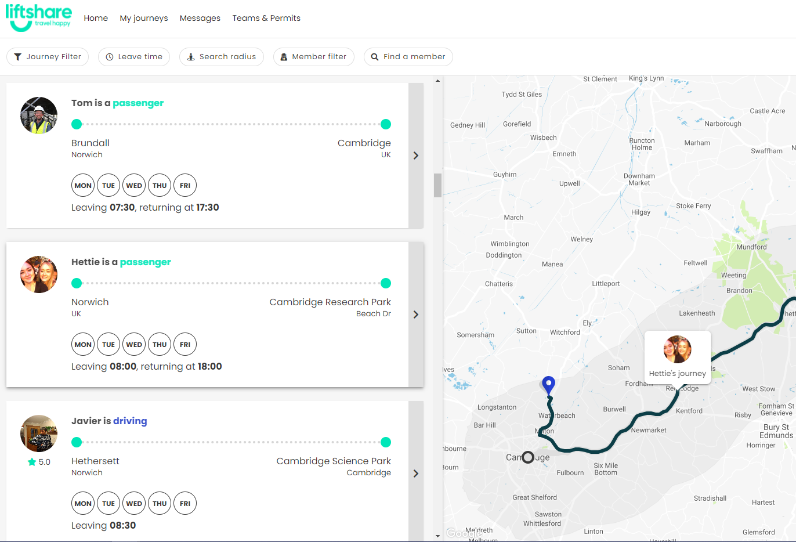
Liftshare
Empowering staff to find regular lift sharing matches to give them better access to work options, while reducing their commuting costs & carbon footprint.
"The whole Liftshare system is constantly evolving and improving to provide us with more and more valuable data. The Liftshare scheme has been a huge success and I would be more than happy to recommend their services to other businesses."
Sandy Farar, Business Services Manager
Arup

Slide 15
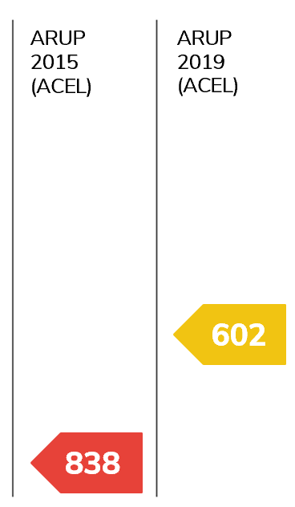
955
Results:
staff
50%
of staff Liftsharing in
3 months
28%
drop in commuter
Co2e emissions
30%
Average Car Occupancy Level
Fewer cars parking onsite
1.05
1.42
Contributors to success:
Success
Liftshare Parking
Incentive
Strong Liftshare
Parking Policy
Story
Notes:
I now want to look at another case study in a rural area. ARUP.
I want to show how they managed to solve their parking problems and cut their emissions by 28% in 1 year.

Slide 16
How low can you go?
And how fast?
Ali Clabburn, Chairman
Mobilityways
ali@liftshare.com

