Slide 1
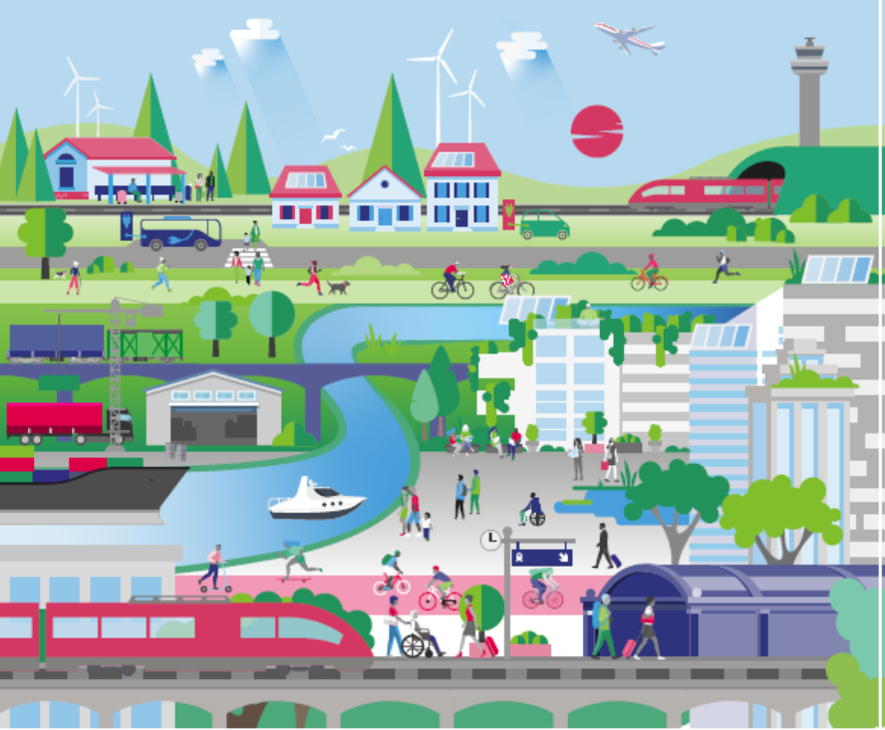

Andrew Summers
Strategic Director, Transport East

Slide 2
Contents
Introduction to Transport East & our Transport Strategy
Evidence base: Transport Carbon emissions in the East
Our pathway to net zero transport

Slide 3
Our Transport Strategy
Transport East
Sub-national Transport Body for Norfolk, Suffolk, Essex, Southend and Thurrock
Transport Strategy published 2022:
Vision:
“A thriving Eastern region with safe, efficient and net-zero transport networks advancing a future of inclusive and sustainable growth for decades to come”
Strategic priorities
Decarbonisation to net zero
Connecting our growing towns and cities
Energising coastal and rural communities
Unlocking our international gateways

Slide 4
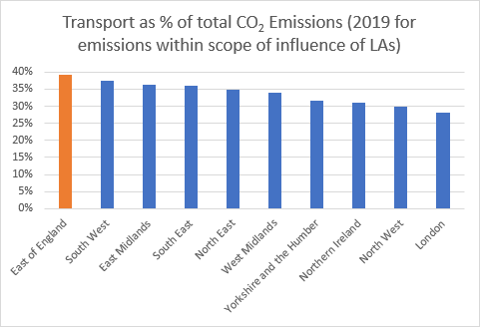
Current emissions
Transport Emissions
Source: Transport East Net Zero Report, KPMG for Transport East, 2020

Slide 5
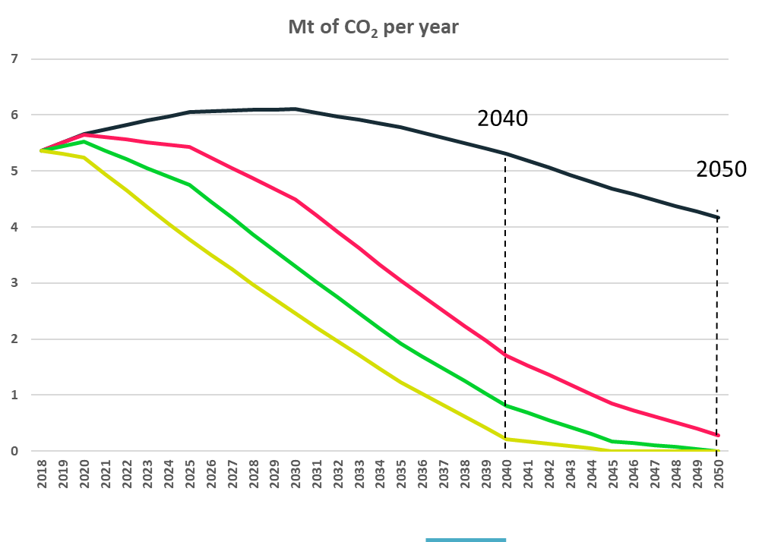
Future trajectory
Transport Emissions
BAU – do nothing
Current policy and committed funding
‘78% by 2035’
(UK 6th Carbon Budget)
Net zero by 2040: aggressive shift beyond Paris agreement
Source: Transport East Carbon Baseline, Energy Systems Catapult for Transport East, 2021
5

Slide 6
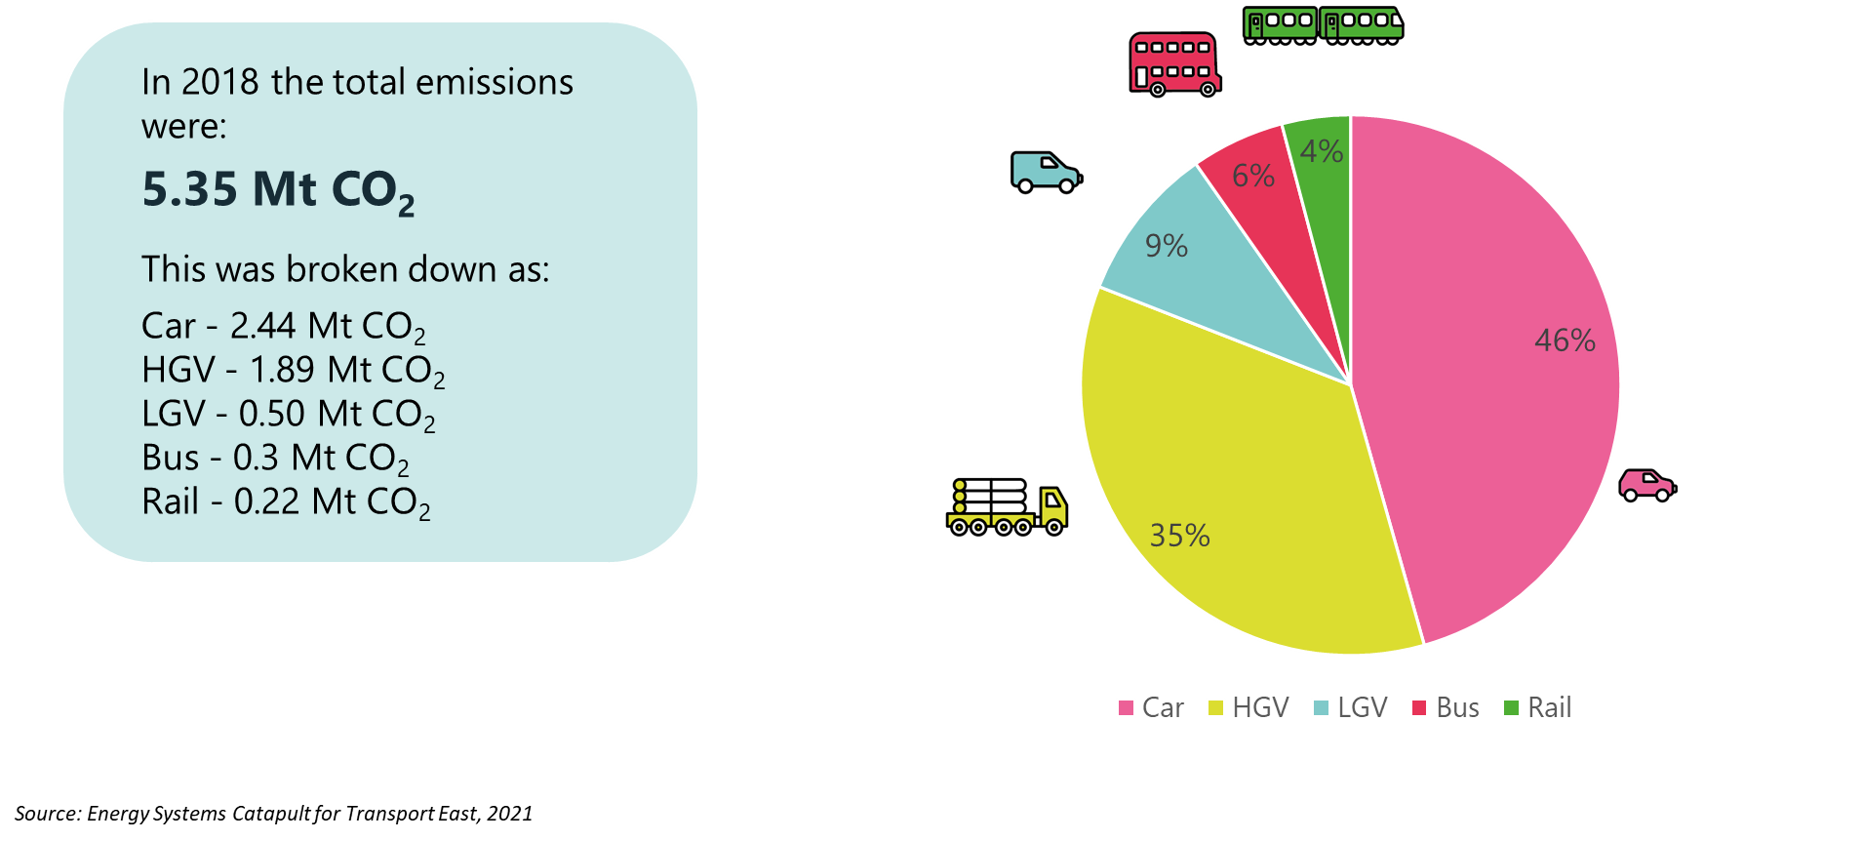
Breakdown by vehicle type
Transport Emissions
Source: Transport East Carbon Baseline, Energy Systems Catapult for Transport East, 2021
6

Slide 7
Breakdown by area type
Transport Emissions
Source: Transport East Carbon Baseline, Energy Systems Catapult for Transport East, 2021
7

Slide 8
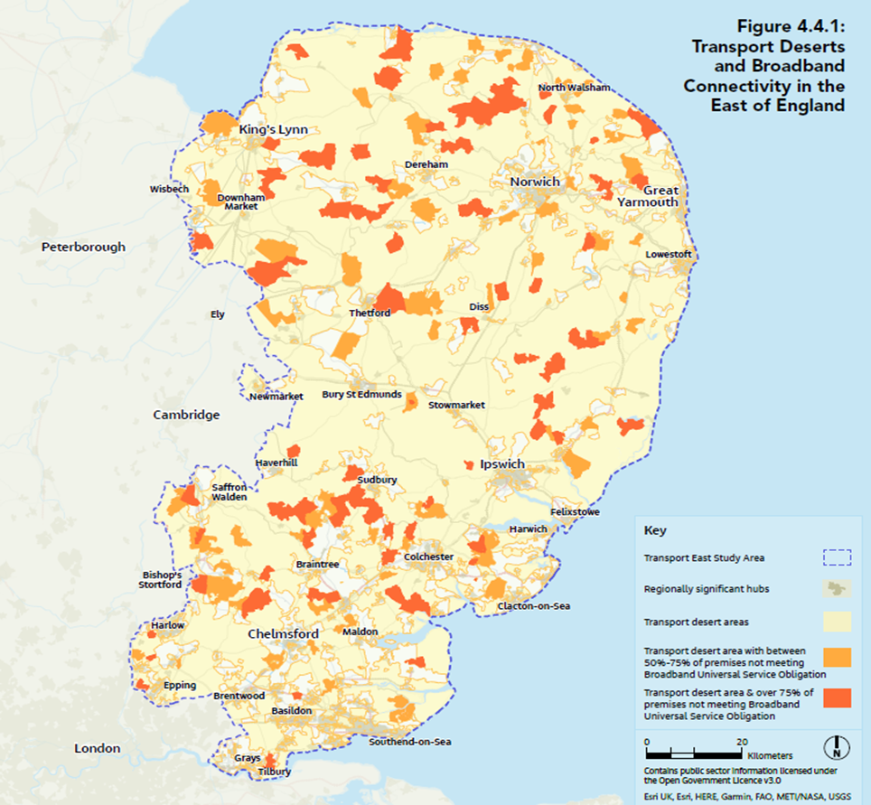
Rural Transport
Focus
2/3 of rural residents cannot access education, employment and services by sustainable modes
These areas also align with lack of EV infrastructure
To tackle decarbonisation in the East, we must fix our rural transport deserts
Transport East is creating a Centre of excellence for Rural Mobility
8

Slide 9
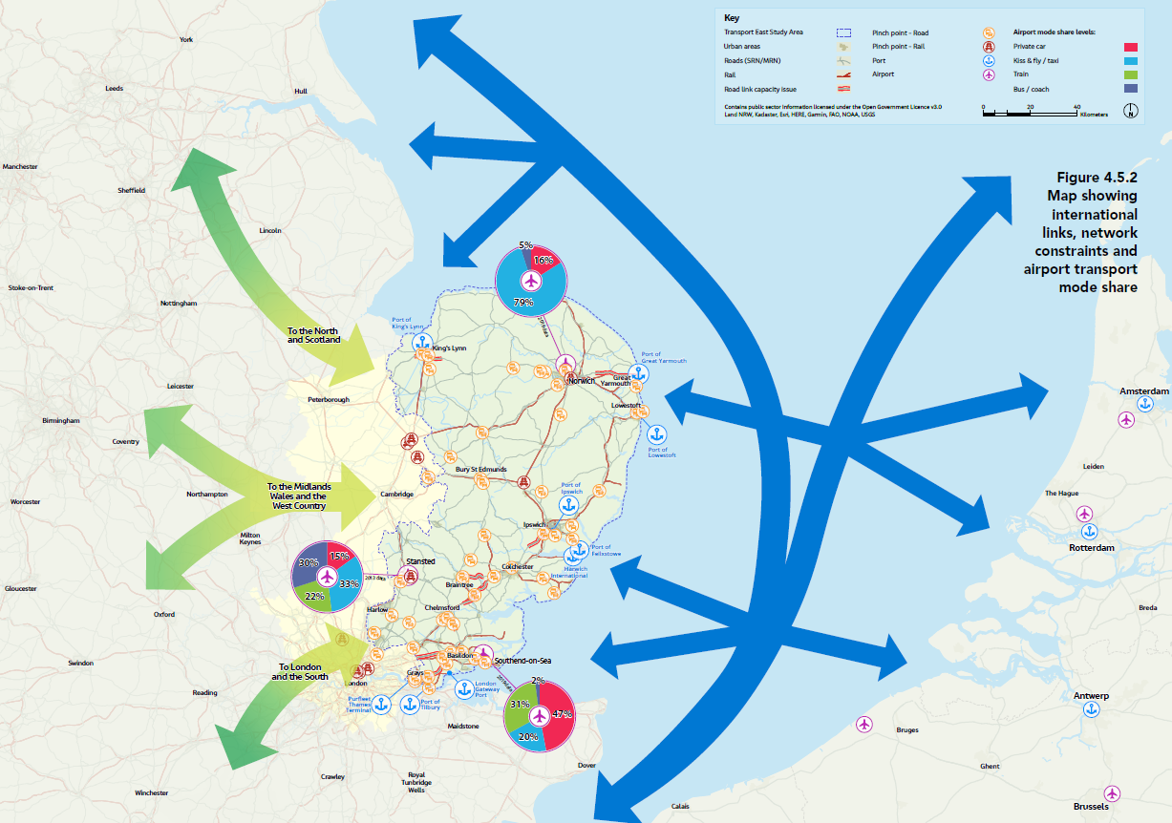
Freight
Focus
44% of the region’s emissions are from freight
13 Ports and 3 airports
Over half of UK’s freight containers flow through our region
9

Slide 10
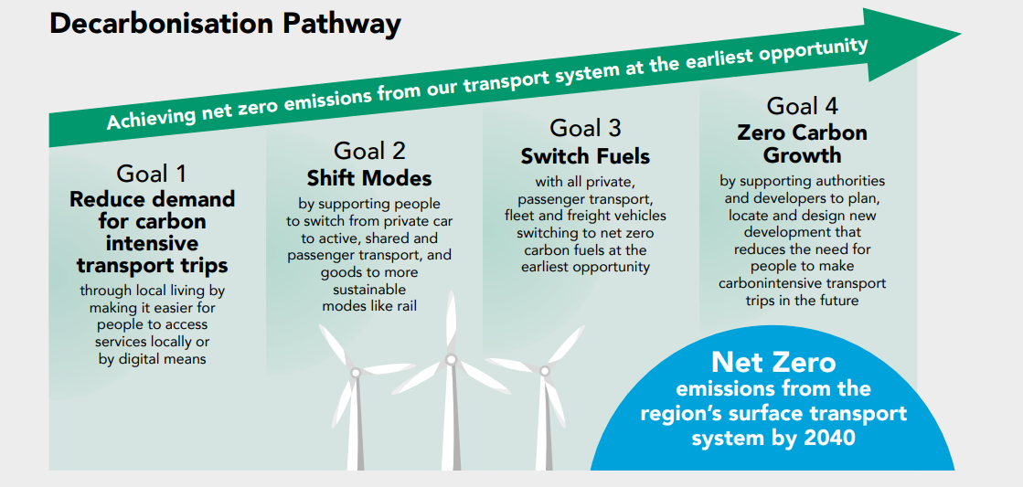

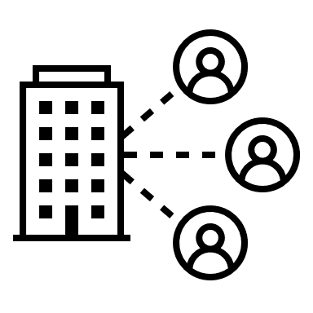













Strategic Approach
10

Slide 11
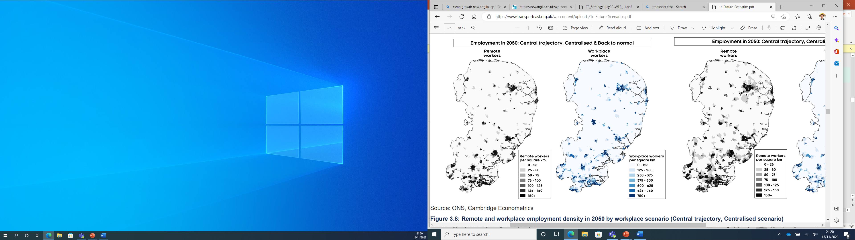
Reducing the need to travel…
Goal 1
…through local living, making it easier for people to access services and jobs locally or by digital means
2050, (15% remote working)
2050, (32% remote working
[-400,000 trips a day]
Digital connectivity
Digital Highways
Bring services closer to people
Travel Demand Management
11
Source: Future Transport Scenarios, Cambridge Econometrics for Transport East, 2021

Slide 12
Switch Modes
Goal 2
…by supporting people to switch from private car to active, shared and passenger transport, and goods to more sustainable modes like rail
For your commute (or most common journey) what factors are important to you when considering your transport options?
Factor (barrier) | % saying ‘very important’
Reliability | 75
Safety | 61
Convenience | 55
Personal Security | 51
Frequency of Service | 49
Crowding | 48
Health benefits | 27
Carbon footprint | 26
Breaking down barriers to sustainable travel
Supporting behaviour change
Source: Transport East Public Survey on travel habits, Copper Consultancy for Transport East, 2021
12

Slide 13
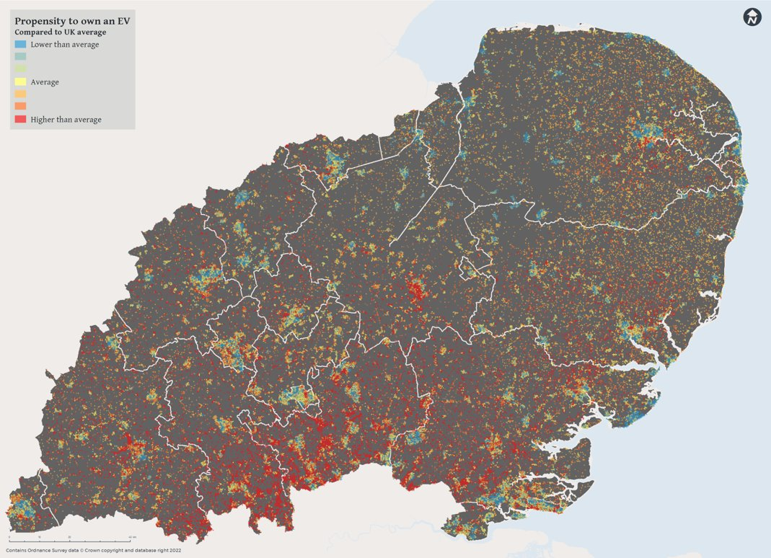
Switch Fuels
Goal 3
…with all private, passenger transport, fleet and freight vehicles switching to net zero carbon fuels at the earliest opportunity
An electric car revolution
Switching to cleaner passenger and fleet transport
13
Source: Transport East EV demand tool WSP, 2022

Slide 14
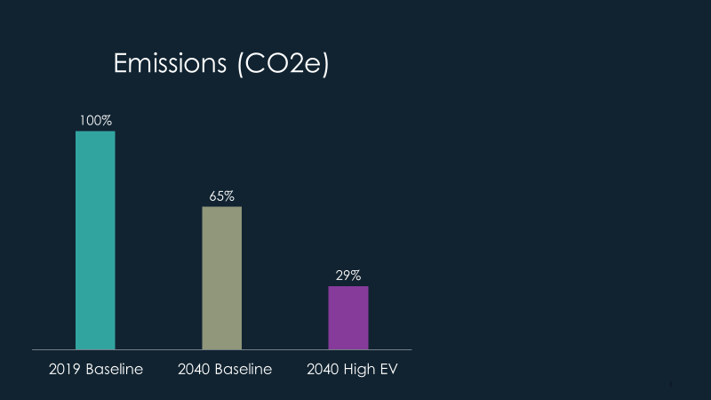
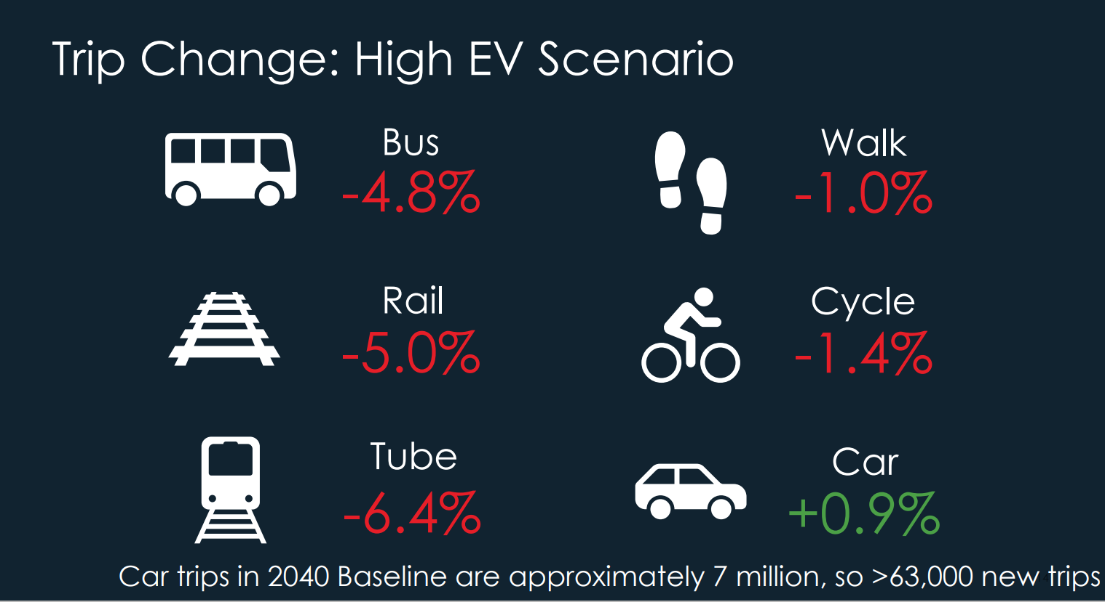

Will EV’s deliver net zero carbon?
Goal 3 (continued)
A high-EV strategy in the would achieve a significant shift in carbon emissions.
High EV scenario: 88% of cars and 81% of LGVs to be EV by 2040.
However, it doesn’t get us all the way and may have adverse impacts
Source: Transport East – People-based modelling tool, ARUP, 2022
Notes:
TE has also been using our new people-based model to test the wider implications of the move to EVs.
High EV uptake does make a substantial difference to transport emissions across the region – but doesn’t get us all the way. This illustrates the importance of also tackling emissions from larger vehicles – both freight and passenger transport.
EV Proportion by scenario
2019 2040 Baseline 2040 High EV
Car 1% 33% 88%
LGV 0% 12% 81%
Consistent with DfT’s common analytical framework

Slide 15
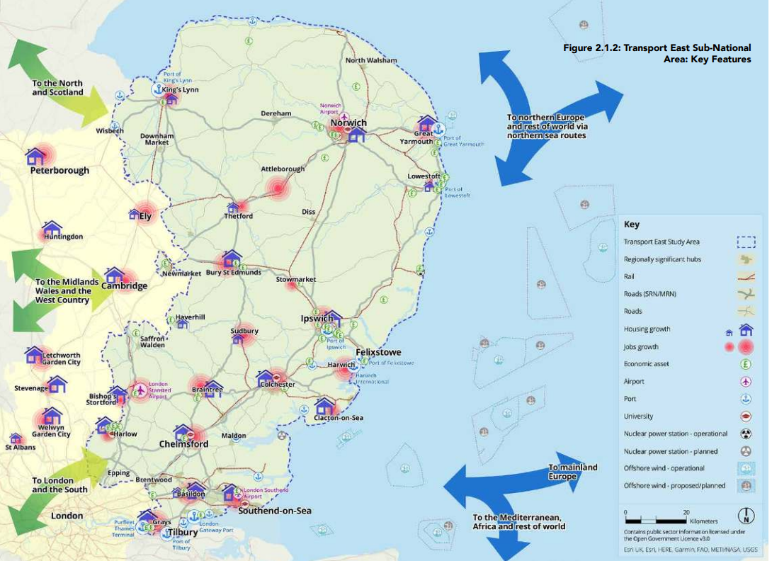
Net Zero Transport Growth
Goal 4
…by supporting authorities and developers to plan, locate and design new development that reduces the need for people to make carbon intensive transport trips
Development in places that helps people travel sustainably
Designing places to encourage sustainable transport
15

Slide 16
Summary
Transport accounts for 42% of carbon emissions in the East (highest in UK)
Rural and Freight are major contributors in our region
Four stage pathway:
  Reducing the need to travel
  Switch modes
  Switch fuels
  Net zero transport growth
The Transport East partnership is developing a suite of tools to support partners to deliver net zero
Andrew Summers – Transport East
Andrew.summers@suffolk.gov.uk
16

