Slide 1
Clean Growth for Business
Putting change into action
Challenges & Solutions for the built environment
Ashley Shorey-Mills
Head of Supply Chain Engagement @ Suffolk chamber of Commerce
www.sizewellcsupplychain.co.uk

Slide 2
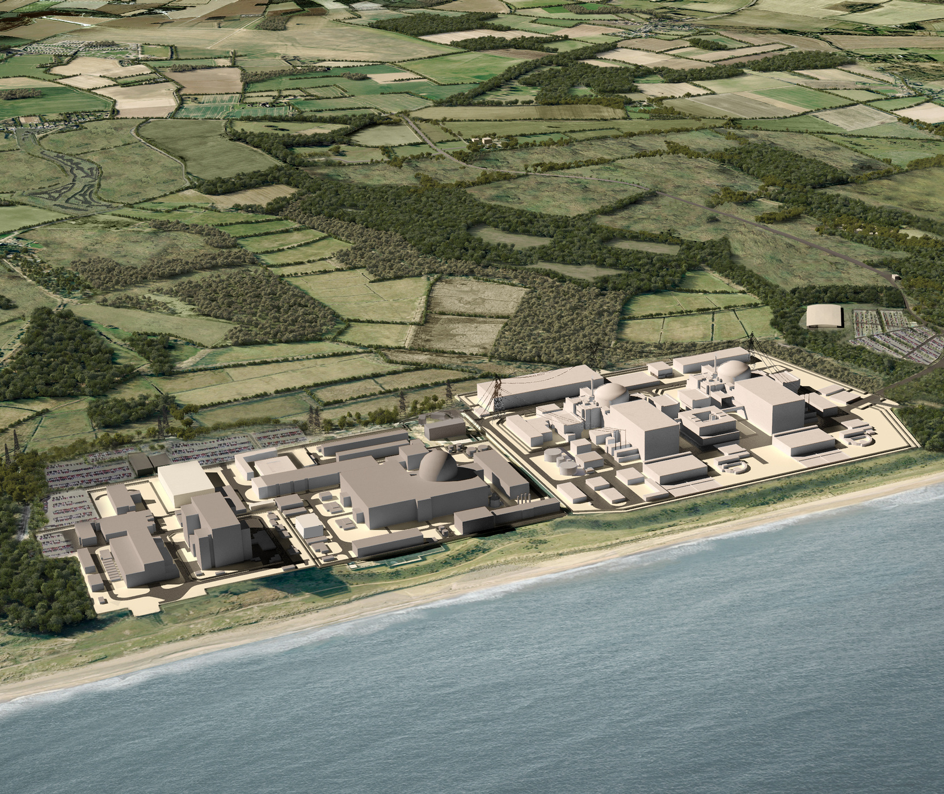
Our Role
What we do
Local Supply Chain engagement
Events & Communications
Introductions & Relationship building
Webinars & Workshops
Up to date news & Stories
Sizewell C Supply Chain portal management
Advanced notice on Tender information and early involvement
Set out the local
agenda
Hold Sizewell C
to account

Slide 3
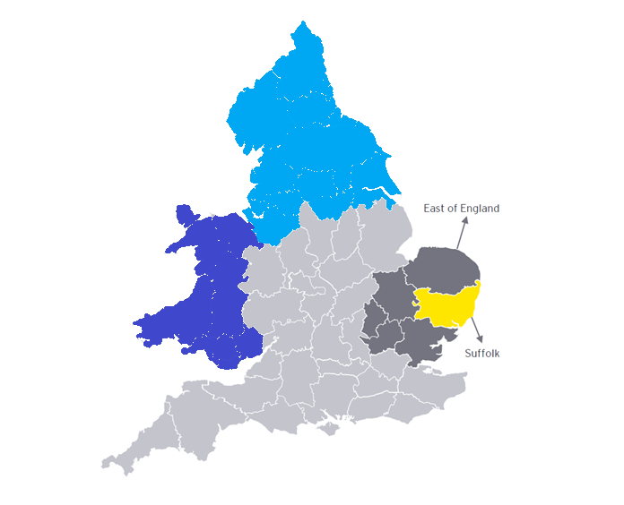
Sizewell C Consortium
The National Commitment
£2.5bn
To be spent in the North of England during construction
£4.4bn
To be spent in the East of England during construction
Core commitments aligned to UK leveling up
Future Nuclear supply chain
Partnerships and sharing of expertise
Huge % of spend in core regions
£900m
To be spent in Wales during construction
£2.0bn
To be spent in Suffolk during construction (N.B. a subset of East of England, not additional)

Slide 4
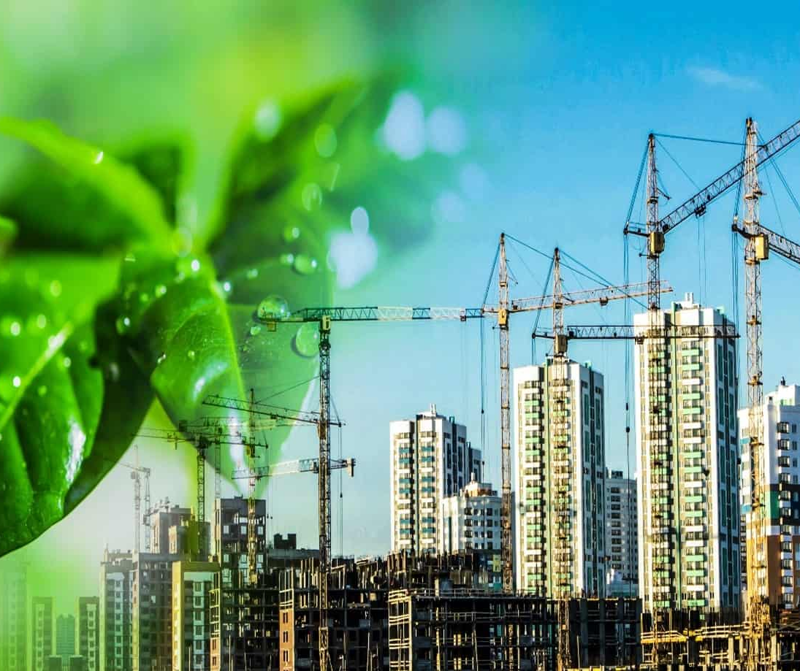
Large projects
Making the most of Norfolk & Suffolk
24 projects listed as NSIP’s in various stages
Unified drive for increase in social value
Support dedicated for sectors
Geographically critical for Net Zero
The projects “want” local and will support you

Slide 5
Clean Growth
Greater opportunities in future contracts
Future Business
Long Term business sustainability
Lower emissions and cost savings
Not acting & reporting on social value will limit future opportunity
Lack of action will drive up variable costs
Gen Z are more focused on social value and seek aligned work
Innovation is key to Social value
Support in all channels
Building for the future
Why take Clean Growth serious?
Variety of support available
Greater staff retention
Continuous development

Slide 6
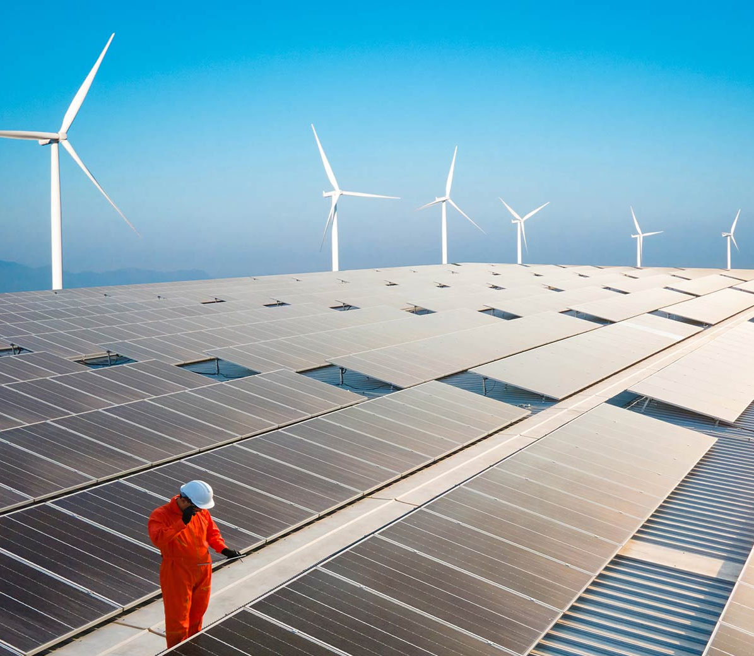
Clean Growth
Greater opportunities in future contracts
Future Business
Major projects 10%+ on SV
Sizewell C will be relevant scoring
Suffolk highways circa 20% SV scoring
Construction Playbook ethos
BNG : 10% from 2023*
SME’s : The point of difference
Start the journey…..
Long Term business sustainability
Lower emissions and cost savings
Why take Clean Growth serious?
Variety of support available
Greater staff retention
Continuous development

Slide 7
Social Value
Increasing UK content (Local)
What does this mean?
Increase Biodiversity in the UK
Reducing environmental footprint
The local supply chain forms a key part of the projects strategic aims and the UK Governments wider social value alignment
Social
Value
Optimising local community opportunities
Tackling workforce inequality
Invest in skills, education & local employment

Slide 8
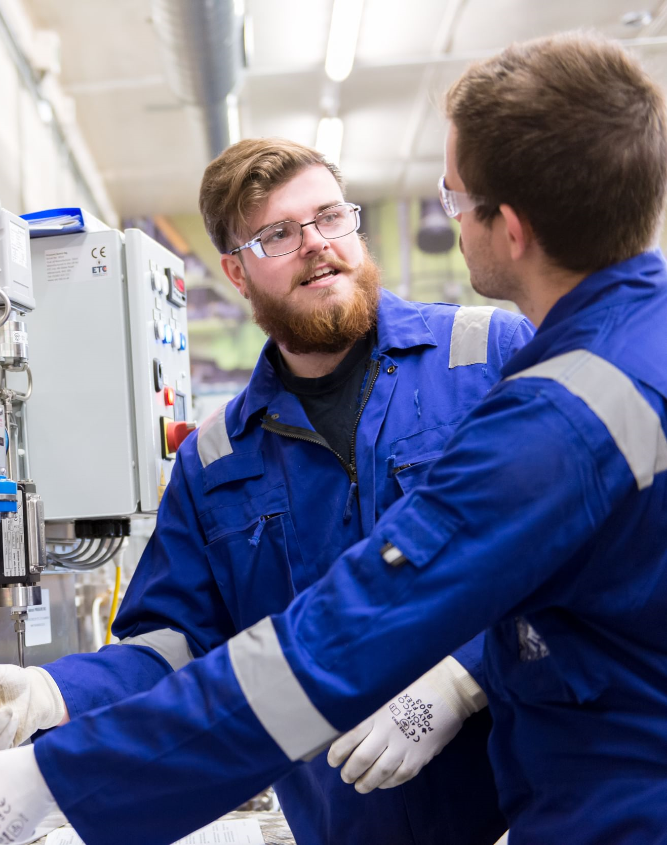
Next Steps
Your action plan
Ensure Net Zero action is started
Make messaging positive
Collective responsibility
Engage with support : LEP, Chamber, LA’s
SME’s are agile, use this to your advantage
Make SV part of your everyday
Invest in your own Supply Chain
Report on it….
Think about additionality

Slide 9
Clean Growth for Business
Putting change into action
Challenges & Solutions for the built environment
Ashley Shorey-Mills
Head of Supply Chain Engagement @ Suffolk chamber of Commerce
www.sizewellcsupplychain.co.uk

