Slide 1
Professor Fiona Lettice
Pro Vice Chancellor Research and Innovation

Slide 2
What is REF21?
Research Excellence Framework is the periodic peer assessment of research quality in UK HEIs undertaken by Research England
The last REF results were published in 2014
REF results drive QR income to HEIs (£15-18m pa to UEA since 2014)
A REF submission consists of details of staff, outputs, research income and PGR completions, plus impact case studies and research environment statements
The REF21 submissions were made in March 2021, delayed from November 2020 due to the pandemic

Slide 3
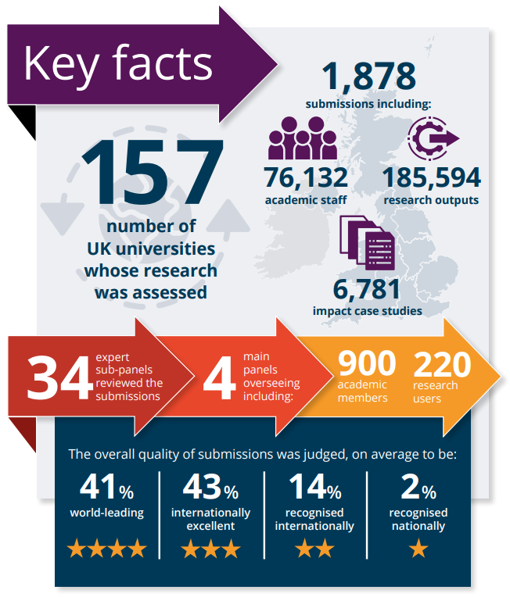
National Average | UEA
Overall: 41% world leading (4*) | Overall: 47.1% world leading (4*)
Overall: 84% world leading and internationally excellent | Overall: 91% world leading and internationally excellent
Outputs: 36% world leading (4*) | Outputs: 43.4% world leading (4*)
Impact: 50% outstanding (4*) | Impact: 57.9% outstanding (4*)
Environment: 50% world leading (4*) | Environment: 43.5% world leading (4*)

Slide 4
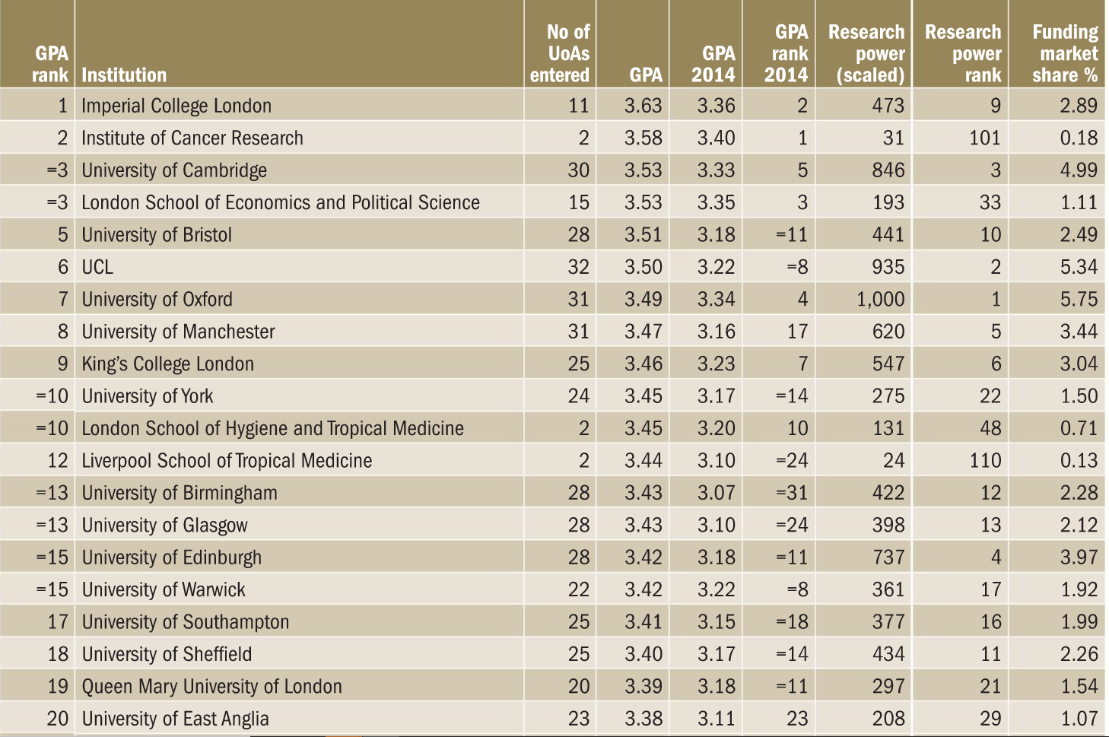

Slide 5
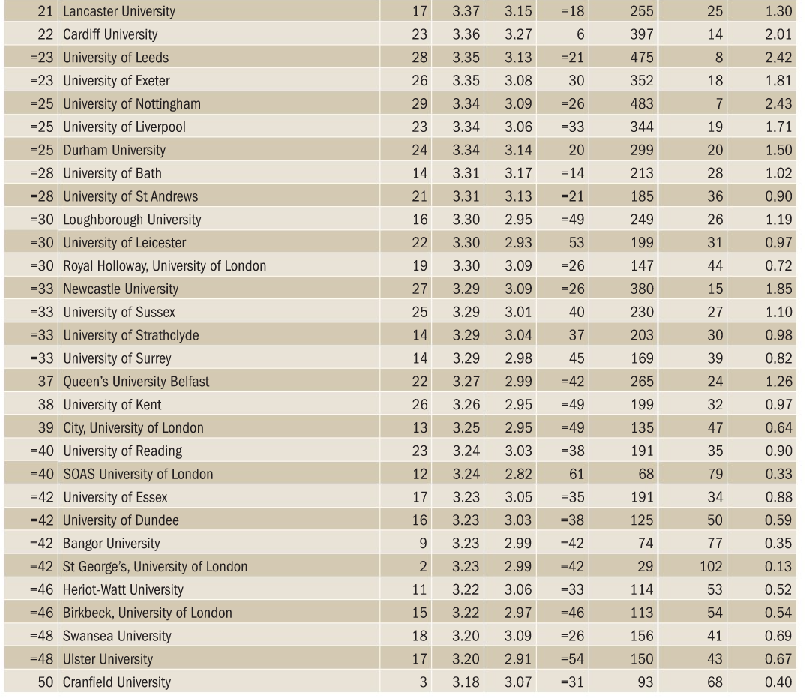

Slide 6
Outputs Ranking – Times Higher Education Top 20
Rank 21 | Institution | GPA21 | GPA14 | GPA Change | Rank 14 | Rank Change | Power
1 | Imperial College London | 3.51 | 3.16 | 0.35 | 4 | 3 | 9
2 | London School of Economics | 3.5 | 3.21 | 0.29 | 1 | -1 | 33
3 | University of Cambridge | 3.43 | 3.16 | 0.27 | 4 | 1 | 3
3 | Institute of Cancer Research | 3.43 | 3.21 | 0.22 | 1 | -2 | 102
5 | University of Bristol | 3.42 | 3 | 0.42 | 15 | 10 | 10
6 | University of Glasgow | 3.39 | 2.94 | 0.45 | 28 | 22 | 13
7 | University of Birmingham | 3.35 | 2.97 | 0.38 | 21 | 14 | 12
7 | University of Warwick | 3.35 | 3.13 | 0.22 | 6 | -1 | 17
7 | Queen Mary University London | 3.35 | 3.09 | 0.26 | 7 | 0 | 21
10 | University of Oxford | 3.34 | 3.17 | 0.17 | 3 | -7 | 1
10 | UCL | 3.34 | 2.99 | 0.35 | 18 | 8 | 2
12 | University of York | 3.33 | 3.01 | 0.32 | 13 | 1 | 23
13 | University of Manchester | 3.32 | 2.96 | 0.36 | 23 | 10 | 5
13 | University of East Anglia | 3.32 | 3.04 | 0.28 | 10 | -3 | 29
15 | King's College London | 3.3 | 3.05 | 0.25 | 9 | -6 | 6
15 | Royal Holloway, UoL | 3.3 | 3 | 0.3 | 15 | 0 | 43
17 | University of Southampton | 3.28 | 3.01 | 0.27 | 13 | -4 | 16
17 | University of St Andrews | 3.28 | 3 | 0.28 | 15 | -2 | 36
19 | University of Edinburgh | 3.27 | 2.97 | 0.3 | 21 | 2 | 4
19 | University of Sheffield | 3.27 | 3.03 | 0.24 | 12 | -7 | 11
19 | Durham University | 3.27 | 2.99 | 0.28 | 18 | -1 | 20
19 | University of Bath | 3.27 | 3.04 | 0.23 | 10 | -9 | 28
19 | University of Surrey | 3.27 | 2.95 | 0.32 | 25 | 6 | 39
19 | Liverpool School of Tropical Medicine | 3.27 | 2.88 | 0.39 | 41 | 22 | 112

Slide 7
Impact Ranking – Times Higher Education Top 20
Rank 21 | Institution | GPA21 | GPA14 | GPA Change | Rank 14 | Rank Change | Power
1 | London School of Hygiene and Tropical Medicine | 3.78 | 3.74 | 0.04 | 2 | 1 | 46
2 | Liverpool School of Tropical Medicine | 3.76 | 3.57 | 0.19 | 6 | 4 | 109
3 | Imperial College London | 3.72 | 3.68 | 0.04 | 3 | 0 | 9
3 | Institute of Cancer Research | 3.72 | 3.87 | -0.15 | 1 | -2 | 102
5 | UCL | 3.65 | 3.54 | 0.11 | 7 | 2 | 2
6 | King's College London | 2.64 | 3.53 | -0.89 | 8 | 2 | 6
7 | University of Southampton | 3.53 | 3.4 | 0.13 | 20 | 13 | 14
8 | University of Oxford | 3.62 | 3.51 | 0.11 | 9 | 1 | 1
8 | University of Manchester | 3.62 | 3.45 | 0.17 | 16 | 8 | 5
8 | St George's, UoL | 3.62 | 3.64 | -0.02 | 4 | -4 | 99
11 | University of Cambridge | 3.61 | 3.49 | 0.12 | 12 | 1 | 3
12 | University of Bristol | 3.6 | 3.5 | 0.1 | 10 | -2 | 11
12 | University of York | 3.6 | 3.46 | 0.14 | 14 | 2 | 22
14 | University of Sheffield | 3.58 | 3.43 | 0.15 | 18 | 4 | 10
15 | Cardiff University | 3.54 | 3.61 | -0.07 | 5 | -10 | 13
16 | University of Edinburgh | 3.52 | 3.46 | 0.06 | 14 | -2 | 4
16 | University of Birmingham | 3.52 | 3.22 | 0.3 | 40 | 24 | 12
16 | University of Exeter | 3.52 | 3.2 | 0.32 | 43 | 27 | 17
16 | University of East Anglia | 3.52 | 3.31 | 0.21 | 32 | 16 | 29
20 | Loughborough University | 3.5 | 3.18 | 0.32 | 48 | 28 | 24
20 | University of Strathclyde | 3.5 | 3.33 | 0.17 | 31 | 11 | 30

Slide 8
Key Subject Results
Top 5 Times Higher Education overall subject rankings
Top 20 Times Higher Education overall subject rankings
13th Art and Design: History, Practice & Theory
=14th Business & Management Studies
=14th Politics & International Studies (up 11 places from 2014)
=14th Psychology, Psychiatry & Neuroscience (up 16 places from 2014)
15th Public Health, Health Services & Primary Care
16th Economics & Econometrics
=16th Communications, Cultural & Media Studies
17th Biological Sciences
19th English Language & Literature
=20th Clinical Medicine
=1st Agriculture, Food and Veterinary Sciences
2nd Anthropology and Development Studies (8th for Power) (but are 1st for Development Studies only)
3rd History (up 23 places from 2014)
4th Earth Systems and Environmental Sciences (9th for Power)
=4th Social Work and Social Policy
5th Area Studies (4th for Power)

Slide 9
Key Subject Results
Top 15 Times Higher Education subject output GPA rankings
Top 20 Times Higher Education subject impact rankings
2nd Agriculture, Food and Veterinary Sciences
=5th Clinical Medicine
6th Anthropology and Development Studies
7th History
=7th Art and Design: History, Practice and Theory
8th Area Studies
=9th Public Health, Health Services and Primary Care
=9th Social Work and Social Policy
11th Allied Health Professions, Dentistry, Nursing & Pharmacy
11th Psychology, Psychiatry and Neuroscience
=11th Biological Sciences
13th Business and Management Studies
14th Earth Systems and Environmental Sciences
=1st Agriculture, Food and Veterinary Sciences
=1st Politics and International Studies
=1st Social Work and Social Policy
=1st Anthropology and Development Studies
=4th Chemistry
=5th Earth Systems and Environmental Sciences
7th Area Studies
=8th History
=16th Business and Management Studies
=20th Education

Slide 10
UoA 6 – Agriculture, Food and Veterinary Science – Overview
20 FTE submitted from UEA, QIB and TSL
Food and Health focus from Farm to Fork to Faeces
Themes:
1. Nutrition for Human Health
- flavonoids, fats and micronutrients impact on age-related chronic disease
2. Food Security
- resistance to infection in plants, climate and crop yield
3. Food and Gut Health
- microbe-host interactions and responses, AMR
4. Microbes in the Food Chain
- foodborne pathogens eg listeria, salmonella
SDGs 2 (Good Health and Wellbeing) and 3 (Zero Hunger and Promoting Sustainable Agriculture)

Slide 11
UoA 6 – Agriculture, Food and Veterinary Science – Impact Cases
Shaping new national and international policy and guidance on sodium (salt) in our food - Lee Hooper
Improving global crop disease diagnosis to reduce economic loss and improve food security - Sophien Kamoun

Slide 12
Research - Research (uea.ac.uk)
Life-changing research by UEA – REF2021 on Vimeo
Results analysis - REF 2021
REF 2021: research excellence framework results | Times Higher Education (THE)

