Slide 1
Norfolk and Suffolk Economic Strategy – Evidence Report
New Anglia LEP
January 2022

Slide 2
Economic Strategy – Evidence Base
1. Introduction and Overview
This evidence base is intended as a companion document to the Norfolk and Suffolk Economic Strategy 2022. The evidence base consists of the core data sets that informed and underpinned the analysis and narrative in the Strategy.
We’ve opted to predominantly rely on Office for National Statistics and other comparable central government data releases in compiling the evidence base, as these data sets are constructed around well recognised, comparatively stable data methodologies, which also facilitate (in most instances), benchmarking matrices at a national, regional, LEP and local authority level.
In terms of timescales, we’ve tried to access the most up-to-date data available. However, we acknowledge that a significant proportion of the data in the evidence base reflects economic conditions and outputs that existed prior to the onset of the pandemic and associated lockdowns. The data also precedes the impact of the new UK and EU trade agreement. It’s unlikely we’ll have a clearer picture of the overall economic impact of the lockdowns combined with impact of the change in trading arrangements until sometime around 2023/24 – as many of the core data sets run on 1–2 year delay.
Alongside this report we have published an online, interactive data dashboard, which contains a significant proportion of the main data sets in the evidence base. This dashboard will be regularly updated on an ongoing basis as and when the Office for National Statistics, and/or the owners of the data, release the latest update. In addition, we will maintain a repository of the workbooks that the evidence base was based on – these will be made available upon request.
As with previous economic strategies, we will look to review the overall economic landscape in Norfolk and Suffolk on an annual basis, these updates will be presented as a narrative report.

Slide 3
Contents / Index
1. Introduction and Overview
2. Scenario Analysis
UK Competitiveness Index
3. Business and Employment Support
(Covid lockdown response measures)
Furlough
SEISS
CBILS and BBILS
4. Key Metrics Analysis
Employment/Unemployment Rate
UC Claimant Rate
GVA Analysis
3 Strategic Opportunities
Sector Overview
Median Wages
Hours Worked
4. Key Metrics Analysis (cont…)
Median Dwelling and Rental to Median Wage Ratio
Enterprise Rate
Scale-Up/High Growth
Inward Investment
Broadband Coverage
5. Trade and Export Analysis
Trade Export, Import and Balance – Goods
Trade Export, Import and Balance – Services
Total Trade Balance
6. Innovation Analysis
Innovate UK funding
Innovation Performance

Slide 4
Contents / Index
7. Clean Growth Analysis
Green Jobs Analysis
Co2 Emissions
Residential EPC Ratings
Renewable Power Supply (to be added at a later date)
EV registrations
RHI Accredited Installation take-up
EV registrations
RHI Accredited Installation take-up
8. Skills and Labour Market Analysis
Vacancies
Jobs by Sector
Qualifications and Attainment
STEM Analysis
Skills Shortages
Young People not in Employment, Education or Training
Apprenticeships
National Insurance Number Registrations
9. Deprivation Analysis
Indices of Multiple Deprivation
10. Population Analysis
Age demographics
Migration
11. Case Studies
Marina Centre, Great Yarmouth
Gateway to Growth, University of East Anglia
Future Breckland
Snetterton Heath Employment Area
New Anglia Advanced Manufacturing and Engineering
Eastern Enterprise Zone Site, Sproughton
Anglian Water Commitment to Net Zero
Future Fens Integrated Adaption
West Suffolk Solar Farm
Great Yarmouth Operations and Maintenance Campus
Broadland Food Innovation Centre
Energy Skills Centre, East Coast College
Integrated Care Academy, University of Suffolk
City College Norwich Digi-Tech Factory
Bacton Gas Terminal Coastal Protection Works

Slide 5
2. Scenario Analysis

Slide 6
Scenario Analysis
The following section seeks to outline a series of projections, rather than forecasts, based on a combination of underlying high-level data (which is often lagging in terms of time relevance) and more up to date, but qualitative business intelligence, collected from a number of sources, business intermediaries and partner relationships.
These scenarios should be viewed as outlines or framing projections and they come with a caveat of the uncertainty surrounding substantive or additional lockdown/restrictive measures being introduced by the government in the foreseeable future.

Slide 7
Scenario Analysis
Background and Framing
This evidence base seeks to frame the available data not only through the lens of covid lockdowns and their associated impact – but also takes account of the UK’s withdrawal from the EU trade agreement, which has also had a very significant impact on factors such as: supply chains, access to materials, energy prices, and availability of skills and labour.
The trade agreement withdrawal and covid lockdowns have converged, and their influence on economic conditions has over-lapped – it is very hard, if not practically impossible to disentangle the impact of one from the other, or to definitively identify specific outcomes and impacts, as a consequence of either covid lockdowns or the withdrawal from the trade agreement in isolation.
The evidence base indicates that both the EU trade withdrawal and the covid lockdowns have had widely divergent impact on the local and national economy on a sector by sector basis, rather than having a unilateral effect across the economy as a whole.
As an example, covid lockdown restrictions have had a very severe cashflow impact on many businesses within the hospitality and retail sectors – however, even within the hospitality industry – those businesses that operate in what might be referred to as the ‘staycation’ industry have seen bookings at least sustain themselves through the pandemic, or even exceed previous trends.

Slide 8
Scenario Analysis
Background and Framing
In our most recent economic analysis documents (e.g. the 2020 Restart Plan), we’ve cited the Office for Budgetary Responsibility’s (OBR) analysis to form the basis of our medium to longer term economic outlook and projections – the OBR reports take into account the joint or blended impact of both covid related and EU trade withdrawal analysis, as well as incorporating broader, underlying trends and data. The latest OBR ‘economic and fiscal outlook’ reports were published in October 2021. The next iteration of these reports will be published in March 2022 – we have taken the latest (Oct 2021), insights into account in drafting this evidence base, and we will look to review, revise and update our analysis, taking account of the subsequent OBR insights.
The OBR includes a segment where they review their forecasts against several other well-respected models – including the Bank of England’s. It’s clear from the October 2021 iteration, that all of the major forecasts are reflecting a comparatively more positive outlook (though precise scale of and speed of recovery against individual metrics varies slightly), than initially anticipated back in the summer of 2020. They all also raise the issue of inflation as a potential factor to pay close attention to, though again they all suggest the rate will peak through 2022, before tapering off through 2023/24.

Slide 9
Scenario Analysis
Output and Labour Market
The key point in this October 2021 OBR report was that while the overall economic output levels were severely negatively impacted through 2020, the overall output levels have recovered through 2021 more quickly than expected. Similarly, while a significant proportion of employees were furloughed during the peak of the lockdown, labour demand levels have since recovered far more positively than initially anticipated.
“The first wave of the pandemic led to a 25 per cent fall in GDP from January 2020 to its trough in April, followed by a strong but fitful recovery over the remainder of last year as public health restrictions were successively loosened and then tightened. In our March forecast, we expected the January 2021 lockdown to cause output to fall by 4.7 per cent in that month, before progressively recovering as the vaccine was rolled out and restrictions eased. In fact, output fell by only 2.4 per cent in January, as consumer spending and business activity proved, once again, more adaptable to the restrictions than we anticipated.”
“The labour market has also proved more resilient than we assumed in March. The reopening of the economy has drawn 3.2 million workers off furlough since March, leaving only 1.3 million on the coronavirus job retention scheme (CJRS) at its closure in September, 0.7 million fewer than we had expected in March”
Source: page 9, Oct 21’ OBR Economic & Fiscal Outlook Report

Slide 10
Scenario Analysis
Inflation
However, a major concern moving into 2022 is the underlying inflationary risk. Much of this risk is seemingly founded on rising energy costs, materials costs and supply chain bottlenecks – as well as increased bureaucracy costs associated with withdrawal from the EU trade agreement – although this does vary from industry to industry rather than being a unilateral issue. The OBR report suggests that the rate of growth is likely to be moderate through 2022, as the growth rate was slowing down through the second half of 2021.
“Inflation reached 3.1 per cent in September, up from a low of 0.3 per cent in November 2020.”
“CPI inflation is expected to continue to rise, peaking at 4.4 per cent in the second quarter of 2022, 2.6 percentage points higher than in March 2021”
However, the OBR is currently forecasting that inflation risks will diminish in the medium term, as the risk factors alluded earlier recede.
“with inflation returning to the 2 per cent target in 2024, as energy prices stabilise, supply bottlenecks ease, and a modest tightening in monetary policy counteracts the extra stimulus from the fiscal package”
Source: page 10 & 11, Oct 21’ OBR Economic & Fiscal Outlook Report

Slide 11
Scenario Analysis
Covid Scenarios
1. No further major outbreaks or variants (which pose an increased risk to health compared to the omicron variant), i.e. current vaccines continue to prove efficacious in mitigating the worst impact of Covid, and on-going vaccine take-up rates are deemed at least adequate by the UK government to ‘protect the NHS’ – and therefore future widespread lockdowns or social distancing restrictions are not needed. Essentially a return to ‘normal’ by the summer of 2022 and thereafter, albeit with regular Covid vaccination programmes delivered successfully to those deemed ‘clinically vulnerable’
2. Current restrictions and social distancing measures remain in place on a semi-permanent basis, with no specific end date applied to the relaxation of: mask wearing indoors, regular LFT and PCR testing, social distancing in hospitality venues, proof of vaccination/proof of negative test for overseas travel and overseas visitors - even with vaccines proving relatively efficacious in relation to current and any future variants.
3. A new, far more virulent, and vaccine resistant variant of the Covid virus emerges with the next 6-12 months, resulting in the imposition of tighter restrictions than those currently in place – remembering those in place through spring of 2020.

Slide 12
3. Business and Employment Support
(Covid lockdown response measures)

Slide 13
Headline Impact and Take-up of Covid Support Measures in Norfolk and Suffolk
The following section looks at the take-up of the following:
CJRS (Coronavirus Job Retention Scheme or Furlough support)
SEISS (Self-employment income support scheme)
CBILS (Coronavirus Business Interruption Loan Scheme) and BBLS (Bounce Back Loan Scheme)
The above were the major national level support measures that the UK government offered to help mitigate the immediate impact of Covid restrictions. They provide a useful benchmark metric to understand the scale of take-up and impact in both counties – and how this compared to the national trend.

Slide 14
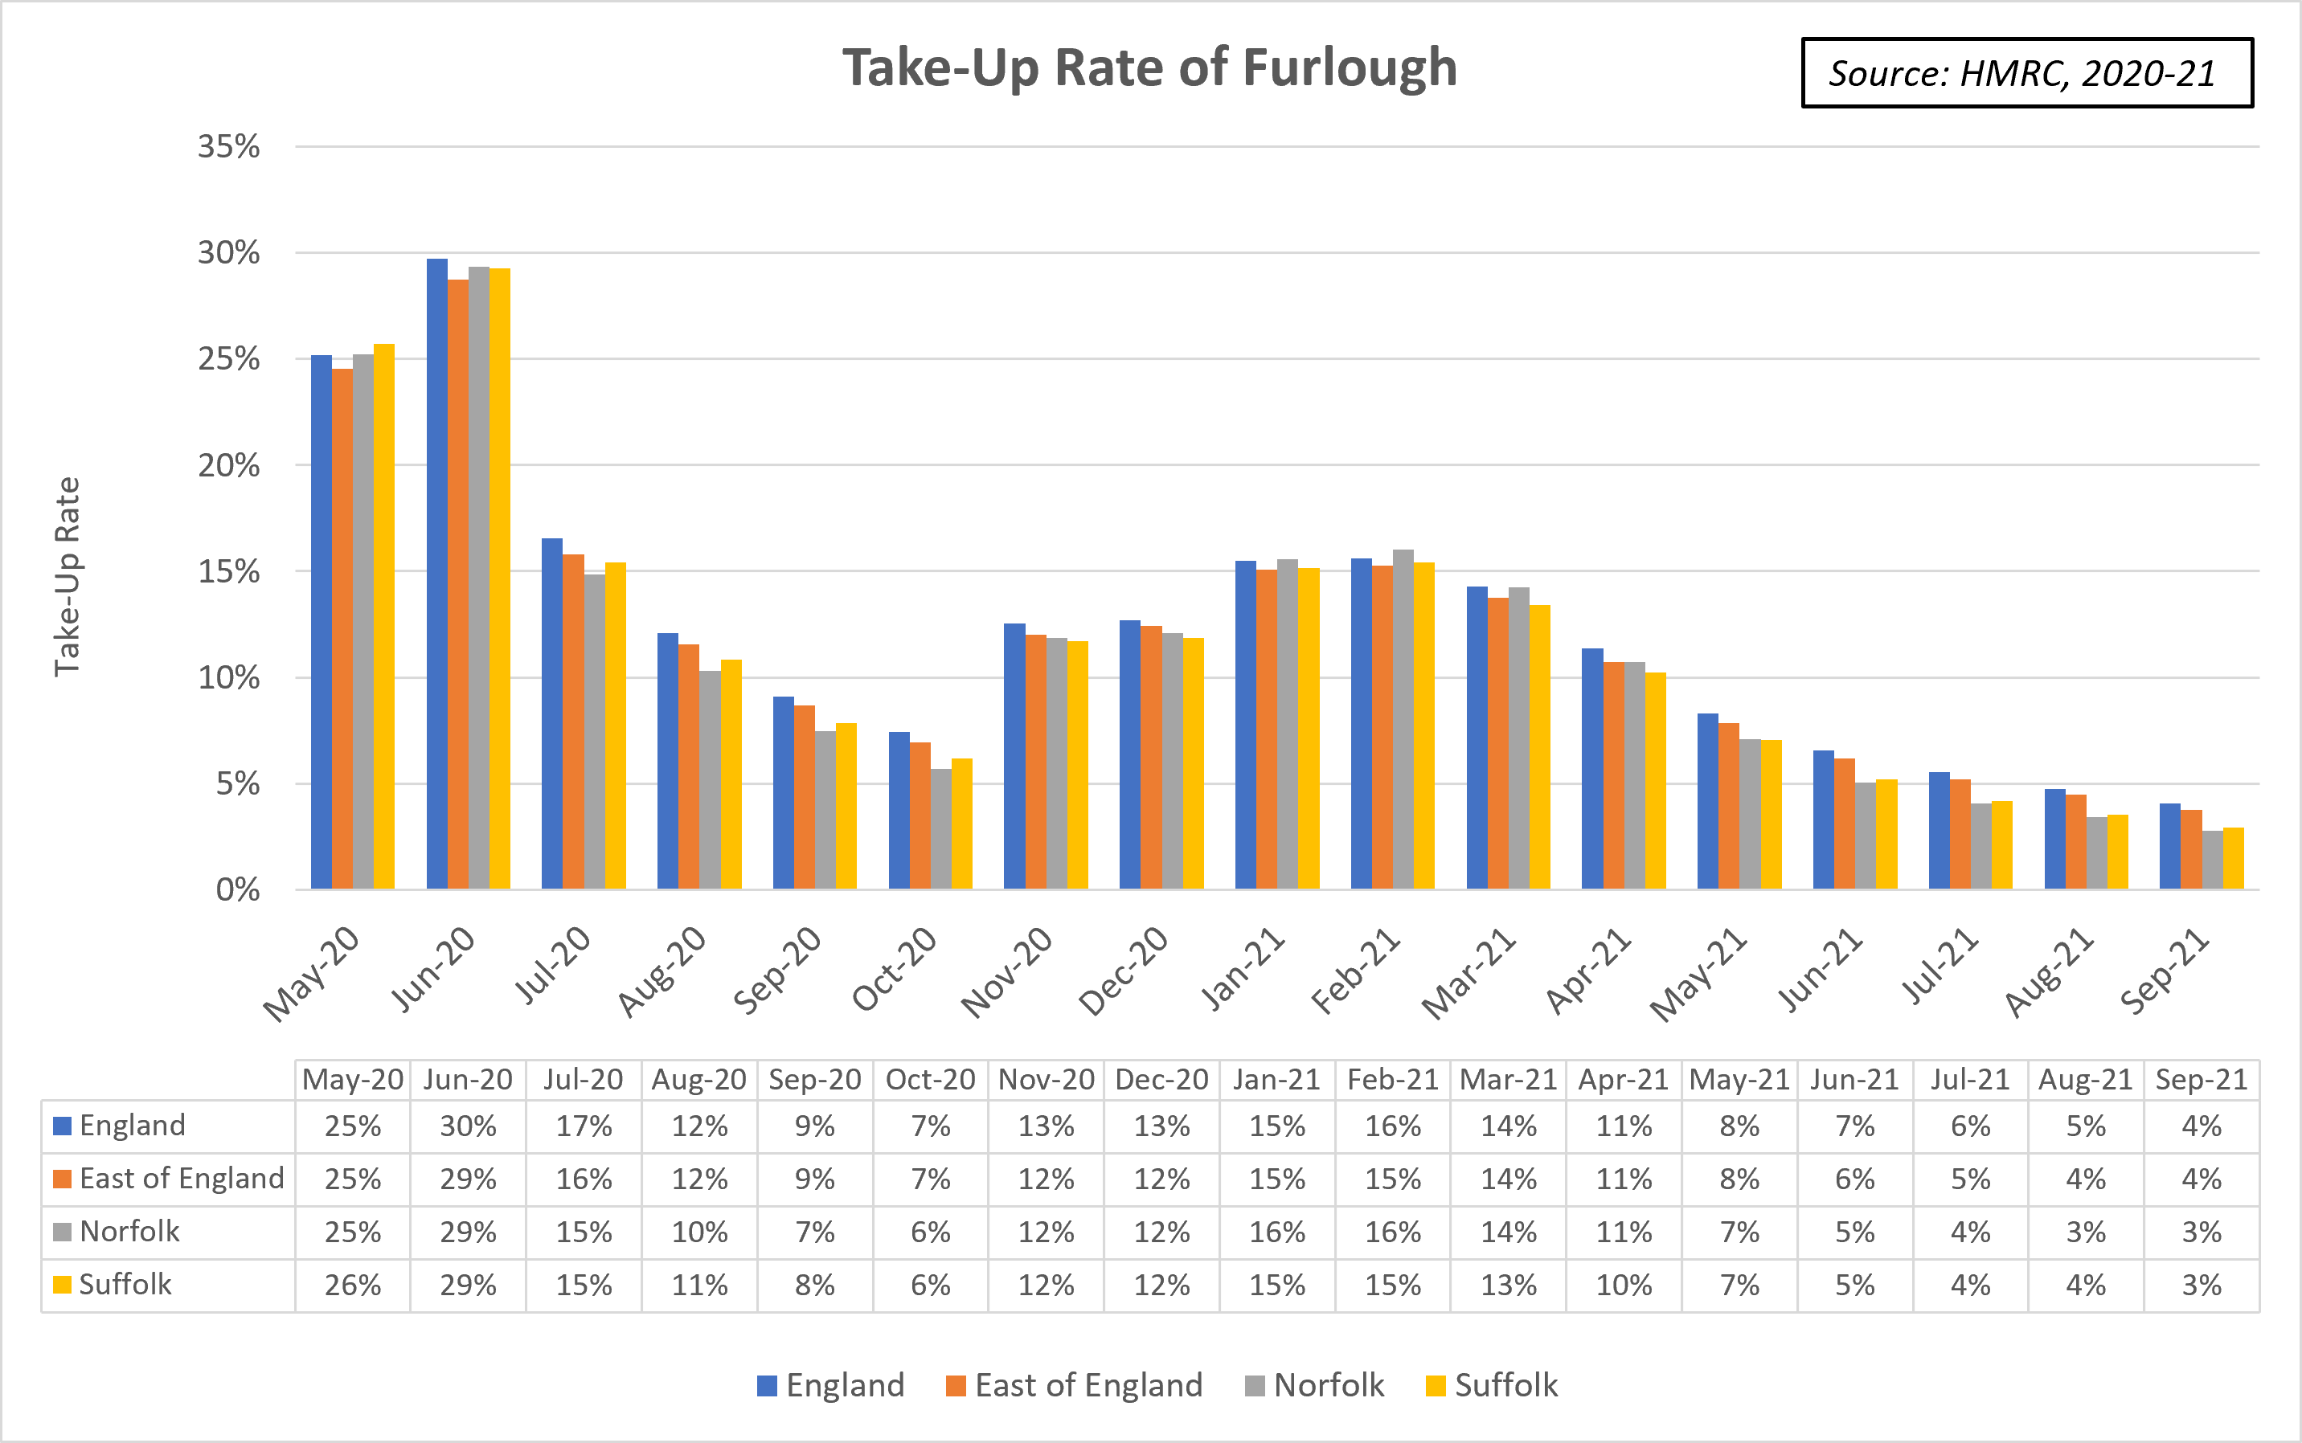
Furlough
As a result of the trading restrictions brought about by the first lockdown of 2020, around 30% of all eligible workers were receiving support through the furlough schemes, at both a national and a local level.
There was a noticeable reduction in furlough figures as the economy reopened through the summer months, falling to 6% in Norfolk and Suffolk by October.
As the tier restrictions and a second lockdown kicked in, the furlough rate crept back up to around 16% (Norfolk) and 15% in (Suffolk) in January 2021, although encouragingly, these were far from the levels seen through the summer of 2020.
Since February, the take-up rate has been decreasing each month across all sectors, with the Norfolk and Suffolk numbers falling to 3% in September 2021.
Furthermore, it has been positive to see that Norfolk and Suffolk figures have tracked slightly below the national and regional levels throughout the restrictions.
Source: HMRC

Slide 15
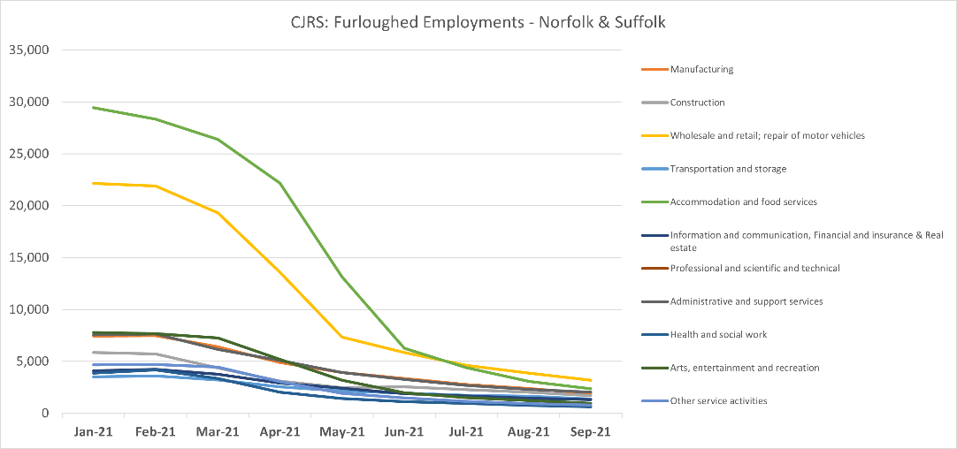
Furlough by Sector
Sector data relating to furlough at a local level shows that furloughed employments are primarily concentrated in Accommodation and Food and Wholesale and Retail, with 29,000 and 22,000 furloughed employments in both sectors respectively in January 2021.
National level data indicates that hospitality and visitor/retail sectors saw the largest take-up rates – running at around 75-87% at their peak.
However, since the beginning of 2020, the volume of furloughed employments across all sectors has been falling, with September 2021 showing furloughed employments in Accommodation & Food and Wholesale and Retail at 2,000 and 3,200 respectively.
Source: HMRC

Slide 16
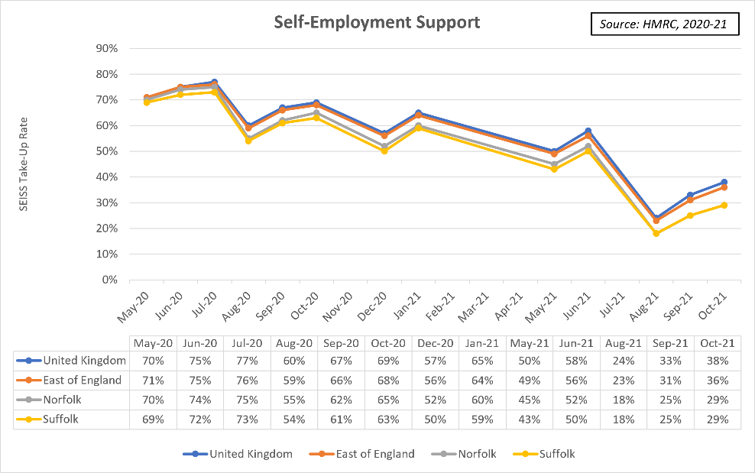
SEISS – Self Employment Support
This graph reflects the contrasting nature of the SEISS (Self Employment Income Support Scheme), compared to the furlough scheme.
The data shows that the take-up rate in Norfolk and Suffolk peaked in July 2020 at around 74% of eligible self-employed, just below the UK peak of 77%.
Since this peak in July 2020, the take-up rate has been quite volatile, often in correlation with the introduction/easing of restrictions, however it has generally followed a downwards trend.
Figures in August 2021 were the lowest on record, with a take-up rate of 18% across Norfolk and Suffolk.
However, from August to the latest figures in October, the take-up rate has risen up to 29%, most likely due to the rising case numbers and the anticipation of new restrictions.
As a result, this metric will be an important one to track in the coming months.
The average value of a claim in June 2021 was £2,200 in Norfolk and £2,300 in Suffolk – which is roughly in line with the UK average (£2,300).
This has fallen from £2,800 and £2,900 in June 2020 for Norfolk and Suffolk respectively.
Source: HMRC

Slide 17
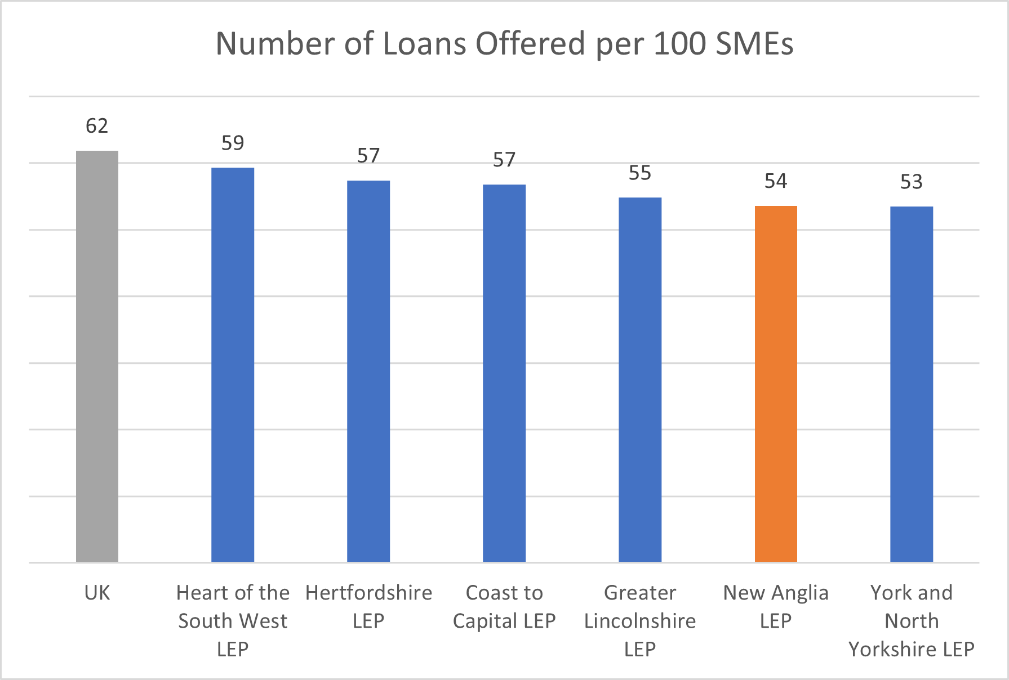
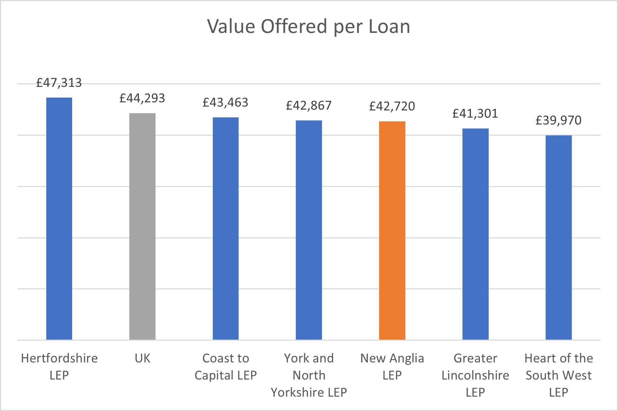
CBILS and BBILS – Business Loan Support
Source: British Business Bank
Norfolk and Suffolk saw fewer numbers of loans offered per 100 SMEs than the national average and nearly all of our comparator LEP regions, with 54 loans offered per SME in Norfolk and Suffolk compared with 62 nationally.
This perhaps indicates that SMEs in Norfolk and Suffolk were in less need of significant financial support as a result of the impact of COVID-19.
Furthermore, not only were there fewer loans offered per 100 SMEs in Norfolk and Suffolk than the national average, but the average value per loan was also less - £42.7k locally relative to £44.3k nationally.

Slide 18
4. Key Metrics Analysis

Slide 19
Key Metrics Analysis
This section looks at a series of key metrics that we have continuously monitored, even prior to the Covid outbreak, in order to assess the trajectory and overall health of the Norfolk and Suffolk economy and have been foundations in all previous economic strategy analysis.
This section looks at:
  Unemployment, Employment & Claimant Count rates
  Business/Enterprise Demographic, Start-up & Incorporation Data
  Salary and Dwelling Affordability Data
  GVA (Gross Value Added)
There are several layers of GVA analysis, as this metric is the most widely used means to measure the underlying value of the economy of any given location (National, LEP, or Local Authority etc) in the UK. Rather than measuring overall output, we are seeking to understand whether the value – the productivity of the output is increasing – or otherwise over time.

Slide 20
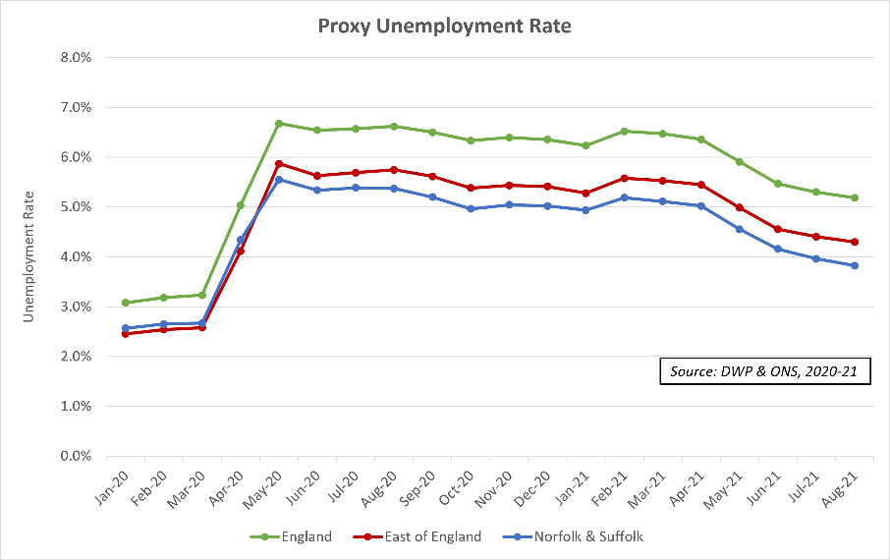
Unemployment Rate
Unemployment data at a local, county, and LEP level, is updated on a rolling monthly basis, reflecting the average unemployment rate over the preceding 12-month period. This means that the ‘official’ data will not provide a timely indication of the impact of the current restrictions in terms of increases in unemployment.
Therefore, we have agreed with the Norfolk Office for Data Analytics (NODA) and the Suffolk Office for Data Analytics (SODA) to use a ‘proxy’ unemployment indicator—the Alternative Claimant Count.
We can see from the above figures that Norfolk and Suffolk are once again tracking in line, but just below national and regional levels. The levels peaked through April 2020 and remained consistent through the autumn, before falling over the festive period.
We can see from the data that unemployment rates are above where they were prior to the pandemic outbreak - although still much lower than we were anticipating in terms of ‘worst case’ scenarios. However, it is worth noting that the raft of government support measures for businesses have still not been withdrawn by government and therefore we could see further increases in unemployment as these support measures are wound down.
Source: Stat-Xplore & ONS

Slide 21
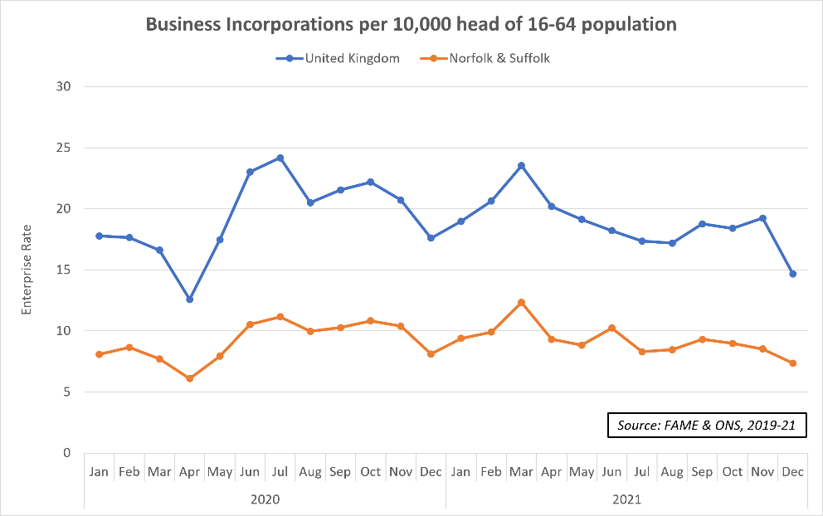
Enterprise Rate
This chart shows us the enterprise start-up rate in relation to the 16-64 population.
The data reflects only those businesses registered with Companies House and is therefore a proxy of enterprise activity, rather than a direct reflection of overall activity.
We can see that the initial lockdown caused a very sharp dip in business formations, then a rapid uptick through the first half of the summer of 2020. There was another notable dip through December 2020, before another peak in March 2021, before a gradual tailing off of activity through summer 2021.
Norfolk and Suffolk track below the UK average figure, with a consistent gap of around 5-10 enterprises less per 10,000 head of 16-64 year old population. This gap remained in place, regardless of lockdown conditions.
However, it is worth noting that this data set only reflects the number of start-ups, rather than indicating the sustainability of enterprises registered with Companies House.
Source: FAME & ONS

Slide 22
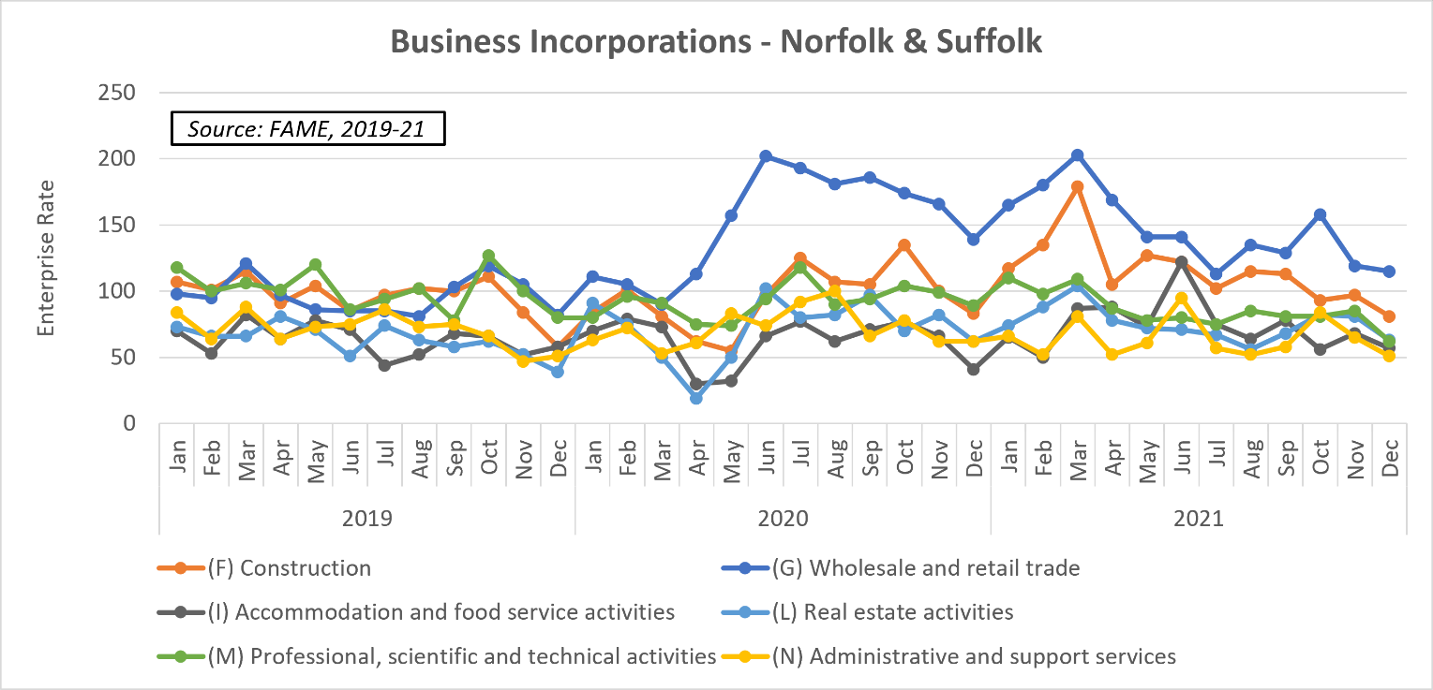
Business Incorporations by Sector
Source: FAME

Slide 23
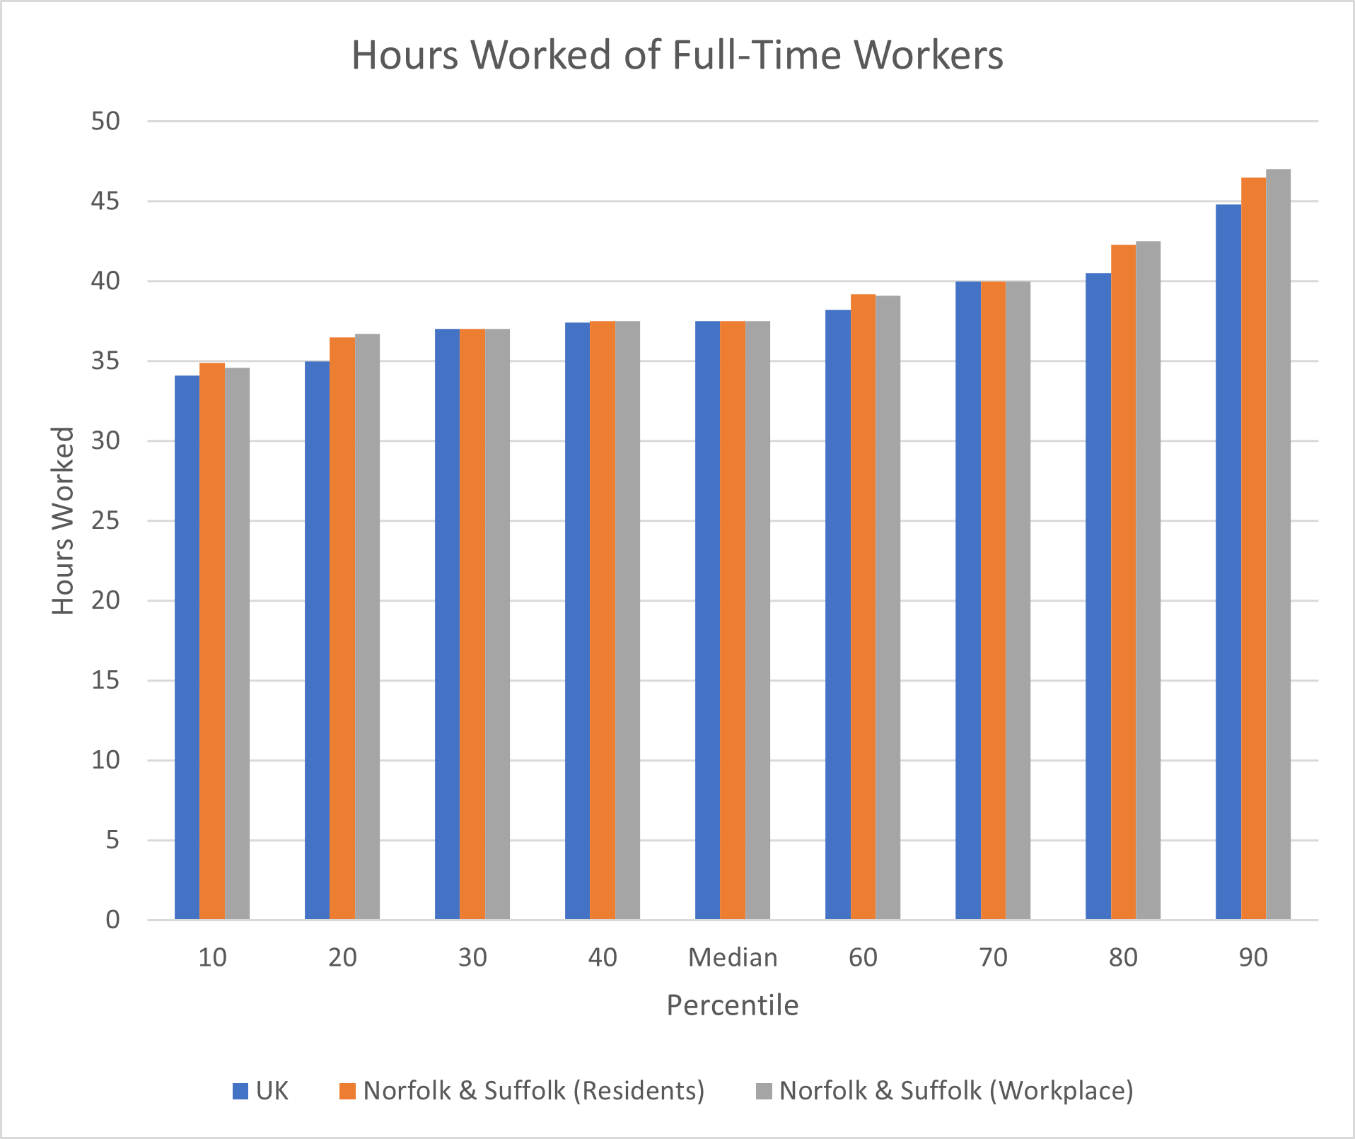
Hours Worked
The median hours worked by Norfolk and Suffolk’s residents and workers is equal to the UK average (37.5 hours per week)
Across all the percentiles for hours worked, Norfolk and Suffolk track closely to national levels. However, the above average number of hours worked in the 80th and 90th percentiles in Norfolk and Suffolk should be noted.
Source: ONS, 2021

Slide 24
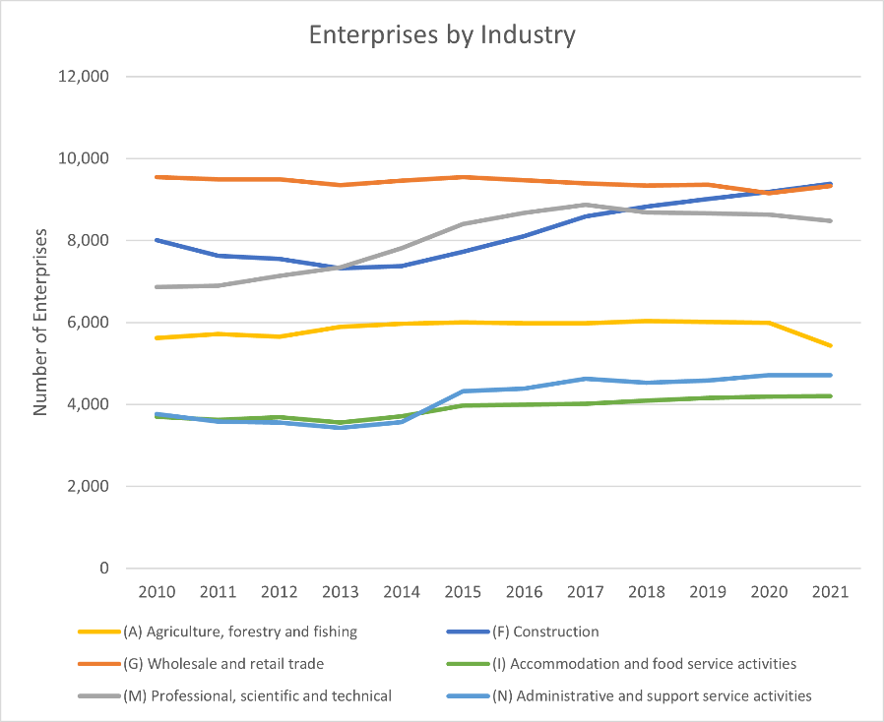
Enterprises by Sector
The graph shows the trendline for the number of enterprises across the six largest industries in Norfolk and Suffolk.
“Wholesale and Retail Trade”, “Construction” and “Professional, Scientific and Technical” have consistently been the top industries in terms of volume of enterprises since 2010, with all three comprising of over 7,000 enterprises.
The growth in the number of enterprises within “Construction” and “Professional, Scientific and Technical” is of particular note, rising by 1,400 and 1,600 respectively since 2010.
Source: ONS

Slide 25
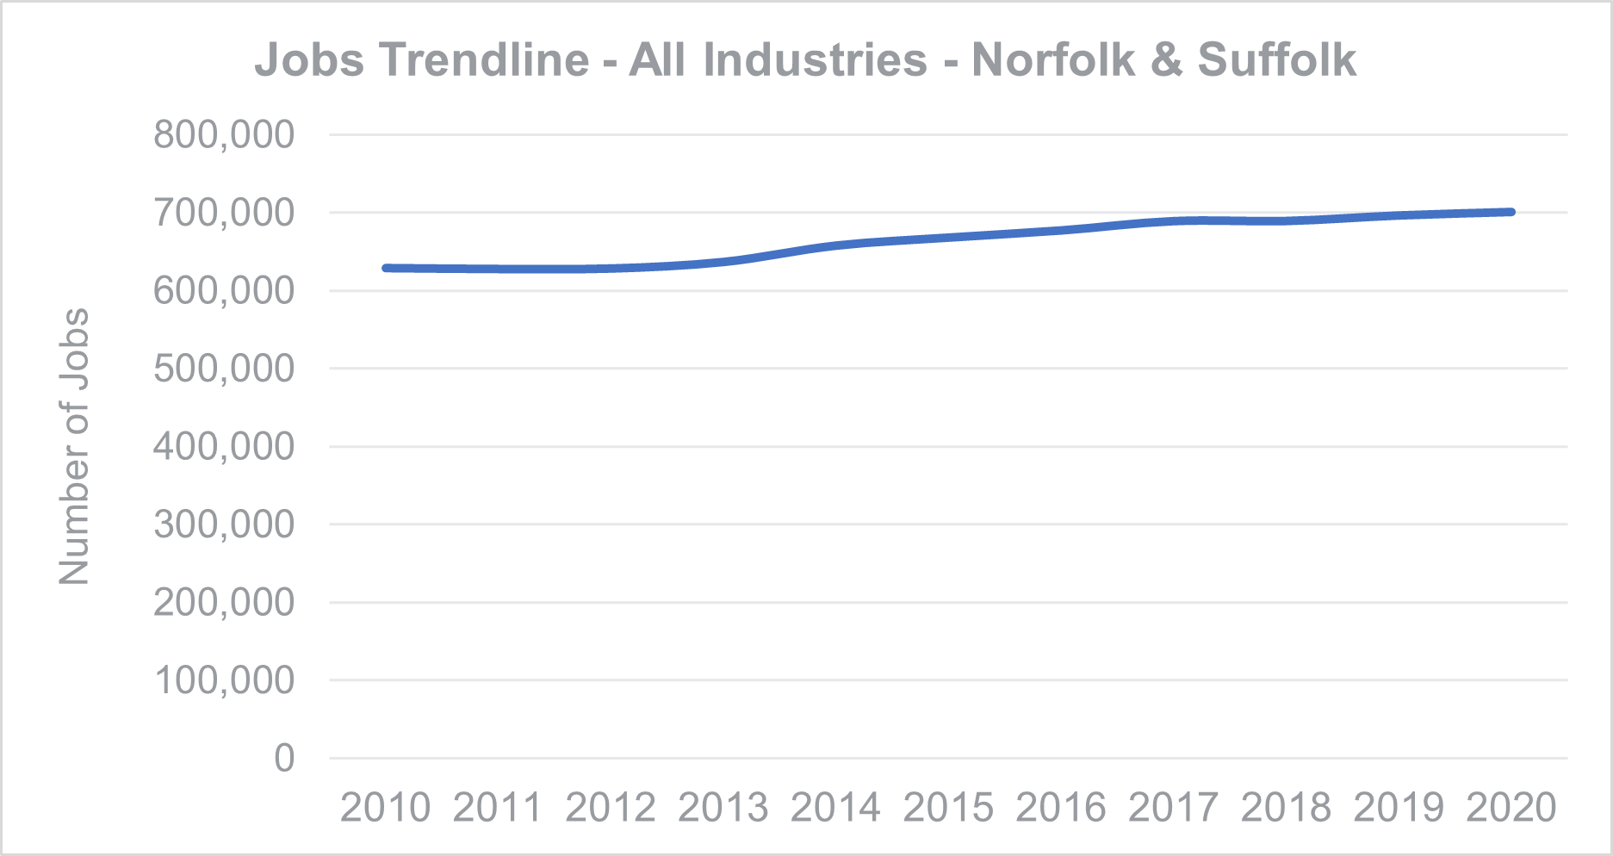
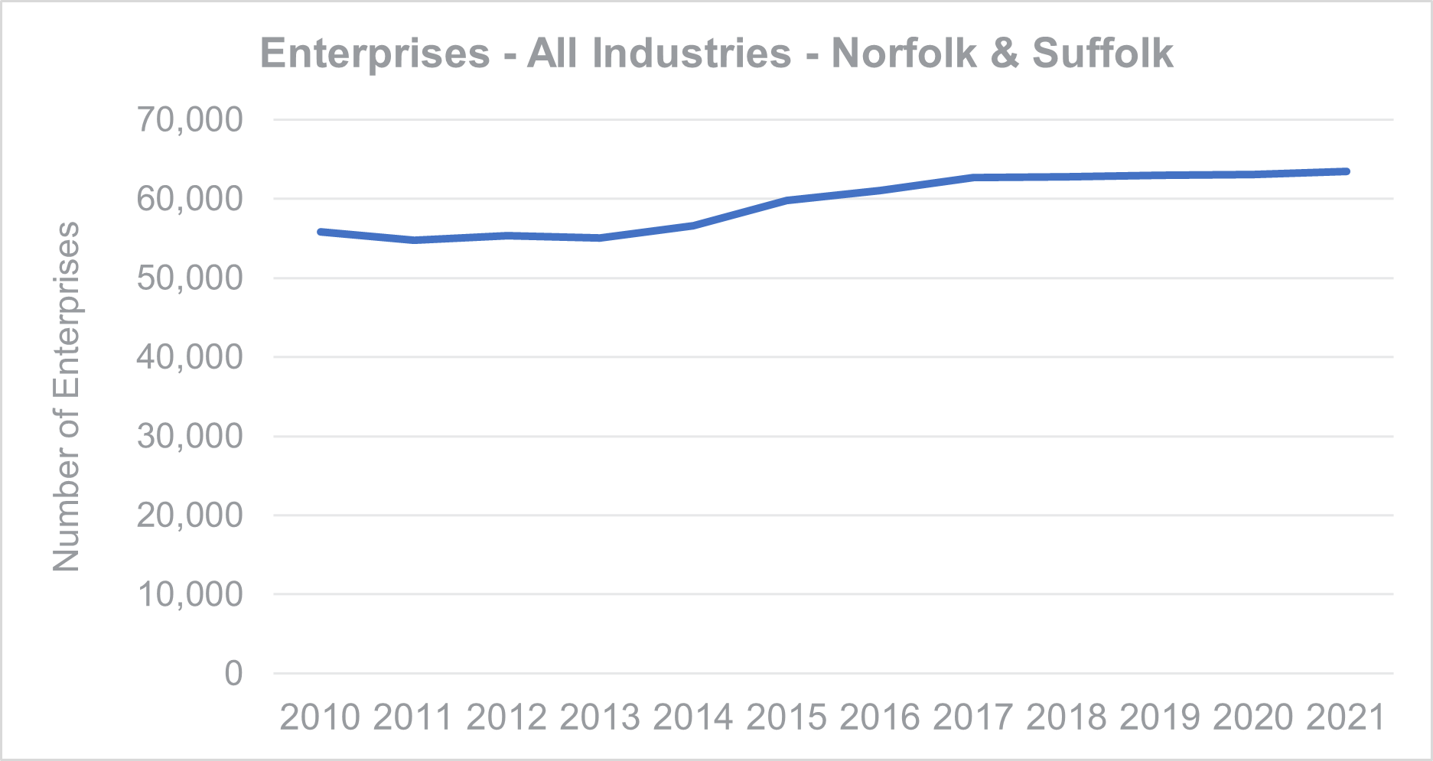
Jobs and Enterprises across all sectors
Source: EMSI
Source: ONS
In 2020, the number of jobs in Norfolk and Suffolk was 700,000.
This figure has been steadily rising between 2010 to 2020, with the combined number of jobs across both counties rising by almost 100,000 people.
In 2021, the number of Enterprises in Norfolk and Suffolk was 63,500.
This figure has been steadily rising since 2013, with the combined number of enterprises across both counties rising by 8,500.

Slide 26
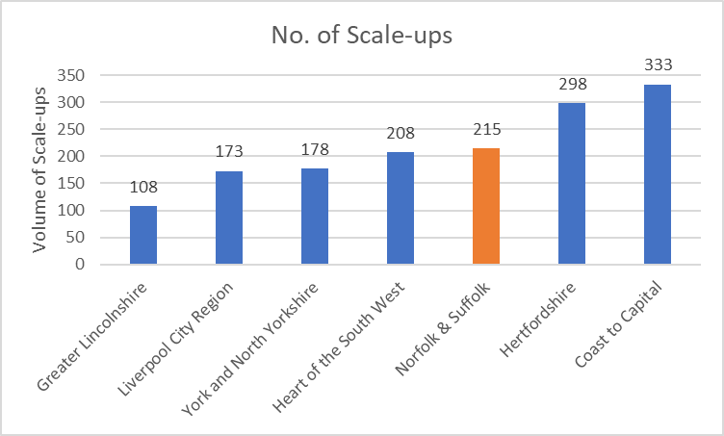
Business Scale-ups: (Norfolk and Suffolk LEP Comparison)
Norfolk and Suffolk rank comparatively favourably in terms of the overall volume of scale-ups, third in our standard matrix and 13th of 37 LEPs nationally (excluding London).
In terms of the ratio of scale-ups to overall enterprise volume, Norfolk and Suffolk rank just inside the lower quartile of 37 LEPs (excluding London).
Source: Scale Up Institute and Beauhurst (2020) The Scale up Index 2020

Slide 27
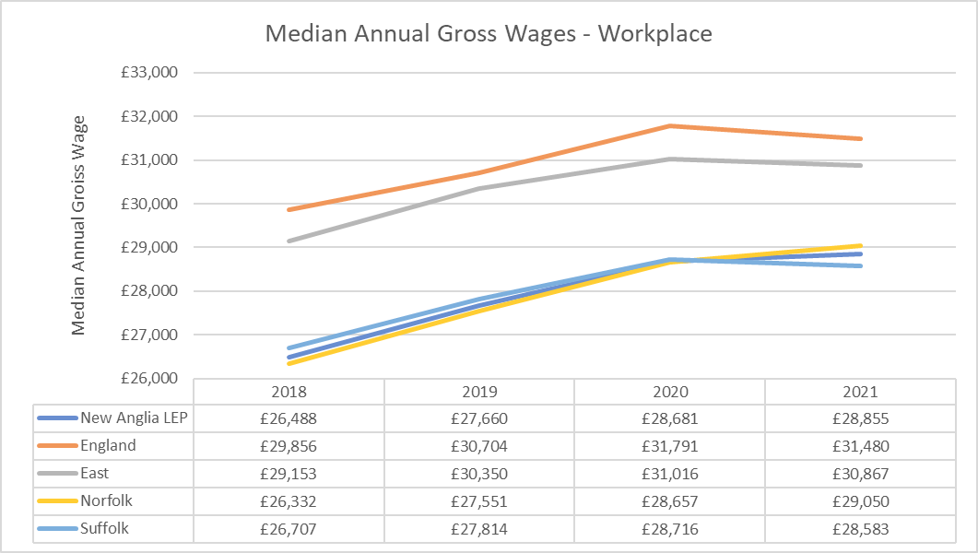
Median Salary
This chart illustrates the comparative gap in median annual earnings between England, the Eastern Region, and Norfolk and Suffolk and the LEP.
It is important to bear in mind that the national median wage has been skewed to an extent by earnings in London and that the Eastern Region’s median wage is potentially skewed by earnings in Cambridge.
However, it is clear that whilst increases and trends have been broadly tracked over the past four years, the intrinsic gap between the median earnings in England and the Eastern region – compared to those across Norfolk and Suffolk - has not been significantly reduced.
Source: ASHE Survey 2021

Slide 28
Median Wages to Median Dwelling Cost Ratio
This table provides an indication of the ratio of median annual wages to the median dwelling cost within a specific location - in essence, the ratio allows us to understand the relative affordability of local dwellings in relation to local wages.
In Norfolk and Suffolk, the median cost of a dwelling is 8.4 times the median annual salary, which is marginally ahead of the ratio for England as a whole at 7.9, but lower than the East of England ration at 9.5.
Therefore, on average the cost of a dwelling in Norfolk and Suffolk is slightly less affordable than the average in England – as a whole, but decidedly more affordable when compared to our region.
Source: ONS – Annual Survey of Hours & Earnings 2021 and HPSSA 2020

Slide 29
Median Wages to Median Dwelling Cost Ratio
Following on from the previous slide, here we see what the affordability of dwellings – relative to median wages is - ranked by the ratio within in each authority – in the column headed ‘Intra LA ratio’.
Here we can see a sizeable variance between Great Yarmouth where the ratio of median wages to median dwelling cost is 6.3, compared with Babergh, where the median wage to median dwelling cost is 10.8.
The column headed ‘Median Norfolk and Suffolk wage to LA Specific Dwelling cost’ provides an indication of the ratio of median dwelling cost in each individual local authority, to the median wage for Norfolk and Suffolk as a whole.
Although there is much the same ranking, we can see that Breckland and Babergh have slightly lower ratios when the Norfolk and Suffolk median wage figure is applied against their respective median dwelling costs, while Mid Suffolk’s and Broadland’s are noticeably higher.
Source: ONS – Annual Survey of Hours & Earnings 2021 and HPSSA 2020

Slide 30
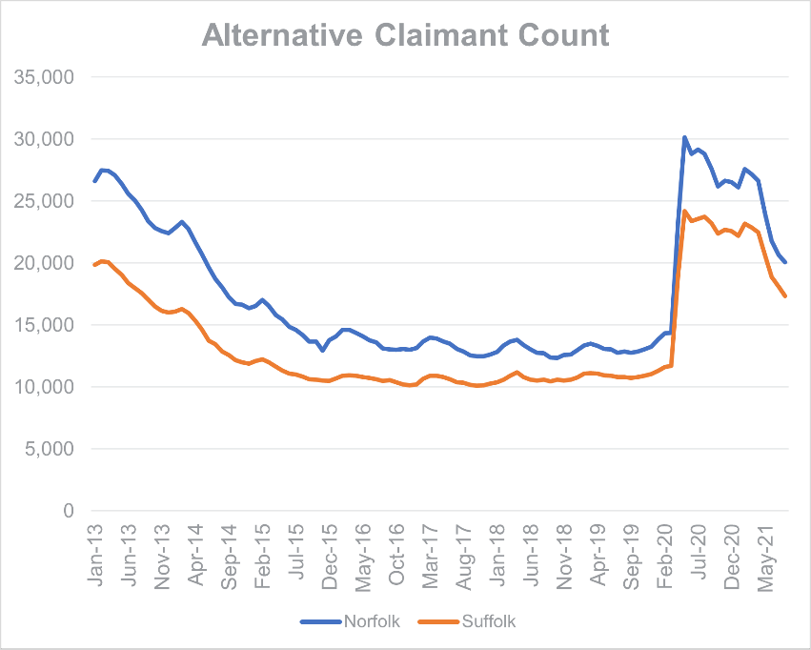
Alternative Claimant Count
As a result of COVID-19 and the economic restrictions that came alongside it, there was an increase of 108% in the alternative claimant count in Norfolk and Suffolk between March 2020 and May 2020.
Since February 2021, the volume of claimants has decreased each month in Norfolk and Suffolk as well as across the UK, falling to the lowest levels seen since May 2020.
Source: Stat-Xplore

Slide 31
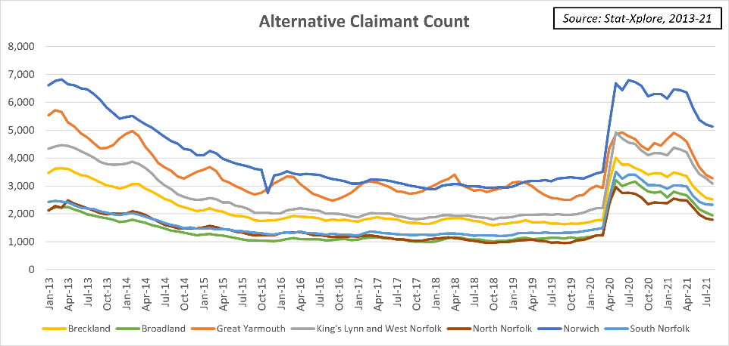
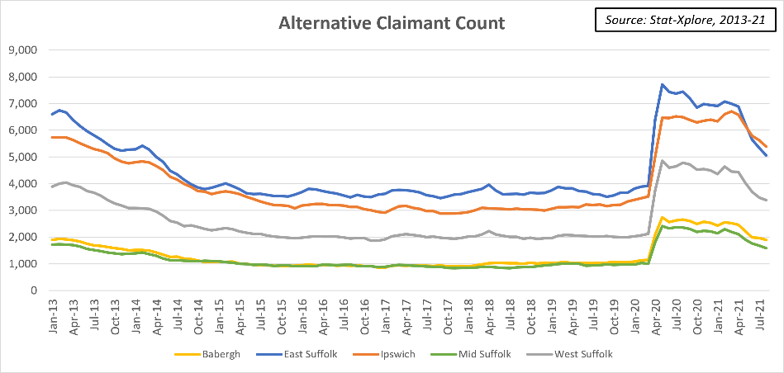
Alternative Claimant Count - LA
Source: Stat-Xplore

Slide 32
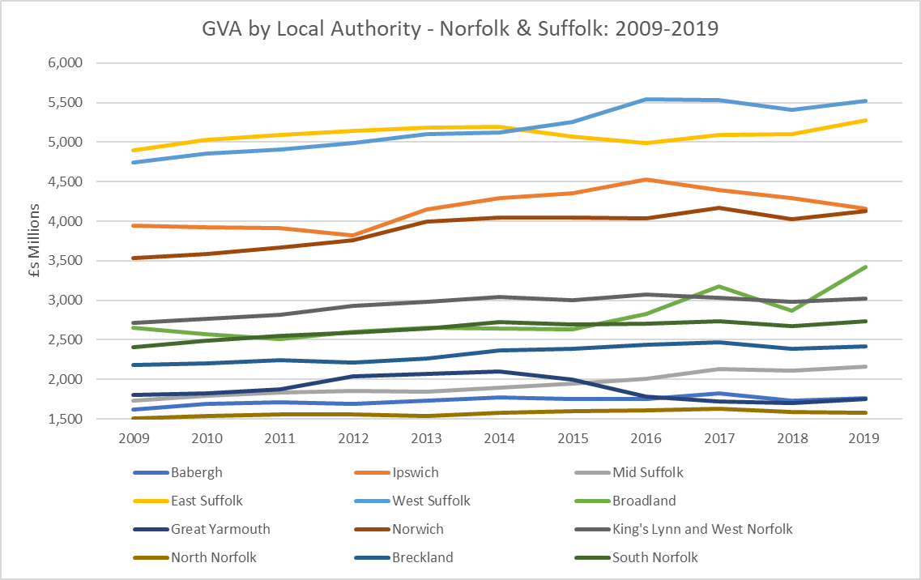
Total GVA by Local Authority
There is a wide disparity over the past decade between the 12 local authority areas that make up Norfolk and Suffolk, not only in terms of the overall volumes of GVA output, but also in the trends of their GVA output.
Both North Norfolk and Babergh have struggled to increase their GVA output over this period and remain the two lowest ranked local authority areas. Meanwhile Mid Suffolk has seen a steady, incremental increase from around 2014 onwards. Great Yarmouth appeared to be following a similar trend before declining around 2015.
Source: ONS GVA ITL 2019 data

Slide 33
Total GVA by Local Authority….continued
Breckland, King’s Lynn and West Norfolk, and South Norfolk appear to have held steady over the past decade. However, Broadland has seen a very noticeable uptick in GVA output since 2015 and has the highest growth rate of all areas from 2017-19. Broadland is the only local authority, other than West Suffolk and Mid Suffolk, to have improved its relative ranking since 2009, moving ahead of King’s Lynn and West Norfolk.
Both Ipswich and Norwich have increased their overall GVA output, although Norwich appears to have sustained a steadier rate of increase, Ipswich is still very marginally ahead.
Source: ONS GVA ITL 2019 data

Slide 34
Total GVA by Local Authority….continued
West Suffolk and East Suffolk continue to be the highest performing local authorities in terms of GVA output – which is not surprising, given their comparative population levels.
It is worth noting that East Suffolk’s output had been slowly increasing through 2009 -14, while West Suffolk's had been slowly tracking upwards. These trends have continued through 2014-19 so that they’ve effectively swapped places, and both appear to be trending upwards since 2018.
Source: ONS GVA ITL 2019 data

Slide 35
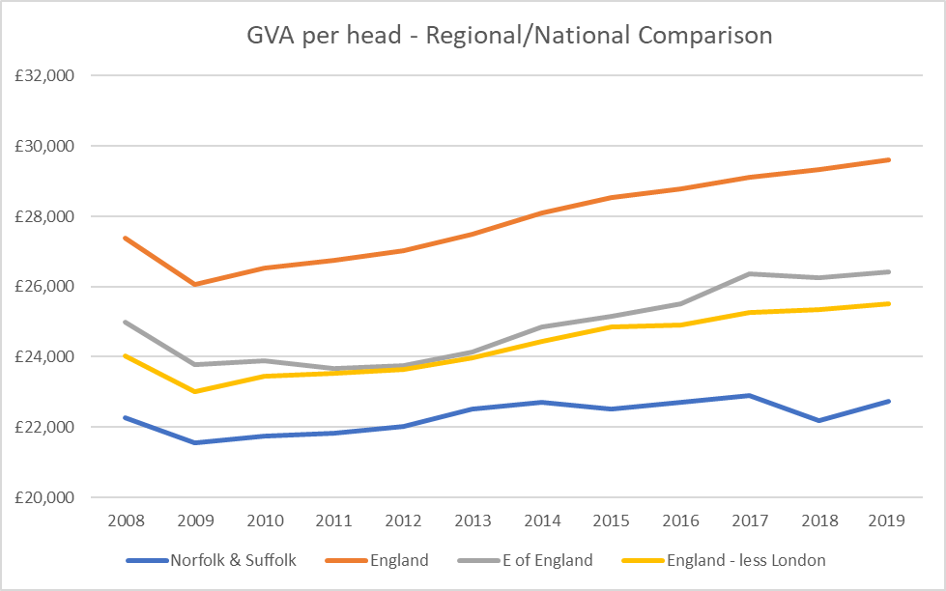
Norfolk and Suffolk GVA per head: 2008-2019
This chart shows the comparative GVA per head of total resident population for New Anglia, in the context of national and regional figures, tracking performance since the impact of the 2008 financial crash.
The chart confirms that Norfolk and Suffolk have tracked below national and regional performance (even when London is removed from the analysis) and that the gap between Norfolk and Suffolk and the average for the region and country has increased since around 2013/14.
Source: ONS GVA ITL 2019 data

Slide 36
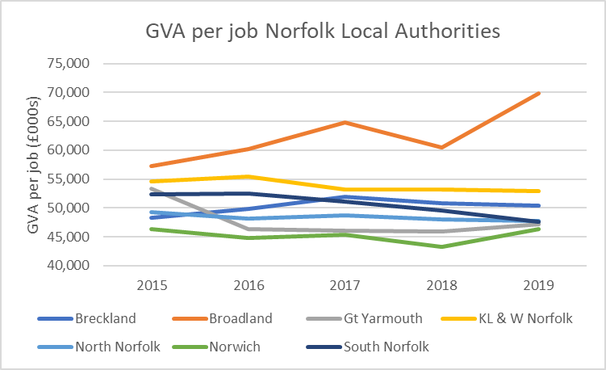
GVA per Job Norfolk: 2015-2019
Source: ONS GVA ITL 2019 data
We can see from the above data that Breckland and particularly Broadland, have seen significant increases in their respective per job GVA output since 2015. However, the other local authority areas have all seen decreases, with Great Yarmouth seeing the most notable drop-off.
Broadland’s outlying performance may be reflective of the comparatively high proportion of jobs in the Finance and Insurance sector -13.3% (compared to the English average of 3.5%), versus Norwich 3.9%, which has the next highest proportion of jobs in that sector.
Norwich, despite a marginal increase, remains the lowest performing GVA per job local authority area.

Slide 37
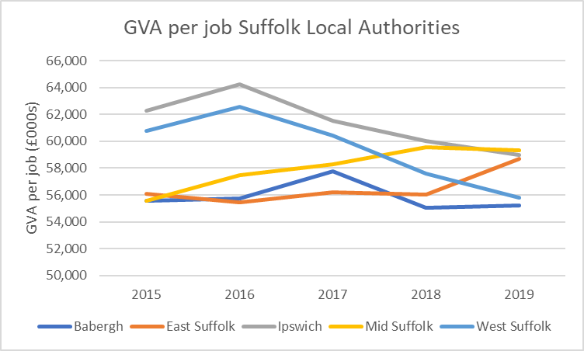
GVA per Job Suffolk: 2015-2019
Source: ONS GVA ITL 2019 data
East Suffolk and in particular, Mid Suffolk, have both seen notable increases in their GVA output per job since 2015. Meanwhile, Ipswich and West Suffolk have both seen sharp decreases from 2016 onwards.
Ipswich, Mid Suffolk and East Suffolk local authority areas were seeing a GVA per job figure between £58,000 - £59,000 in 2019. While Babergh (£55,291 per job), and West Suffolk (£55,788) were in close proximity with one another.

Slide 38
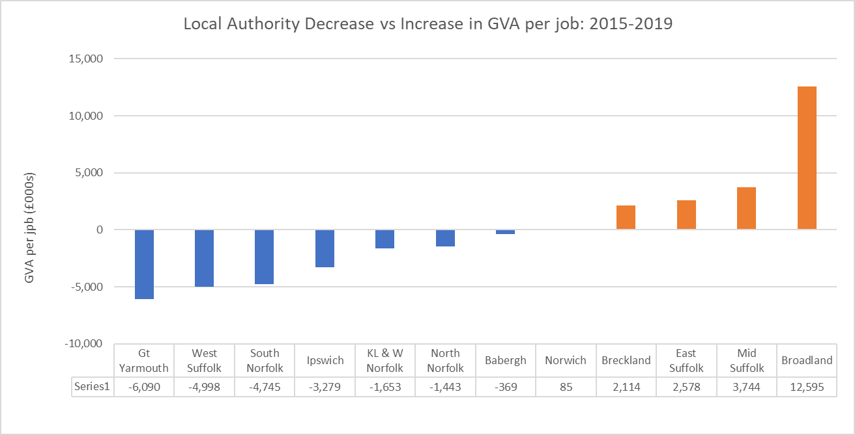
GVA per Job Decrease and Increase Norfolk and Suffolk
This chart shows the GVA per job decrease or increase across each local authority area.
We can see that 7 local authority areas have seen relative decreases in the per job GVA output - although Norwich, Breckland, East Suffolk, Mid Suffolk and in particular Broadland - have seen increases.
Broadland is home to the largest concentration of occupations in the professional, scientific and technical disciplines, with comparatively little employment in lower productivity activities. – which probably goes some way to explain the comparatively high output figure.
Source: ONS GVA ITL 2019 data

Slide 39
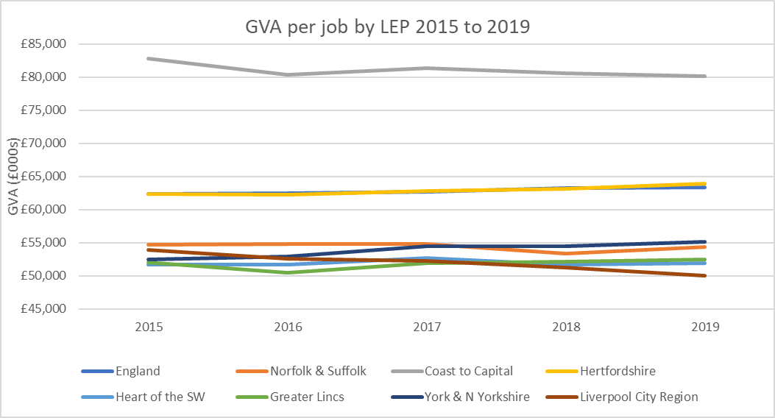
GVA per Job Norfolk and Suffolk - LEP Comparison
Source: ONS GVA ITL 2019 data
The chart and accompanying table illustrates that Norfolk and Suffolk’s (orange line) GVA per job has not noticeably improved since 2015. However, York and North Yorkshire’s performance has improved steadily since 2015 and has moved ahead of our area. Heart of the South West and Greater Lincolnshire have remained relatively flat over the same period, while Liverpool City Region has tailed off.
Hertfordshire and Coast to Capital remain significantly ahead of the pack in terms of GVA per head – although the latter performance has tracked down since 2015, while Hertfordshire is almost precisely reflective of the very modest increase in trend and value seen in England.

Slide 40
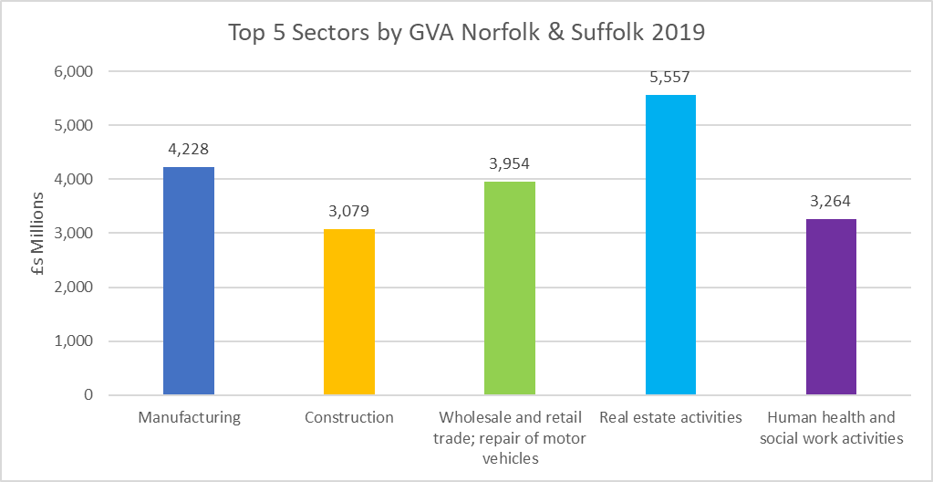
GVA by Sector
The chart opposite shows that certain sectors – such as Real Estate Activities, while comparatively small in terms of employee volume, are significant in terms of their overall GVA contribution. This pattern is mirrored at a regional and national level.
While the importance of the Human Health and Social Care sector in terms of both employment levels and GVA is evident – this chart underlines the significance of Manufacturing's contribution to the area’s overall GVA output.
Source: ONS GVA ITL 2019 data

Slide 41
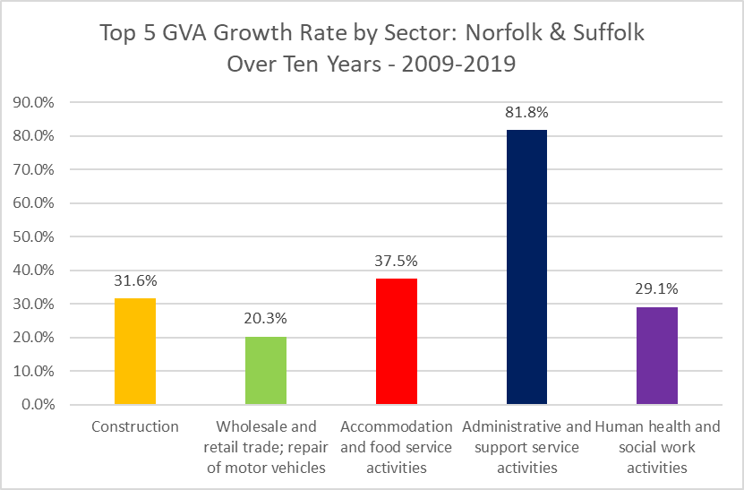
GVA by Sector
This chart provides a contrasting picture to the previous one, by illustrating the growth rate of GVA value over the past decade.
Here we can see that while working from comparatively low GVA volume bases, the Accommodation and Food sectors and the Administrative and Support sectors have seen notable growth in GVA value.
The rate of growth in Accommodation and Food is encouraging as the area has invested a good deal of resource and effort in increasing the value of its Visitor Economy.
Source: ONS GVA ITL 2019 data

Slide 42
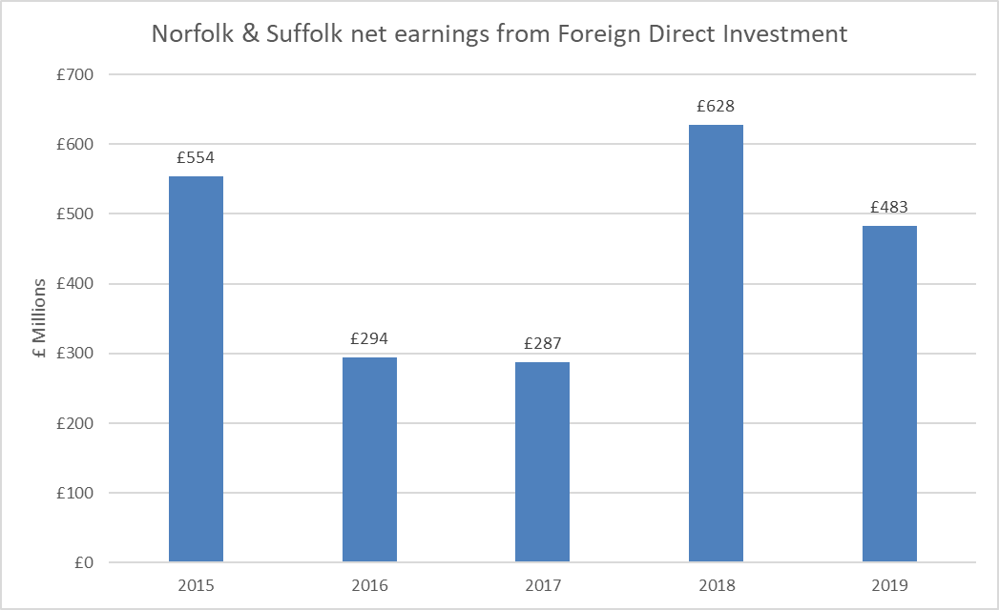
Inward Investment – Foreign Direct Investment (FDI)
The chart opposite shows data relating to the net earnings from FDI (foreign direct investment) in Norfolk and Suffolk.
We can see that over the past 5 years, the net earnings levels have fluctuated considerably – which is not unusual for FDI activity, which can be influenced by single large-scale project investments.
It appears that while the area saw two years of relatively modest levels of net earnings, the latest two years returned to a healthy level.
Source: ONS FDI Statistics (experimental) – 2019 data

Slide 43
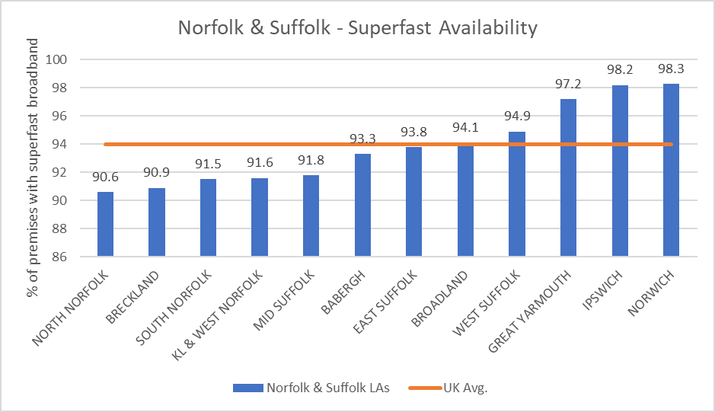
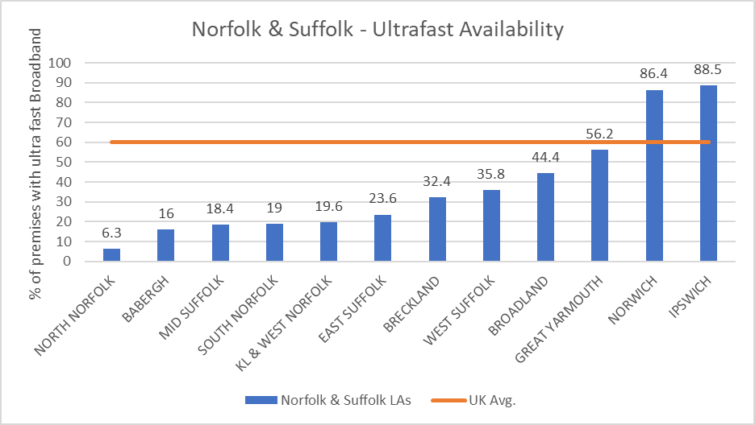
Fixed Broadband Coverage
Source: Ofcom: Connected Nations Report - 2020
The two charts above contrast the provision of superfast broadband with ultrafast to premises across both counties.
We can see that broadly speaking, both Ipswich and Norwich have markedly better rates of availability compared to many other locations across Norfolk and Suffolk, and both have availability rates in excess of the UK average.
Locations such as North Norfolk (6%), Babergh (16%), Mid Suffolk (18%), South Norfolk (19%), King’s Lynn and West Norfolk (20%), East Suffolk (24%), Breckland (32%) and West Suffolk (36%), all have ultrafast availability rates well below the UK average of 60%.

Slide 44
UK Competitiveness Index (CI)
The UK CI report ranks all 362 local authority areas across the UK. This allows us to analyse which decile each of our Local Authorities fall into.
The analysis combines a wide range of metrics to arrive at a comparative index ‘score’. Many of the metrics mentioned in the preceding slides – especially those relating to wages, enterprise rates, and GVA outputs contribute to arriving at this comparative score.
This scoring matrix not only allows us to benchmark where specific locations rank in relation to one another at a fixed moment in time, but due to its annual refresh schedule, it allows us to understand the trajectory of specific locations’ economies over time, and thereby allows us to identify whether the evidence base indicates the economy is demonstrably improving, stagnating, or losing ground – in relation to the overall national trend.
It is worth remembering that this is a comparative matrix – i.e. the UK score is always ‘100’, and therefore it effectively rates how well or otherwise the economies of local authorities are performing in relation to the UK trend as a whole.
Notes:
Complied by Nottingham and Cardiff Business Schools – goes back to 2002.
The aim of the UKCI is to assess the relative economic competitiveness of regions and localities in the UK by constructing a single index that reflects, as fully as possible, the measurable criteria constituting place competitiveness. The UKCI considers that the competitiveness of localities and the competitiveness of firms to be interdependent concepts. Measuring such competitiveness, however, is no easy matter and, as indicators of national competitiveness have shown, cannot be reduced solely to notions of Gross Domestic Product (GDP) and productivity.
http://cforic.org/downloads/
Methodology
Input factors
Economic Activity Rates
Business Start-up Rates per 1,000 Inhabitants
Number of Business per 1,000 inhabitants
Proportion of Working Age Population with NVQ Level 4 or Proportion of Knowledge-Based Business
Output Factors
Gross Value Added per head at current basic prices
Productivity - Output per Hour Worked
Employment Rates
Outcome Factors
Gross weekly pay
Unemployment rates

Slide 45
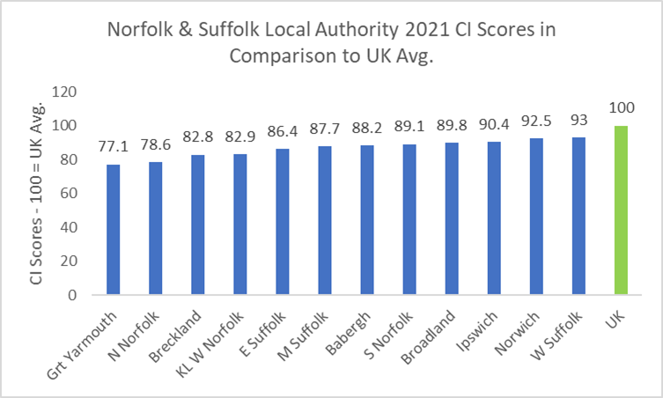
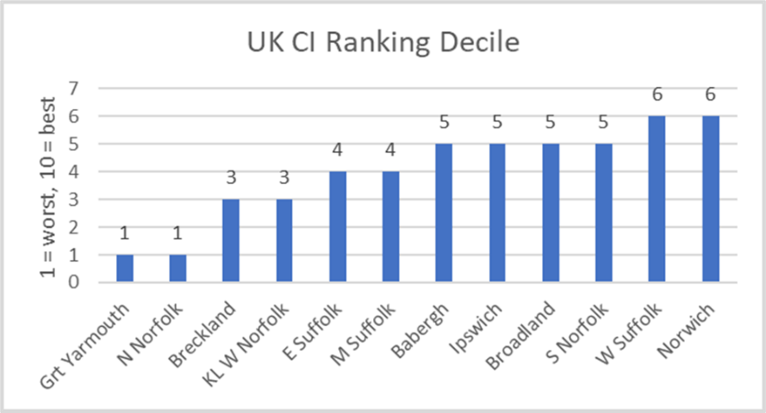
UK Competitiveness Index (CI)
UKCI Competitiveness Index, 2021
The chart on the left-hand side shows that in terms of overall ‘competitiveness’ score, all of Norfolk and Suffolk’s local authorities rank below the national average.
The chart on the right-hand side shows that two of our local authorities rank in the worst decile in terms of competitiveness and even our ‘best performing’ local authority areas only rank in the 6th best decile.
As a LEP area, Norfolk and Suffolk rank 30 out of 47 comparable areas, which is where we ranked in 2018.
Notes:
Complied by Nottingham and Cardiff Business Schools – goes back to 2002.
The aim of the UKCI is to assess the relative economic competitiveness of regions and localities in the UK by constructing a single index that reflects, as fully as possible, the measurable criteria constituting place competitiveness. The UKCI considers that the competitiveness of localities and the competitiveness of firms to be interdependent concepts. Measuring such competitiveness, however, is no easy matter and, as indicators of national competitiveness have shown, cannot be reduced solely to notions of Gross Domestic Product (GDP) and productivity.
http://cforic.org/downloads/
Methodology
Input factors
Economic Activity Rates
Business Start-up Rates per 1,000 Inhabitants
Number of Business per 1,000 inhabitants
Proportion of Working Age Population with NVQ Level 4 or Proportion of Knowledge-Based Business
Output Factors
Gross Value Added per head at current basic prices
Productivity - Output per Hour Worked
Employment Rates
Outcome Factors
Gross weekly pay
Unemployment rates

Slide 46
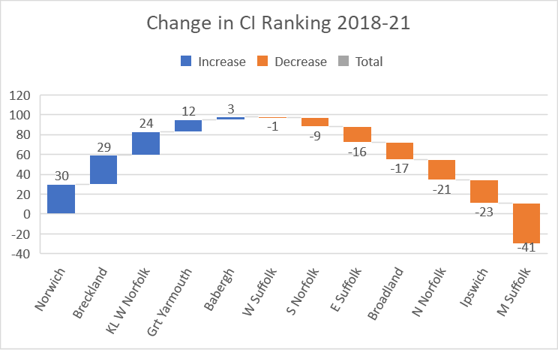
UK Competitiveness Index (CI)
This chart illustrates the movement of each of the Norfolk and Suffolk local authority areas – within the overall UK ranking, between 2018 to 2021.
The areas aligned with blue indicate where local authorities have improved their ranking while those in orange indicate those areas that have slipped in the ranking.
UKCI Competitiveness Index, 2021

Slide 47
Strategic Opportunities and Sector Analysis
The following slides examine the latest headline data and intelligence around our 10 ‘foundation’ sectors, which are in turn set in the context of our three overarching strategic objectives which underpin the golden thread of economic strategy – clean growth.
The three strategic opportunities were first arrived at as part of the Local Industrial Strategy work and were developed in conjunction with local private and public sector partners – securing widespread recognition and agreement to reflect the specific nature of the local economy and its distinct opportunities for future growth.

Slide 48
Strategic Opportunities & Sector Analysis
Definitions
Agri-food – the combined output and activity from agricultural, animal husbandry, and horticultural activity – as well as all associated food and drink processing, food and related human health scientific and manufacturing R&D, specialised food wholesale and retail, food and drink focused hospitality
Clean Energy – manufacture, construction, and installation of all types of clean energy apparatus including all supply chains levels, the operations and maintenance of all clean energy projects and installations, research and development across all forms of clean energy
ICT Digital – capturing all technical as well as creative activity that involves either the manufacture and production of ICT/telecommunications equipment and/or devices, as well as activities (including R&D) associated with software and games design, programming and AI, fibre and wireless telecommunications and all web-based commerce and marketing and solutions.
The above definitions are not intended to replace or replicate strict Standard Industrial Classification (SIC) sector definitions, while specific SIC sector codes definitions will be composite elements within these strategic opportunities , they are deliberately intended to be cross-cutting and are understood to often operate in support of one another - fundamentally underpinning our over-arching objective of clean growth.

Slide 49
Foundation Sector Analysis
The economic strategy will seek to assess the scale, comparative specialisation and landscape of future challenges and opportunities across our foundation sectors:
  Advanced Manufacturing and Engineering
  Agri-food Tech
  Construction and Development
  Digital Tech
  Energy
  Financial Services and Insurance
  Health and Social Work
  Life Sciences and Bio-tech
  Ports and logistics
  Visitor Economy (Inc. Tourism and Hospitality)
The following table provides a comparative breakdown of the GVA, average wages and employment proportion shifts and concentrations of employment in each of these sectors in Norfolk and Suffolk, using the latest available data.

Slide 50
Foundation Sector Analysis
Sub-sector(s) | GVA | Avg. Wages per Job | Jobs | Jobs % Change (2019-20) | Location Quotient
Advanced Manufacturing & Engineering | £4.0b | £34,081 | 89,879 | -3.2% | 1.02
Agri-Food Tech | £3.1b | £22,570 | 71,702 | -1.6% | 1.37
Construction & Development | £2.7b | £40,307 | 41,051 | +5.8% | 1.19
Digital Tech | £1.2b | £36,398 | 21,264 | -0.7% | 0.60
Energy | £1.1b | £36,483 | 10,280 | +0.7% | 1.07
Financial Services & Insurance | £1.3b | £32,935 | 23,374 | +7.3% | 0.97
Health & Social Work | £2.8b | £23,471 | 95,737 | -0.2% | 1.04
Life Sciences & Bio-tech | £0.6b | £31,310 | 14,382 | +0.8% | 1.02
Ports & Logistics | £1.7b | £31,177 | 41,601 | -2.0% | 0.96
Visitor Economy | £2.1b | £19,982 | 89,185 | +1.4% | 1.01
Source: EMSI
*The full SIC code breakdowns/methodology used to define each sector are available upon request

Slide 51
Foundation Sector Analysis
Sectors where there are proportionately more jobs relative to England as a whole include, agriculture (1.9%), manufacturing (9.4%), human health and social care (13.8%) and construction (5.5%), with marginally higher proportions of employment in wholesale and retail (15.8%), public administration (4.5%) and arts and entertainment (2.9%). Overall, there are not significant deviations from the averages in England across any sector – with the exception of professional, scientific and technical services (6% in Norfolk and Suffolk, compared to 9.1% for England) and information and communications (2.5% compared to 2.9% for England).
Therefore, the Norfolk and Suffolk economy is not overly reliant on any one or small cluster of sectors. This lack of reliance on a single sector is likely what has made the economy comparatively resilient in the face of the major sectoral disruption we’ve encountered over the past 2 years.
This evidence also indicates that a successful economic strategy cannot focus on boosting productivity and jobs in one or even a couple of specific sectors. Instead, it must be cross-cutting, seeking to support innovation in diverse activities (such as in digital) that can deliver productivity enhancing benefits across all, particularly more traditional sectors that are likely to be a substantive part of our local economy.
In assessing the current sector make-up in Norfolk and Suffolk, we should also acknowledge the future shape and nature of our economy, set in the context of wider transitions and shifts that are likely to change over the coming decade or so.
Significant influencing factors include automation, artificial intelligence (AI), more general digital solution implementation, as well as climate change pressures, including consumer driven demand shifts and regulatory measures. Therefore, our strategy looks to take account of which sectors and skills sets we predict will grow in significance and demand, as well as taking account of more immediate shortfalls and pressures.

Slide 52
Foundation Sector Analysis
Both Brexit and Covid restrictions have had a profound impact on both local and national economic conditions, resulting in highly disparate effects across sectors and even within sub-sectors. The prospect of further lockdowns or restrictions, (e.g. social distancing which will especially affect the tourism and hospitality sector), is still a very real prospect. The initial impact of the Covid lockdowns measures on specific sectors has been recorded in both our June 2020 Restart Plan and in the subsequent update in November 2020.
Across the economy as a whole, and in relation to individual sectors, the Norfolk and Suffolk economy has broadly mirrored national trends throughout the time of Covid restrictions and since Brexit. However, given the comparative scale of activity around the agricultural sector we have detected acute challenges around securing sufficient labour, throughout the picking and processing elements of this sector.
The following slides provide insights into the specific challenges and opportunities facing each of our foundation sectors.
These insights have been secured through an interrogation of the ongoing weekly business intelligence reports we have been gathering since the start of the pandemic, combined with feedback from our range of sector and industry groups – who are themselves tasked with gathering and reflecting their respective sector or industry’s concerns and aspirations.
Both of these routes to intelligence and insight are ongoing and will aid us in iteratively shaping both the analysis and various interventions as the economic strategy is delivered over the coming years.

Slide 53
Foundation Sector Analysis
Advanced Manufacturing and Engineering
Construction and Development
Challenges include:
Availability of key materials.
Price increase for materials.
Labour shortages.
Exacerbation effect of the array of infrastructure projects on materials and labour.
Challenges include:
Inflationary burdens.
Increased cost of raw materials.
Supply chain disruptions.
Funding - investments into new machinery and digital technology is of course expensive (likewise for products that help reduce carbon footprints). Not just SMEs struggle in this space.
Wage pressures and labour shortages.
Opportunities include:
Regional Infrastructure and Regeneration projects offer a major opportunity for the sector.
Adoption of new technologies / innovation.
Delivery of the Net Zero Strategy – retrofitting and adopting more sustainable methods of construction.
Opportunities include:
Positive growth forecast for 2022.
Sustainable HR management, lean and digitisation are three priorities / opportunities that will deliver innovation, productivity and support the transition to net zero.
Digital tech adoption to boost productivity.
Increased investments into R&D.
Localised supply chains.
Productivity East is a major asset for the sector.

Slide 54
Foundation Sector Analysis
Creative Industries
Financial Services
Challenges include:
Sector is dispersed across the two counties.
Labour shortages.
Challenges include:
Strengths in FinTech not acknowledged by Khalifa Review.
Retention and recruitment is emerging as a challenge for the financial services sector – exacerbated by the pandemic and working from home trend.
Opportunities include:
Creative Unlimited.
Strong ambitions around net zero production skills.
Skills focus supporting young people into the sector and promoting destination for talent to work and stay.
Supporting cross-sector innovation through technologies/capabilities such as UX design, gamification, etc.
Engagement with Health and Social Care sector to develop innovative solutions to improve health outcomes and quality of life.
Opportunities include:
Further enhancing the major FinTech offer.
Promote and strengthen our ESG (Environmental, Social and Governance) and green investment credentials given the crucial role the sector has to play in driving the clean growth agenda.
Strengthen the links between FIG and FIPS – the two cluster networks representing Norwich and Ipswich.

Slide 55
Foundation Sector Analysis
Health and Social Care
Life Sciences and Bio Tech
Challenges include:
Labour challenges exacerbated by EU Exit and Covid-19 pandemic.
Negative impact on earnings of social care staff.
Challenges include:
Highly specialized subject areas – difficult to attract new audience and stakeholders to the work being done.
Opportunities include:
Shared learning around the transformational partnerships working across Norfolk and Suffolk.
The Integrated Care Academy at University of Suffolk links the care sector with the VCSE sector and will be leading academic partners for local health and social care services working in mental health, care for the elderly and end of life care.
The Norwich Institute of Healthy Ageing partnership develops and implements effective strategies to promote sustained population behaviour change, in order to improve physical and mental wellbeing.
The University of East Anglia Health and Social Care Partnership is working together to make it easier to do more research and innovation. Single focus is on increasing collaboration to bring benefits to service users and health and social care professionals. Strategic focus on healthy ageing; young people’s wellbeing and living with long-term conditions.
The Norwich University of the Arts has partnered with regional universities and the University of Essex to develop creative and innovative solutions to both social care and mental health
Innovative local companies transforming the sector (e.g. Stowmarket Innovation Labs, Norwich Research Park, Adastral Park).
MedTech facility at Felixstowe
Opportunities include:
International expertise in the fields of food, health, and microbiome – advanced cluster of animal health and emerging pharmaceutical manufacture.
Delivery of the Department for International Trade High Potential Opportunity in Plant Science building on the world-class research at Norwich Research Park and the agri-food sector.

Slide 56
Foundation Sector Analysis
Ports and Logistics
Visitor Economy
Challenges include:
The sector has been hit hard by supply chain disruption and backlog at ports.
Price of containers has gone through the roof.
Labour challenges e.g. the impact of the HGV driver shortage.
Challenges include:
The sector has been hit hard by the Covid-19 pandemic and is facing challenges around recruitment and retention due to perceptions.
Potential for staycation trend to decline in 2022.
Opportunities include:
Freeport East opportunity – Port of Felixstowe and Gateway 14.
UK’s largest container port at Felixstowe.
Nationally significant ports for the energy and agri-food sectors.
Strong logistics cluster - A14 corridor emerging as a major location for smart logistics hubs.
Port expansion and innovation plans (e.g. Operations and Maintenance Campus, 5G technology, PowerPark).
Decarbonisation plans across ports.
Opportunities include:
East of England Development Plan sets the agenda moving forward.
Opportunity to attract more foreign visitors in 2022.
Extending the season all year round.
Adoption of digital technologies and driving innovation in the sector.
Sustainable Tourism Plan.
Eco-tourism opportunities.
East Academy for Skills in Tourism.

Slide 57
Foundation Sector Analysis
Culture and Heritage
Challenges include:
The sector has been hit hard by the Covid-19 pandemic.
Disproportionate impact on self-employed / freelancers.
Nearly 7,000 people are employed in East Anglia's cultural economy and the sector had been growing until the pandemic hit. Between 2015 and spring 2020, the sector had grown by £38million - employing nearly a quarter more people than it had in 2020. However, when the pandemic hit, it shrank by 28% in terms of its contribution to the economy.
Opportunities include:
New vision and strategy for the culture sector.
Head East campaign celebrating the rich diversity of arts, culture, and heritage.
Change leadership programme is equipping current and next-generation creative and cultural leaders with the skills they need to drive creative, social and economic change across Norfolk and Suffolk.

Slide 58

Business, Enterprise and Scale-ups: Case Study
Supporting West Suffolk’s SME’s
SMEs account for 98% of all businesses operating in West Suffolk and helping these businesses to start, grow, survive and thrive not only requires expert advice, but businesses need the right environment in which to develop.
Recognising this, West Suffolk Council has invested in the extension and refurbishment of the enterprise agency Menta’s Business Centre in Haverhill and agreed for Menta to manage the Harvey Adams Centre in Brandon, a key location along the Cambridge Norwich Tech Corridor. The Harvey Adams Centre is now fully occupied and the businesses within have full access to the support and guidance available from Menta.
The Council has also supported Menta to establish new co-working space in the centre of Bury St Edmunds called @Inc. The flexibility of this space enables new start-ups to move towards having their own business premises.
In addition, the brand-new Epicentre building at Haverhill Research Park, funded by West Suffolk Council, includes a small laboratory space alongside a range of business spaces for differing company types and sizes. This new offering in Haverhill is already much in demand, allowing Haverhill to grow its role in supporting Cambridge and the wider Cambridge Norwich Tech Corridor network.
@Inc co-working space
Credit: Menta

Slide 59
5. Trade and Export Analysis

Slide 60
Trade and Export
The following section outlines Norfolk and Suffolk’s trade and export activity.
It must be noted that the data has only recently been made available (Nov 2021) to provide an insight into the output at a county level and even then, the data is reflective of activity up to 2019.
However, what is available still provides a useful sense of where we are in relation to our usual range of LEP comparator areas. We have decided to use a LEP level comparison matrix for this section – as the nature of trade and exports often relies on workforces, resources and assets that stretch across county level boundaries.
While the above statement is applicable to almost every facet of economic activity – it is often of even greater relevance in the context of trade and export.

Slide 61
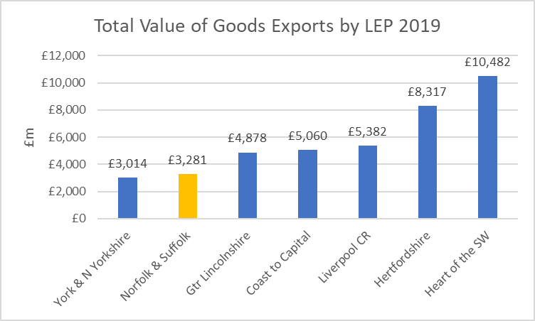
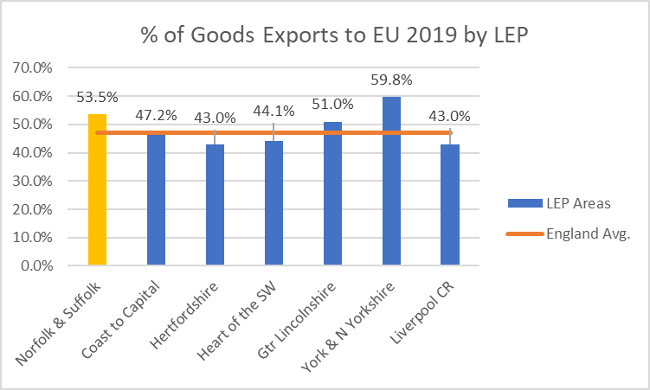
Trade: Export of Goods
Source: Export/Import Values: DIT - & HMRC – 2019 data
The figures in the chart above show that in 2019, the export of goods to the EU constituted a 6.5% higher proportion for Norfolk and Suffolk than the average for England as a whole.
Of the other LEPs in our comparator matrix, we can see that Norfolk and Suffolk’s overall export value to the EU is significantly lower than 5 of the other 6 in our comparator matrix, however, only Greater Lincolnshire and York and N. Yorkshire registered higher proportions of goods exports to the EU – underlining the areas importance to Norfolk and Suffolk.
It is perhaps worth noting that these two, along with Norfolk and Suffolk, are among the most prominent and productive food producing LEPs in England.

Slide 62
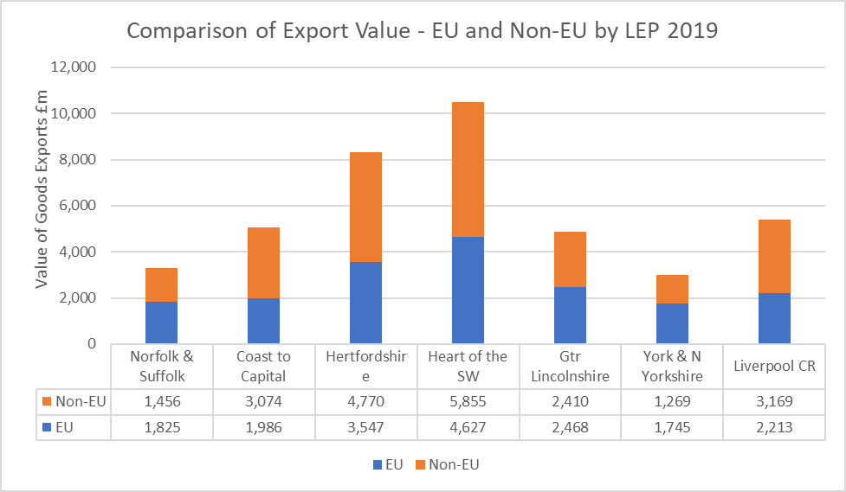
Trade: Export of Goods – EU and Non EU Markets
The figures in the chart opposite show a variance across the comparator matrix in terms of the majority of LEPs exporting higher values to Non-EU markets, with the exception of York and North Yorkshire and Norfolk and Suffolk, while Greater Lincolnshire was roughly equivalent.
These figures suggest that Norfolk and Suffolk faces more significant challenges in the wake of the EU trade agreement, as it is an area that unlike several other LEPs, conducts more export trade with EU, rather than non-EU markets.
Source: Export/Import Values: DIT - & HMRC – 2019 data

Slide 63
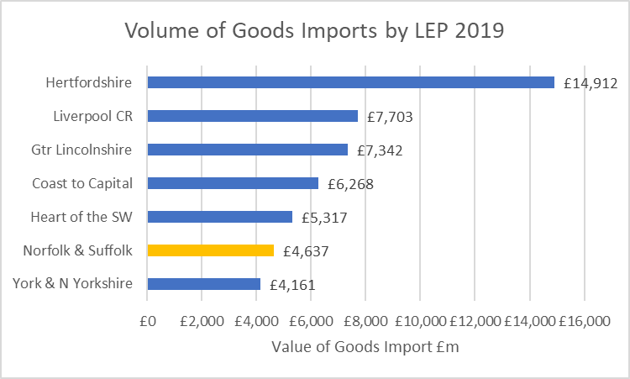
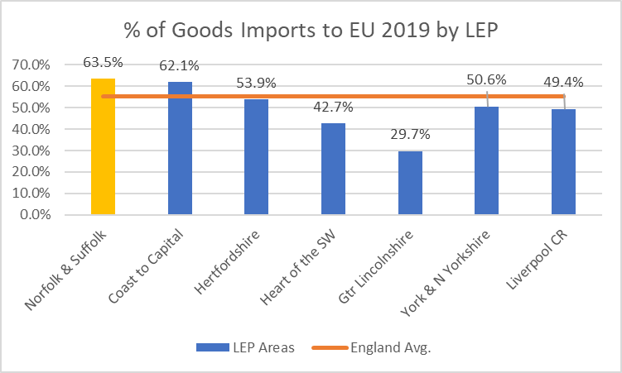
Trade: Import of Goods from the EU
Source: Export/Import Values: DIT - & HMRC – 2019 data
The figures in the chart above show that in 2019, the import of goods to the EU constituted an 8% higher proportion for Norfolk and Suffolk than the average for England as a whole.
Of the other LEPs in our comparator matrix, we can see that Norfolk and Suffolk’s overall value of imports from the EU is higher 5 of the other comparators in the matrix.
As outlined in the previous export slides, these import figures suggest that in comparison to other LEP areas – Norfolk and Suffolk is more reliant on imports from EU markets

Slide 64
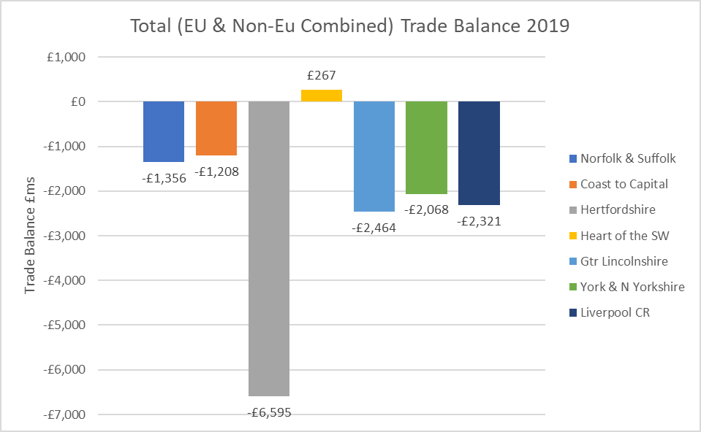
Trade Balance: Goods
England and the UK as a whole has experienced a sustained period of running up annual balance of trade deficits, so these figures are not surprising.
The figures in the chart opposite show a wide variance within the LEP comparator matrix, with Hertfordshire LEP’s goods trade balance significantly in deficit. While the only LEP area running a goods trade surplus in Heart of the South West
We can see, the goods trade balance deficit in Norfolk and Suffolk in 2019 was significant in absolute terms – (£1.35bn), it was comparatively modest – compared to the deficits seen in 4 of the other LEPs in the matrix.
Source: Export/Import Values: DIT - & HMRC – 2019 data

Slide 65
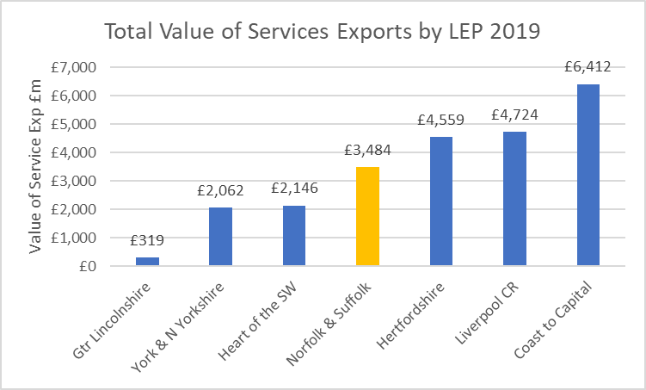
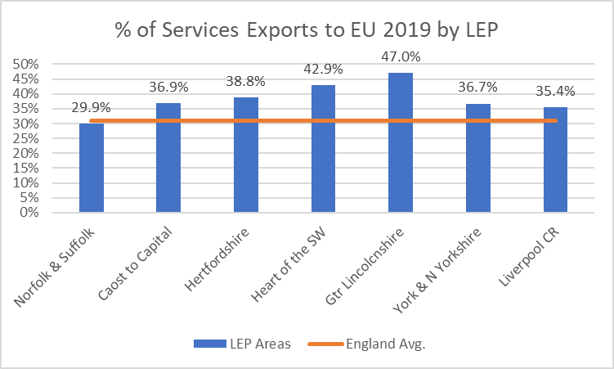
Trade: Export of Services
Source: Export/Import Values: DIT - & HMRC – 2019 data
We can see from the chart above that the value of Norfolk and Suffolk’s service exports were greater than either York and North Yorkshire, or Heart of the South West in 2019 and significantly more than Greater Lincolnshire. Although we are some way below both Hertfordshire and Liverpool City Region and considerably below the value exported by Coast to Capital.
The chart on the left-hand side indicates that in 2019 Norfolk and Suffolk’s percentage of service export value is slightly less than the average for England, and the lowest out of all of our usual LEP comparators.

Slide 66
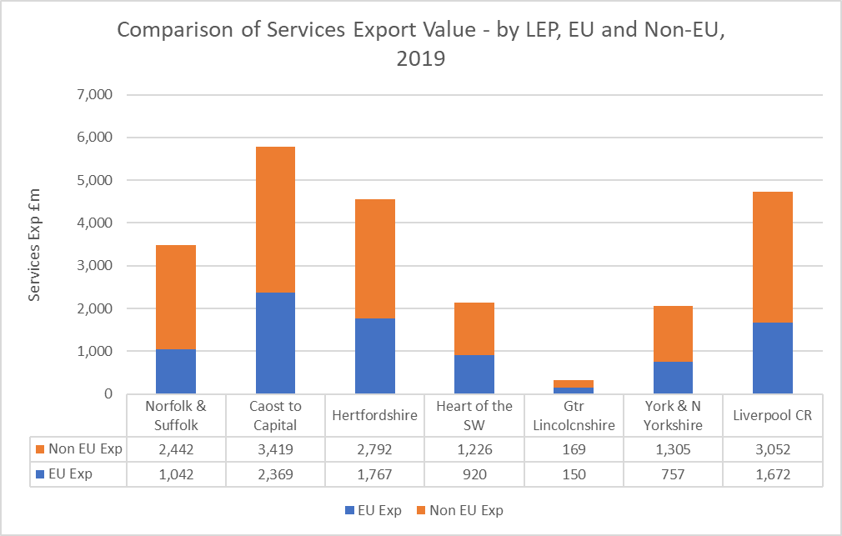
Trade: Export of Services – EU and Non-EU Markets
This chart allows us to see the wide variance of value of exports between our usual comparator LEP areas.
With Coast to Capital exporting more than 18 times the value in services than Greater Lincolnshire.
Norfolk and Suffolk’s service export value was 10 times that of Greater Lincolnshire in 2019, and just over one and half times smaller than Coast to Capital’s.
Source: Export/Import Values: DIT - & HMRC – 2019 data

Slide 67
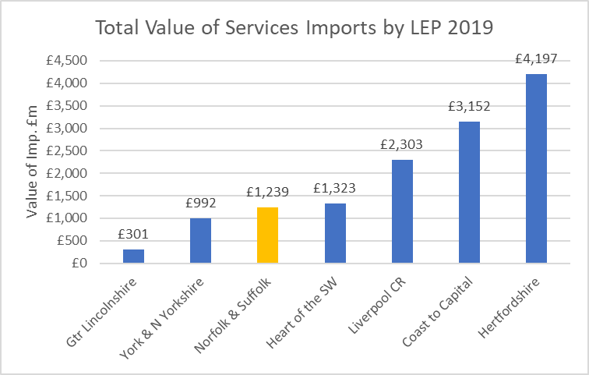
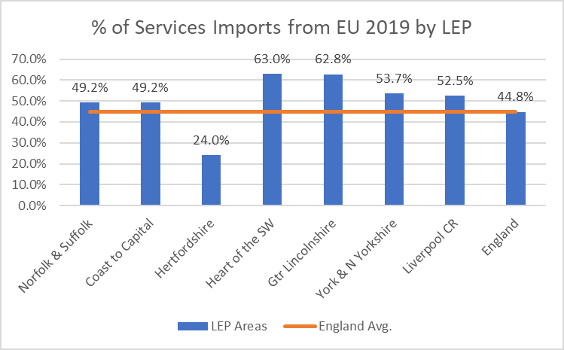
Trade: Import of Services from the EU
Source: Export/Import Values: DIT - & HMRC – 2019 data
We can see from the chart above that Norfolk and Suffolk services import more than 3 times less import value than Hertfordshire LEP, but more than 4 times that of the lowest value area – Greater Lincolnshire.
The chart on the right-hand side allows us to understand the percentage of services import value flowing from the EU. Here we can see that Norfolk and Suffolk were edging just above the national average in terms of the value of import services in 2019.

Slide 68
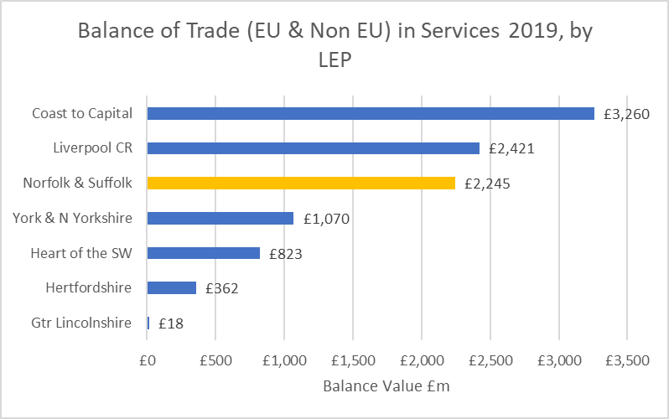
Trade Balance: Services
This chart allows us to assess the balance of trade with regards to services.
The balance for all comparator regions is positive, although there are significant variances between comparator LEP areas.
Norfolk and Suffolk’s trade balance is around 124 times higher than Greater Lincolnshire, as the lowest performing LEP in the matrix, and is around one a half times lower than Coast to Capital as the top performing LEP area.
Source: Export/Import Values: DIT - & HMRC – 2019 data

Slide 69
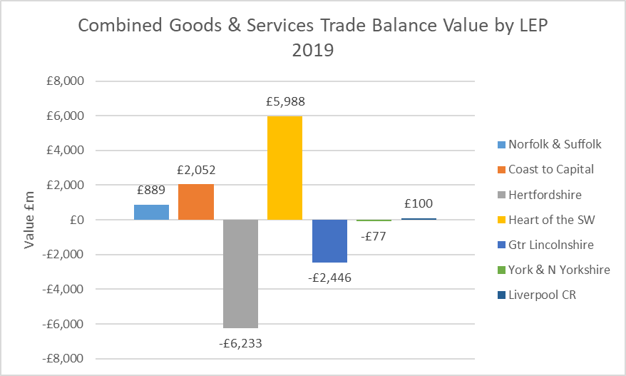
Total Trade Balance: Goods and Services
Here we can see that Heart of the South West, Coast to Capital, Liverpool City Region and Norfolk and Suffolk all returned positive trade balances in 2019.
The largest variance was between Heart of the South West and Hertfordshire LEP.
Source: Export/Import Values: DIT - & HMRC – 2019 data

Slide 70
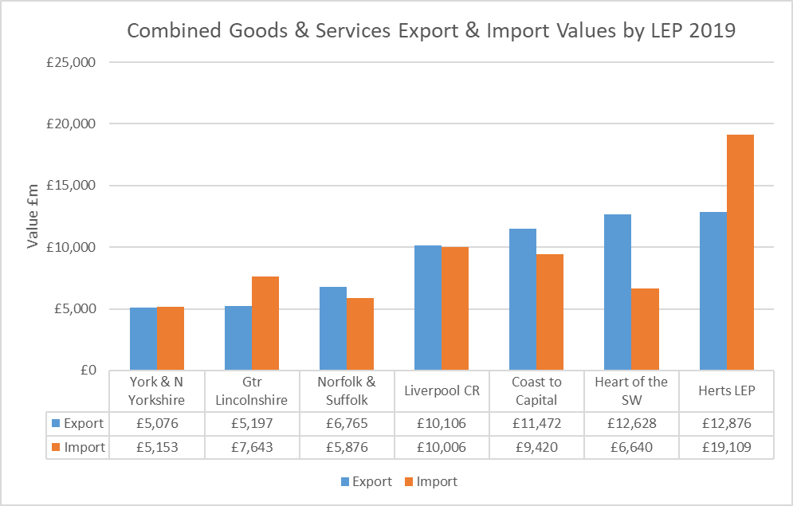
Total Trade Value: Goods and Services –
Combined EU and Non EU
This chart allows us to view the breakdown of both goods and services combined, with import and export values separated out.
Source: Export/Import Values: DIT - & HMRC – 2019 data

Slide 71

Trade – Goods and Services: Case Study
Clean energy export development
Clean energy businesses in Norfolk and Suffolk are realising the enormous offshore wind opportunities on the eastern seaboard of the USA through an export development initiative spearheaded by New Anglia LEP and GENERATE. A transatlantic partnership agreement with the City of Virginia Beach was signed in 2021, reflecting shared economic development priorities in clean energy, agri-food and digital technologies.
Signing of Partnership Agreement by New Anglia LEP and the City of Virginia Beach

Slide 72
6. Innovation Analysis

Slide 73
Innovation Analysis
Innovation activity is an area of analysis which continues to prove challenging to secure quantitative data around, mainly due to the embedded nature of innovation activity and how challenging it is to arrive at an economy-wide agreed definition of innovation as a stand-alone output or outcome.
However, as a Local Enterprise Partnership, we recognise the significance of innovation – not least as a crucial ingredient in driving up productivity gains, increasing investment levels, increasing exports, enhancing earnings potential and driving up the profitability of our business base.
Therefore, we have identified a data set produced by Innovate UK – which tracks the levels of innovation funding they provide – as this facilitates a benchmarking matrix, allowing us to make both inter and intra regional/LEP comparisons.
While certainly not comprehensive or wholly reflective of all innovation funding and activity, it still provides a useful proxy, and potentially highlights where there are gaps in innovation funding and support for Norfolk and Suffolk from central government sources.

Slide 74
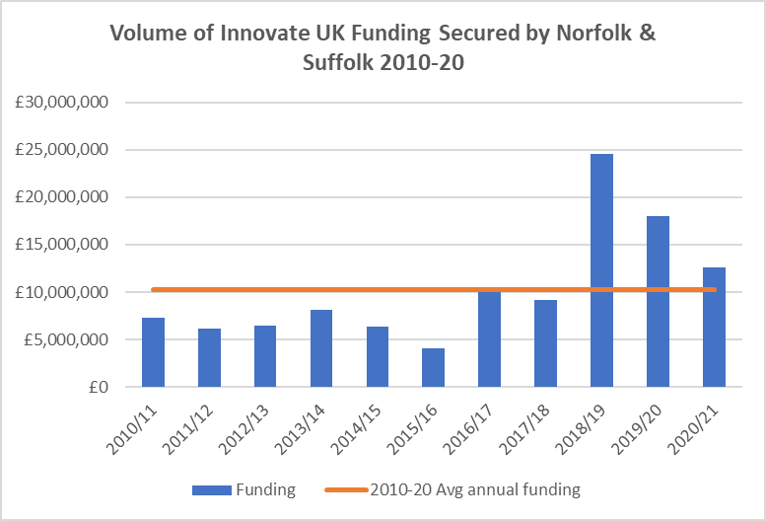
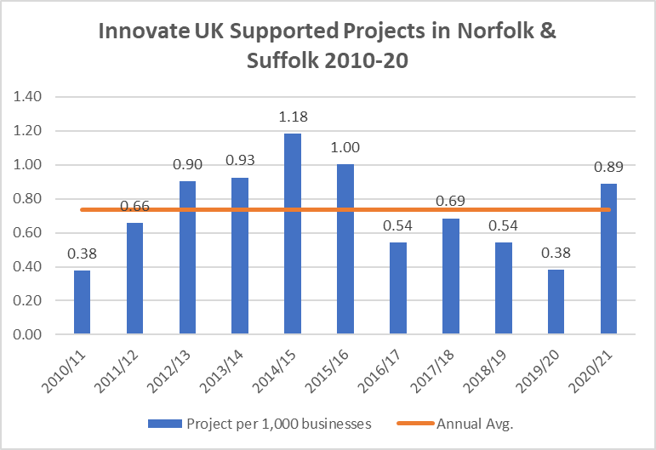
Innovation Funding (Innovate UK) – Norfolk and Suffolk
Source: UK Innovate Funding data 2020/21
The chart on the left-hand side shows that the volume of Innovate UK backed projects has exceeded the 2010-20 average in each of the last 3 years, following several years of sustained below average performance, going back to 2010/11.
The chart on the right-hand side shows that Norfolk and Suffolk has increased the overall amount of Innovate UK funding through the last 3 years, above the average going back to 2010/11.

Slide 75
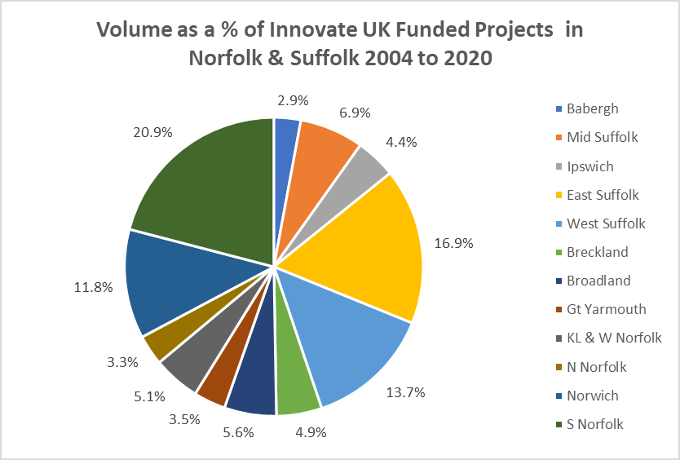
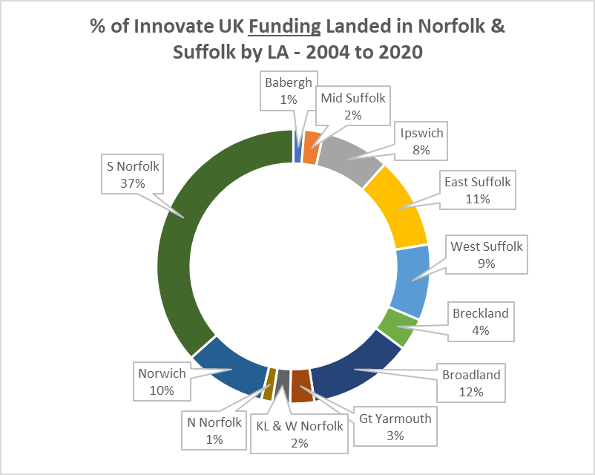
Innovation Funding – Norfolk and Suffolk Comparison
Source: UK Innovate Funding data 2020/21
These charts provide an insight into specific locations within Norfolk and Suffolk where Innovate UK funding has supported projects.
Both charts indicate that ‘Innovate UK supported innovation activity’ is highly concentrated in four local authority areas – South Norfolk, East Suffolk, West Suffolk and Norwich.
However, the chart on the right-hand side indicates that South Norfolk, East Suffolk, Norwich and Broadland have attracted the most funding. South Norfolk in particular (where NRP is based) has secured a proportion of funding which equates to more than the next 3 highest recipients combined.

Slide 76
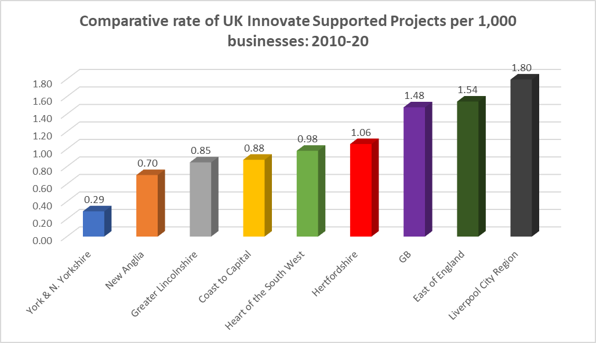

Innovation Funding – Norfolk and Suffolk Local Authorities
Source: UK Innovate Funding data 2020/21
Here we are assessing how successful or otherwise Norfolk and Suffolk has been, as a whole, in securing support and funding from Innovate UK since 2010 – compared to our typical matrix of LEP comparators, and in relation to the regional and national averages.
While we can see several variations in terms of how specific areas and LEPs have performed across both measurements – it becomes obvious that Norfolk and Suffolk is significantly below both the regional and national averages in terms of the volume of projects that are supported by Innovate UK funding, and in the terms of the average amount of funding secured to support those projects.

Slide 77

Innovation Activities by LEP
This chart shows the relative position of Norfolk and Suffolk in comparison to all LEPs across England.
On the right-hand side we’ve listed the top three performing LEPs and the bottom three on the left-hand side. Greater Manchester and Stoke-on-Trent are the LEPs on either side of Norfolk and Suffolk in the overall ranking.
We can see that Norfolk and Suffolk are closer to the bottom, than the top of the rankings in terms of overall score but are only marginally below the national average.
Source: UK Innovate Funding data 2020/21

Slide 78

Innovation Activities by LEP
The chart provides a comparison with a selection of LEPs we’ve historically tracked Norfolk and Suffolk’s performance against, covering a range of metrics.
We can see that Norfolk and Suffolk are very ‘in the middle of the pack’ within this particular comparator matrix and are much closer to the top performing LEP (York and North Yorkshire), than they are to the lowest performing LEP (Liverpool City Region).
Source: UK Innovate Funding data 2020/21

Slide 79

Innovation Analysis – Case Study
Hethel Innovation
Hethel Innovation accelerates real growth of businesses and communities by providing space to grow, business insight and creating connected communities. Hethel Innovation helps businesses of all sectors to innovate, adopt agile principles and remove barriers to growth. It also project manages an ERDF-funded innovation support programme for food and drink businesses.

Slide 80
7. Clean Growth Analysis

Slide 81
Clean Growth Analysis
In this section we have assembled a number of metrics that will start to form a foundation for our ‘Clean Growth Taskforce’ to understand our relative position – in terms of achieving tangible clean growth goals.
Clean growth is effectively the golden thread that we are aiming for throughout the Economic Strategy.
Therefore, as well as tracking carbon emissions output across Norfolk and Suffolk, we are also keen to incorporate measures such as:
  Domestic property EPC ratings
  Electric Vehicle (EV) registration rates
  Draw down rates of funding for domestic renewables and low carbon heating solutions
  Generation and associated value of ‘clean growth’ jobs
It is likely this section will evolve and potentially expand as the economic strategy and the work of the Clean Growth Taskforce progresses.

Slide 82

Green Jobs Analysis
Background:
EMSI has created a broad definition of Green Jobs through the collation of 365 job titles.
These keywords are used to pick up all vacancies within the EMSI dataset that are connected to environmental sustainability (such as conservation, energy efficiency, renewable energy, and water/wastewater).
In addition, through analysing these Green Job vacancies EMSI has also been able to identify 112 specific Green Skills using their open library.

Slide 83


Green Jobs Analysis
Source: EMSI
Not only has there been a sharp rise in the volume of Green Jobs in Norfolk and Suffolk since April 2020, but there has also been a sharp rise in the volume of green skills. This shows that not only is there demand for tailored green jobs, but there is also demand for the greenification of traditional roles.
The main Green Jobs being recruited for are: Managers, Environmental specialists, Electricians and Engineers

Slide 84

Green Jobs Analysis
25%
higher
21%
higher
17%
higher
The low wages in Norfolk and Suffolk is potentially going to make it difficult for local businesses to recruit from outside of the region due to not being able to offer a competitive salary.
On the other hand, this could be attractive for businesses interested in relocating to Norfolk and Suffolk as the cost for labour would fall.
With the higher relative wages of Green Jobs, there is a strong opportunity to reskill the existing workforce due to this attractive salary.
Furthermore, you are relatively better off (25% increase in income) if you work in the Norfolk and Suffolk green sector in comparison with the Comparator LEPs or the UK average.
Source: EMSI, 2019-2021

Slide 85


Carbon Emissions
The above charts show the percentage by which emissions have been reduced since the financial crisis and the subsequent recession. There is widespread agreement that collectively we should be prioritising ‘cleaner growth’ as we emerge from the latest Covid lockdown recession
These charts indicate that Suffolk and Norfolk are both outperforming both the East of England and England as a whole in terms of the rate of emissions reduction relating to domestic power consumption
However, it is also clear that there are challenges in terms of reducing emissions relating to our industrial processes. It should be noted that certain industries, including the food processing industry currently generate a high volume of Co2 as part of their standard operations. The comparatively high proportion of food processing activity across the patch – e.g. sugar refining, means this is likely to be very challenging for us to outperform regional and national comparators.

Slide 86


Carbon Emissions
We can see from the transport chart that Norfolk and Suffolk face a particular challenge when it comes to reducing emissions in relation to transport. The high rate of logistics activity, combined with the comparatively rural character of the patch, means that residents and businesses have been comparatively reliant on fossil-fuel powered automotive transport.
More urban and more densely populated areas across England are in a position to offer a wider array of viable public transport alternatives, as well as being more suited to early adoption/installation of EV charging networks.
The chart on the right-hand side indicates that Norfolk and Suffolk are some way behind both the East of England and England as a whole in terms of their emissions reduction rate since 2008. However, transport accounts for between 32-39% of total emissions. Therefore, the disparity between the rate of overall emissions reduction is significantly impacted by a large volume of freight movement that is travelling through the area via our sea ports, rather than specific activity taking place on the patch.

Slide 87


Residential EPC Ratings
Source: Energy Performance of Buildings Data – DLUHC – Nov 2021
The chart on the left-hand side indicates that while both Norfolk and Suffolk are trailing the average performance for residential dwellings with and EPC rating of C or better, the relative margin is quite narrow.
Overall, it appears Norfolk is slightly behind Suffolk in terms of the proportion of the residential dwellings with a rating of C or better, however, the right-hand slide shows a more nuanced picture, when the data is broken down by individual local authority areas.
The chart on the right-hand shows the proportion of residential dwellings with an EPC rating of C or better, by local authority. The Orange line is the average proportion across England.
We can see that Norwich (47%), South. Norfolk (43%), West. Suffolk and Ipswich (42%) and Mid Suffolk are all tracking slightly above the national average.
However, 7 local authority areas are tracking below the national average, with North Norfolk seeing a very low 28% of its dwellings registered with a C rating or better.

Slide 88

Clean Growth Analysis – EV Registrations
This chart shows the plug-in registration rate per 1,000 head of population in each local authority in Norfolk and Suffolk and how this compares to the average in England (15.98 per 1,000 head of population).
We can see that Great Yarmouth has a registration rate 4.5 times lower than the national average and just over 3 times lower than the Mid Suffolk rate.
There are many factors which may contribute to these varying rates, including average household income, availability of EV charging infrastructure and typical working patterns and employment locations etc.
Source: DfT: Plug-in Cars & LGV data: 2020/21

Slide 89

Clean Growth Analysis – RHI Accredited Installation (Domestic)
This chart shows the RHI accredited installation rate per 1,000 households in each local authority in Norfolk and Suffolk and how this compares to the average in England (2.4 per 1,000 households).
We can see that only Ipswich and Norwich local authority areas have a rate lower than the national average and more than 18 times lower than the East Suffolk per household rate.
There are many factors which may contribute to these varying rates, including average household income, suitability of alternative heating systems, and types of property e,g stand alone properties versus terraced or apartment configurations.
RHI Definition: The Domestic RHI supports the installation of renewable and low-carbon-heating by individual households. Eligible technologies on the Domestic RHI scheme include air source heat pumps, ground source heat pumps, biomass boilers, biomass stoves with integrated boilers and solar thermal panels.
Source: BEIS: Domestic RHI data 2014 - 2019

Slide 90
8. Skills and Labour Market Analysis

Slide 91
Skills, Vacancies and Qualifications Analysis
The following slides draw heavily on the data and evidence base compiled around the Norfolk and Suffolk Local Skills Report, initially published in March 2021 and refreshed and updated in January 2002. The latest version of this report and the accompanying evidence base is available on our website.
In addition, the vacancies data in particular draws on data compiled by EMSI (Labour Market Insight), which the LEP updates on a monthly basis.

Slide 92

Vacancies
Since February 2021, there has been a healthy uptick in job postings across all industries. This was most probably due to companies recruiting for the easing of economic restrictions on 12 April, which notably included outdoor serving at restaurants and pubs, plus the opening of gyms and tourist attractions.
In May 2021, there was another sharp increase, most likely due to the further easing of restrictions, such as the reopening of indoor hospitality, accommodation and leisure. There was another slight uptick in July as industries prepared for the full easing of legal restrictions on 19 July. All remaining closed businesses, such as nightclubs, were able to reopen, and capacity limits in sporting, entertainment and business events were lifted. Furthermore, hospitality venues were no longer required to follow social distancing rules.
In terms of all vacancies across all sectors – there has been an increase of 32,611 in the volume posted in December 2021 compared to December 2020. This is a strong indication of the job market recovering from COVID-19.
While this is encouraging to an extent, it is also likely reflective of the difficulties many sectors are facing in terms of filling vacancies.
We are tracking qualitative intelligence from employers in the hospitality industry that they are struggling to resurrect their pre-pandemic staffing levels. Similarly, there is a nationwide severe shortage of HGV drivers. It is important to view these shortages in the context of the combined impact of both lockdown restrictions and the impact of Brexit as both have restricted the free movement of people from the EU.
Source: EMSI

Slide 93

Vacancies
A percentage change graph since January 2020 was also made to better analyse the relative peaks and troughs experienced in each industry.
Construction has seen the most significant recovery in vacancies post-COVID – after suffering a dip of 17% below January 2020 values in May 2020, vacancies since risen to nearly 140% above Jan-20 values in December 2021.
All 6 industries are now notably above January 2020 values, indicating a strong recovery in the job market.
Accommodation and Food in particular has seen a rapid recovery – the sector suffered heavily from national restrictions with vacancies dropping to nearly half of January 2020 values in February 2021.
However, as restrictions have eased, Accommodation and Food vacancies are now double January 2020 values.
Source: EMSI

Slide 94

Jobs by Sector
The two largest sectors of employment in Norfolk and Suffolk are the health sector and the retail sector, making up 14% and 11% of the workforce, respectively.
This is roughly the same as the national average, where they each contribute 13% and 9% respectively.
New Anglia LEP’s local industrial strategy outlines three strategic opportunities: Clean Energy, Agri-food and ICT and Digital Creative.
Agri-food can be roughly mapped to “agriculture, forestry and fishing” plus “accommodation and food services”, which contribute 4% and 8% of the total employment of Norfolk and Suffolk.
This is a clear strength of Norfolk and Suffolk, with these sectors only contributing 8% combined nationally.
However, ICT and Digital Creative is more of a cause for concern when mapped against “information and communication”, with the sector making up 2% of the area’s employment, whilst it represents 5% nationally and 3% on average across the area’s Comparator LEPs.
The other main area of discrepancy between Norfolk and Suffolk and the national average is the notable lack of employment within the professional, scientific and technical sector (6%), relative to the national average (9%).
Source: Business Register and Employment Survey

Slide 95

Jobs by Sector
This graph shows the trendline for the six largest industries in Norfolk and Suffolk. Throughout this 17-year period, wholesale and retail has employed the most people, fluctuating between 110,000-120,000 jobs.
Health and Social Work is second with just under 100,000 jobs, which has been constantly increasing since 2003.
Whilst the number of those employed in Accommodation and Food, Administration and Support and Education have been steadily increasing over this time period, those employed in manufacturing have been steadily falling, with all four currently employing around 60,000 people.
Source: EMSI

Slide 96


Qualification Levels
Source: Annual Population Survey
Source: EMSI
Norfolk and Suffolk has above average proportions of the working population with NVQ Levels 1, 2 and 3 qualifications
However, this could largely be due to the low proportion of the workforce with Level 4+ qualifications
The local authority where this is most pertinent is in Great Yarmouth, where just 15% of the working population hold an NVQ Level 4+ qualification
A contributing factor to the low percentage of the 16-64 population having Level 4+ qualifications could be due to there being fewer roles in Norfolk and Suffolk which have an estimated education level of Level 4+
The Norfolk and Suffolk economy is skewed more towards occupations which require lower-level qualifications

Slide 97

STEM Analysis
The proportion of Higher Education qualifiers in ‘STEM’ (Science, Technology, Engineering & Maths) subjects across Norfolk and Suffolk is 5% below the England average.
The following slide shows a breakdown of these percentages by sector subject area.
Source: HESA
*Data is based upon students studying at local providers,
rather than those domiciled in the area

Slide 98

STEM Analysis
The largest volume of qualifiers both locally and nationally are in “Business and management”, “Subjects allied to medicine” and “Social Sciences”, with the latter two having a notably larger proportion locally relative to nationally.
Furthermore, Norfolk and Suffolk is also currently just above the England average for HE qualifiers in “Medicine and dentistry”.
The area should be aiming to see a high proportion of graduates specialising in medicine related subjects due to the future demands of the ageing population.
Norfolk and Suffolk tracks below the England average for HE qualifiers in “Physical sciences”, “Mathematical sciences”, “Computing” and most notably “Engineering and Technology” (1% compared with 6%).
If Norfolk and Suffolk seek to establish thriving Clean Energy and ICT and Digital Creative sectors, the area should aim to exceed the England average.
However, the low numbers within Engineering should hopefully be boosted by the opening of UEA’s Productivity East.
In “Agriculture, food and related subjects”, the area is matching the average in HE qualifiers.
However, a larger proportion of achievements in these subjects is needed to fulfil the future opportunities the sector presents.
Source: HESA
*Data is based upon students studying at local providers,
rather than those domiciled in the area

Slide 99


Skills Shortage Analysis
Due to the high volume of vacancies in Health and Social care, it is unsurprising to see that three of the top 6 hard skills in demand are nursing, personal care and mental health
Source: EMSI, 2019-2021

Slide 100

Young People not in Education, Employment or Training (NEET) Analysis
Historically Norfolk and Suffolk has had contrasting situations regarding the proportion of NEET or not known students, with Suffolk having an above average proportion whereas as Norfolk consistently tracked below.
However, over the last few years the situation has improved in Suffolk – Suffolk now only has 5% NEET, less than Norfolk and the England average
Source: Department for Education

Slide 101

Apprenticeship Analysis
Apprenticeship achievements are concentrated mainly in “Business, Administration and Law” (28%), “Health, Public Services and Care” (27%), and “Engineering and Manufacturing Technologies” (14%)
This almost exactly mirrors the national picture, however the gap of 18% nationally relative to 14% locally in “Engineering and Manufacturing Technologies” should be closed if the area is to be competitive in their Clean Energy strategic opportunity.
Source: DfE Localism Dashboard
*Geographies are based upon the home postcode of the learner

Slide 102

Apprenticeship Analysis
Over the last two academic years, the volume of both apprenticeship job postings and starts has decreased.
Source: EMSI & DfE Localism Dashboard
*Geographies are based upon the delivery postcode

Slide 103

National Insurance Number Registrations
After the United Kingdom EU referendum in 2016, there was a sharp fall in the volume of National Insurance Number (NINo) registrations in adult overseas nationals entering the UK across both Norfolk and Suffolk.
There was a slight uptick in 2019, however registrations dramatically fell again in 2020 and 2021 as a result of COVID-19.
In 2016, there were 13,845 registrations across both Norfolk and Suffolk, which has fallen to 1,076 in 2021 (a 92% decrease).
Source: Department for Work & Pensions

Slide 104
9. Deprivation Analysis

Slide 105
Deprivation Analysis
The overall Index of Multiple Deprivation is a measure of multiple deprivation based on combining together specific dimensions of deprivation.
In the current English Indices of Deprivation 2019, seven domains of deprivation are considered and weighted as follows:
  Income (22.5%)
  Employment (22.5%)
  Education (13.5%)
  Health (13.5%)
  Crime (9.3%)
  Barriers to Housing and Services (9.3%)
  Living Environment (9.3%)
These domains each have multiple components, the specifics of which can be found in the “English indices of deprivation 2019: technical report”.

Slide 106

Inclusivity – IMD Analysis
The chart opposite provides an indication of the proportion of Lower Super Output Areas (LSOA) across Norfolk and Suffolk that are in each decile of deprivation.
Overall, we can see that Norfolk and Suffolk has around 52% of LSOAs in ‘least deprived range of the scale, and 48% in the most deprived range of the scale.
Source: MHCLG, 2019

Slide 107

Inclusivity – IMD Analysis
This chart provides an insight into the proportion of LSOAs in each local authority area in Norfolk and Suffolk that are either below or above the national average – in relation to the overall, combined indices of deprivation.
We can see there is a very wide variance between 6 of our 12 local authorities barely registering at all in terms of the proportion in the most deprived decile, while Ipswich, Norwich and Great Yarmouth are all well in excess of the national average.
The following slides will attempt to shed light on some of the underlying drivers of these outcomes.
Source: MHCLG, 2019

Slide 108

Inclusivity – IMD Analysis
This chart provides analysis of which of the 8 standard indices where Norfolk and Suffolk LSOAs is either below or above the national average in terms of the proportion of them in the most deprived decile.
Or, put another way – it highlights the specific areas where we are collectively facing the biggest challenges in terms of relative deprivation.
The data suggests that both ‘education’ and ‘barriers to housing’ are the most prominent areas where we face challenges.
Source: MHCLG, 2019

Slide 109

Inclusivity – IMD Analysis
While the previous chart indicated that education is an indices where Norfolk and Suffolk has a higher proportion of LSOAs in the most deprived decile, this varies considerably across our local authority areas.
While several local authorities have proportions of LSOAs above the national average, Norwich, Great Yarmouth and Ipswich are where these challenges are the most acute.
Source: MHCLG, 2019

Slide 110

Inclusivity – IMD Analysis
In contrast to the preceding slide, we can see that in terms of barriers to housing, Norwich, Ipswich and Great Yarmouth are well below the national average in terms of the proportion of LSOAs in the most deprived decile.
However, 8 out of 12 local authority areas have LSOAs that are above the national average in this indices, with local authorities Mid Suffolk and North Norfolk with the highest proportions.
Combined, these two charts illustrate the nuances in terms of understanding the levelling up challenge in relation to ‘Place’.
Source: MHCLG, 2019

Slide 111
10. Population Analysis

Slide 112

Population - Age
Norfolk and Suffolk has an ageing working age population, with a higher proportion of the population between ages 55 to 64 than the UK average.
Norfolk and Suffolk also has a high retired population, with 24% of the total population over 65, in comparison with 19% nationally
Source: EMSI

Slide 113

Population - Density
As expected, Norwich and Ipswich have by far the highest population density out of the districts in Norfolk and Suffolk, with population densities of 3,600 and 3,400 people per sq. km respectively.
The variance in population density across the region is worth highlighting, with Norwich and Ipswich both being two of the most densely populated districts outside of London (94th and 93rd percentile), whilst King’s Lynn has one of the lowest population densities (105 people per sq. km)
Source: ONS, 2020

Slide 114
Population - Annual Internal Migration in Norfolk & Suffolk By 5-year age groups (year ending June 2020)
LA name | 0-4 | 5-9 | 10-14 | 15-19 | 20-24 | 25-29 | 30-34 | 35-39 | 40-44 | 45-49 | 50-54 | 55-59 | 60-64 | 65-69 | 70-74 | 75-79 | 80-84 | 85-89 | 90+ | Total
Babergh | 101 | 49 | 34 | -293 | 139 | 99 | 134 | 140 | 54 | 79 | 29 | 116 | 114 | 33 | 18 | 20 | 5 | 25 | 27 | 923
Breckland | 83 | 99 | 19 | -255 | 223 | 120 | 98 | 113 | 41 | 134 | 113 | 224 | 193 | 128 | 106 | 57 | 45 | 54 | 43 | 1,638
Broadland | 195 | 146 | 33 | -353 | 223 | 188 | 354 | 211 | 158 | 100 | 36 | 50 | 45 | 34 | 39 | 20 | 22 | -2 | 26 | 1,525
East Suffolk | 246 | 144 | 97 | -590 | 302 | -37 | 152 | 240 | 233 | 176 | 156 | 225 | 241 | 236 | 146 | 57 | 17 | 11 | 34 | 2,086
Great Yarmouth | -40 | -26 | -7 | -146 | -7 | -64 | -11 | -53 | 22 | 23 | 66 | 93 | 79 | 57 | 23 | -22 | 4 | -15 | 1 | -23
Ipswich | -123 | -144 | -88 | -183 | 28 | -87 | -98 | -182 | -121 | -118 | -44 | -102 | -76 | -61 | -24 | 1 | 8 | 3 | -13 | -1,424
King's Lynn and West Norfolk | 54 | 45 | 21 | -281 | 190 | 6 | 24 | 10 | 40 | 72 | 151 | 173 | 157 | 77 | 32 | -4 | -25 | -14 | 10 | 738
Mid Suffolk | 75 | 85 | 77 | -294 | 224 | 163 | 183 | 108 | 99 | 92 | 67 | 135 | 86 | 84 | 41 | -11 | 25 | -8 | -7 | 1,224
North Norfolk | 52 | 26 | -22 | -217 | 41 | 24 | 9 | 77 | 42 | 106 | 192 | 196 | 297 | 149 | 115 | 32 | -24 | -18 | -13 | 1,064
Norwich | -243 | -194 | -93 | 2,739 | -1,064 | -299 | -391 | -221 | -150 | -60 | -36 | 30 | -54 | 2 | -13 | 16 | -3 | -16 | -56 | -106
South Norfolk | 194 | 184 | 269 | -432 | 332 | 246 | 320 | 246 | 203 | 118 | 175 | 134 | 148 | 86 | 64 | 33 | -17 | 11 | 31 | 2,345
West Suffolk | -3 | 18 | 32 | -427 | 300 | 204 | 48 | 47 | 31 | -1 | 82 | 64 | 47 | 13 | 21 | 4 | 4 | 22 | 34 | 540
Norfolk & Suffolk | 591 | 432 | 372 | -732 | 931 | 563 | 822 | 736 | 652 | 721 | 987 | 1,338 | 1,277 | 838 | 568 | 203 | 61 | 53 | 117 | +10,530
Source: ONS

Slide 115
11. Case Studies

Slide 116

Case Study: Marina Centre, Great Yarmouth
Outreach from high quality leisure facilities like the redeveloped Marina Centre site in Great Yarmouth increases lifelong engagement in physical activity, addressing deprivation, inequalities and poor health outcomes that constrain the local economy. Their agglomeration with other high quality, year-round attractions – such as a restored and repurposed Winter Gardens – are also key to the ongoing resilience of the visitor economy.
Marina Centre, Great Yarmouth

Slide 117

Case Study: Gateway to Growth
Gateway to Growth is an innovative project designed to unlock the talents of graduates and Norfolk’s thriving Small-Medium Enterprises (SMEs).
The University of East Anglia led a successful bid to the Office for Students Challenge Competition receiving funding for three years.
The project aims to boost engagement between graduates and Norfolk’s SMEs through internships and enhanced skills training linked to Norfolk’s Enterprise Hubs.

Slide 118

Case Study: Future Breckland
Thriving People & Places is an investment focused master planning exercise. It is anchored around a new way of looking at market towns in the post-Covid economy, as key socio-economic drivers and growth hubs.
Concluding in April 2022, it is expected to support an investment pipeline of c. £650m and identify opportunities for c. 9,500 new jobs and £675m GVA.
Watton Market – Future Breckland consultation

Slide 119

Case Study: Snetterton Heath Employment Area
When fully developed, the Snetterton Heath Employment Area will boast more than 300,000m² of commercial floorspace on over 90 hectares of land. It will support the creation of 1,750 jobs, contributing over £100 million annual GVA and creating an investment pipeline of over £220 million in private sector investment.
Development of the Snetterton Heath Employment Area will be kickstarted by the delivery of a £3.8 million primary substation, developed by the public sector in 2022.
Snetterton Heath Employment Area Site

Slide 120

Case Study: New Anglia Advanced Manufacturing and Engineering (NAAME)
New Anglia Advanced Manufacturing and Engineering is the LEP-recognised sector group devoted to promoting and supporting the manufacturing and engineering industry throughout Norfolk and Suffolk. The network provides a range of initiatives supporting skills, peer-to-peer learning, talent sharing, supply chain connectivity and cross-sector collaboration. NAAME’s core objective is to create opportunities that stimulate innovation and productivity gains through collaboration in pursuit of inclusive growth.

Slide 121

Case Study: Eastern Enterprise Zone site, Sproughton
Enterprise Zone status has enabled the development of the old British Sugar site at Sproughton – now a major logistics and industrial park with high tech occupiers such as Amazon and LDH La Doria.
New Anglia LEP has worked with partners Ipswich Borough Council and Babergh Mid Suffolk Councils to build out the stalled 14 ha site and encourage businesses on to the park.
So far public sector investment of £22m has leveraged £75m of private sector investment, creating 33,000 m2 of new floorspace, along with site infrastructure including electric vehicle charging points. The site is ready to welcome more businesses, with many plots already reserved.
LDH La Doria’s new building

Slide 122

Case Study: Anglian Water commitment to net zero
Anglian Water, along with the rest of the water industry have pledged a commitment to be net zero by 2030. This, alongside other environmental drivers, will create a very different look and feel to infrastructure development i.e wetland, solar etc.
The water industry is the first sector to publish a roadmap on how it will set about achieving this ambitious goal.

Slide 123

Case Study: Future Fens Integrated Adaption
The Fens provide a fifth of UK crops – but with lots of the area below sea level, the climate crisis poses a significant threat. Future Fens: Integrated Adaptation, as showcased at COP26, puts integrated water management at the heart of landscape planning to unlock new opportunities such as more productive agriculture, long term food security, increased biodiversity, sustainable housing, thriving places and a renewed local pride.
Anglian Water’s manifesto has been developed through a regional partnership sponsored by Anglian Water, Water Resources East, Environment Agency and Cambridge and Peterborough Combined Authority.

Slide 124

West Suffolk Solar Farm
West Suffolk Solar Farm (Toggam Solar) is owned by West Suffolk Council and produces green energy income that is invested into local council services and community projects.
The 12.4 MW solar array is made up of 47,748 panels and produces green energy which the Council sells to the National Grid.
The farm has generated over £7M in income since 2016 which (after costs) has seen £1.6M invested into public services. Annually, it produces around 11,500 MWh; in May 2020 alone, it produced 2007 MWh of electricity – enough to power 600 average homes for a year.

Slide 125

Case Study: Great Yarmouth Operations and Maintenance Campus
The creation of an Operations and Maintenance (O&M) campus – a wind energy centre of excellence – on the southern peninsula of Great Yarmouth Port will accommodate Tier 1 suppliers, catalyse significant private sector inward investment, provide up to 32,040m² of prime industrial/commercial space, create around 650 jobs and help address a long-standing ambition to ensure a minimum of 50% UK supply chain content in offshore renewable infrastructure
Designer image of Operations and Maintenance Campus, Great Yarmouth

Slide 126

Case Study: Broadland Food Innovation Centre
A new £11.4m food innovation centre at the Food Enterprise Park at Honingham is set to open later this year offering a unique opportunity for the food and drink sector in Norfolk and Suffolk to capitalise on the region’s expert local knowledge and food supply base.
The new 38,000 sq ft facility will include 13 food-grade units, two test kitchens, meeting spaces and a sensory tasting facility.
The centre will provide the opportunity to help nurture new ideas and enable our region to focus more on processing Norfolk’s and Suffolk’s agricultural output locally, minimising food miles and reducing the environmental impact.
3D model of Broadland Food Innovation Centre

Slide 127

Case Study: Energy Skills Centre, East Coast College
East Coast Energy Training Academy is located at East Coast College’s Lowestoft campus and combines cutting-edge technology and state-of-the-art facilities to support the development of higher-level technical skills and expertise in the energy, maritime and engineering sectors.
A regional centre of excellence with national and international specialisms, it supports the development of higher-level technical skills and professional expertise, specifically in the energy, engineering, maritime and offshore industries.
Energy Skills Centre, East Coast College

Slide 128

Case Study: Integrated Care Academy
Work is underway on the construction of a new health and wellbeing quarter at the University of Suffolk in Ipswich.
The space will include the Integrated Care Academy - a unique alliance between the University, NHS Integrated Care System and Suffolk County Council. It will be an area of the campus dedicated to the promotion of integrated care amongst students, practice partners and the wider community.
The project is supported by £4m from New Anglia LEP’s Getting Building Fund and these new facilities will allow the University of Suffolk to shape the future of the region’s health and social care services.
The new facilities are expected to open later this year.
A designer image of the inside of the new Integrated Care Academy

Slide 129

Case Study: City College Norwich Digi-Tech Factory
The new £11.4m Digi-Tech Factory at City College Norwich opened its doors in October 2021, paving the way for a major expansion of the specialist training that will be vital for businesses in the burgeoning digi-tech industries.
The Digi-Tech Factory is equipped with £750,000 worth of the latest computer technology. Its teaching spaces are fitted with 4K interactive touchscreens, high specification PCs, and double or large screens to suit whichever type of software is likely to be used, and to simulate the working environments where students will eventually be employed.
This facility is not only a striking addition to the campus at City College Norwich but a priceless asset to the region as it looks to futureproof its skills in this fast-growing sector
City College Norwich Digi-Tech Factory

Slide 130

Case Study: Bacton Gas Terminal Coastal Protection
Works
Natural gas will play a vital role as part of the ‘energy transition’ as the UK moves towards a net-zero economy.
The Southern North Sea is the UK’s natural gas basin, with a third of the UK’s domestic gas requirements handled at the Bacton Gas Terminal in North Norfolk.
To protect this critically important asset, a UK-first multi-partner innovative sandscaping project was undertaken in 2019, which saw approximately 1.8 million cubic metres of sand placed and engineered on the beaches, providing protection to the gas terminal and extending the life of the village defences for at least the next 20 years.
Completed sandscaping at the Bacton gas terminal

