Slide 1
About The Presenter
Rita joined the Partnership Development team in 2020, bringing with her boundless energy, positivity and enthusiasm for the role and for developing strong relationships with partner agencies. She was awarded a bachelor’s degree in Marketing Management from the University of Greenwich, and whilst at the university she set up a Portuguese society and was active in the Marketing society. She also has the Certificate in Direct and Digital Marketing from the Institute of Direct and Digital Marketing.
1 | Footprint Digital | DIT Presentation 3rd June 2021

Slide 2
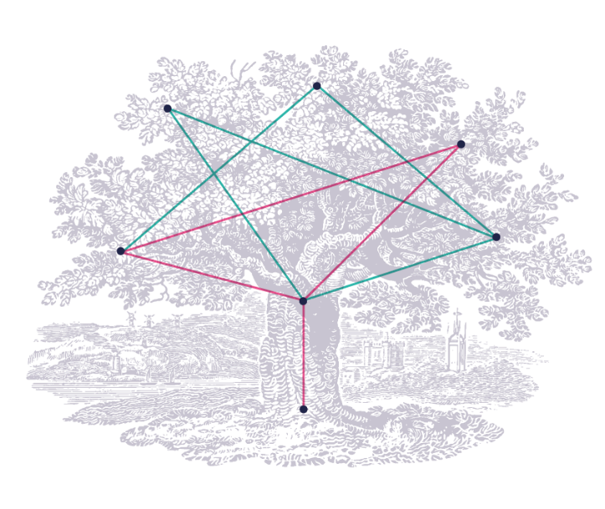
Digital Sustainability
How to create sustainable websites
Notes:
2- Digital Sustainability
- Who has heard of this term before? It’s a fairly new concept and it’s still not a very known subject but it doesn’t mean that it’s not present in our daily lives or that it’s not important
- To better understand this we have to start with the basics

Slide 3
25%
GHG
Source: Project Drawdown
Notes:
3- Electricity and Digital Sustainability
-This is because when you plug a laptop into a socket you don’t get your hands dirty, there is no smell, we don’t realise that electricity can be dirty
-But, Electricity generation contributes 25% of global greenhouse gas emissions, about 10% of that is the digital actions we do online, internet, social media

Slide 4
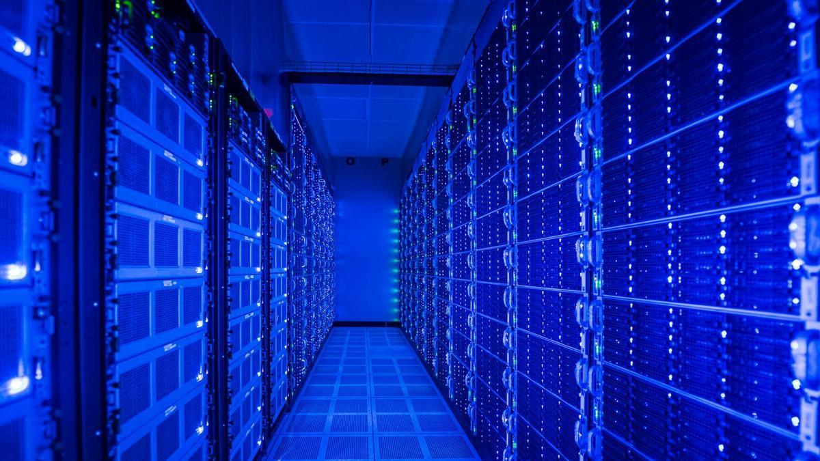
Notes:
4- Cloud/Wireless
LANGUAGE – We have learned to use terms like ‘wireless’ and ‘the cloud’ to make everyday technology seem like it is a weightless formation storing our data
But the truth is that our data is collected, sorted, processed, and stored in big data canters that look like this one. These require a lot of energy 24/7 and also require a lot of energy to cool them down because they create this “sauna” like environment that can get up to 60/70 degrees Celsius
In the beginning of covid, global internet search increased by 40%, because of the increase of video calls, video streaming and binge-watching Netflix, online gaming, social networking – this contributed to the amount of energy that data centres needed to process our requests
When we use our mobile phones or laptops a lot they get warm and we need to let it cool down, and this happens just the same for this data canters they started to have to process a lot more data and getting very warm at the beginning of covid which was a challenge to cool down.
____
Source:
http://www.independent.co.uk/environment/global-warming-data-centres-to-consume-three-times-as-much-energy-in-next-decade-experts-warn-a6830086.html
https://www.standard.co.uk/lifestyle/esmagazine/hidden-environmental-impact-of-phones-a4285491.html?fbclid=IwAR3l1C7UbH2iPSOs9bhYQlNQugSdDsHJzhHoG0tbRNHfqRT48e0bcCL2gYA
https://www.iea.org/reports/data-centres-and-data-transmission-networks

Slide 5
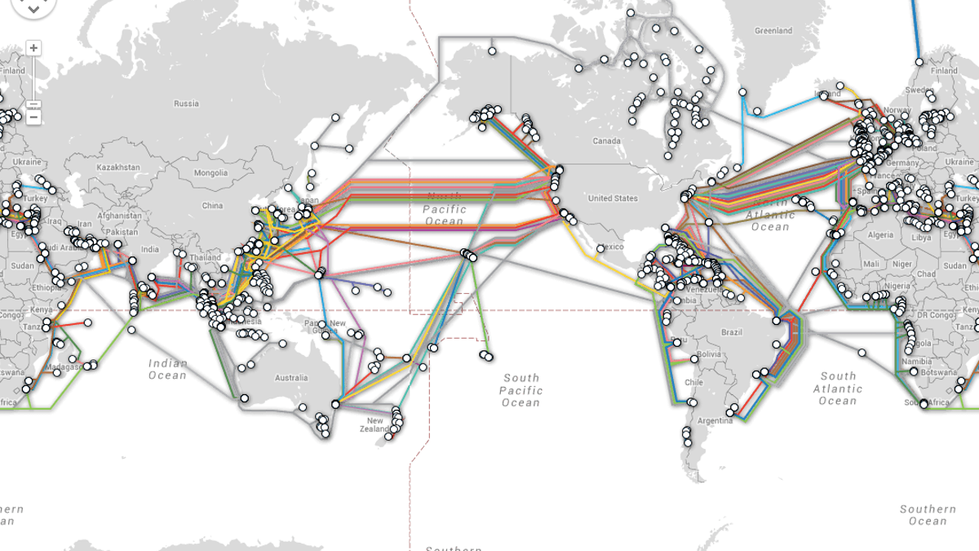
Source: The Conversation
Notes:
5- Undersea cables or Submarine cables
The undersea cables connect all the data centres across the world and it’s a massive infrastructure.
In this map you can see all the cables that link all the data centres. If we connected all of them together it would be enough to go to the moon and back 3 times!
Source:
https://theconversation.com/in-our-wi-fi-world-the-internet-still-depends-on-undersea-cables-49936

Slide 6
80%
Source: https://ourworldindata.org/fossil-fuels
Notes:
6- Reason why this is a big deal
The reason why this is important is because about 80% of all electricity global is still generated by burning fossil fuels, mainly coal which is hugely polluting to the environment.
Although ICT sector is huge investor in renewable energy.
We are still using a lot of fossil fuels to generate electricity. If we can change this, and there are ways and sources to change we should.

Slide 7
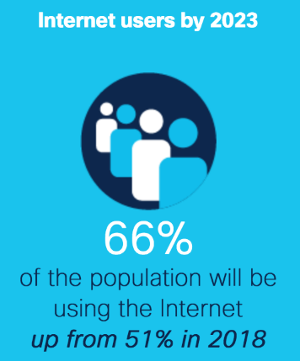
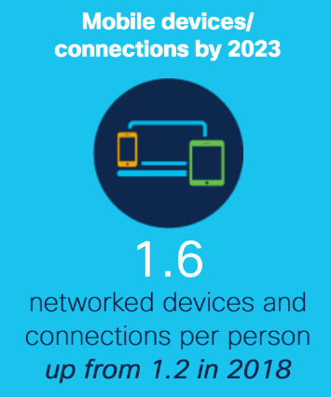
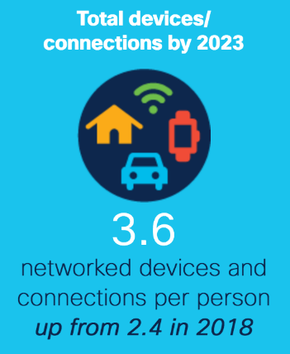
Source: Cisco: Projecting the future of digital transformation (2018 – 2023)
Notes:
7- Stats
Cisco predicts that nearly two-thirds of the global population will have Internet access by 2023. That’s 5.3 billion Internet users.
When we think of sitting behind a desk sending emails all day probably doesn’t seem like we are creating a problem to the environment.
But with the rapid increase of internet connected devices and internet users - the amount of data we transfer continues to grow and the digital carbon impact continues to grow too
While one person’s digital carbon footprint may be quite small, the collective amount of the world’s digital usage is huge– and increasingly worrying.
Sources:
https://www.cisco.com/c/en/us/solutions/executive-perspectives/annual-internet-report/infographic-c82-741491.html
https://www.cisco.com/c/en/us/solutions/collateral/executive-perspectives/annual-internet-report/white-paper-c11-741490.html
https://www.cisco.com/c/en/us/solutions/executive-perspectives/annual-internet-report/air-highlights.html
https://www.mdpi.com/2078-1547/6/1/117/htm

Slide 8
~3%
in 2020
5.5%
by 2025
14%
by 2040
Notes:
8- Digital & Aviation
In fact, as of 2020, the digital carbon impact was about 3.5% of global gas emissions, that is a similar share to the aviation industry pre-covid (so when there were all those flights around the world) – this is the internet and we are a part of it
Scientists predict that the digital carbon impact it can be 5.5% by 2025, which would make it the 4th biggest polluter in the world, if the internet was a country -after China, US and India
And it could be as much as 14% by 2040, which would make it as big of a polluter as the US, which is the second largest polluter in the world
Sources:
https://www.theguardian.com/environment/2017/dec/11/tsunami-of-data-could-consume-fifth-global-electricity-by-2025
https://www.climatechangenews.com/2017/12/11/tsunami-data-consume-one-fifth-global-electricity-2025/
Sources:
https://www.sciencedirect.com/science/article/abs/pii/S095965261733233X
https://www.theguardian.com/environment/2015/sep/25/server-data-centre-emissions-air-travel-web-google-facebook-greenhouse-gas
http://www.independent.co.uk/environment/global-warming-data-centres-to-consume-three-times-as-much-energy-in-next-decade-experts-warn-a6830086.html
https://www.atag.org/facts-figures.html
https://www.sciencedaily.com/releases/2013/01/130102140452.htm
https://ceet.unimelb.edu.au/publications/ceet-final-report-2011-2016.pdf
https://www.southampton.ac.uk/blog/digitalteam/2021/03/03/why-digital-isnt-always-greener-or-fairer/

Slide 9
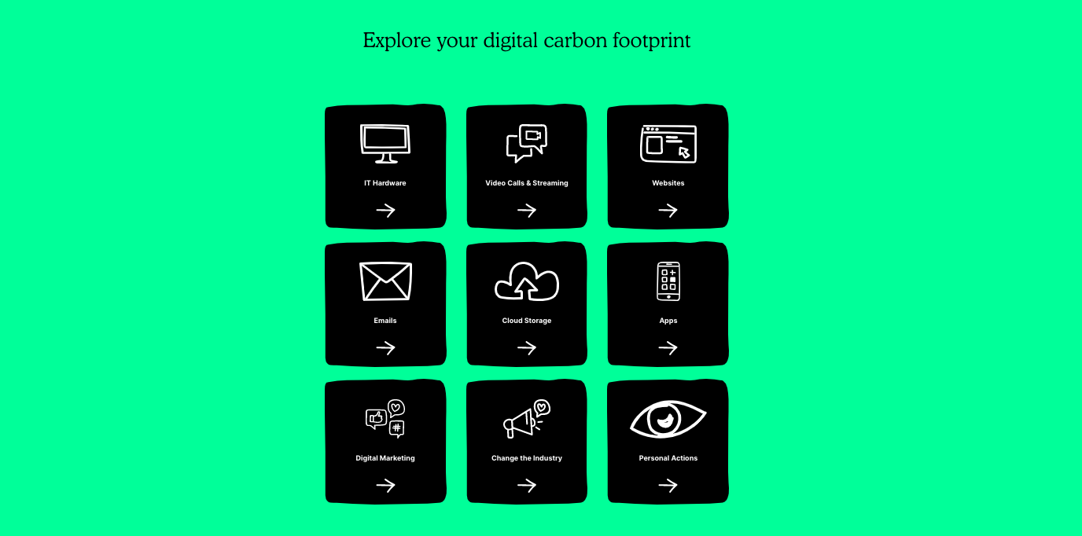
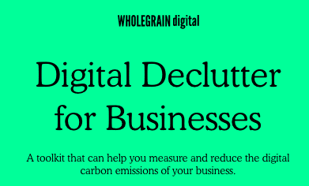
Source: wholegraindigital.com/digitaldeclutter/
Notes:
9- How can we fix it?
Wholegrain digital, one of our partners at footprint Digital has come up with this Digital Declutter for businesses or Declutter toolkit. It’s top-level overview of everything that is contributing to your businesses’ digital carbon emissions. Your IT hardware, video calls, websites, emails,etc.

Slide 10
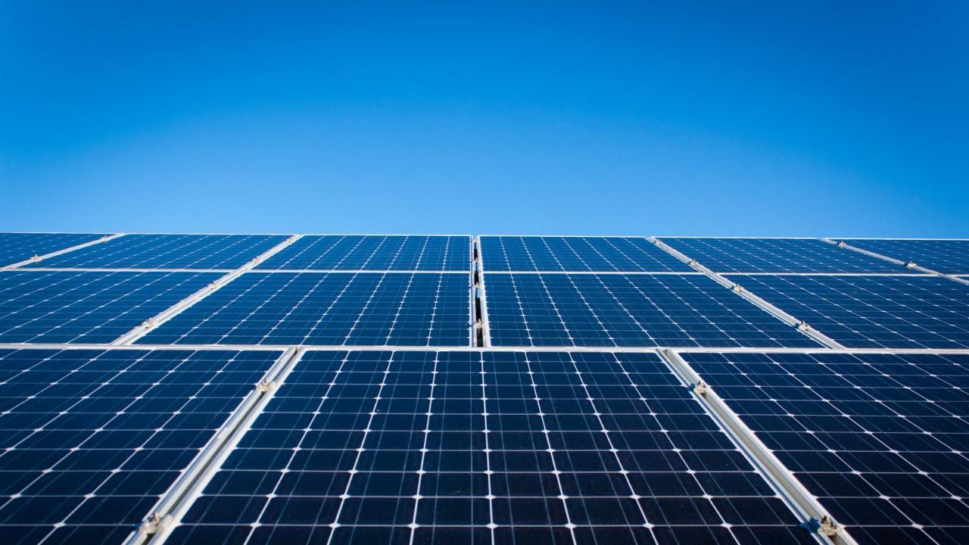
Green hosting
Notes:
10-Let’s get practical – Green Hosting
Green Hosting – if you could only commit to one change I would strongly advise it to be changing to a green hosting provider for your websites,
it’s not more expensive, you can check if your website is powered by renewable energy, they offer you a green badge to place on your website that you could use to raise awareness and for your marketing campaigns
We have changed to a green host provider at footprint in March and it’s great!

Slide 11
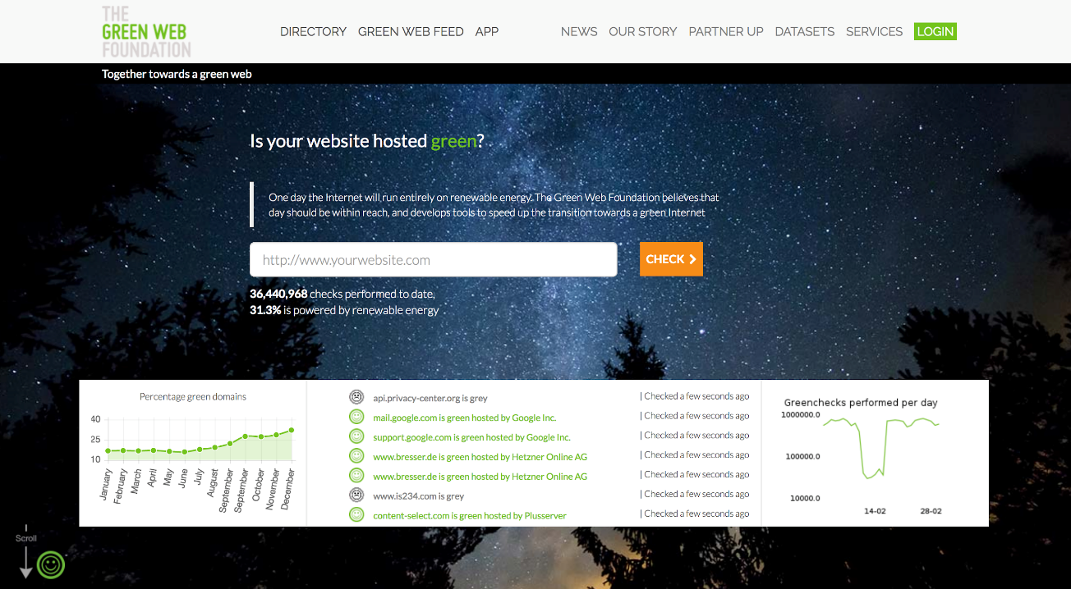
Notes:
11-The Green Web Foundation
There is a way to find out which green hosting provider to use,
The Green Web Foundation is not profit organisation and it’s the platform that has the most information to recommend you the best green hosting providers depending on your location.
They also created a chrome extension, so you can just install it and every time you are on a green website, powered by renewable energy it will show you a green smiling emoji on the top of the page or a grey one when it is powered by dirty energy.

Slide 12
Digital marketing
Notes:
12-Digital Marketing – Other things you can do
Digital Marketing Is one of the biggest aspects that is responsible for the digital carbon emissions
We will look at email and google search

Slide 13
Email
‘Think Before You Thank’
16,433 tonnes of CO2 a year.
Top 10 most ‘unnecessary’ emails sent
1. Thank you | 6. Have a good evening
2. Thanks | 7. Did you get/see this?
3. Have a good weekend | 8. Cheers
4. Received | 9. You too
5. Appreciated | 10. LOL
Source: OVO Energy
Notes:
13 -Email
OVO Energy, a renewable energy provider, published a research about the environmental impact of emails.
They calculated that the average carbon footprint of an unnecessary email (an email with up to 4 words) is approximately 1g of CO2.

Slide 14
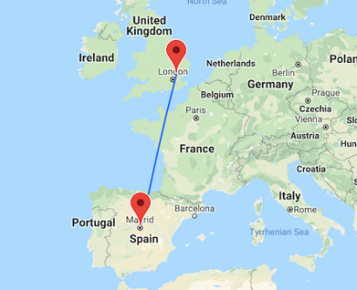
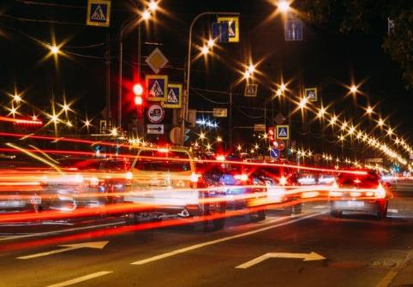
16,433 tonnes of CO2 per year.
81,152 flights from London to Madrid.
3,334 diesel cars off the road.
Source: OVO Energy
Notes:
14- UK Quote
“If each UK adult sends just 1 less email a day, it would reduce our carbon output by over 16,433 tonnes a year - the equivalent of 81,152 flights to Madrid or taking 3,334 diesel cars off the road.”
Source: https://www.ovoenergy.com/ovo-newsroom/press-releases/2019/november/think-before-you-thank-if-every-brit-sent-one-less-thank-you-email-a-day-we-would-save-16433-tonnes-of-carbon-a-year-the-same-as-81152-flights-to-madrid.html

Slide 15
Email
‘Brits sending 1 less email a day would save 16,433 tonnes of carbon a year’
x1 email = 1g carbon = 0.000001 tonnes CO2e per email (Source: Mike Berners-Lee)
365 days per year / 12 months = 30.417 emails per mon
0.000001 tonnes of CO2e x 30.417 emails per month x 12 months per year = 0.000365004 tonnes CO2e saved per person, per year
UK population of 52,351,213 adults (18 and over. Source: ONS)
87% of adults use the internet daily and 86% of all adults use email (Source: ONS)
86% of 52,351,213 = 45,022,043
45,022,043 adults x 0.000365004 tonnes of carbon saved per person per year = 16,433 tonnes of carbon saved per year by total UK population
Source: OVO Energy
Notes:
15- Here’s the maths in case you don’t believe me

Slide 16
Google search
0.2 g 0.2 g
Source: Google
Notes:
16-Google Searches
Google confirmed that in terms of greenhouse gases, one Google search is equivalent to about 0.2 grams of CO2. Which is the same as a drop of water
https://googleblog.blogspot.com/2009/01/powering-google-search.html

Slide 17
Google search
6
3.5B 700 t
Source: Google
Notes:
17-Google Searches vs Blue Whales
Google processes 3.5Bn searches per day. (A little bit outdated as this are stats from 2019)
But for this exercise lets stick with this number.
That is 700 tonnes of CO2, similar weight of 6 blue whales. Imagine 6 blue whales just floating in the air every day just from google searches
This is why Google is one of the leaders in investing in Renewable energy and shouting about how their processes are powered by clean energy.
https://googleblog.blogspot.com/2009/01/powering-google-search.html
https://www.blog.google/outreach-initiatives/sustainability/100-percent-renewable-energy-second-year-row/

Slide 18
Tools
Notes:
18- I will leave here some tools that can help you

Slide 19
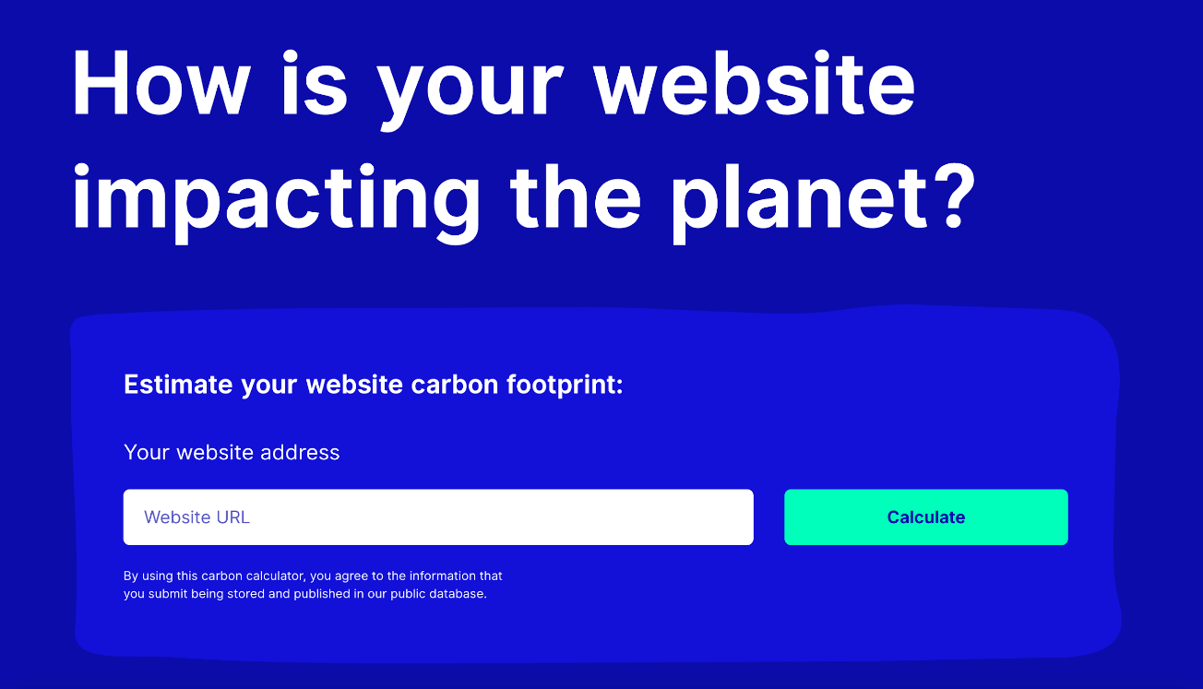
https://www.websitecarbon.com/
Notes:
19-Website carbon calculator
This platform is very easy to use you just copy any url and paste it there and it will calculate the CO2 emissions of that particular page, it doesn’t take into account the whole website but it’s very good.
Calculators takes into account the relationship between GB and kWh. Research shows that it takes 5kWh to transfer 1GB of online data.
Calculating the carbon emissions of website is somewhat of a challenge, but using five key pieces of data we can make a pretty good estimate:
Data transfer over the wire
Energy intensity of web data
Energy source used by the data centre
Carbon intensity of electricity
Website traffic

Slide 20
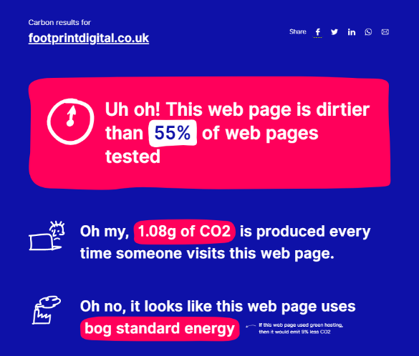
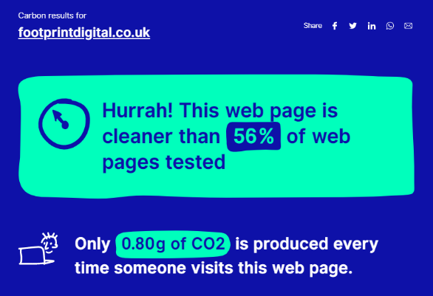
2020
2021
Notes:
20-Footprint Green Hosting Change
At the beginning of the year we changed into a green hosting at Footprint. This is just our home page but you can see the difference it made to change to green host provider and changed some of the content in our page and some images to make it less heavy.

Slide 21
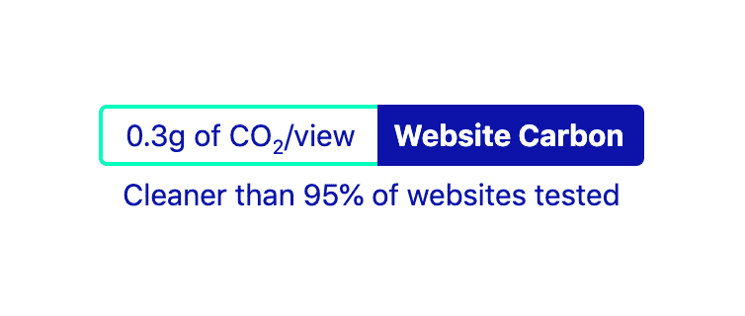
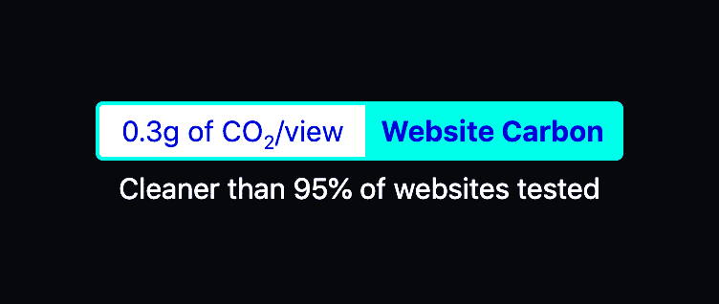
Carbon badge
Source: Wholegrain Digital
Notes:
21-Badge
You can also have this badge embedded in the footer of your website and that way it calculates the carbon emission of your website real time on every single page on your website
Source: https://wholegrain.gitlab.io/website-carbon-badges/

Slide 22
Notes:
22- This is how it looks on a website

Slide 23
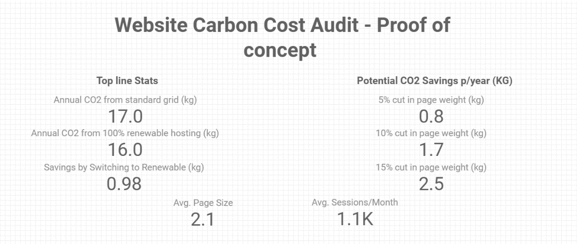
Carbon Reporting Tool
Notes:
23-Carbon Reporting Tool
One of the downsides of website carbon calculator tool was that you could only calculate one page at a time.
So we talked to them and asked if it was possible to calculate the carbon emissions of an entire website. We have partnered with them and created it
So this is a tool that we collaborated on, this is just a proof of concept (it’s still in Beta and looks quite ugly) but it works!
This are the carbon emissions of footprintdigital.co.uk
On the left you can see the top line stats which are how the website is currently performing
On the right we incorporated this “potential savings” the name is quite self-explanatory but it’s just shows the impact that it would have if you cut your page weight by 5,10 or 15%.

Slide 24
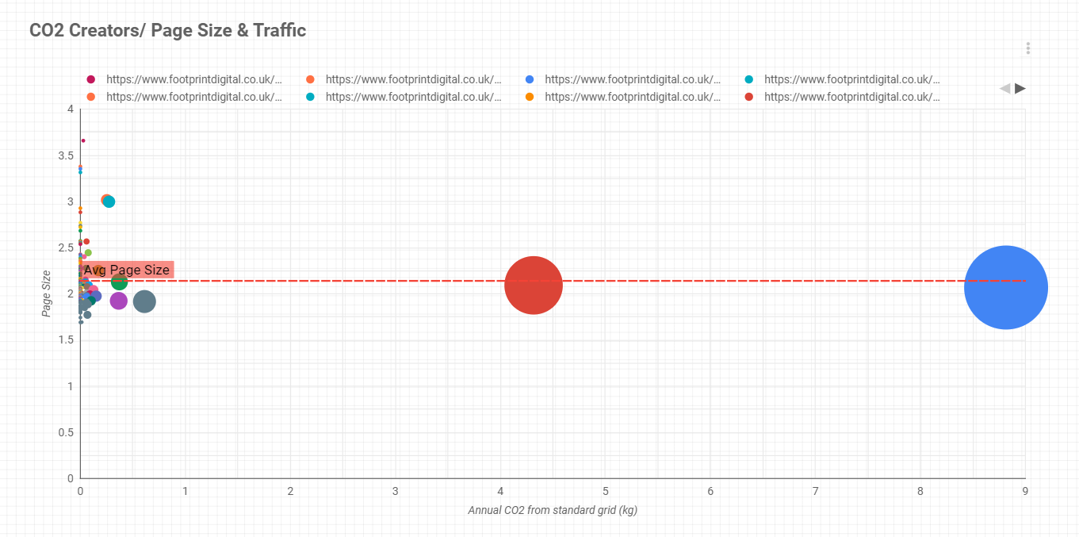
Carbon Reporting Tool
Notes:
24- This is the second feature
The bigger the bubble the bigger the carbon footprint of the page
This makes it very easy to see which pages are generating more CO2 and go back to them and see if you could make any changes, like changing some code, images, video, etc which will also improve the page speed of that page

Slide 25
BUSINESS UNUSUAL
Notes:
25- Business Example

Slide 26
Notes:
26-Organic Basics
- Sell sustainable underwear and activewear
- They are a very ethical and responsible brand and they wanted to incorporate this mind-set into their website and digital presence
Organic Basics is a sustainable apparel company based in Copenhagen. Earlier this year, they launched a low-impact version of their website that reduces data transfer by up to 70% compared to their regular website.

Slide 27
Notes:
27-Low Impact Website
- In 2020 they launched their low impact website
- So they also have their normal website
- Low impact website – they are highlighting the importance of being aware of your carbon emissions while navigating a website
- In this website it reduces data transfer by up to 70% in comparison to their regular website
o Images won’t be loaded unless requested
o Adapts to reflect the amount of renewable energy it’s currently running on.
o Loads only the most crucial programming scripts, frameworks and cookies.
o Compresses all data to the greatest extent possible.
The Low Impact website reduces data transfer by up to 70% in comparison to our regular website.
1. Does not load any images before they are actively requested by the user.
2. Adapts to reflect the amount of renewable energy it’s currently running on.
3. Informs the user of the impact of their browsing behavior.
4. Does not make use of videos.
5. Compresses all data to the greatest extent possible.
6. Loads only the most crucial programming scripts, frameworks and cookies.

Slide 28
Carbon-responsive design
Notes:
28- How it works
The more carbon there is per kWh and the fewer assets are called up (the site can theoretically close), the less carbon there is per kWh the more elements they load (HD photos, animation, etc.). – This is called a carbon-responsive design.

Slide 29
Notes:
30- How the low impact website looks when you shop

Slide 30
Notes:
31- How a product looks individually

Slide 31
Notes:
32- You can select then the colour you want and reveal the image with the model only if you want to see it

Slide 32
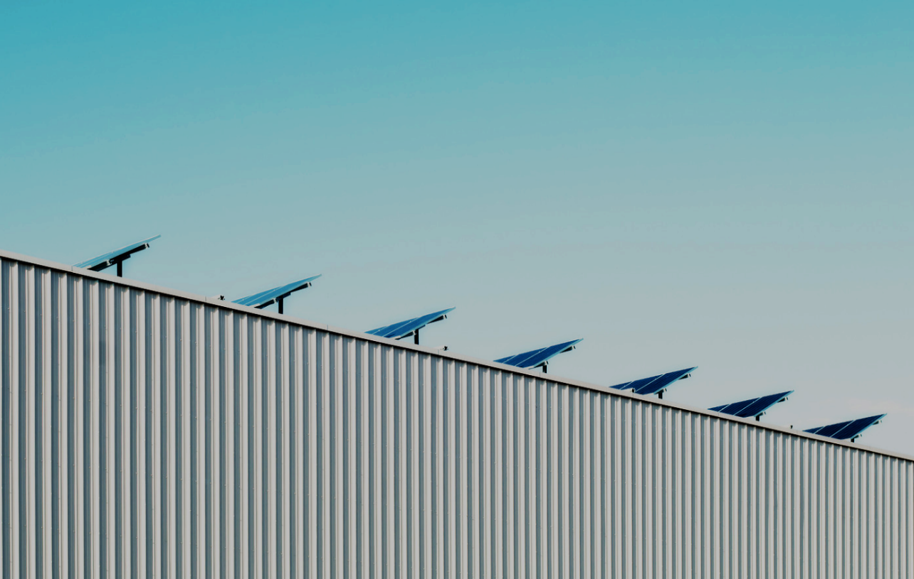
Sustainable websites
Cheaper
Smaller
Faster
Accessible
User-friendly
Resilient
Notes:
33- A little overview
Sustainable websites are good for profit and the planet. They are:
-Cheaper
-Smaller
-Faster
-More Accessible
-User friendly
-Resilient
Reducing carbon footprint of your website will make you more money.

Slide 33
Thank you
Connect with me
Rita Matias:
www.linkedin.com/in/rita-marques-matias/
rita.matias@footprintdigital.co.uk
Connect with Footprint Digital
LinkedIn: Footprint Digital Ltd
Instagram: @footprintdigital.ltd
Twitter: @footprintdigit
Email: enquiries@footprintdigital.co.uk
Visit: www.footprintdigital.co.uk

