Slide 1
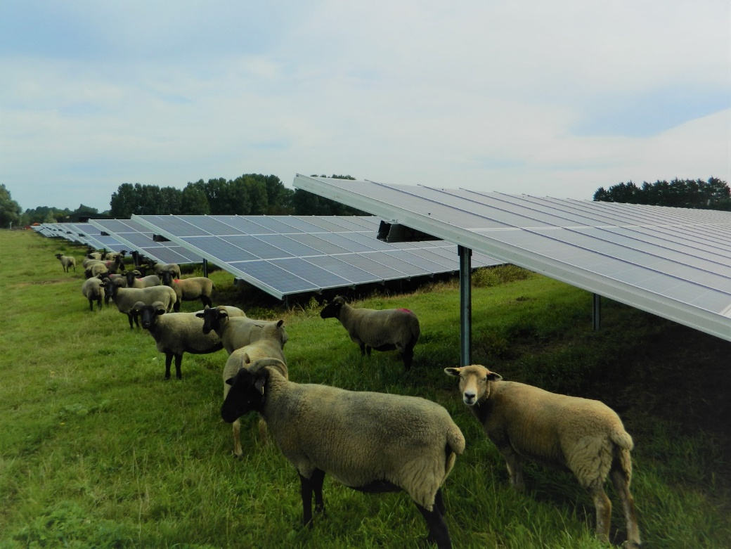
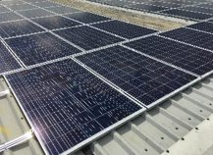
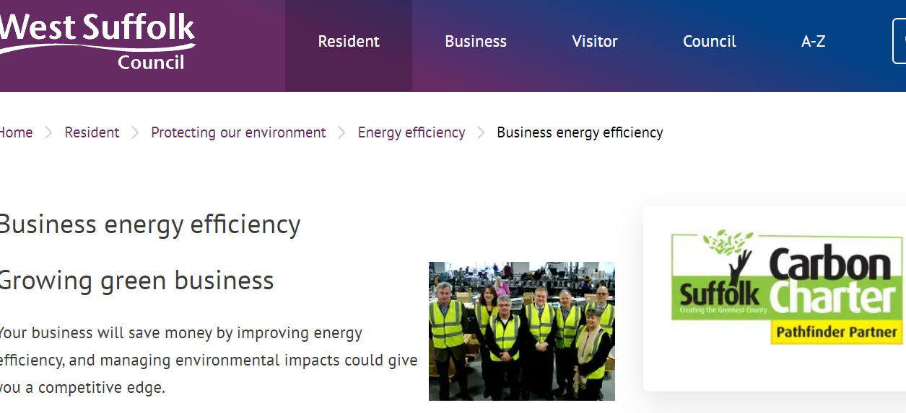
West Suffolk Council Energy in Business
Andrew Oswald
Environment and Energy Team
Email: Andrew.oswald@westsuffolk.gov.uk

Slide 2
What is the Challenge?
Notes:
This image is from a Committee for Climate Change report talking about the challenges and pathways to achieving the Net Zero Emissions that is the stated goal to achieve the 1.5oC target set in the Paris Agreement of 2015.
Net Zero Emissions acknowledges that it may not be possible to completely remove all sources of emissions from our society, things like agriculture, industrial processes, construction and transportation.
It then requires us to make either significant emissions capturing or additional activities to offset emissions from other areas to counter for the emissions remaining.
You can’t see very well but it has the different emissions sources stacked on the left and then on the right showing that any amount left must be balanced by these additional emissions reductions or offset ting activities.
You may have heard people talk about the Toggam Solar Farm marking Forest Heath District Council Carbon Neutral, this was based upon the assumption that the solar generated electricity was offsetting electricity generated from the wider grid and the normal emissions that arise from generation of electrical energy in the grid.

Slide 3

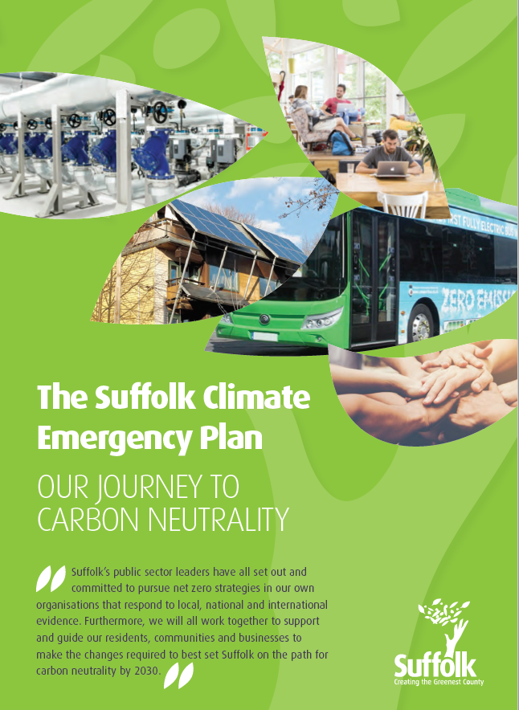
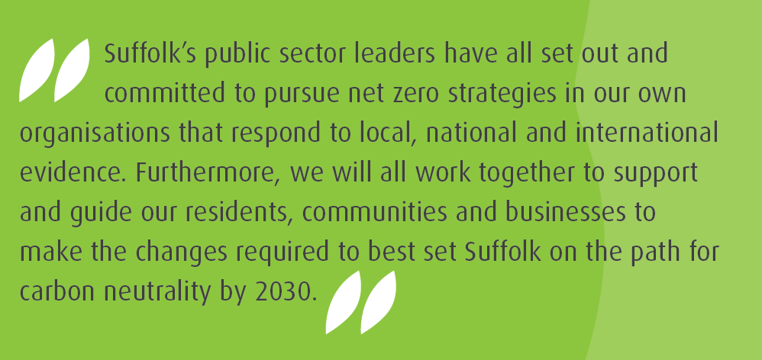
Suffolk-Climate-Emergency-Plan.pdf (greensuffolk.org)

Slide 4
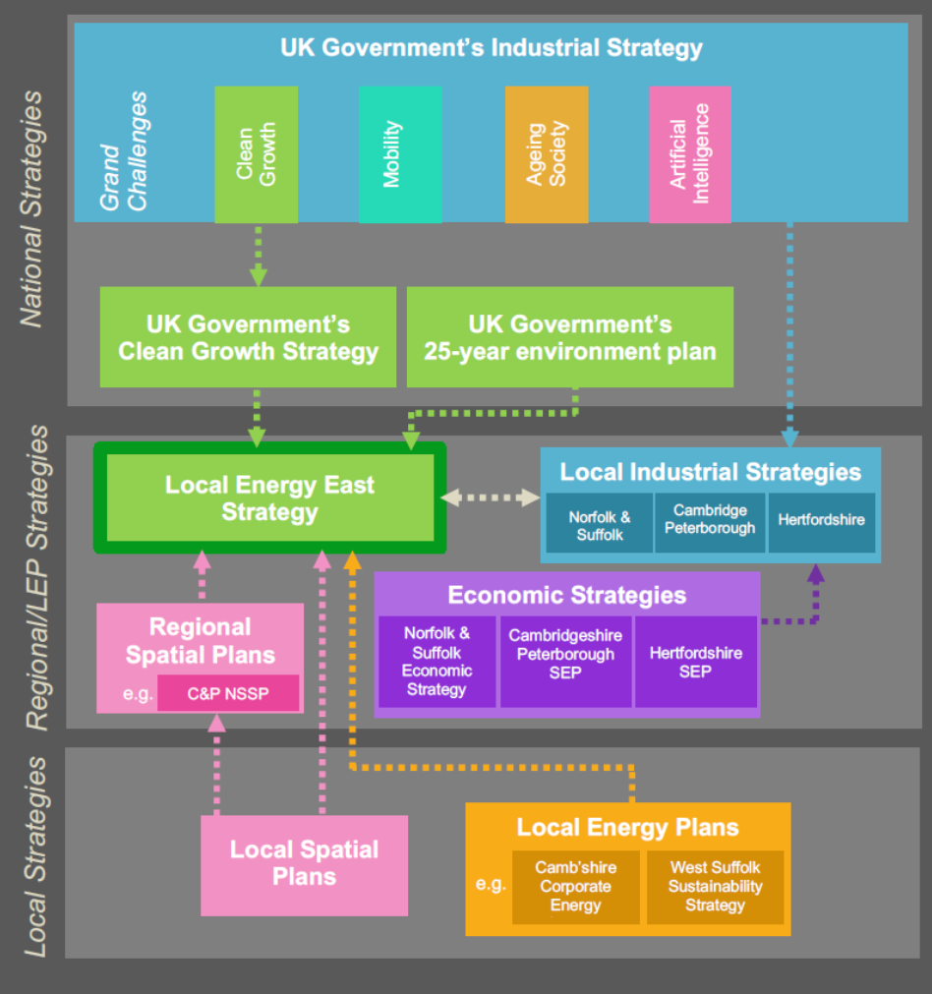

Existing Council energy strategies & plans
Existing energy strategies & plans
Development of energy strategies & plans
1998 First environmental action plan - St Edmundsbury Agenda 21
2003 First ISO14001 accredited environmental policy – St Edmundsbury
2007 First review/policy statement - St Edmundsbury Climate Change & Energy Dependency
2009 First County-wide policy statement – as part of Suffolk Creating the Greenest County
2015 Community Energy Plan
2017 Third Suffolk Climate Action Plan
2018 First West Suffolk Energy Investment Framework
2019 First Climate Emergencies declared in West Suffolk and across Suffolk
Suffolk Climate Emergency (community)
West Suffolk Climate (Council)
West Suffolk Energy Investment Strategy
Notes:
Convenant of Mayors 2020: for signatories who have joined between 2008 and 2015
commitment to go beyond EU's 2020 targets of 20 % in terms of reduction in CO2 emissions
Convenant of Mayors for Climate and Energy: for signatories joining after 2015
local authorities commit to reduce their CO2 emissions (and possibly other greenhouse gas) by at least 40%, increase their resilience to the impacts of climate change and provide secured access to sustainable and affordable energy by 2030
Mayors Adapt
Local authorities who signed up for this (between 2014 and 2016) made the political commitments to take action to adapt to climate change
SEAP/SECAP Monitoring report
assessing the progress of the action plan
Baseline Emission Inventory (BEI)
quantifies the CO2emitted in the signatory's territory
Risk and Vulnerability Assessment (RVA)
measures the level of risk by analyzing potential climate hazards and assessing the vulnerabilities on the signatory’s territory
Sustainable Energy (and Climate) Action Plan (SE(C)AP)
outlines the measures and policies the municipal council will implement to achieve their targets
has to be approved by the municipal council within the described timeframe (one year for SEAPs and two years for SECAPs) following their official decision to join the Covenant of Mayors initiative

Slide 5
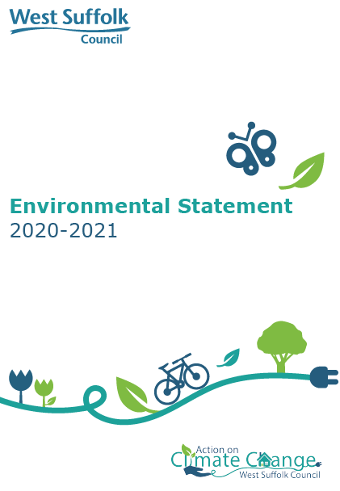
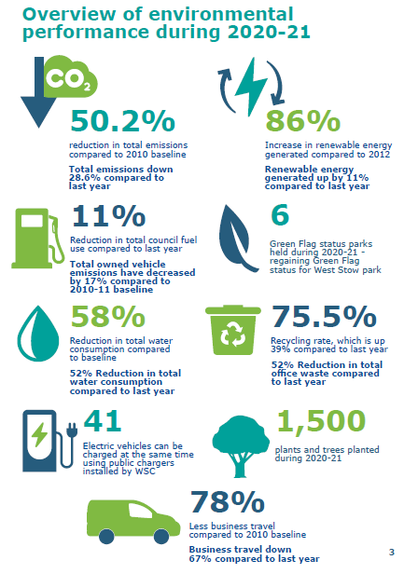
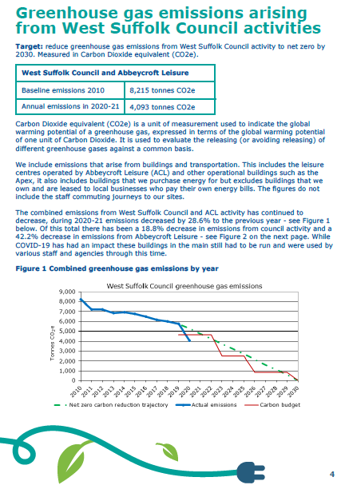

Slide 6
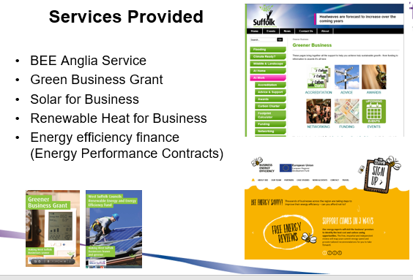

Slide 7


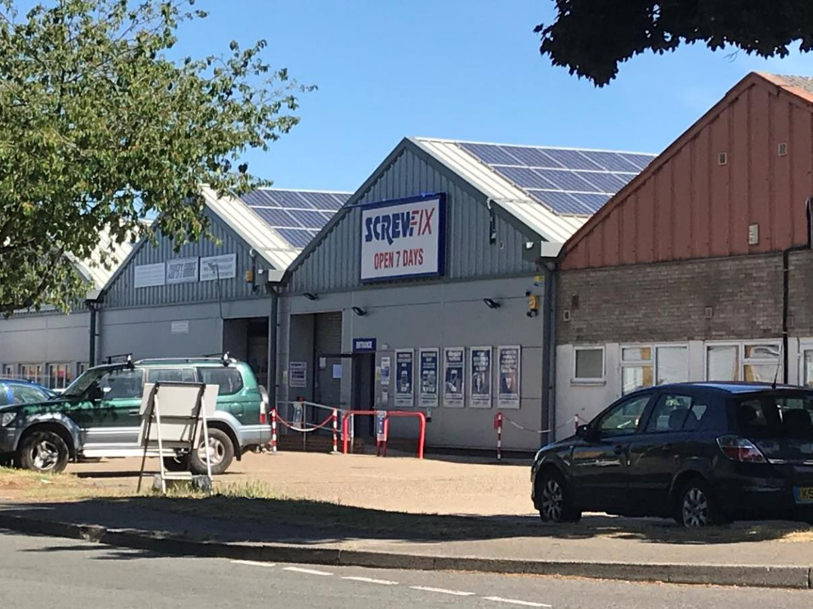
ACCESS PROJECT
What do we want?
To work with technology partner/s to demonstrate peer to peer trading on business like this.
Can incorporate low carbon energy generated on or off site, stored if necessary to cope with demand.
Work with the businesses on demand side reduction and improve their energy management and efficiency.

Slide 8
What are we looking for
Engage 50 businesses, with a view to work with around 10-15 to actually deliver technology/services and trial peer to peer energy trading
Actual energy data for a baseline and then to demonstrate benefits, savings.
Energy saving – could be actual saving or a shift in energy consumption periods.
Measure and manage the local grid and support efficient use of the generated, stored and used energy, data collection of present performance to start as soon as possible.
Save 600,000 kWh and 250 tonnes Carbon dioxide (CO₂) annually due to the project
15% energy efficiency improvement across participating businesses
Assess the potential to upscale across the Eastern Power Network.

Slide 9
West Suffolk Solar for Business- launched in 2015
Invested £3.1 million in roof mounted solar across 60 sites with a total installed capacity of 4MW
Delivered savings on electricity expenditure to a range of businesses and organisations
Council fully funded, own and install the solar
with a 25 year lease signed between the council
and landlord
Council sell the electricity to the business at 10 p/kWh

Slide 10



Supporting Suffolk Businesses to reach Net Zero
June Davenport, BEE Anglia
12th October 2021

Slide 11

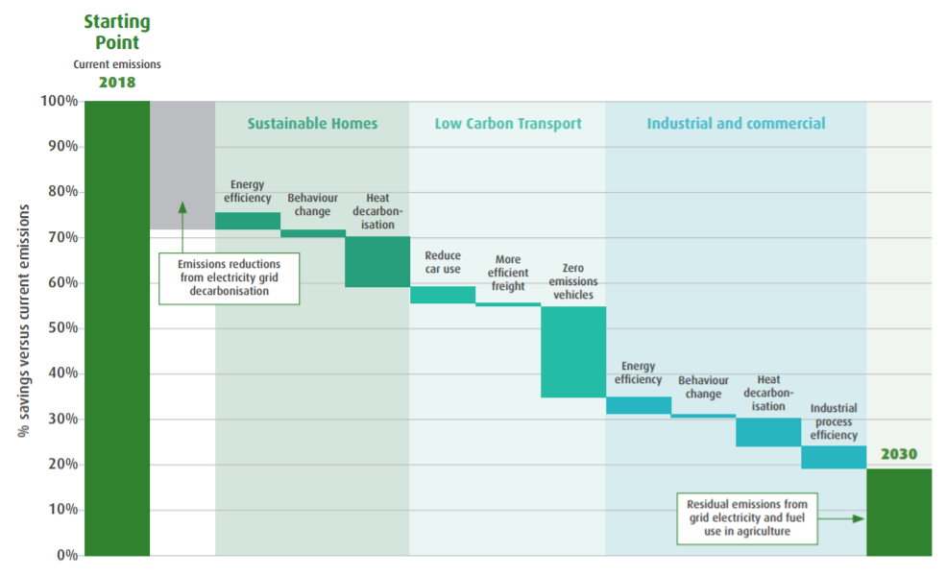
Suffolk’s Climate Emergency – the road to Net Zero

Slide 12

How do you get to Net Zero business?
Is it even possible?
Where do we start?
What would really change?
What does it mean?

Slide 13



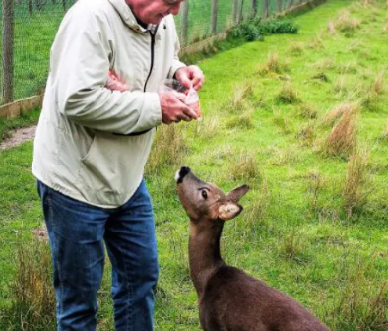

Stokes Sauces
www.stokessauces.co.uk

Slide 14


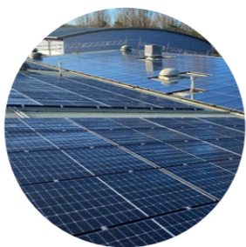
Precision Marketing
“Becoming carbon neutral is something we have been striving towards for the past 6 years, for our customers, for our employees and for the planet.
“Since the beginning of 2020 we have officially been operating a carbon neutral business model, but our journey won’t stop there; we will continue to introduce new sustainable initiatives, new ways of working to improve our carbon footprint and reduce our impact on the environment as part of our carbon neutral company commitment.”
Nick Pryke – Chief Operating Officer
www.precision.co.uk

Slide 15

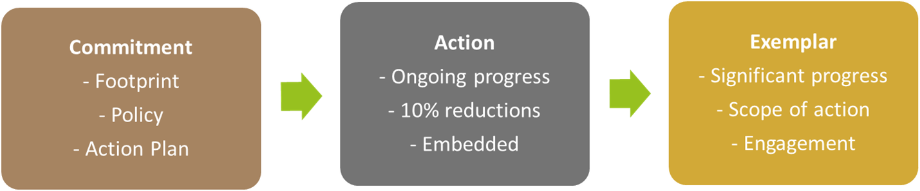
What is the Carbon Charter?
An accreditation scheme to recognise businesses working towards Net Zero
A support network
Independent verification of commitment
Recognised in Suffolk County Council’s Climate Change Commercial Ask (www.suffolk.gov.uk/business/tenders-and-supplying-us/climate-change-commercial-ask)
www.carboncharter.org

Slide 16
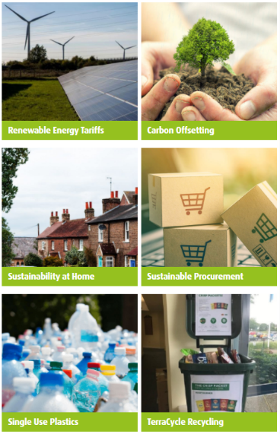
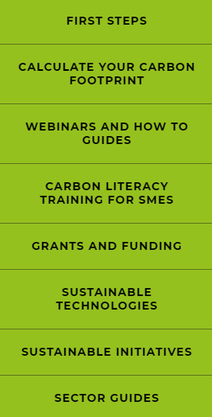
Supporting Businesses – Carbon Charter
Understanding Impacts
First Steps
What to do next?
Easy templates
Plain English guides
Free consultancy (member only)
www.carboncharter.org

Slide 17


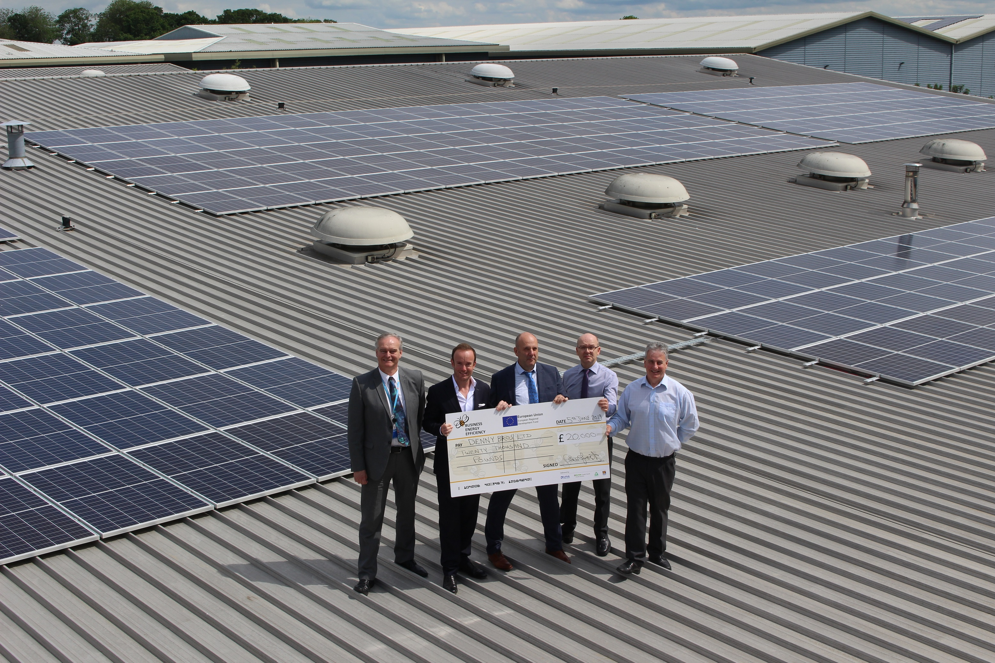
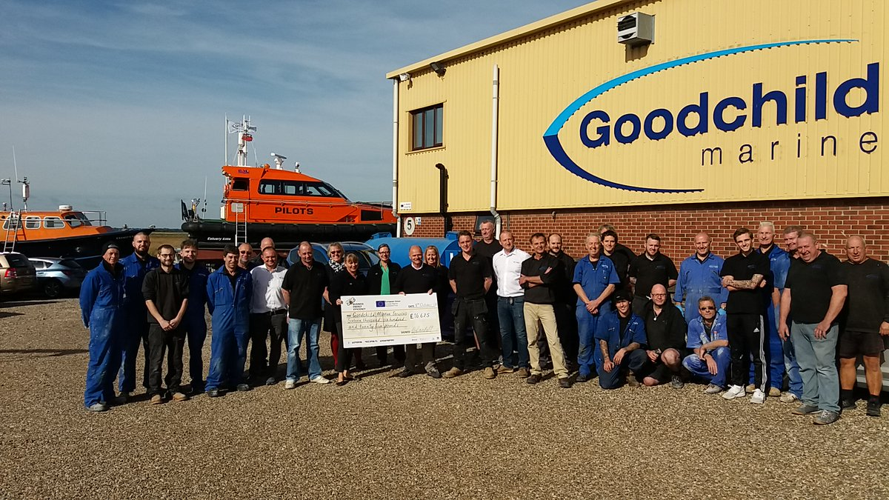
Grants
www.beeanglia.org
Most carbon saving measures
Up to 40%
240 Norfolk & Suffolk businesses supported so far
Enquiries until the end of 2021

Slide 18
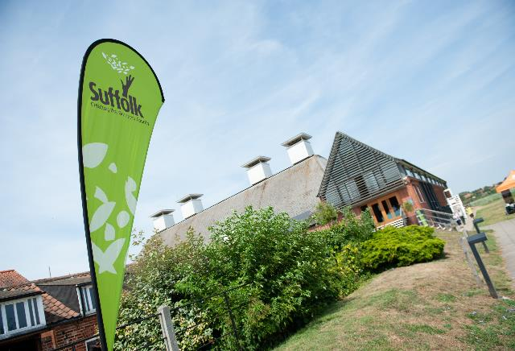
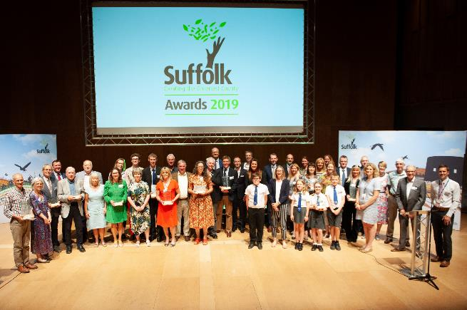


Greenest County Awards 2021
Launch: 8th Sept
Entries by: 14th October
Ceremony: 12th November
www.greensuffolk.org/awards/
Notes:
Greenest Business
Greenest Small Business
Greenest School
Greenest Community
Enhancing Biodiversity & Landscape
Green Hero
Waste Reduction & Recycling

Slide 19
Carbon Charter
amy.coulter@groundwork.org.uk
www.carboncharter.org
BEE
Anglia
beeanglia@groundwork.org.uk
www.beeanglia.org
West Suffolk
Council
Andrew.oswald@westsuffolk.gov.uk
Energy efficiency (westsuffolk.gov.uk)

