Slide 1
Norfolk & Suffolk Economic Renewal Plan
[Event/Meeting name]
[Name and organisation of person presenting]
[Date]
Notes:
This slide deck is designed to support any event or meeting that presents the opportunity to share knowledge and seek input to help shape and develop the Norfolk and Suffolk Economic Renewal Plan
The person delivering the presentation can pick and choose the relevant slides dependent on the aim of the event/meeting and its audience.

Slide 2
Aim of today
Set out the National and Local context and the reasons for this work
Outline the approach to developing the Norfolk and Suffolk Economic Renewal Plan
Briefly review how our economy is doing and test some emerging observations
Review current interventions and check they are fit for purpose
Start to develop new actions and interventions needed
Notes:
This slide sets out the structure of this slide deck and the discussion it is designed to support
The aim of today’s session is to:
Introduce the work we are doing on developing an Economic Renewal Plan, led by the LEP but working with businesses, colleges, universities, VCSE and local councils.
To review how the Norfolk and Suffolk economy is doing and test some of the emerging observations.
To review the current actions and interventions in place and check if they are still fit for purpose.
And to get your views on the actions and investments needed to make the Norfolk and Suffolk economy renew and grow in a way that makes it more resilient, innovative, and benefits all our people.

Slide 3
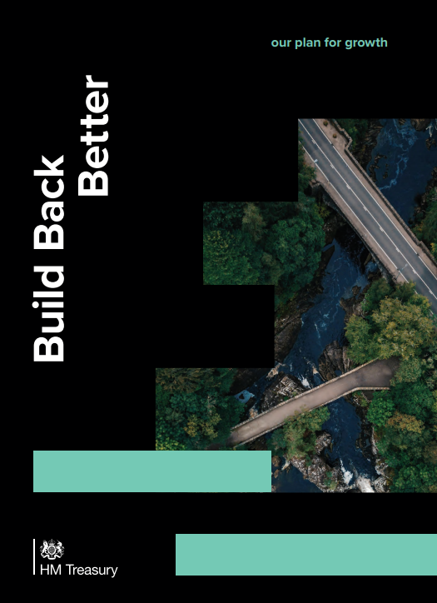
National Context
Plan for Growth published March 2021 replacing the National Industrial Strategy – but strong alignments
Pillars of Growth
  Infrastructure
  Skills
  Innovation
The People’s priorities
  Levelling up
  Supporting Net Zero
  Global Britain
Government to set clear metrics to monitor progress
New approach to national and local funding
Notes:
This slide sets out the main aims and elements of the Government’s Build Back Better : Plan for Growth
In March 2021 Government published its Build Back Better: Plan for Growth which replaced the National Industrial strategy of which much of the essence is reflected in their new plan.
It sets out the government’s plans to support economic growth through significant investment in, what they call the three pillars of growth - infrastructure, skills and innovation.
In addition to these, government have set out three long-term policy objectives that they want growth to deliver – the People’s Priorities:
Levelling up - the UK government’s most important mission is to unite and level up the country, improving everyday life for communities throughout the UK and ensuring everyone can succeed regardless of where they live.
Supporting Net Zero - the UK will continue to be at the forefront of tackling climate change and is already a world leader in clean growth.
Global Britain - Focusing on global investment and trade.
Government are committed to setting clear metrics to monitor progress of which the Renewal Plan will need to take account of going forward.
In addition to the plan, government have set out a programme of national strategies and plans which will be published in the next 12 months.
The government’s evolving approach to national and local funding provided both challenges and opportunities but reinforces the importance of collaboration and smart thinking to ensure we can secure investment for all parts of Norfolk and Suffolk.
NOTES if presenter wants to elaborate.
Government’s three pillars of growth:
Infrastructure – Its focus is on increasing the quality of infrastructure which is lower than many other countries - investment in broadband, roads, rail and cities as part of their £100bn capital spending plan
Skills – With a focus on improving high quality technical training, lifelong learning & quality apprenticeships (play a crucial role in shaping peoples’ life chances – strong foundation of advanced skills and a number of world leading universities, but lags behind international comparators)
Innovation – With a focus on high growth companies, start up and scale up, attracting the brightest people, SME support management training offer, incentivising the development of creative ideas and tech. (including cutting-edge research and how businesses adapt their products and processes, will be an important part of improving UK productivity growth. The UK has a world-leading research base, and while we have some of the best companies in the world, we also have a lower proportion of innovative firms overall than other advanced economies)
The Peoples Priorities:
Levelling up - Which government sees as their most important mission – Focusing on towns that are struggling, freeports, digital and transport connectivity, every region has at least one globally competitive city. (improving everyday life for communities throughout the UK and ensure everyone has an opportunity to succeed regardless of where they live)
Supporting Net Zero - the UK will continue to be at the forefront of tackling climate change and is already a world leader in clean growth. Focusing on delivering the Ten Point Plan for a Green Industrial Revolution, leveraging significant private sector investment and supporting up to 250,000 highly-skilled jobs – we will take action to fulfil our commitment to be the first generation to leave the natural environment in a better condition than we found it; and we will ensure the finance sector can play its role to support the transition to net zero
Vision for Global Britain – Focusing on global investment and trade. the UK’s prosperity is built on our integration into the global economic and financial system. Following our exit from the European Union, we can also take advantage of the opportunities that come with our new status as a fully sovereign trading nation. We will role model free and fair trade, ensure the UK remains a leading destination for global investment, and support opportunities for trade and collaboration.

Slide 4
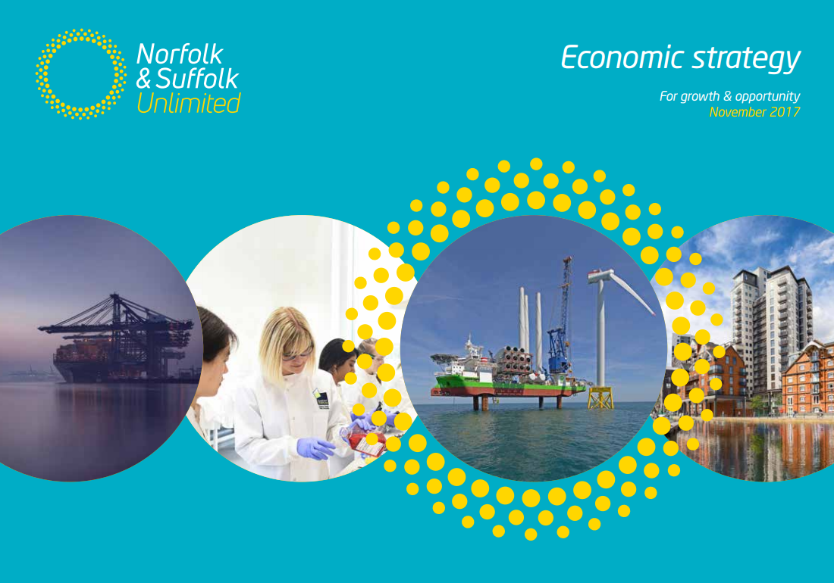
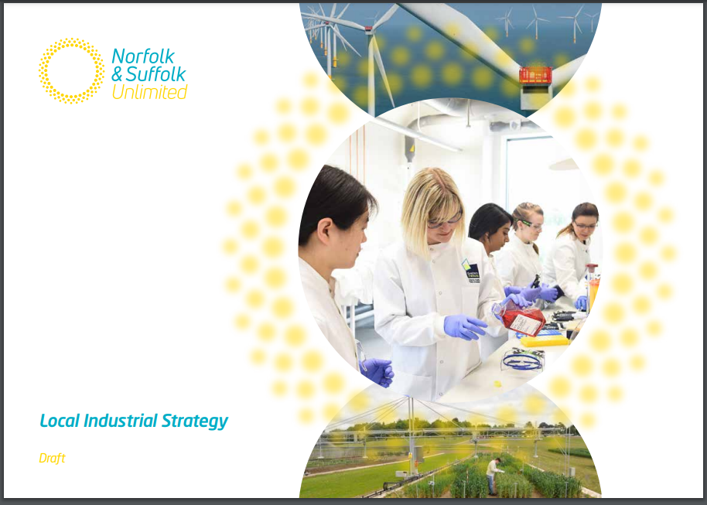
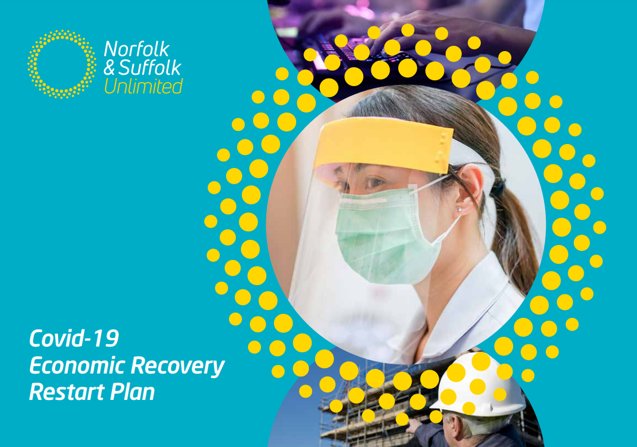
Local Context
Economic Strategy, Local Industrial Strategy & Economic Recovery Restart Plan
Partners have agreed the vision, aspirations & strengths still stand
Clean, Inclusive and Productive growth
Net Zero higher on everyone's agenda
Alignment of themes, foundations, pillars and priorities
Strong evidence base to build on
Our Collaboration is a competitive advantage
Notes:
This slide sets out the local context.
Despite the challenges of the past year, from an economic strategy perspective we are in a strong position. The Economic Strategy, Local Industrial Strategy and the Restart Plan all provide a strong foundation for us to build on.
They set the blueprint for our shared vision to drive clean, inclusive, productive economic growth across Norfolk and Suffolk. Pledging to work together to transform our growing economy into one of the best places in the world to live, work, learn and succeed in business.
During the development of the Restart plan, partners all agreed that the vision, aspirations, and strengths set out in these still stand firmly. But our actions and interventions need to evolve and adapt.
The pandemic has changed how we live and work in ways that will alter our behaviour long after the pandemic subsides.
Skills, Innovation, Business Support, Infrastructure and place all remain important ingredients to achieving our vision and ambitions. But we will need to evolve the language to align with different audiences and with government’s Plan for Growth.
We have a strong evidence base to build on which we will need to evolve and adapt the narrative to position Norfolk and Suffolk as a place with potential.
To date the strong collaboration across Norfolk and Suffolk has proven to be a competitive advantage in securing more than our fair share and recognition for strong delivery. This will become more important going forward not just locally but nationally too.

Slide 5
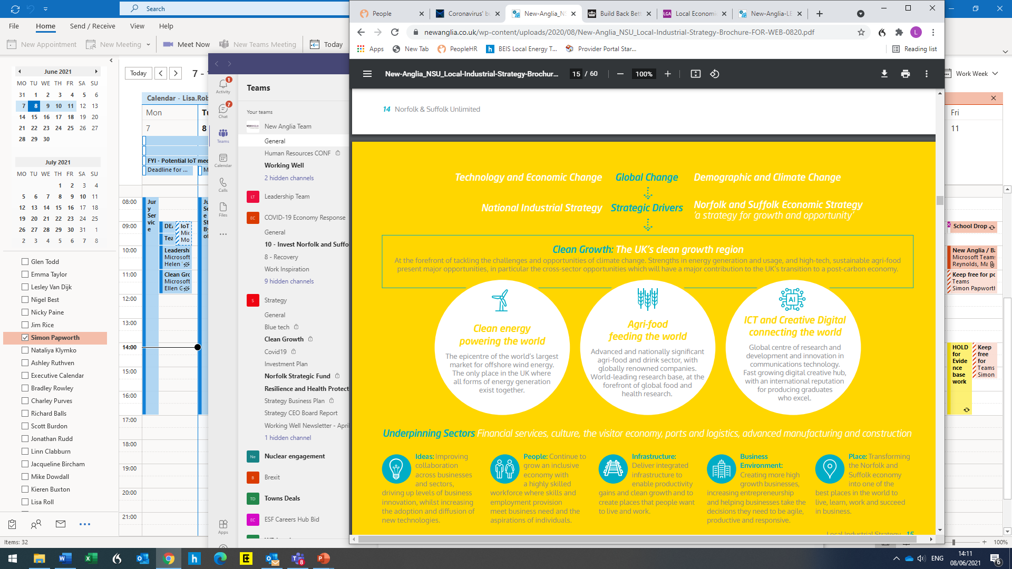
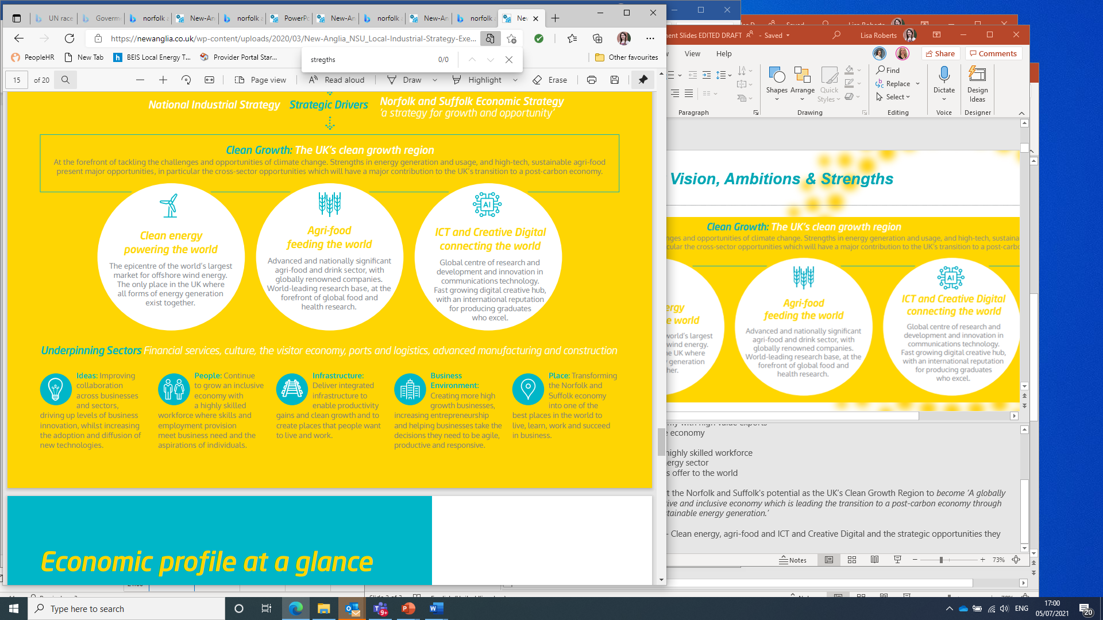
Clean Recovery - Our Vision, Ambitions & Strengths
Notes:
This slide sets out the vision, ambitions and strengths that Partners agree still firmly stand – Key message is the Renewal plan needs to drive a zero Carbon recovery.
The Economic strategy sets a clear vision to drive clean, inclusive, productive economic growth across Norfolk and Suffolk. With partners from across private, public, education, and VCSE pledging to work together to transform our growing economy into one of the best places in the world to live, work, learn and succeed in business.
Collectively we set clear ambitions for Norfolk and Suffolk to be:
The place where high growth businesses with aspirations choose to be
An international facing economy with high value exports
A high performing productive economy
A well-connected place
An inclusive economy with a highly skilled workforce
A centre for the UK’s clean energy sector
A place with a clear, ambitious offer to the world
These ambitions will be refined to ensure clean growth is embedded throughout the ambitions. We will also look to add a clear ambition as a net zero economy.
The Local Industrial Strategy set out the Norfolk and Suffolk's potential as the UK’s Clean Growth Region to become ‘A globally recognised, technology-driven, creative and inclusive economy which is leading the transition to a post-carbon economy through sustainable food production and sustainable energy generation.’
The Renewal Plan will show our collective commitment to capitalising on the area’s major strengths and opportunities in clean energy, agri-food, information and communication technology and digital creative, alongside ensuring the underpinning sectors, with the addition of the care and VCSE sectors, get the support needed.

Slide 6
Clean, Zero Carbon Recovery – Central Focus
Critical that the Renewal plan drives a clean, zero carbon recovery.
Lets not miss the opportunity!
Decarbonisation
Behavior Change
Water Efficiency
Regenerative
Sustainability
Alga
Carbon Capture
Sustainable Agricultural Practices
Biodiversity
Cleaner Air
Circular Economy
High Value Jobs
Innovative Technology
Electric vehicle revolution
Opportunities
Challenge
Reduced Emissions
Pioneering
Renewable Energy
Infrastructure Upgrade
Skilled Workforce
Hydrogen
New Market Opportunities
Evolved culture
Notes:
This slides emphasizes the key message – It is critical that the Renewal plan drives a clean, zero Carbon recovery.
As the ‘UK’s Clean Growth Region’ and the pressing need to take action against climate change it is critical that the Renewal Plan drives a clean, zero carbon recovery.
Important as it is to repair the economic damage, a quick return to business as usual could be environmental harmful and a missed opportunity.
The economic slowdown, following the 2008 financial crisis, saw a reduction in global greenhouse-gas emissions. But this didn’t last long and in 2010 emissions had reached a record high, in part because measures implemented to stimulate economies had limited regard for the environmental consequences.
It is important that we do what we can to ensure the same pattern doesn’t repeat itself.
A clean, zero carbon recovery could not only bring about significant emission reductions, but also create more jobs and economic growth than a high-carbon economy.
Clean growth cannot be delivered by one partner alone or by one strand of investment or actions. It is important that partners play a role in developing actions to secure their buy in and for them to own their role in delivering them.
This will be a central focus for the development of Norfolk and Suffolk Economic Renewal Plan.

Slide 7
Local Context Moving Forward
Clean
Productive
Inclusive
PLACE
An opportunity to move to the next level
Not a new strategy, an evolved plan.
Approach to Renewal Plan
  Consolidate
  Refine
  Agile
Co-design, bottom up, defining of roles
What does success look like? How do we measure it?
Growth
Agri-food
Clean Energy
ICT/Digital Creative
Underpinning Sectors
Skills, Innovation, Infrastructure, Business Environment
Alignment of local strategies & Plans
Notes:
This slides sets out the approach to developing the Economic Renewal Plan.
The change in national policy context is an opportunity for us to move our strategies and plans to the next level.
The approach that we are proposing to develop the Renewal plan is – consolidate, refine and agile
The Renewal plan will not be a new strategy but an evolved plan which will consolidate the Economic Strategy, Local Industrial Strategy and the Restart plan into one.
It will look to refine our ambitions and strengths helping to focus actions and interventions where the biggest gains and impact can be achieved.
We will need to review and agree what success looks like and how we measure it.
We need to remain agile to the continually changing landscape being able to adapt the actions and interventions as the circumstances change.
The renewal plan needs to be co-designed from bottom up and clearly define the different roles of partners to maximise our efforts and resources and achieve efficiencies.

Slide 8
The Economic Renewal Plan will …
Consolidate of Economic Strategy, LIS, Restart Plan and the Investment Plan
Have strong buy in from all partners and is codesigned
Refine our ambitions, strategic opportunities and interventions
Clearly illustrates economic opportunities and challenges
Set out the potential of Norfolk and Suffolk at a strategic level
Provide a regional framework to help priorities investments
Be underpinned by a shared qualitative and quantitively evidence base that aligns with interventions
Sets out clear refined action and the roles of partners in delivery
Draws out place more that previous strategies/plans
Aligns with government Plan for growth
Be accessible to all
Drive a clean, zero carbon recovery
Notes:
To deliver an Economic Renewal Plan that meets the needs of Norfolk and Suffolk, including making the case for future investment, the plan will:
Consolidate the Economic Strategy, LIS, Restart Plan and the Investment Plan
Have strong buy-in from all partners and is codesigned
Refine our ambitions, strategic opportunities and interventions
Clearly illustrate economic opportunities and challenges
Set out the potential of Norfolk and Suffolk at a strategic level
Provide a regional framework to help prioritise investments
Be underpinned by a shared qualitative and quantitative evidence base that aligns with interventions
Sets out clear refined actions and the roles of partners in delivery
Draws out place more than previous strategies/plans
Aligns with government’s Plan for growth
Be accessible to all
Drive a clean, zero-carbon recovery

Slide 9
Approach in detail and Timeline
Scope & Define
Agree approach to developing Renewal Plan
Seek agreement to consolidate, refine & to be agile
Review existing evidence, map need and gaps & appropriate methods to fill them.
Agree Evidence framework
Update, Review & Refine
Refine aspirations and strengths.
Review current interventions locally & nationally.
Update current evidence & build evidence base where gaps have been identified.
Agree framework for Renewal Plan.
Development of Interventions
Use evidence & insight to agree existing & develop new interventions.
Agree how success will be monitored, measured & reported.
Agree how to keep the evidence and plan up to date & agile.
Review investment plan
Draft, Design & Consultation
Draft & design Renewal Plan
LEP Board, Local Authority Leaders and Sector Chairs review draft.
Sign Off and Publish
Engagement & Communications
Inform partners of intention of developing the Renewal Plan. Agree scope.
Local partners help to inform & develop evidence base through a series of one to ones, other methods & tools.
Local partners co-design integrating it into the consultation process.
Local partner endorsement.
Collaborative implementation.
April / May
June / August
August / September
October / December
January
Notes:
This slide sets out the different stages of developing the Renewal Plan and the opportunities there are to input and feed in ideas and actions
This sets out the more of the details of the proposed approach and the timeline.
Over the last few months partners have been agreeing the overall approach and scoping the evidence base.
We are now at the stage of beginning to review current and develop new actions and interventions and further develop the evidence, through workshops and discussions with businesses and other partners.
We are clear that quantitative evidence can only take us so far and the qualitative evidence and information we get from businesses is absolutely crucial to identifying the right actions to take.
Over the course of the summer we will be using several events of develop and test ideas and actions, before pulling the strategy together in the Autumn with the view to publishing in the new year.
The draft Renewal Plan will be shared with partners for comments and feedback in November. Design in December and sign off and publish in January 2022.

Slide 10
Economic Context
Notes:
This section sets out some key facts and observations about our economy, the targets and ambitions we set in the Economic Strategy and Local Industrial Strategy.

Slide 11









Our economy – Pre Pandemic and EU Exit
A £36.4bn economy
£21,995
and
GVA per hour of
with GVA per head of
£30.57
growing 1.8% average per annum
1.7m
people
719,500
with 62,750 businesses
&
jobs
13.9%
growth
since 2013
3.6% growth since 2012
7.8% growth
since 2012
76.8% employment
rate
NVQ4+
31.0%
& 11.1% no qualification or NVQ1
earning
£527.80 median
weekly wages
Notes:
This slide shows how the economy was performing prior to the pandemic and the exit of the EU.
The above slide reflects the key economic metrics of the Norfolk and Suffolk economy – before leaving the EU had really kicked in, and heading into the 2020 pandemic, and subsequent lockdown.
We can see that while overall output, and population were incrementally growing – the region was still trending below UK averages for productivity.
However, both enterprise rates and jobs were growing at a healthier rate, and the region was making up ground in terms of median wages. Though steady progress was being made in terms of higher attainment levels, we were still some way adrift of the national average.
Overall, the Norfolk and Suffolk economy was keeping pace with national trends and improving on the whole – but we were maintaining, rather than closing the gap on a number of key metrics.
Source:
Data from Norfolk & Suffolk LIS – published New Anglia LEP website Jan 2020 (Data in the LIS taken from a range of sources reflecting economic situation in 2016-2019

Slide 12
Our economy – Update & Tracking Impact
Furlough Rates in Norfolk & Suffolk followed UK national trends – Peaking at 30% of eligible employments in June 2020, latest figures show 11%.
76.5% employment
rate
Norfolk & Suffolk unemployment rate around 6-7%, the furlough scheme and other support measures still masking likely true impact - which could see figures rise to 10% later in 2021.
2017: £30.5
Latest Figures: £31.1
Productivity Levels: have reflected the national picture in terms of performance and growth – but underlying productivity is still effectively stagnant, and Norfolk and Suffolk still lags behind the UK average.
Resident population increased from 2019-2020 to 1.67m people (1% increase) – anecdotal evidence suggests housing demand and prices have risen significantly, in some areas by around 20%
GVA Per Hour Worked
Qualification Level: 35% of 16-64 year olds have an NVQ level 4 or higher – incremental year on year improvement, but still 8% below UK national average at 43%.
35%
Qualifications & Alignment: Matching national averages in many qualifications by subject – except still lagging in ICT and Engineering – 2 critical areas to support strategic opportunities for growth, especially at a higher level
NVQ4 +
UK: 43%
Median annual wage has risen to £27.2k, however, the disproportionate impact lockdown has had on certain sectors may be inflating this gain
earning
£527.80 median weekly wages
The number of jobs has plateaued since 2018 at around 700,000 – again, any negative impact on this figure, may be masked by the extension of various support measures, especially furlough
Notes:
What Lies Beneath the Headline Data?
In many ways its important to bear in mind we are dealing with 2 simultaneous severe shocks to the economy – and the impact of lockdowns are far more immediately evident and straight forward to metricate and track across an array of indicators
The impact of leaving the EU however, whilst reflected to a degree in anecdotal, qualitative evidence is far more difficult to readily identify and was always likely to take a longer period of time to come to light, and at this juncture its simply too early to say with any degree of certainty what the precise economy wide impact has been.
The extent of government support for individuals in employment, and for business owners (extending to VAT and business rate holidays etc), is likely masking what the true cost and impact of the last 12 months+ has actually been. This explains for example why we are seeing the lowest level of business insolvency on record – at a time when we've been in a sustained economic contraction, with incredibly difficult trading conditions for many businesses.
This slide reflects combined, headline data for all of Norfolk and Suffolk. There are of course, significant, place-specific variances across all of these metrics
Observations
Due to the limitations on the availability of certain data – we can’t produce a snapshot that updates the previous slide exactly.
We have however identified certain metrics that act as proxies and provide an informed indication of how both Brexit and lockdown restrictions are effecting the Norfolk and Suffolk economy here and now.
Both the furlough and unemployment rates in the region have tracked national averages and trends very closely. There is still a significant degree of uncertainty around unemployment rates in particular – dependent on a number of factors.
As mentioned earlier – and unsurprisingly, it appears as though the region’s productivity level has remained stable, but stagnant in relation to UK wide conditions.
There has been a notable increase in housing demand, alongside a very frantic housing market – in the wake of lifting of lockdown restrictions and the accompanying stamp duty relief.
We haven’t detected any major shifts in terms of proportions of level 4 attainment, or in terms of skills alignment with market demand – a wealth of evidence indicates we need to increase the proportion of the workforce with STEM related skills.
Median wage levels are perhaps looking healthy (though we need to exercise some caution, as the specific nature of the impact of lockdown may be skewing the figures – by suppressing the volume of lower paid jobs in the calculation)
Similarly, the volume of overall jobs may be artificially being inflated by the array of government support schemes businesses are currently able to access – once these are removed, it’s possible we could see this metric start to trend downwards.
Sources:
Furlough: HMRC CJRS Monthly Updates – Local Authority split May 2021
Productivity: regional GVA 2019 (published May 2021)
Qualification and Alignment: Norfolk & Suffolk LSR – evidence base (March 2021)
Median Wage: EMSI June 2021 – LEP profile
Unemployment Rate: Stat-Explore – ‘Alternative Claim Count – latest quarterly count 2021
Jobs: NOMIS – June 2021

Slide 13
Our economy – OBR March 2021 Projections
OBR Forecast Model (March 2021) | Upside Scenario | Central Scenario
Economic effects
Real GDP Growth in 2020 | -10.6% | -11.3%
Return to pre-virus peak (2109 Q4) | 2021 Q4 | 2022 Q4
Peak Unemployment | 5.1% | 7.5%
Long Term GDP scarring | 0.0% | 3.0%
Impact for Norfolk & Suffolk Economy: Assuming we are seeing a scenario somewhere between the upside and the central – but closer to the central
We could see a £1.3bn+ reduction
in GDP by 2024
Unemployment - likely 25,000 more people unemployed, projections could go up to 50,000+ more unemployed by Q1 2023
Notes:
This slide shows the projection of the impact of EU Exit and the pandemic combined on the Norfolk and Suffolk Economy. This is based on the latest March 2021 OBR Forecasting Model.
Over the past year or so, the Office for Budgetary Responsibility’s bi-annual economic forecasts have been recognised as a trusted source of modelling/projecting. Many of our partners are using these forecasts as the basis for their own respective strategy planning/work.
This slide map their scenario projections across to the Norfolk and Suffolk economy. The projections, have attempted to blend the impact of both the EU Exit and Covid related lockdowns
It is clear from the data in this slide that the impact of lockdown and Brexit has had a sizeable impact, and, is likely to curtail overall economic growth over the next few years.
Important to always bear in mind these ‘projections’ are based on the available data (which often comes with a lag), and factors such as ‘variants’ emerging – therefore they should be viewed as informed guesstimates, but the reality of conditions and outcomes can rapidly change.
NOTES for reference
OBR Approach - explanation
The OBR (Office for Budgetary Responsibility), is currently the most widely referenced source in terms of assessing the economic impact of lockdown measures, and predicting the speed and shape of projected recovery.
Both NODA and SODA are citing the OBR’s scenario modelling, and their approach has also been used by NCC in formulating their 5 year ‘Long Term Impact of Covid’ report. In addition, external consultants HATCH Regeneris are basing their scenarios off of the OBR’s March 2021 baseline in providing a report for the Norfolk and Suffolk inward investment team.
The OBR provides 3 scenarios when forecasting – Upside/Central/Downside. For reference, below is a snapshot of the circumstances applicable to each of their 3 scenarios, as outlined in their latest report – March 2021:
We can now determine that we are currently facing a scenario, somewhere in between the Upside and the Central scenario – with vaccines widely available from the spring, but with restrictions still in place as we attempt to mitigate the impact of variants.
The above slide therefore reflects the Central scenario, given the economy is still coping with relatively stringent restrictions.
An upside scenario in which the virus was speedily brought under control by the November lockdown. It was then kept under control by the rapid deployment of effective vaccines (reaching the majority of adults in the spring) and the effective operation of test, trace and isolate, with only relatively low levels of public health restrictions. The economy therefore rebounded strongly to its pre-pandemic level by the end of 2021, and there was no medium-term economic scarring relative to our March 2020 forecast.
A central forecast, in which the virus was only partially brought under control by the November lockdown, effective vaccines were rolled out more slowly (reaching the majority of adults by the middle of the year) and test, trace and isolate was only partially effective in controlling the virus. As such, relatively stringent health restrictions remained in place until mid-year. The economy therefore recovered more slowly, reaching its pre-pandemic level by the end of 2022 and suffering a moderate degree of medium-term economic scarring which lowered real GDP by 3 per cent relative to our March forecast.
A downside scenario in which the virus was not brought under control by the November lockdown, vaccines were of limited effectiveness (in part because of mutations in the virus), and test, trace and isolate was largely ineffective. As a result, stringent restrictions remained in place over the first quarter of 2021 and there was also a further wave of infections the following winter. Output recovered even more slowly, only regaining its pre-pandemic level by 2024, and there was a high degree of medium-term economic scarring, which lowered real GDP by 6 per cent relative to our March forecast.
Sources
OBR Economic Forecast March 2021 – modelled for Norfolk & Suffolk using Regional GDP estimate (May 2021) & NOMIS June 2021 data

Slide 14
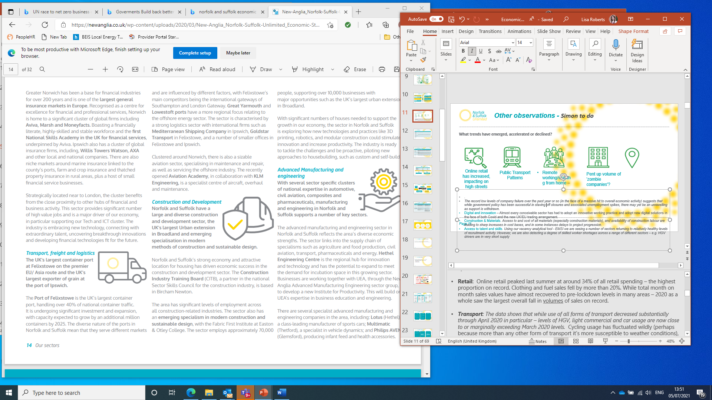
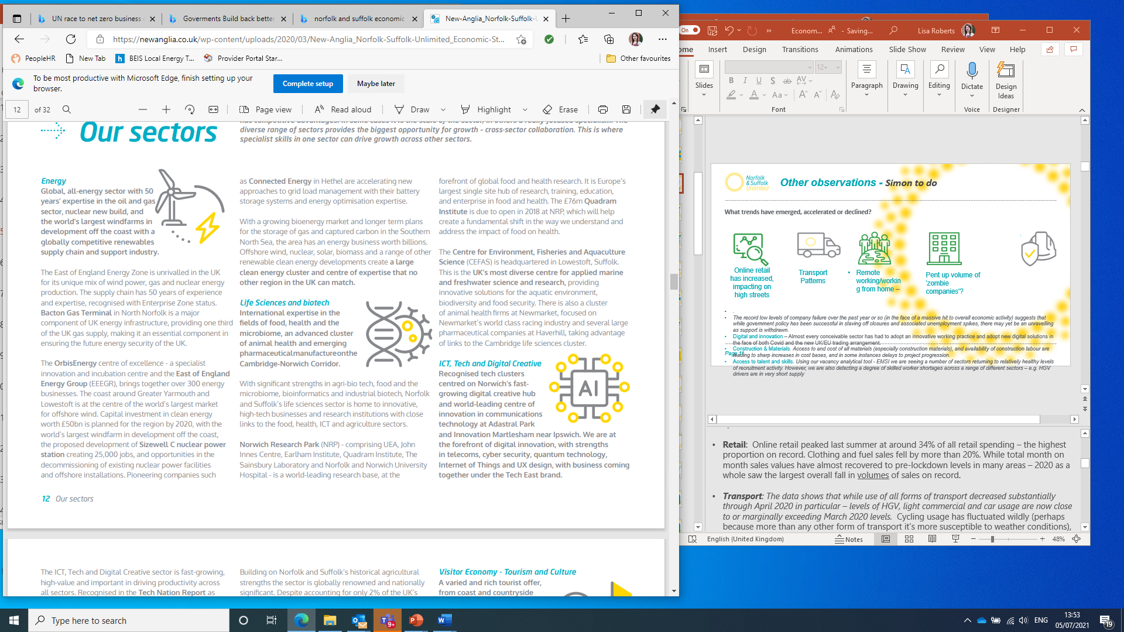


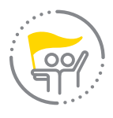

Other observations
What trends have emerged, accelerated or declined?
Digital innovation adoption & implementation has accelerated
Online retail has increased & both large and small retailers are disappearing from some high streets
Remote working, adaption of flexible working has accelerated but has impacted on commercial office space, unclear of true impact given current restrictions
Pent up volume
of 'zombie companies’?
Potentially hiding unviable business models
Construction & materials - restrictions of supply have led to increase in cost and some materials being unavailable.
Access to talent and skills –
some sectors struggling to fill jobs.
Transport patterns returned to normal except public transport
Notes:
This slides sets out some other observations that have been made on the quantitative and qualitative evidence that is available.
Perhaps, rather than seeing the current situation as a ‘fixed’ step change – with resulting defined outcomes, it is more accurate to describe the current situation as a shift in the underlying foundations of many aspects of our economy – the outcome and nature of which is likely to be uncertain, evolving, and in flux for several years, before more stable patterns become established.
Therefore, individuals and organisations displaying or possessing characteristics that support and drive responsiveness, agility, and innovation are likely to be even more valuable than they have in recent years.
It seems reasonable to assume that many of these new ways of working will remain in place for at least several months – even once restrictions are more fully lifted – as many new patterns of working have the potential to deliver cost savings, and new routes to market, lower overheads, enhance productivity and improve quality of life.
However, these benefits will of course not be unilateral, and could come with some hidden risks and costs. E.g. some emerging research suggests increased rates of working from home could actually disproportionately harm women's progression and mental health in the workplace.
Some other key observations that are worth noting include:
Transport: The data shows that while use of all forms of transport decreased substantially through April 2020 in particular – levels of HGV, light commercial and car usage are now close to or marginally exceeding March 2020 levels. Cycling usage has fluctuated wildly (perhaps because more than any other form of transport it’s more susceptible to weather conditions), while use of both buses and trains remains relatively low – bus usage at 61% as of March 2020 levels, and train usage at 46%.
Digital & Innovation: Almost every conceivable sector has had to adopt an innovative working practice and adopt new digital solutions in the face of both Covid and the new UK/EU trading arrangement. However, analysis cannot be viewed in sector silos - i.e. as much as some sectors have been almost unilaterally hit (hospitality and retail most obviously), there are layers of nuance within almost every sector, reflecting how individual enterprises have responded and realigned – with those most able and willing to take a more innovative and digital approach seemingly coming out best. While this may have been applicable in 'normal' trading conditions as well, the circumstances of Brexit and Covid combined have accentuated the outcomes.
Retail: Online retail peaked last summer at around 34% of all retail spending – the highest proportion on record. Clothing and fuel sales fell by more than 20%. While total month on month sales values have almost recovered to pre-lockdown levels in many areas – 2020 as a whole saw the largest overall fall in volumes of sales on record.
Remote/Flexible Working: Acceptance of working from home by most office-based companies has dramatically increased, and has been (generally) less disruptive than initially feared, however, it's still very early to assess and determine to what extent this change of behaviour will play out in the coming months/years. The move to home working has had an impact on some high streets with the lunchtime and after-work footfall significantly decreasing.
Zombie Companies: The record low levels of company failure over the past year or so (in the face of a massive hit to overall economic activity) suggests that while government policy has been successful in staving off closures and associated unemployment spikes, there may yet be an unravelling as support is withdrawn. Timing and clarity are likely to be crucial factors to ensure fallout is minimised. Unprecedented long-term low levels of interest rates had already made taking on debt relatively cheap for companies. Should interest rates start to creep up to manage inflation – then some companies could face acute cash-flow issues
Construction & Materials: Access to and cost of all materials (especially construction materials), and availability of construction labour are leading to sharp increases in cost bases, and in some instances delays to project progression. We are aware that there are a number of key opportunities on the horizon (Off-shore Wind and Sizewell to name 2 of the biggest), that will place the availability of labour and materials under further pressure. In addition, there is consistent anecdotal evidence at a local level that demand for warehousing space (often a crucial component in large scale construction projects) is at a premium – due to emerging knock-on pressures from both Brexit and Covid.
Access to Talent & Skills: Using our vacancy analytical tool - EMSI - we are seeing a number of sectors returning to relatively healthy levels of recruitment activity. However, we are also detecting a degree of skilled worker shortages across a range of different sectors – e.g. HGV drivers are in very short supply A number of hospitality venues are reporting real difficulties in securing more qualified and experienced staff. The digital sector in Norfolk and Suffolk have also indicated concern that the advent of more widespread remote working has led to increased competition and wage inflation for talent in the area.
Sources:
Retail: ONS Impact of the pandemic on retail sales 2020 Impact of the coronavirus (COVID-19) pandemic on retail sales in 2020 - Office for National Statistics (ons.gov.uk)
Transport: Dept for transport Statistics – ‘Use of Transport modes since March 2020’
Remote Working: ONS LFS, House of Commons Library ‘Coronavirus: Impact n the labour market’ – June 2021
Companies: FAME – enterprise incorporation data, ICAEW – ‘Business Rescue: are zombie companies on the rise?’ Apr 2021: Business rescue: are zombie companies on the rise? | ICAEW
EADT article – ‘Meet the Zombie Company: How furlough grew Zombie businesses in Norfolk & Suffolk | East Anglian Daily Times (eadt.co.uk)
Innovation & Digital: Tech UK article: State of Digital Adoption in the UK March 2021: Help to Grow & the State of Digital Adoption in the UK (techuk.org)
Construction & Materials: BEIS Materials Price Index – latest 2021 data, Cost hikes of three products reveals financial impact of construction materials crisis | New Civil Engineer
Access to Talent & Skills: EMSI, anecdotal feedback from local recruitment agencies – June 2021

Slide 15
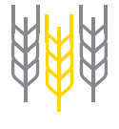
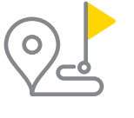
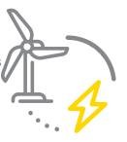


Our Sectors
Access to talent has been a major concern for agricultural businesses, disruption has also been felt in terms of supply chains. Capitalising on the popularity of local food is an opportunity.
The sector has been amongst the hardest hit. The picture is complex, as while the industry has not recalled a significant proportion of the workforce from furlough, hospitality in particular is really struggling to recruit sufficient labour into certain roles.
Visitor Economy Tourism & Cultural
Agri-Food
Continuing shortfall in higher level qualifications in STEM related subjects could risk future supply of talent to capitalise on major opportunities.
The pandemic has pushed the health and social care sector into the frontline of dealing with the crisis. There is opportunity to support the sector to understand how to make best use of technology to drive efficiencies
Clean Energy
Health and Social Care
While headline figures have not detected a major leap in demand within the IT sector itself, the need for improvement of IT skills across the economy/workforce as a whole is a big priority for business.
The pandemic has negatively affected resources and income of the sector organisations. It is extremely diverse and such diversity requires further analysis to enable the relative strengths of the sector to be optimised.
ICT Digital
Voluntary, Community & Social Enterprise
Notes:
Headline Observations
Over the following couple of slides, we have attempted to gather both available quantitative and qualitative evidence to provide a headline insight into impact and current state of play across all major sectors in Norfolk and Suffolk, setting these observation in a national context – where applicable.
Every sector has dealt with an almost unprecedented level of challenge and uncertainty over the past 12 months or so. For some, there have been tangible opportunities, and sustained patterns of growth in particular product lines and service offerings.
This has made it almost impossible to assess sector specific impact – as the baseline of activity has in many cases been severely impacted, and the nature of adaption and recovery has varied even within sectors – e.g. some hospitality businesses have adapted to offer online ordering and delivery services, some have the spare space to offer outdoor dining – others simply don’t. Certain manufacturers have diversified their entire operations to meet PPE of medical supply demand – while others have adopted a less responsive to immediate demand cycles and taken the opportunity to consolidate and plan on what a post pandemic landscape might look like.
Script & Observations
Agri-Food: The region is the single most important focus for export and import of food in the UK. It is the key place where nutritious food is produced and plays a vital role in global-leading research, innovation and logistics to enhance productivity, drive the transition to net zero, deliver the levelling up agenda, and support a strong Global Britain. The UK depends on Norfolk and Suffolk as part of the wider East of England for its food and drink.
Energy & Clean Energy: Off-shore Wind Farms and Sizewell offer most apparent sizeable opportunities, though a unique combination of these combined with potential for Hydrogen and anaerobic digestion, offer distinct test bed potential, and the prospect of shifting the region’s productivity output and offering an increased volume of employment above the local median wage.
ICT Digital: Local surveys and business intelligence suggests that while headline figures have not detected a major leap in demand within the IT sector itself, the need for improvement of IT skills across the economy/workforce as a whole is a big priority for business. In addition, a major shift in recruitment challenges within the IT sector is becoming increasingly evident, the increased uptake and acceptance of more flexible work patterns and locations means London firms in particular are now able to compete for top local talent more easily.
Visitor, Culture and Hospitality: The picture is complex, as while the industry has not recalled a significant proportion of the workforce from furlough, hospitality in particular is really struggling to recruit sufficient labour into certain roles e.g chefs. In addition, the sector has had to cope with shifting measures in terms of social distancing, and also juggle with complex social distancing requirement and rules. Our business intelligence indicates this has increased levels of uncertainty both among some business owners and their staff as to the sustainability of their current viability and employment prospects. However, demand for staycation properties has been very high as the UK population faces continued international travel restrictions – which help to drive future sustainability and revenues.
Retail: . The sustained decrease in day-time footfall, as many offices have remained closed in larger town centres, has further undermined the short to mid-term prospects for high street retail. We are detecting increasing anecdotal evidence suggesting the need to re-evaluate the scale of town centre floor space designated for retail usage. Seasonal retail patterns have also been impacted by indirect factors – e.g. international travel restrictions impacting on ‘normal’ summer clothing demand etc.
Health & Social Care: The relative scale of the market in Norfolk and Suffolk (driven by the comparatively high and increasing proportion of older people in the population), is high. However, the sector often offers low wages and low per hour productivity output. There is a persistent shortfall in the sector in terms of both skills and available labour – as evidenced by the volume of vacancies advertised. The nature of the challenge around social distancing associated with Covid protection measures, has presented especially acute challenges for this sector, both literally and psychologically. Planning for possible future spikes in demand/pressure on services will be necessary.
Voluntary/third Sector: The pandemic has negatively affected resources and income of the sector organisations. It has been noted that while more affluent demographics have been able to access employment, services and opportunities, communities with lower incomes have struggled – due to a range of factors, including access to adequate kit and familiarity with digital platforms/solutions. It is extremely diverse and such diversity requires further analysis to enable the relative strengths of the sector to be optimised.

Slide 16
Our Sectors
The sector has played a pivotal role in the response to the pandemic, from supporting the call to produce Personal Protective Equipment (PPE) at pace, to ensuring a continued and stable supply of food and drink
Acute increase in demand for warehousing space poses particular cost and planning challenges. Freeport East is a significant opportunity.
Manufacturing and Engineering
Ports & Logistics
The sector has adapted well to home working however challenges remain in terms of uncertainty and added cost deriving from the EU exit, and attracting talent is still a challenge within certain roles.
Labour challenges have been exacerbated by steadily increasing demand across a number of large projects. Cost and supply of martials continues to be a challenge.
Professional, Financial & Insurance Services
Opportunities for the sector to capitalise on potential new international market opportunities, outside the EU.
Construction
Life Sciences
Notes:
Manufacturing & Engineering: The sector has played a pivotal role in the response to the pandemic, from supporting the call to produce Personal Protective Equipment (PPE) at pace, to ensuring a continued and stable supply of food and drink. There have been examples of remarkable agility to capitalise on opportunities – e.g. distilleries switching from beverage to sanitiser production. There are persistent issues around certainty of demand for certain goods, as well as uncertainty and delays around supply chains – resulting from a combination of challenges associated with Covid management and the UK's new trading arrangement with the EU.
Prof. Financial & Insurance Services: based on our business intelligence reports, large segments of this sector’s workforce working from home has proved to be more effective than initially anticipated. Many companies are now re-evaluating their real estate requirements, and this may bring opportunities as some firms in more expensive locations nearer to, or in London, may seek to lower their cost base even further. However, challenges remain in terms of uncertainty and added cost deriving from the EU exit, and attracting talent is still a challenge within certain roles e.g qualified solicitors in Norfolk and Suffolk
Life Sciences: It remains to be seen whether the sector as a whole can capitalise on potential new international market opportunities, outside the EU. Access to talent is likely to be of paramount importance driving future growth – particularly in terms of higher end attainment levels and ensuring a supply of labour/new entrants with appropriate STEM related qualifications.
Ports & Logistics: The acute increase in demand for warehousing space poses particular cost and planning challenges. The freeport opportunities could be vital for this sector in terms of forging its next stage of development locally and into the next decade.
Construction: – Labour challenges have been exacerbated by steadily increasing demand across a number of large projects. The combination of Brexit and Covid restrictions has driven up the cost of materials and delayed supply chains – leading to delays in project timelines

Slide 17
Strategic Opportunities - Actions & Interventions
Notes:
This section sets out some observations on Norfolk and Suffolk’s strengths and strategic opportunities and makes an assessment on the current interventions and suggests areas for consideration where new interventions are needed.

Slide 18
Clean Energy
Challenges
Opportunities
Delays in planning approval
Community dissatisfaction
Labour shortages and skills needs for major infrastructure
Government’s oversight of Norfolk and Suffolk role in the transition to net zero
Sector Deals - Offshore Wind, Nuclear and North Sea Transition Deal
Cross-transferable opportunities
Wealth of engineering knowledge and experience, and a skilled workforce.
Supply chain benefits
Hydrogen opportunities
Notes:
Norfolk and Suffolk is a global exemplar for clean, low-carbon energy production, with expertise in all forms of energy generation. At the heart of the world’s market for offshore wind, we will continue to play a core role in the UK's transition to a zero-carbon economy. The global pandemic has affected both the supply and demand for energy, with one of the most visible impacts being the drop in oil and gas prices and resulting contraction of the supply chain.
Some of the challenges the sector faces includes:
Although throughout the pandemic renewable energy, and in particular offshore wind, has remained resilient. However delays in planning approval to major offshore wind projects which affects wider certainty, supply chain and skills.
Community dissatisfaction with infrastructure coming onshore still continues to be a challenge.
Pye Tait and CITB report sets out the labour shortages and skills needs for major infrastructure projects.
Access to labour and delays in materials have potential to impact projects. Links to pandemic and EU Exit.
Oversight from gov’t when talking about UK’s energy assets given the major role that this region is playing across all forms of energy and delivering the transition to net zero in areas of deprived communities (no greater example of Global Britain, Net Zero, Levelling Up, Skills, Infrastructure and Innovation all coming together).
However there are also opportunities for the sector:
We are at the forefront of the delivery of all three sector deals in Offshore Wind, Nuclear and North Sea Transition Deal.
The All Energy Industry Council are exploring and will determine where cross-transferable opportunities exist.
Wealth of engineering knowledge and experience, and a skilled workforce who can transition into our clean energy sectors.
Major Operation & Management opportunity with existing and planned projects.
Supply chain benefits for the region across all forms of energy.
Hydrogen opportunity with particular opportunity being developed at Bacton & through the recently designation of Freeport East.
Nuclear new build (SZC) and opportunities around AMR/SMR technologies.
SNS gas fields ideally placed to take advantage of Carbon Capture Use and Storage.
Orbis Energy, EEEGR and All Energy Industry Council playing a strong role to enhance innovation ecosystem and business environment.

Slide 19
Clean Energy Interventions
Impact achieved
Fit for Offshore Renewables launched
Energy Skills Centre – East Coast College
Investment in Lowestoft port to unlock future projects
Operations and Maintenance Campus Great Yarmouth.
Solar carports pilot Babergh/Mid Suffolk
Planned solar project Norfolk Food Enterprise Zone
Current activities to continue / evolve
Decarbonisation academy
Bacton Hydrogen Hub
All energy supply chain
Energy Focused Enterprise Zones
Eastern Energy Hub and Powerpark – Lowestoft
EV strategy and infrastructure pipeline development
Activities to stop
Are there any activities that need to be stopped?
Notes:
This slide shows examples of the impact achieved through current interventions and highlights activities which should continue or need to evolve and any activity which should stop as they are no longer a priority / supports delivery of our ambitions.
Impact Achieved
Fit for Offshore Renewables - New Anglia Programme, a partnership between New Anglia LEP and the ORE Catapult, with 15 businesses working towards accreditation.
Energy Skills Centre at East Coast College - £10m Growth Deal project
£2.7m of Lowestoft Town Deal being invested in Port improvements
£800K Getting Building Fund to a solar carports project in Babergh /Mid Suffolk
A solar farm is planned as part of next stage provision at the Norfolk Food Enterprise Zone
Current activities to continue / evolve
Decarbonisation Academy, working with partners including the South East Energy Hub and the Energy Systems Catapult.
Supporting new energy projects and initiatives, such as the Bacton Hydrogen Hub, working in partnership with Hydrogen East, OGTC, ORE Catapult and North Norfolk District Council
Create a connected all energy supply chain, delivering programmes that support local SMEs and the wider business base through initiatives such as: Increasing UK content in the offshore wind supply chain, working with developers and local businesses to make best use of the Offshore Wind Growth Partnership; Delivering local supply chain opportunities linked to Sizewell C; Work with partners such as the ORE Catapult to ensure businesses in Norfolk and Suffolk can continue to benefit from programmes such as Fit for Offshore Renewables, which saw the first cohort from the region announced in 2020.
Eastern Energy Hub and Powerpark are the next big initiatives in Lowestoft connected to energy supply chain development locally
Supporting development on the energy focused Enterprise Zones to help boost the supply chain for the sector

Slide 20
Clean Energy Interventions
Activities to restart
Building local power generation portfolio with GSE Energy Hub
Work with ORE Catapult on collaborative all energy systems planning
Activities to scale up
Fit4Offshore renewables – support for energy sector businesses
EV infrastructure investment
Gaps and Emerging ideas
Leiston Energy Campus
Freeport opportunity – need for ‘road to net zero’ interim investment for port infrastructure/ vessels – explore
Building opportunity for local communities and businesses to access strengths in clean energy.
Notes:
This slide continues from the last slide, highlighting activities to restart, scale up and gaps and emerging ideas to feature in the Renewal Plan
Activities to Restart
Continue to build new solar and other inland renewables projects with the GSE Energy hub as a pipeline of investable propositions for green investment
Continue to develop the concept of an all-energy systems centre of excellence in our region with ORE Catapult – is this a physical centre or a collaborative project?
Activities to Scale up
Potential opportunity to scale up the Fit4Offshore business growth and support project
Regional EV strategy planning with Cambridge and Peterborough and local pilots such as the solar carports project in Babergh/Mid Suffolk should generate a pipeline of investable projects
Gaps / Emerging Ideas
East Suffolk are exploring opportunities for an Energy Campus in Leiston in collaboration with EDF
Freeport opportunity – what are the interim interventions that can move the marine sector towards net zero?

Slide 21
Strategic opportunity – Agri-food
Challenges
Opportunities
Major labour challenges
Supply chain gaps
Lack of long-term business models.
Unpredictable demand
Changes in funding and food standards.
Certainty around SAWS.
Concerns around precedent set in other countries.
Increase in short term pricing of stock
Capitalising local food popularity.
Build on the work of Flavours Connexion to strengthen local supply chains
Food Innovation Centre and the support and cluster package it offers.
Nutritious food HPO
Increased need for digital adoption and take up of agri-tech.
Notes:
This slide shows the size of the Agri Food sector in Norfolk and Suffolk, some key brands and specialisms.
Norfolk and Suffolk has the largest agri-food sector in the UK and world-leading research into plant and soil technology and agricultural systems. The impact of the pandemic on the sector has been complex and immediate. Unprecedented demand at food retailers has put pressure on the food system in some areas, whereas the closure of the hospitality industry has created surplus in others.
Some of the challenges the sector faces includes:
Labour challenges will remain a huge concern for growers and producers across the sector - to pick harvest (likely to continue), for tractor drivers, for grading machinery operatives,
Supply chain gaps due to closure of food outlets
Many small food producers who have developed new local supply chains do not have long-term business models to capitalise on this.
Unpredictable demand and uncertainty about when it will pick up
Brexit and changes in funding of agriculture, food standards, etc
Certainty around SAWS - The Seasonal Agricultural Workers Scheme.
Concerns around precedent set in Australia FTA around lowering of standards.
Increase in short term pricing of stock due to availability issues.
However there are also opportunities for the sector:
Whilst it has presented challenges for the sector, the pandemic has increased the public’s interest in locally produced food and there is an opportunity to capitalise on this.
Build on the work of Flavours Connexion - an online business “match-making” service which was launched to help East Anglia’s food producers and buyers find each other amid the supply chain disruption of the coronavirus lockdown - to strengthen local supply chains
Establishment of the Food Innovation Centre which will deliver bespoke food-grade incubator units, test kitchens and industry-standard sensory testing facilities, integrated with a Food Hub delivering in-depth innovation support.
High Protentional Opportunity at Norwich Research Park around nutritious food which has been recognised by the Department for Investment and Trade.
Increased need for digital adoption and take up of agri-tech, which will boost productivity.
The sector also has a big role to play in supporting the transition to a post carbon economy.

Slide 22
Agri Food – Interventions
Impact achieved
Food Innovation Hub project funded and underway
DiT agreement to promote our inward investment strengths in food and nutrition
Regional narrative in development
Regional agri-food robotics and agri-tech collaboration projects
Current activities to continue / evolve
Regional narrative – finalise, promote & develop regional inward investment priorities
Deliver Food Innovation Hub project
Continue to develop opportunities to link up research centres in regional collaboration
Build regional and Norfolk/Suffolk natural capital plans
Activities to stop
Are there any activities that need to be stopped?
Notes:
This slide shows examples of the impact achieved through current interventions and highlights activities which should continue or need to evolve and any activity which should stop as they are no longer a priority / supports delivery of our ambitions.
Impact Achieved
Food Innovation Hub - due to open 2022; The innovation support programme runs 2021-23 with some support beyond that.
DiT High Potential Opportunity agreed June 2021 to be developed with LEP, NRP and other partners.
Working across New Anglia, Cambridge and Peterborough and Lincolnshire LEPs to develop a regional narrative and inward investment story around agrifood
CERES is a regional agritech programme involving a number of universities including UEA and JIC - https://www.ceresagritech.org/
The Centre for Doctoral Research in Agrifood robotics is a regional project led by Lincoln uni, involving UEA and NRP
Current activities to continue / evolve:
Develop a Regional narrative – finalise, promote & develop regional inward investment priorities
Deliver Food Innovation Hub project
Continue to develop opportunities to link up research centres in regional collaboration
Build regional and Norfolk/Suffolk natural capital plans
A regional natural capital plan is being developed by Water Resources East and Local Nature Recovery Strategies by NCC/SCC - these are complementary and will help in the planning and prioritisation of environmental land management schemes
No activity has been identified as needing to stop but you may have some thoughts on this.

Slide 23
Agri Food – Interventions
Activities to restart
Develop opportunities for the Suffolk Food Enterprise Zones
Activities to scale up
Develop green investment opportunities for natural capital
Share best practice in environmental land management for sustainable productive farming to enable roll out
Gaps and Emerging ideas
Scope opportunity for a ‘farm to fork advice and grant programme’ building on LEADER and Food Innovation Hub.
Consider how to support agri-tech innovation in future
Embed natural capital /public goods advice for farmers into 1 or develop a separate scheme
Embedding net zero in future sector initiatives
Notes:
This slide continues from the last slide, highlighting activities to restart, scale up and gaps and emerging ideas to feature in the Renewal Plan
Activities to Restart
The Suffolk FEZ includes Gateway 14, the bit around Jimmy’s Farm/ Wherstead Park and the Suffolk Food Hall – strengthening the offer across the region linking up and complementing the Food Innovation Centre in Norfolk
Activities to Scale Up
Lots of new investment models and providers around environmental land management – Water Recourses East and Natural Capital East are specialists in these
The Government’s future funding of agriculture will be mainly through ELMS (Environmental Land Management Schemes) – there are trials going on now but lots to do for the majority of farmers to have appropriate and viable schemes
Gaps / Emerging Ideas
UK Shared Prosperity Fund should enable a future food sector business support programme to cross farming and food processing sectors to support the entire food chain. To be scoped but lots of expertise locally to make it work
Agri-tech Growth Initiative was successful – we need to consider what a successor scheme could look like and how it might best work
As in previous box, a need for advice and support for farmers to develop natural capital /public goods schemes
There is a need to embed net zero in future sector initiatives to ensure reliance and suitability

Slide 24
ICT / Digital Creative
Challenges
Opportunities
Major impact on contracts.
Aggressive recruitment market.
Cyber security
Businesses embrace remote working and look for digital ways of engaging consumers.
Opportunities for Big Data and AI.
Supporting cyber security
New emerging markets
Cross sector opportunities
DigiTech Centre
Institute of Technology
Notes:
Underpinning the whole economy, Norfolk and Suffolk’s ICT and digital creative sector has companies and expertise of international reach with significant potential to support economic recovery and resilience.
The lockdown has thrown the digital sector into the spotlight as businesses transition to homeworking en masse, and people look for new ways to work, learn, shop and socialise virtually.
Innovative digital businesses have been working in a variety of ways to fight the ongoing pandemic, from partnering with healthcare providers to deploying technology solutions free of charge.
Some of the challenges the sector faces includes:
Creative sector has seen some real challenges in their recovery awaiting the final easing of restrictions. Major impact on contracts.
Aggressive recruitment market. London pricing hitting the remote working market. Businesses turning to mainland Europe for recruitment to find the right digital skills.
Cyber security proving to be a major concern
However there are also opportunities for the sector:
Major focus on digital services and infrastructure as businesses embrace remote working.
UX design, games, animation and augmented reality very busy as businesses look for digital ways of engaging consumers.
Opportunities for Big Data and AI to support sectoral recoveries.
Tech sector has a role to play in supporting cyber security.
Monetisation and streaming of cultural and entertainment content is an emerging market
Online retail for small retailers is an opportunity for many companies in the sector
Demand for film content never been higher with streaming ‘giants’ commissioning huge quantities of content.
Major cross-sector opportunities e.g. offshore wind, nuclear, agri-tech.
Close to a number of major skills projects coming onstream and live e.g. DigiTech Centre.
The bid for an Institute of Technology led by the University of Suffolk supported by partners will provide higher level vocational and technical course provision in tech if successful.

Slide 25
ICT / Digital Creative Interventions
Impact achieved
More than 250 businesses supported through the NCC Go Digital Pilot Project
East Suffolk Smart Towns project
Digital poverty /skills projects during pandemic
Current activities to continue / evolve
BT Adastral Park 2025 vision
SETI testbed – continue to develop and seek funding
Deliver Digital Hub and Digi-tech Factory (Norwich Town Deal)
Activities to stop
Are there any activities that need to be stopped?
Notes:
This slide shows examples of the impact achieved through current interventions and highlights activities which should continue or need to evolve and any activity which should stop as they are no longer a priority / supports delivery of our ambitions.
Impact Achieved
Go Digital provides free, quality business support for SMEs based in Norfolk and is funded by Norfolk County Council, North Norfolk District Council, Kings Lynn and West Norfolk Borough Council, South Norfolk Council, Broadland District Council and Breckland Council designed to help businesses do more with digital. Businesses are also eligible for a grant worth up to £500 to help achieve their aims.
£250K from Getting Building Fund to the East Suffolk Smart Towns initiative supporting town businesses to be more digital savvy
LEP Digital Inclusion project for £200K during pandemic supplying laptops to digitally excluded ESF participants – other partners had similar initiatives
Current Activities to continue / evolve
Continue to work with BT Adastral Park on delivery of their 2025 vision including the Future Networks Research Centre and more cluster initiatives
Work with BT Adastral Park, UEA, Cambridge Norwich Tech Corridor and other regional partners to further develop and deliver SETI, a ground breaking research testbed for data transfer at scale
Deliver the Digital Hub as a focal point for digital/ICT business clustering, and the Digi-Tech Factory at City College Norwich for digital sector training and education – both Norwich Town Deal projects

Slide 26
ICT / Digital Creative Interventions
Activities to restart
Sync the City and other hackathon-style in person events
Activities to scale up
NCC Go Digital Project
Investment readiness support for ICT/digital
Inward investment pitch for film/TV opportunity
Gaps and Emerging ideas
Digital creative/film sector vision for Norwich across business/ skills
Careers inspiration/ employer engagement – pilots seeking funding
Creative Hub in Kings Lynn as a catalyst for regeneration
Opportunity for more research, innovation and commercialisation in clean tech building local supply chains.
Notes:
This slide continues from the last slide, highlighting activities to restart, scale up and gaps and emerging ideas to feature in the Renewal Plan
Activities to Scale Up
NCC Go Digital project has more funding via C CARE
Invest East team have worked with ICT /digital creative sector re investment readiness – eg Creative Unlimited project
Norfolk Screen and Suffolk Screen – is there more we can do? Massive opportunity at the moment…
Gaps and Emerging Ideas
NUA have a strong vision for a net zero creative studio in collaboration with film/tv and gaming industries – developing pilot ideas for delivery
CRF projects – some project activity in this space to deliver activities with industry businesses, offer placements and career inspiration – if funded, will inform future delivery
Kings Lynn has a Creative Hub in its Town Deal bringing creative businesses together
Increasing the opportunity for more research, innovation and commercialisation in clean tech building local supply chains ensuring businesses can capitalise on the clean growth opportunities.

Slide 27
People, Business and Place - Actions & Interventions
Notes:
This section sets out some key facts about the themes of People, Business and Places along with the assessment of current interventions and identification of gaps when actions and interventions need to be developed.

Slide 28
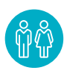
People
Reskilling would yield positive economic returns
108% increase in unemployed claimants in Norfolk and Suffolk but consistently maintained a lower percentage of claimants than the UK average
Impacts on both young people and older workers
Reskilling would yield positive economic returns in about 3/4 of cases
.
Ipswich and Norwich and coastal locations have the highest furloughing rates
120 LSOAs in the most educationally deprived decile nationally
Engineering and business development job types in most demand
Net imports and net exports of people.
Notes:
The pandemic has affected individuals in various ways, from being furloughed to being made redundant or seeing a reduction in hours and pay or their apprenticeships and education paused and disrupted.
The region’s employment rate was of course negatively impacted by COVID-19, with a 108% increase in unemployed claimants in Norfolk & Suffolk between March and May of last year. And the impacts of the government support stopping are yet to be seen.
However, it is encouraging that the area has consistently maintained a lower percentage of claimants than the UK average, as well as vacancy numbers over the last two months exceeding levels seen prior to the pandemic (Source: ONS, 2020 & EMSI, 2020).
Broadly speaking – younger members of the workforce have been hit hardest - though older workers who’ve been made redundant face acute challenges also.
Research shows that, for UK employers, reskilling would yield positive economic returns in about three-quarters of cases. Analysis also reveals that, if workers are to realise the full benefits of reskilling over the next decade, more than 90 percent of the UK workforce will need to be trained.
While segments of the workforce who can work from home (typically office and/or professional services employees) have been able to adapt more smoothly than perhaps anticipated. Those workers who have to be ‘on site’ have faced more restrictions and changes to their everyday working patterns. In terms of a very broad generality – workers who have to be present in their place of work are often those at the lower end of the pay spectrum – therefore the lockdown in particular has arguably had a disproportionate impact on those at the lower end of the earning spectrum.
Furlough data suggests both town centers (Ipswich & Norwich) as well coastal locations (East Suffolk , N. Norfolk, and Gt. Yarmouth) have seen persistently high proportions and volumes of employees on furlough reflecting the prominence of the most affected sectors.
Norfolk and Suffolk has 120 LSOAs in the most educationally deprived decile nationally, heaviest concentrations are in Gt. Yarmouth, Waveney, Ipswich, Norwich, and Kings Lynn.
Currently highest job type demand is in areas such as engineering and business development. Experimental data from EMSI suggests ‘clean growth’ jobs attract around 29% higher median advertised wage than the local economy average.
South Norfolk and East Suffolk appear to be our highest ‘net importers’ of people, while Norwich and Ipswich are the highest net exporters.
Additional points you may wish to draw out
Observations Impact of Covid & Brexit of People & Skills
The proportion of students progressing within education and achieving higher qualifications in Norfolk & Suffolk is below the national average, with particularly low numbers holding Level 4+ qualifications - 35% of 16-64 year old's in Norfolk & Suffolk hold Level 4+ qualifications, compared to 43% nationally (Source: DfE, 2018/19 academic year & Annual Population Survey, 2020)
This is felt most prominently in Engineering, where just 1% of Higher Education’s qualifiers are in Engineering & Technology, compared to 6% nationally (Source: HESA, 2018/19 academic year)
There is a demand side issue potentially contributing to this lack of progression to higher level qualifications as well, with there being 15% fewer jobs that require Bachelor’s Degree level qualifications in Norfolk & Suffolk than the average UK region (Source: EMSI, 2020).
This ultimately has a negative impact of the median wage of Norfolk & Suffolk, with the area consistently tracking below the national average, with the current discrepancy being £27.2k in Norfolk & Suffolk relative to £30.2k nationally (Source EMSI, 2020).
Norfolk & Suffolk has an ageing population with 44% of the population over 50 years old (Source: ONS, 2019) Is the area’s Health and Social Work sector adequately prepared for a future surge in demand?
Norfolk & Suffolk has a high employment rate which consistently tracks above the national average, as well as a high proportion of sustained employment destinations in school leavers (Source: Annual Population Survey, 2020 & DfE, 2018/19 academic year)
Strategic Opportunities:
Clean Growth related vacancies dipped due to the pandemic but have shown strong growth since last summer, with demand mainly being for engineers and electricians (Source, EMSI, 2020).
The Digital Creative & ICT sector has been relatively stagnant in Norfolk & Suffolk, showing little employment growth since 2003. It also appears to have suffered quite heavily from COVID-19, with the Information & Communication industry being one of the most heavily impacted (Source: EMSI, 2020).
However, whilst the sector itself has seen little growth, the volume of digital roles has steadily grown in the economy, particularly in Financial/Insurance and Architectural/Engineering activities (Source: EMSI, 2020).
The Agri-Food & Drink sector is a clear strength of the region, with there being a high density of employment as well as wages being 9% above the national average (Source: EMSI, 2020).

Slide 29
People
Impact achieved
Apprenticeship Levy Share Scheme supported 214 transfers
Work Well Suffolk supported 517 participants.
More than 350 students involved in the Virtual Work Experience programme
Job Support programme established
Kickstart placements
Current activities to continue / evolve
Institute of Technology bid submitted
Capital investment in HE/FE estates including the Offshore Wind Skills Centre
Delivery of ESF Youth Pledge and employability programmes
Support for recent graduates
Activities to stop
Avoid developing new employability activity until end of current programmes –
over-provision issue
Notes:
This slide shows examples of the impact achieved through current interventions and highlights activities which should continue or need to evolve and any activity which should stop as they are no longer a priority / supports delivery of our ambitions.
Impact Achieved:
The Apprenticeship levy Share Scheme has been operational for 18 months and has been successful in arranging 214 transfers to a variety of sectors which include: engineering, early years, construction, social care and health, plus general office roles. We have worked with 17 large employers who were in a position to transfer unspent apprenticeship levy to small organisations. Businesses levy sharing include Vattenfall and EDF.
Both councils have provided additional enhancement for either apprentice employers or the apprentice themselves. The Recruit, Retain and Reward project was launched by Norfolk County Council in August 2020. It provides an incentive grant of £1000 when businesses recruit a new apprentice, or an apprentice made redundant due to Covid-19, aged 16-24 years of age. The incentives are to incentivise a new substantive role and businesses are eligible if they do not pay the apprenticeship levy (i.e. their pay bill is less than £3m per annum) and their business is registered in Norfolk. To date, 147 successful applications have been made, including:
141 applications for new apprentices and 6 redundant apprentices; 127 applications have been paid so far
70% supporting apprentices aged 16-18 and 30% aged 19-24
Business Admin & Construction – top two most impacted sectors
Breckland, North Norfolk, Norwich – top three most impacted districts in Norfolk
70% of evaluations so far, cite the grant as being ‘important’ in the businesses’ decision to recruit an apprentice
ESF funded Work Well Suffolk is a three-year project (2020 – 2022) being managed by Suffolk County Council aimed at supporting individuals in Suffolk to tackle barriers to employment. Its aim is to help more than 2,000 people into employment by tackling barriers to work that they may face. In total the project has now supported 517 participants to date.
A virtual work experience project is being trialled in collaboration with Suffolk County Council, NEACO and the Enterprise Adviser Network over the spring/summer term, targeting year 10 students and providing a structured programme of work inspiration activities, helping students understand a range of working environments and sectors and providing the opportunity to take part in mock online interviews.
The Job Support programme offers signposting to information and support for both employers and individuals. It includes our popular Employment Opportunities page with over 300 live roles, advice on training, well being and finances.
Kickstart is part of the ‘A Plan for Jobs opportunities’ announced by Rishi Sunak in summer 2020. They offer 16-24 year olds on Universal Credit 25 hours/week paid employment for a 6 month period funded by the Government. The Chambers of Commerce and councils have been involved with a number of ‘gateways’ offering hundreds of opportunities with our local employers. Suffolk Chamber of Commerce have 640 placements approved for funding with another 86 pending of which they have almost 150 placements filled. 210 employers engaged with them!
Current Activities to Continue
Work with Government and partners to secure an Institute of Technology in the region which builds on our strengths and meets the increasing need for higher level technical skills in key areas such as energy, engineering and manufacturing. We hope to hear the outcome of the current bidding round later this year.
Ensure the successful delivery of all our educational capital investments including the East Coast College second phase of Offshore Wind Skills Centre following the funding boost, which will support new entrants in the sector, as well as supporting internal progression for existing staff through replacement posts.
Several ESF projects support the delivery of the Youth Pledge and are only recently up and running – to 2023.
ESF programme has a number of employer engagement projects – eg West Suffolk College NASCENT and Place 21 projects, VENI working in the visitor economy, and our own Careers Hub – delivering now to 2023, and all aimed at connecting the education system with employer needs.
Major programme of employability projects in ESF – supporting people with barriers to employment, especially physical and mental health barriers. Due to end 2023 – workshop in July 21 to start to capture the best practice to take forward into future projects
Our 3 universities and the LEP have been working together to raise the profile of our graduates and the opportunities that are available to them. Information is now hosted on the LEP website and a video interview has been produced.
Activities to Stop
A lot of Government employability provision at the moment as well as local programmes – need to avoid displacement and support existing projects to succeed.

Slide 30
People
Activities to restart
Some face to face engagement across programmes including school career events and mentoring
Volunteering
Activities to scale up
Careers inspiration and employer engagement in education system
Employment opportunities promotion for sectors needing staff
Self employment support – funding sought to meet demand
50+ Choices
Lifelong learning
Gaps and Emerging ideas
New approaches to face-to-face skills and employment signposting – Community Shop, Thetford, Multi-User Hub Kings Lynn.
Build sector programmes – skills and business support combined
Development of decarbonisation academy and associated curriculum development
Notes:
This slide continues from the last slide, highlighting activities to restart, scale up and gaps and emerging ideas to feature in the Renewal Plan
Activities to Scale Up
Build on excellent employer engagement good practice in the ESF programme (eg Place 21 and NASCENT – West Suffolk College) and seek opportunities to scale up
Build on the LEP Employment Opportunities page and promotional work with partners and identify further opportunities to support sectors tackling staff shortages
C-CARE project support for self employment due to start autumn 2021. Also CRF bids submitted to enable further self employment support, building on the Growth Hub Start-Up programme which ends in the autumn 2021
Need to build on the 50+ Choices pilot that was carried out at the start of 2021 encouraging employers to better support their older workforce through offering targeted training, flexible working, signposting to financial support services and encouraging healthy lifestyles. Other local initiatives are supporting the 50+ generation to get back into work.
The Skills Advisory Panel want to build a culture of lifelong learning. This will address our low educational attainment levels and raise productivity. Norfolk Adult Learning won the Adult and Community Learning Provider of the Year award at the Tes (Times Educational Supplement) Further Education awards, often referred to as the ‘Oscars of education’. In life before Covid, 98% of provision was delivered in 200 venues across the region, but by April 2020 everything had changed and all provision moved online. As a result, learners remained connected with education and, crucially, with each other.
Gaps and Emerging Ideas
Major skills shortages across the economy – a need for more activity to make sectors popular and ensure a pipeline of people with the right skills/qualifications into those sectors
Face to face and alternative signposting approaches – the Norfolk Community Foundation-led Community Shop in Thetford has been successful in onward signposting to other support; the proposed Multi-User Hub (Town Deal) in Kings Lynn will bring together signposting to a range of services at one site.
Development of decarbonisation academy is an opportunity to deliver on our ambitions as the UK’s Clean Growth region through:
Developing the workforce needed to decarbonise our economy
Providing new training and skills
Supporting innovation and new technology
Promoting training and commercial opportunities to businesses
The pilot project will look to develop the institutional and physical infrastructure needed to support the rapid deployment of high-quality training programmes needed to deliver cutting-edge property decarbonisation schemes. The project will address supply chain and education.

Slide 31
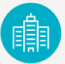
Business
To capitalise on any opportunity – businesses need support
Local intelligence suggests:
  Over 1/3 small businesses closed since the crisis began. Of those:
    1/3 are not sure whether they will ever reopen
    1/3 small businesses have shelved product development plans
    1/4 region’s exporters have reduced or cancelled international sales
    Opportunity to drive innovation, in particular in Net Zero
Notes:
The pandemic saw thousands of businesses being forced to stop trading entirely, or saw income levels reduce sharply, but there were some that innovated and thrived. The impact across sectors varies.
Its apparent that in order to capitalise on any opportunity – businesses need support - business planning, financial and funding support, skills provision and infrastructure investment and softer support measures, such as effective networks and peer to peer networks.
It’s fair to say that the following is still a major point of focus - returning to ‘normal’ working conditions include implementing social distancing; lack of business demand; sufficient cashflow; and bringing staff back.
Local intelligence reports suggested that impact saw over 1/3 small businesses closed since the crisis began – of those, 1/3 are not sure whether they will ever reopen, 1/3 small businesses have shelved product development plans, 1/4 region’s exporters have reduced/cancelled international sales.
There are clear windows for business growth and expansion – particularly related to clean growth and export opportunities – the challenge may lie more in how we ensure local businesses are well placed and well equipped to capitalise on these opportunities.
Norfolk and Suffolk has strong innovation assets, but innovation is concentrated in a small number of innovative firms, and world-class research assets, including Norwich Research Park and UEA. However, the pandemic has forced many businesses to innovate, there is an opportunity to grasp and support businesses to further their innovation journey in particular towards becoming net zero.

Slide 32
Business
Impact achieved
Over 16,000 calls via the Growth Hub hotline during the pandemic
Business Resilience & Recovery scheme awarded £4.8m to 123 projects generating £75m of private match funding.
The @inc space – a new flexible co-working space in Bury St Edmunds
Low Carbon Innovation Fund - levered in £9.654m private sector match funding
Impact achieved
Awarded 42 grants through the New Anglia Growth through Innovation Fund
100 businesses have registered for the Innovation Growth Mentoring Project launched in November
NAAME Talent Sharing Platform launched and supported 50 employers in first 3 months
Current activities to continue / evolve
Growth Hub programme – evolve to meet net zero needs
Evolve self employment programme towards individual skills/people programme
Invest East – investment readiness
Work with DiT on investment opportunities
Connected Innovation Programme
Developing a peer mentoring support programme
Growth Through Innovation programme
Funding Fit series re innovation funding
Notes:
This slide shows examples of the impact achieved through current interventions and highlights activities which should continue or need to evolve and any activity which should stop as they are no longer a priority / supports delivery of our ambitions.
Impact
16,000 calls equated to 1,594 (66 days) hours of time on teams calls related to Covid-19
The @inc space delivered by business support organisation MENTA is a creative workspace for freelances, entrepreneurs and creatives. It has ben established with support from the New Anglia LEP Business and Resilience and Recovery grant scheme. The coworking hub has been set up with post-Covid working in mind – including private Zoom rooms for virtual meetings, as well as breakout meeting spaces, collaborative areas and access to MENTA's business support, networking and events offer.
The New Anglia Grants through Innovation fund provides grants of up to £25,000 to help businesses invest in innovation, research and development. As of May 2021, £739,000 had been awarded to 42 projects, generating £903,000 in private match funding.
The Innovation Grant Mentoring Project is led by Norfolk County Council. It aims to increase awareness of innovation funding streams, and support businesses in Norfolk and Suffolk to develop stronger skills in writing bids and inspire them to apply for innovation grants, for delivering innovative research and development ideas. Support is delivered through mentoring as well as coaching in bid writing and through a focused programme of workshops. A partnership project including New Anglia LEP, Norfolk County Council, Suffolk County Council and supported by the regions’ innovation partners, the project aims to increase the number of successful applications for Innovate UK funding from Norfolk and Suffolk, which will drive innovation and grow businesses in the area. To date, 100 businesses have registered; 22 applications have been received for mentoring/bid writing; 10 businesses have been accepted for mentoring/bid writing and three businesses have made applications to an Innovate UK competition to date, with support from the programme with other businesses working towards future competitions with the programme’ s bid writing coaches and mentors.
The Talent Sharing Platform is now up and running on the NAAME website with 50 employers from Norfolk and Suffolk employers engaged in NAAME Talent Sharing Platform through one-to-one engagements, roundtables and meetings. The TSP has generated significant interest from other manufacturing groups in the UK as well as from academic research. Due to the positive response to the TSP, the team is currently investigating opportunities for utilising the platform to promote the region to skilled workforce.

Slide 33
Business
Activities to restart
Larger business grants – seek opportunity to provide/fund
Activities to scale up
Export advice and support in changing environment
Consultancy offer to businesses
Portfolio of inward investment locations
Connected Innovation – building a region-wide programme for innovation support
Marine Science Campus Lowestoft
Gaps and Emerging ideas
Identify areas where specialist net zero support needed in future
Which sectors need sector-specific support programmes?
Ladder of support – embedding innovation support across programmes
Innovate Local – local pop-up and flexible innovation offer – Babergh /Mid Suffolk
Innovation and Collaboration Incubator, Kings Lynn
Notes:
This slide shows examples of the impact achieved through current interventions and highlights activities which should continue or need to evolve and any activity which should stop as they are no longer a priority / supports delivery of our ambitions.
Activities to evolve –
Top 2 are CRF bids led by the LEP – outcomes expected summer 2021 for pilot projects to March 2022. These are – a project to pivot Growth Hub delivery towards Net Zero, and a project to deliver ongoing self employment support, building on the Start Up programme but with a stronger emphasis on individuals and their skills needs.
Invest East coming to an end but with further focused work ongoing – partners keen to build on successful investment readiness model
Build on food and health HPO success
Connecting up innovation centres and assets to open up access and encourage cross sector innovation, through the Connected Innovation Programme. This is a new programme which is linking up all of the innovation centres across Norfolk and Suffolk, such as OrbisEnergy and Hethel Engineering Centre, to enhance business communication and collaboration and improve supply chain connections.
Developing a peer mentoring support programme, which works with existing providers to enable businesses to access support for expert support when seeking investment for innovation.
Activities to restart
LEP Growing Business Fund, Growing Places Fund and wider Growth Deal coming to an end. Rural Growth Programme and LEADER also ended – there is an emerging gap for larger business grants to enable ambitious business developments.
Activities to scale up
Export advice is currently provided by DiT and the Growth Hub – is there a need for further specific funding and what should it target?
The LEP Business Resilience and Recovery Programme included a consultancy offer which has been popular with businesses – where are there opportunities to repeat this?
Continue to work to develop inward investment locations and unlock barriers to development for sites with potential – what investment is needed to achieve this?
Connected Innovation is a Norfolk Strategic Fund/ Suffolk Inclusive Growth Fund project connecting innovation hubs across the region and maximising national innovation connections, for example with the Catapults.
The Marine Science Campus in Lowestoft will build on work at Cefas and at the Maritime Skills Centre at East Coast College with a major national centre for marine science expertise.
Gaps and Emerging Ideas
As we mainstream low carbon/net zero support across all business support programmes, what (if any) should be the emphasis of specialist net zero projects, building on the ERDF funded BEE Anglia, Eastern New Energy etc.
The Food Innovation Hub project will be delivering sector-specific innovation support for food processing businesses to complement the general Growth Hub offer – which other sectors need a bespoke approach?
UK SPF should enable us to embed innovation support in mainstream business support programmes and pilots submitted to the CRF programme include models for doing this which can be developed further.
Innovate Local – Babergh and Mid Suffolk are an example of a District building a local innovation network and developing models for pop-up incubator space and flexible innovation support delivery on a local scale to tie into regional networks
Innovation and Collaboration Incubator – Kings Lynn has a Town Deal project to develop a new incubator and cluster facility for manufacturing businesses and have carried out an initial scoping and feasibility study.

Slide 34
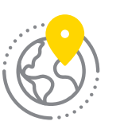
Place
  Focus on places is important as each area has been impacted differently
  Attractive place to live
  Norfolk and Suffolk Unlimited
  Demands of infrastructure have changed
  Net zero infrastructure opportunities
Notes:
The focus on places is important as each area has been impacted differently and will require tailored support. Much of the detailed work to support communities and businesses will be led by Local Authorities, from regeneration of town centres to running support grants, rethinking services and supporting the most vulnerable.
Place will be embedded throughout the intervention in the Restart Plan and the close collaboration with partners across Norfolk and Suffolk will ensure actions in the plan to recognise the different requirements of its towns and urban, coastal and rural areas, connecting pockets of deprivation which exist alongside the largest future opportunities of an area.
Norfolk and Suffolk is an outstanding place to live and do business. 140 miles of coastline, three Areas of Outstanding Natural Beauty – the Norfolk Coast and the Suffolk Coast and Heaths; Dedham Vale/Stour Valley; and the Broads National Park – and a diversity of landscapes, internationally important wildlife reserves and historic sites.
Norfolk & Suffolk Unlimited is a brand for the region’s world-class business offer which will be globally marketed in a bid to attract inward investment.
It promotes the area as a place rich with investment opportunities and positions it as the epicentre of clean energy in the UK and world-leading clusters in the ICT, tech and digital, and agri-food sectors.
Demands of infrastructure have changed:
Digital connectivity is critical given changing working patterns. Good digital connectivity supports inclusive growth and faster speeds support productivity.
Ultrafast connectivity varies considerably across Norfolk & Suffolk: 66% in Ipswich and 85% in Norwich to less than 1% in Breckland, King’s Lynn and West Norfolk, North Norfolk and St Edmundsbury
There have been significant reductions in public transport but an increase in traffic on the roads and although we observed an increase in active travel, this trend has subsided
Transport is the single biggest contributor to the region’s carbon emissions accounting for 39% and of this 98% is from road vehicles. There is an urgent need to encourage greener travel choices once more as well as alternative fuel technologies – both will be needed to support the decarbonisation of transport
Net zero infrastructure opportunities:
The electrification of heat and transport will increase energy use…
We need to think differently with respect to our energy challenges moving forward. How can we supplement traditional methods with local clean energy ones. How do we make these investable opportunities? How do we capitalise on our All-Energy Coast?
How do we support homes to use resources more effectively? Need to consider a whole house approach… heating and transport. How do we resource this challenge?
How do we better use water resources so we can become more self-sustaining and reduce energy?
A selection of methods will be needed to reach net zero in transport – possibly the greatest challenge?
What should be our approach to flood defence?
Other point you may wish to draw on:
Around 65% of the population of Norfolk and Suffolk reside in a community which is neither an urban Centre, or a market town.
Several of our coastal towns and our urban centres contain our most deprived wards, and around 60 of these are in the most deprived decile nationally.
However, recently several of our locations have been cited as among ‘the best place to live’ indexes, with Babergh (8th) and Bury St Edmunds (9th) in the Halifax top 25 ‘Best Places to Live’ index.

Slide 35
Places
Impact achieved
Town Deals £xxxM secured
Launched Norfolk and Suffolk Unlimited
Invest East
Secured £32.1m from Government's Getting Building Fund - funding 13 projects
Better Broadband Programme achieved 97% coverage across Norfolk & Suffolk
The largest free to use public sector LORAWAN deployment in the UK
Current activities to continue / evolve
Full fibre delivery by 2025
Gigabit connectivity planning
Planning for greener travel choices
Alternative Fuel Strategy
Local/community energy
New/retrofit housing
Freeport East
Activities to stop/ reduce
Transport East focus of transport intervention means we can pivot our focus on innovation and clean growth
Notes:
This slide shows examples of the impact achieved through current interventions and highlights activities which should continue or need to evolve and any activity which should stop as they are no longer a priority / supports delivery of our ambitions.
Impact Achieved
Five Town deals – Norwich, Ipswich, Lowestoft, Great Yarmouth and Kings Lynn have secured £XXXm of funding from government to invest in their towns as part of the government's plan to level up regions across the UK.
Establishing a combined team to drive and co-ordinate inward investment and seen a significant increase in interest from FDIs resulting in more live enquires Norfolk and Suffolk have ever seen before.
Secured £32.1m from Government’s Getting Building Fund which will fund 13 projects to help deliver jobs, skills and infrastructure in the wake of the Covid-19 pandemic. Projects include North Walsham Town Centre Revitalisation, Cornhill Redevelopment in Bury St Edmunds and the Great Yarmouth Strategic Seafront projects.
Together, the Getting Building Fund projects will: Create 1,100 new jobs; Safeguard more than 2,900 jobs; Unlock a further £85m of private and public sector investment; Assist more than 500 new learners and deliver more than 1,000 new superfast broadband connections
Phase Two of the Suffolk broadband programme has been completed resulting in superfast broadband coverage approaching 98% of Suffolk premises (businesses and households) with take-up rates over 70% and continuing to rise. They have now moved into Phase 3 which will target the remaining unserved premises with a full fibre (or fibre-to-the-premises (FTTP)) solution offering Gigabit-capable connections in parallel with, and in many cases ahead of, commercial full fibre deployments in urban areas.
The Norfolk and Suffolk Innovation Network is a joint project between Suffolk County Council and Norfolk County Council, funded by the Local Enterprise Partnership (LEP), New Anglia, which delivers dual county connectivity to support large amounts of Internet of Things (IoT) sensors.
Current Activities to Continue
Need to continue to push for investment in digital connectivity and speeds
Need to encourage/promote greener travel choices
Alternative Fuel Strategy being developed with CPCA
Support more local/community energy solutions
Support the housing industry to decarbonise
Delivering the Freeport East ambitions following the successful bid to government, which has a strong focus on supporting the road to net zero, such as the development of a Green Hydrogen Hub.

Slide 36
Places
Activities to restart
Rail improvement planning and project development
Activities to scale up
Regional water planning – co-creation role
Flooding role to be re-defined
Work with networks and partners on feasibility studies and pipeline development for power projects
Gaps and Emerging ideas
How might we re-prioritise our infrastructure thinking moving forward to support clean, inclusive and productive growth?
Notes:
This slide continues from the last slide, highlighting activities to restart, scale up and gaps and emerging ideas to feature in the Renewal Plan
Activities to Restart
Rail improvement planning - following the pandemic there may be a need to review priorities and planning in this sector – with less focus on capacity schemes and more on performance
Activities to Scale Up
WRE are producing a new regional water management plan in the next few years – the Norfolk Water Management Strategy - NCC is involved in developing this.
There is also a big NCC/SCC natural flood management project and other water management initiatives across the 2 counties.
Feasibility for power developments along the Tech Corridor being considered. Other partners looking at power generation projects – work to do to address the barriers to securing projects.

Slide 37
Questions for discussion
What does clean, zero carbon recovery mean to you?
Have we captured the right observations and evidence, have we missed anything obvious? If so, what?
Do you agree with the assessment of the current interventions – What should continue, evolve, scale up and stop? If not what and why?
What new actions and interventions must businesses take to adapt and act on the strategic opportunities? How can the public sector help? – What, how, who and when.
Notes:
This slide out the questions for discussion. Please use the template provide to capture people's comments, views and ideas – completed templates should be returned to Marie.Finbow@newanglia.co.uk.
N.B. If anyone would like to discuss the Renewal Plan with the LEP they can contact Lisa.Roberts@newanglia.co.uk (Head of Strategy) or Marie Finbow@newanglia.co.uk (Strategy Manager).

