Slide 1



Introducing Futures and the National Careers Service
nationalcareers.service.gov.uk
Futuresforyou.com
The-Futures-Group.com

Slide 2

About us

Slide 3
Aim of the Webinar today
The aim of this webinar is to provide information on how the National Careers Service can help you progress in work and learning so that you can reach your potential.
You will learn about how it can help plan your career, review your skills, find the right course, explore careers options, and successfully change jobs.
If you want to progress in your existing employment or you are in insecure employment, the National Careers Service can support you.

Slide 4



The Futures Group
Established by Nottingham City Council and Nottinghamshire County Council in 1995
Publicly-owned not-for-profit social enterprise reflected in our values
Rated as Grade 1 ‘Outstanding’ by Ofsted for our NCS provision

Slide 5
The Futures Group
Deliver the National Careers Service across the East of England and East Midlands
Have ESF funding in both regions to support SMEs, young people and the unemployed
Work covers Careers IAG, Employment Support, AEB, Apprenticeships, Work & Health and Professional Development

Slide 6
National Careers Service Geographical Delivery
East of England
Hertfordshire and Bedfordshire
Cambridge and Peterborough
Norfolk and Suffolk
Essex
East Midlands
Nottinghamshire and Derbyshire
Leicestershire and Northamptonshire
Lincolnshire and Rutland

Slide 7
Feedback from our Redundancy Support
“Your course is a life saver, to be honest being made redundant after 28 years I was truly sick and very depressed. After your course I felt reinvigorated and felt I got my life back most importantly I have a chance of getting work, thank you”
Employee at XMA: July 2020
“May I personally thank your team for the service provided – as stated in the form you were all so personable and professional, responded very quickly to all requests, and the feedback from all those that attended was great” (and they are sometimes hard to please!)
A fantastic offering to companies – especially given that it is free of charge. I would thoroughly recommend you to others”. HR Partner at Hayward Tyler: Aug 2020

Slide 8





What is the National Careers Service?
Information Advice & Guidance
CV and
applications
Careers change &
learning
options
Redundancy and the job
market
Training courses
and
qualifications
Understanding and identifying your skills
Job searching and
Interviews

Slide 9





What can the National Careers Service help me with?
Coping with & moving on from Redundancy
Career progression in the workplace
Help to find work and job searching techniques
Developing self-confidence and motivation
CV review & development
Signposting to other organisations
Understanding your skills and where to improve
Interview skills

Slide 10

Our digital service offer
Explore careers
access over 950 Job Profiles that tell you about the required skills and qualifications in roles, what you’ll do each day, salary, and where the job can lead to in the long-term
Skills Assessment
identify your career skills, motivations, and strengths, matching these to recommended job roles and sectors
Find a course
search for learning and training opportunities in your area and online
Help to get a job
get advice on the different stages of a job hunt, including how to improve your interview technique and write an effective CV

Slide 11

What can you gain from accessing the service?
Most of our customers progress by moving into learning, training, work, volunteering, or by developing personally by building knowledge, confidence and motivation.
Your adviser will check in with you at regular intervals to help you stay motivated
You’ll be asked for your feedback to help us improve the service

Slide 12
Where should I be looking for employment?
Any other ideas?
Newspapers and magazines
Websites and online forums
Recruitment agencies
Word of mouth, friends and family
Social media & smartphone
apps

Slide 13
Labour Market Information
Which Sectors are recruiting?
Distribution, Warehousing & Storage
Health and Social Care
Finance & Business
IT & Technology
Construction
Local and National Government
Education & Training

Slide 14
Learning opportunities
Apprenticeships and Traineeships
HE and FE
Informal learning including online
Adult and Family Learning
Trade Union Learn
DWP Rapid Response
Skills Support for Redundancy

Slide 15

Our response to
COVID-19
We are responding to the individual needs of employers and organisations, including those in furlough/redundancy/recruitment situations
You can access the Service via telephone and digital options
We will consider your circumstances and needs to find the most appropriate way to support you

Slide 16
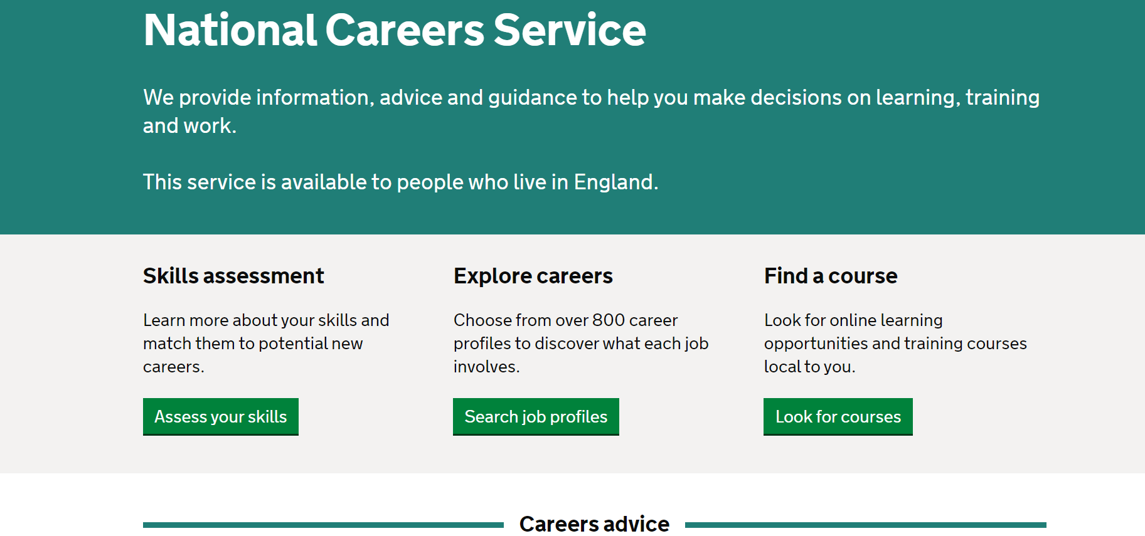
National careers service website
https://nationalcareers.service.gov.uk

Slide 17

Notes:
LiveSlide
https://nationalcareers.service.gov.uk

Slide 18

Your questions
Thank you
Contact: 0800 9179419

