Slide 1
@NewAngliaLEP
Strategic Priorities 2021/22
Presentation to New Anglia LEP Board
27 January 2021
Chris Starkie, chief executive officer
Notes:
The purpose of this presentation to propose the LEP’s strategic areas of focus for the year for consideration and sign off.
As last year – these high-level aims will then be used to develop the LEP’s corporate delivery plan for the year and the LEP budget.
These will be brought for discussion and sign off at subsequent boards.
As you would expect the objectives will also feed into plans for individual LEP teams.
I’m going to start with a few reflections on high and low points from the last year, before considering the issues and challenges facing us this year.
Then I will outline my areas of focus for the coming year.
1

Slide 2
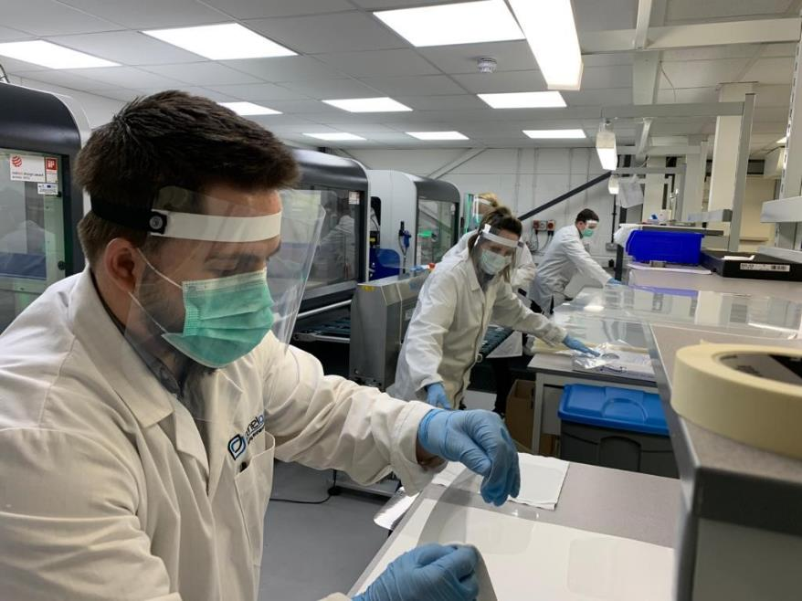
@NewAngliaLEP
Last year in review
Notes:
The past 12 months have been extraordinarily challenging for everyone – the LEP included.
When I gave this presentation this time last year, we were aware the pandemic was breaking out in China and would reach our shores.
But it is probably fair to say its impact on the health and economy of the UK has been more profound and long lasting than anyone had imagined.
Last January much of our attention was on Brexit and whilst that has had a significant impact and been an important part of our work - it has been nothing compared with the pandemic.
So our work and achievements during 2020 must be seen in the context of the worst economic crisis in peacetime.
What did we do:
You, the board, agreed that we would do whatever we could to support businesses through the pandemic, working closely with local authority, business and education partners.
Our aim was to deliver additional activity to support businesses whilst continuing to operate our full suite of programmes and activities.

Slide 3
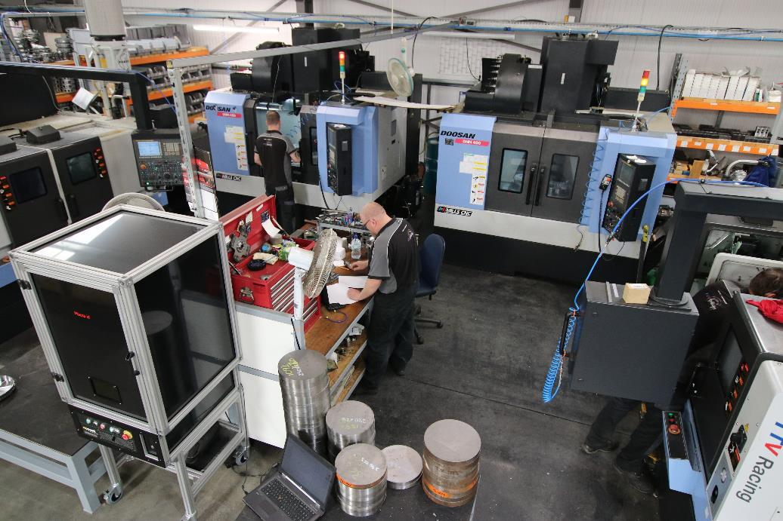
@NewAngliaLEP
The LEP’s response to the pandemic
Notes:
At a strategic level, members of the LEP executive joined and contributed to the work of the Local Resilience Forums in both Norfolk and Suffolk.
That work continues today.
What that means is that the needs of businesses and the importance of the economy has been at the heart of the Covid response in both counties, and we have supported that response.
We’ve done this in a number of ways. Here are 10 examples where we have gone above and beyond our normal activity:
1 Through the development of a PPE supplier platform to enable care homes and other essential users access local and national sources of PPE when stocks were low at the start of the crisis.
2 By supporting a number of local businesses to develop their capabilities to manufacture PPE locally including gowns and masks.
3 Through the development of a jobs platform to help companies and organisations in sectors like care and food processing fill vacancies and provide support to those losing their jobs.
4 By investing more than £4.3m to date in 113 companies to help them become more resilient and take advantage of opportunities through our Reslience & Recovery Scheme.
5 Providing financial assistance to another 132 businesses through our Visitor Economy Grants and Wider Economy Grants.
(Pics show Dance East and TTV Industrial, both recipients of Business Resilience and Recovery Scheme grants)

Slide 4
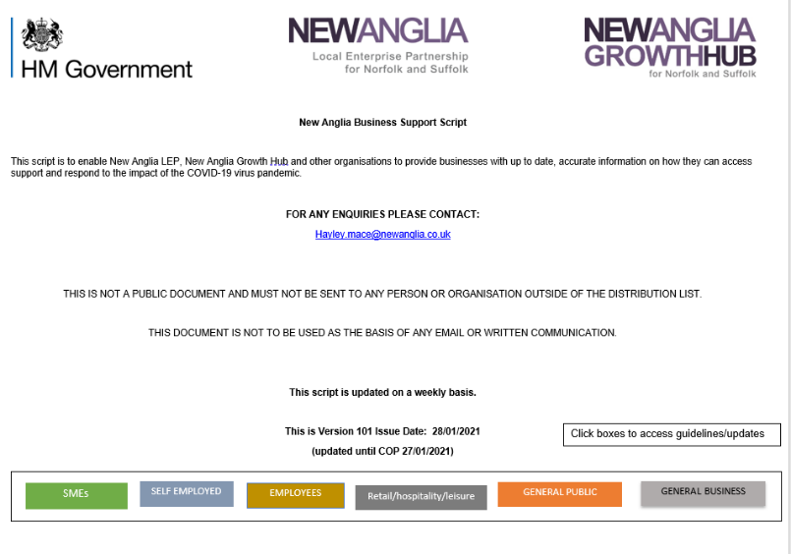
@NewAngliaLEP
The LEP’s response to the pandemic
Notes:
6 Working with Public Health colleagues we have brought together our food processing businesses to provide public health advice on preventing outbreaks and staffing testing.
7 Provided advice to thousands of businesses through the Growth Hub, giving help accessing financial support and other measures to help firms through the pandemic.
8 Developed a business support script with all the latest Government support and advice as well as local provision which is circulated to local authority economic development teams as well as the Growth Hub, the chambers of commerce and the FSB. We have just published the 100th version of this script.
9 Secured funding from Government to provide 205 of laptops to young people seeking employment or participating in apprenticeships.
10 Worked with local authority, business and education partners to develop, in just two months, the Norfolk and Suffolk Economic Recovery Restart Plan.

Slide 5
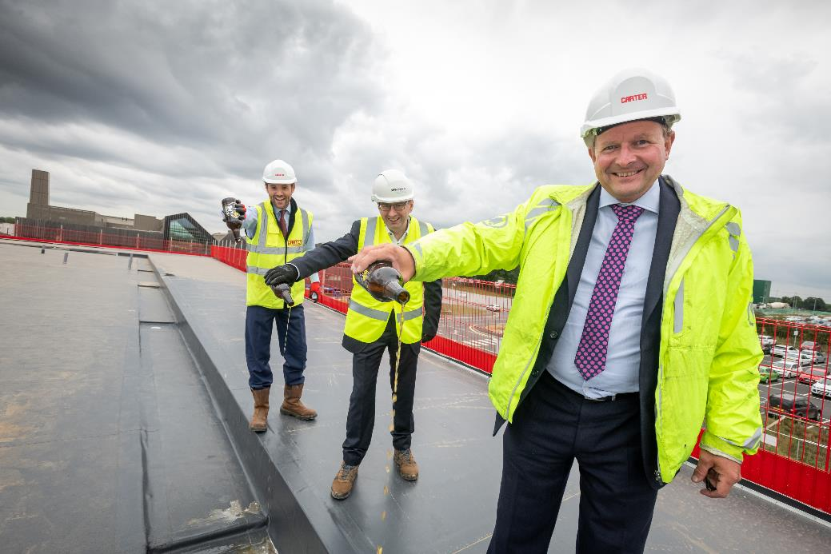
@NewAngliaLEP
We also maintained business as usual
Notes:
We also maintained business as usual
Delivering the final year of our Growth Deal
Successfully bid for £32.1m from the Getting Building Fund
Continued development of our 16 Enterprise Zone sites
Further roll out of our Enterprise Adviser Network
Launch of our three Industry Councils to support local Industrial Strategy, our Innovation Board and our Skills Advisory Panel
Launch of our new inward investment service with Norfolk and Suffolk colleagues and our first two major successes
Continued delivery of our business grant programmes – Growing Business Fund, Small Grants Scheme, Growth Through Innovation and Agri-tech.
Support for five town deals including participation in their boards
Support for partner projects including Cambridge Norwich Tech Corridor
(Pics show the Burtons Building, Ipswich, one of the Getting Building Fund projects and the topping out ceremony at the new Norwich Research Park laboratory complex funded through our Growth Deal).

Slide 6
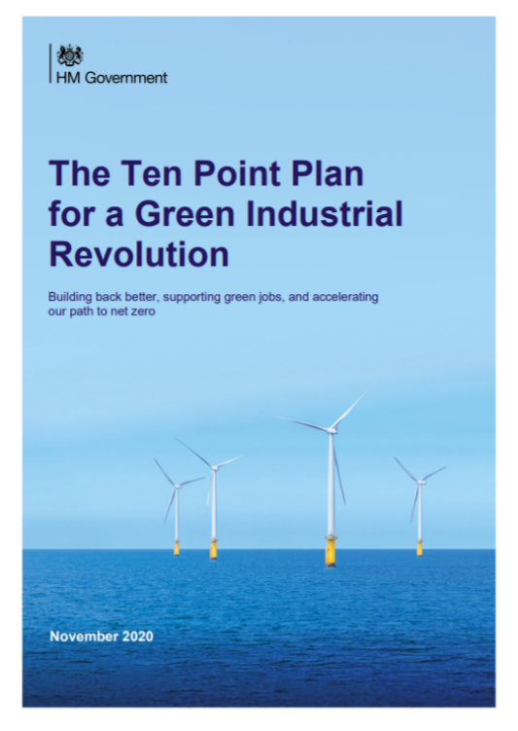
@NewAngliaLEP
External drivers and issues
Notes:
In setting our key priorities for the year we need to consider the main external drivers and issues which will impact on our economy.
The overriding threat is clearly the pandemic. This will clearly be with us for a while and the economic consequences far longer.
The end of the EU transition period and the new trade arrangements with Europe present challenges to our economy in the short term but also some medium-term opportunities.
The Government’s plans for a green industrial revolution are also relevant, with the COP 26 summit in November ensuring that this will be a visible priority.
At the same time continuing themes of inclusive growth, digitisation and productivity remain important for us locally.
Another key thing to consider is the Government funding landscape for LEPs and local growth. A number of our funding streams come to an end over the next year – so we will need to consider the impact of this.

Slide 7
@NewAngliaLEP
Priority One – Covid-19 response and recovery
Notes:
Priority One – Covid-19 response and recovery
We will build on our role as the strategic coordinator of the economic response to the pandemic and deliver a range of interventions to support businesses weather and recover from the pandemic.
We will also follow up the Economic Recovery Restart plan with the publication of the Economy Recovery Renewal plan.
Key interventions will include:
Continuation of the Business Resilience and Recovery Fund
Further development of the LEP Jobs Support Programme
Provision of tailored support through the Growth Hub to help businesses weather and then recover from the pandemic.
Work with public health colleagues to support roll out of C-19 testing to businesses.
Development of the Economic Recovery Rebuild Plan as the economic blueprint for the region – following on from the Restart Plan.

Slide 8
@NewAngliaLEP
Priority Two – Norfolk and Suffolk : The Clean Growth Region
Notes:
Priority Two - Norfolk and Suffolk - the Clean Growth region
We will work with partners to take forward the aims and aspirations of the Norfolk and Suffolk Local Industrial Strategy to position Norfolk and Suffolk as the clean growth region.
This will include:
Establishing the LEP’s Clean Growth Taskforce
Working with the LEP’s three Industry Councils to develop plans to lead decarbonisation in their sectors.
Securing funding for and delivering the Food Innovation Centre on the Food Enterprise Park in Norfolk
Publication of the energy sector recovery plan with actions to support offshore wind, nuclear new build, hydrogen and other renewables.
Leading and facilitating the development of the Decarbonisation Academy

Slide 9
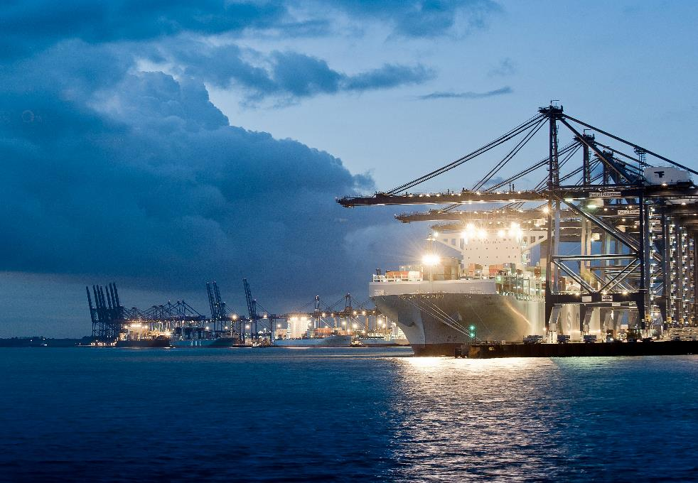
@NewAngliaLEP
Priority Three – International profile and trade
Notes:
Priority Three – International profile and trade
We will help businesses handle the changes brought by the new trade deal with the EU, promote Norfolk and Suffolk on a global stage and take advantage of new global trading opportunities.
This will include:
Supporting a bid for Freeport East – a freeport for Felixstowe and Harwich.
Utilising Norfolk and Suffolk Unlimited brand to target inward investment priorities focused on clean growth, ICT digital and energy.
Developing a promotional campaign under Norfolk and Suffolk Unlimited to attract talent to the area.
Utilising the Growth Hub to help businesses handle challenges from the new trading rules with Europe.
Identifying opportunities for onshoring of supply chains disrupted by EU exit.

Slide 10
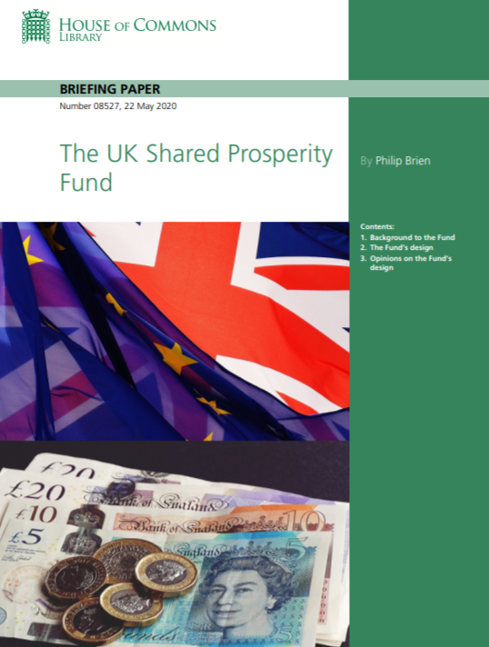
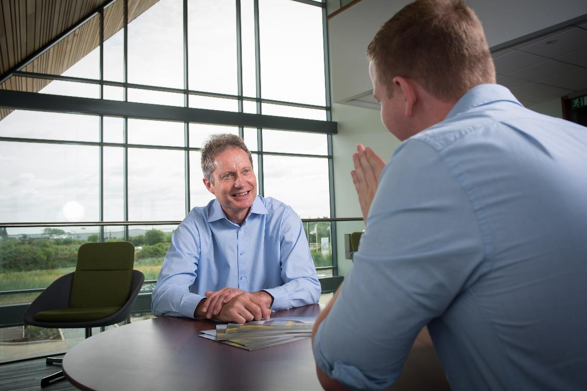
@NewAngliaLEP
Priority Four – Strengthening the LEP
Notes:
Priority Four – Strengthening the LEP
A number of the LEP’s key funding programmes are coming to end over the next 12 months. The LEP will therefore need to work with Government and other partners to secure the funding needed to deliver its ambitions.
This will include:
Securing a funding extension until 2023 for the Growth Hub and wider Growth Programme.
Securing a continuation of core funding for LEPs from the Government from the 22/23 financial year.
Working with fellow LEPs to secure a role for LEPs in the Government’s new UK Shared Prosperity Fund and Levelling Up funds.
Maximising the income opportunities from the LEP’s Enterprise Zones and other existing funding streams as well as being flexible with the use of Government funds.
Strengthening the LEP’s in-house bidding capabilities to take advantage of funding opportunities which can deliver the LEP’s objectives.

Slide 11
@NewAngliaLEP
Underpinning themes
Inclusive growth Innovation Digitisation Skills
Notes:
Whilst our clear focus for the coming year is on the pandemic response and recovery, clean growth and international profile and trade – our plans will also take into account two themes central to our Local Industrial Strategy – inclusive growth and innovation.
The pandemic has also shown the importance of the digital economy – so a third underpinning theme will be digitisation.
At the same time our future success is dependent on improving the skills of our young people and existing workforce so the work of our Skills Advisory Panel will continue to be important.
We will have a number of programmes clearly identified with these themes – but we are also going to ensure that all of our activity is considered in the light of these themes.

Slide 12
@NewAngliaLEP
Strategic objectives
Covid-19 response and recovery
Norfolk and Suffolk – the clean growth region
International profile and trade
Strengthening the LEP
Underpinned by inclusive growth, skills, innovation and digitisation

