Slide 1
@NewAngliaLEP
Name
Title
New Anglia Local Enterprise Partnership
The details/impacts of the UK’s new relationship with the EU following the end of the transition period
Notes:
1

Slide 2
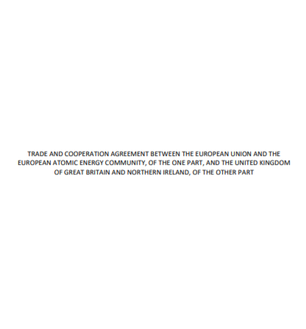
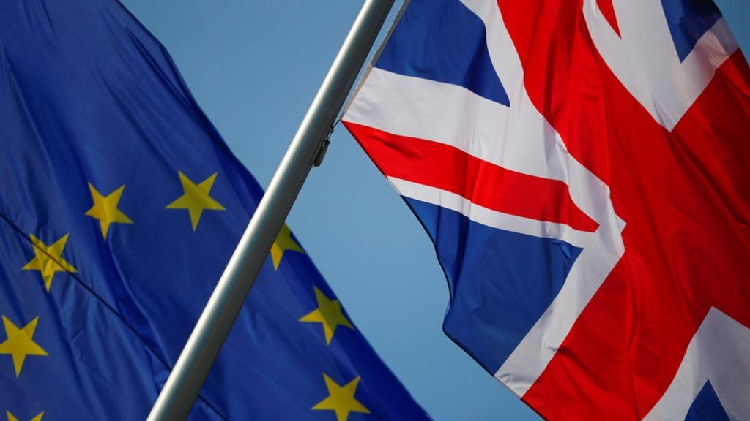
UK-EU Deal Reached
@NewAngliaLEP
Notes:
Deal reached on 24th December and signed off on 30th December ahead of the end of the transition period on 31st December.
This Trade and Cooperation Agreement is accompanied by a series of political declarations and agreements over nuclear and security cooperation.
A Partnership Council will supervise the operation of the Agreement at a political level, providing strategic direction.
The TCA will be reviewed every five years and can be terminated with 12 month’s notice by either side. Quicker if on human rights or rule of law grounds.
Further deals and decisions are likely to be secured in the coming months and years on a range of key issues e.g. services, data adequacy and financial services equivalence.
There will be no role in the UK for the ECJ – disputes will be referred to independent tribunal.

Slide 3
Content of the deal
@NewAngliaLEP
Notes:
Goods: there are no tariffs or quotas on goods traded between the UK and EU. This is accompanied by new customs procedures and formalities including new ‘rules of origin’ requirements which are needed in order to qualify for zero tariffs.
On goods, bespoke provisions were agreed to facilitate the 45% of goods trade that flow through ‘ro-ro’ ports.
Specific annexes were also agreed to reduce the non-tariff barriers for medical products, automotive, chemical products, organic products, and wine.
Services: businesses offering services, such as banking, architecture, and accounting, will lose their automatic right of access to EU markets and will face some restrictions. Rather than following one set of rules for the whole of the EU, UK businesses will need to comply with the regulations in each individual country.
There will no longer be automatic recognition of professional qualifications for people such as doctors, chefs, and architects. It will be harder for people with qualifications gained in the UK to sell their services in the EU. Individuals will need to check each country's rules to make sure their qualification is still recognised.
However, the UK and EU have pledged to keep talking to try to improve access for the service sector in the future.
EU programmes: the UK will continue to have access to various EU programmes, including: the €100bn research and development programme Horizon Europe; the Euratom Research and Training Programme; the fusion test facility ITER; the earth observation programme Copernicus; and access to the EU’s Satellite Surveillance & Tracking (SST) services. The UK will no longer have access to the Erasmus+ student programme (replaced by Turing Scheme – which begins in September 2021). Additionally, the UK must also find a way to replace access to the Galileo satellite system’s encrypted military data.
Data: a temporary arrangement has been put in place to allow data to continue being transferred from the EU to the UK from 1 January. This will initially last for four months (extendable to six months) while the European Commission undertakes to make its adequacy decision.
An adequacy decision is in the best interest of both sides as well as businesses and individuals in the UK and EU. However, if an adequacy decision is not granted by the end of the six month additional bridge period, the UK and EU will exchange data based on their individual international transfers rules. At the moment as both the UK and EU have similar rules based on the GDPR there are clearly defined processes for transferring data requiring the use of appropriate safeguards, such as standard contractual clauses (SCCs) or Binding Corporate Rules (BCRs).
Security: a new security partnership provides for data sharing and policing and judicial co-operation, but with reduced access to EU databases. A new surrender agreement takes the place of the European Arrest Warrant. Cooperation can be suspended by either side swiftly in the case of the UK or a Member State no longer adhering to the European Convention of Human Rights.
Environment and Climate Change: In the trade deal, both sides committed not to undermine green standards and to make efforts to increase environmental protection while promoting sustainable trade. It also allows for each side to set its own policies on things like air quality, emissions, and biodiversity conservation without undercutting each other's standards. The mechanism to enforce this is a consultation between the parties and recommendations by a panel of experts.
State Aid: The deal ends the EU State Aid regime and allows UK to introduce its own system for state aid.
Companies in the EU will be able to challenge state aid awarded to UK rivals in the UK’s national courts if they feel it violates common principles set out in the trade deal. British companies will enjoy equivalent rights in the EU.
The UK agreed to set up an independent state-aid authority, although the deal does not require the UK to have an “ex ante” regime that will vet subsidies before they are granted. Either side would also be able to unilaterally impose tariffs to counter the effect of trade-distorting subsidies, although the other party could then call for accelerated arbitration.
Other:
There will be no role in the UK for the European Court of Justice – disputes will be referred to an independent tribunal.
Continues to allow access for respective businesses to bid for each other’s government procurement contracts.

Slide 4
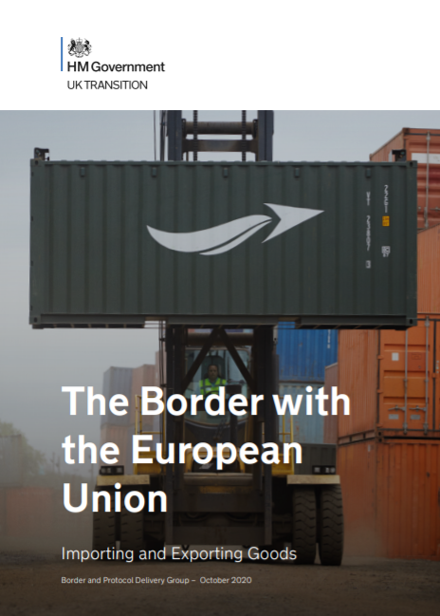
Border Operating Model
@NewAngliaLEP
Notes:
The new border controls are phased in three stages up until 1 July 2021.
From 1 January 2021, the UK will operate a full, external border as a sovereign nation. Full controls are in place for exports. Full controls are in place for staged imports of controlled goods. Optional deferred declarations are in place for imports of standard goods. From 1 April 2021, full controls are in place for animals and products of animal origin; plants and plant products. From 1 July 2021, full controls are in place for all goods.
The new trade deal’s rules of origin chapter is expected to hamper some existing goods supply chains and has sparked concerns from UK and EU trade associations. By imposing high tariffs on products shipped to the UK to be sold on in the EU, it may well end the UK’s role as a distribution hub in the EU.
The mutual recognition of authorised economic operator schemes should mean trusted traders face less friction when moving goods between the UK and EU.
Businesses need to take a range of actions, but to get started they should:
Make sure they have an EORI number starting with GB.
Consider using a customs intermediary to make declarations.
Check if goods need an import or export license e.g. for chemicals or food and apply for what is needed.
Make sure they understand VAT responsibilities.
Consider if they want to make use of deferred declarations if they import goods.
Fully understand the ‘rules of origin’ principles.
May want to use the free Trader Support Service to guide them with the way goods move between GB and NI.

Slide 5
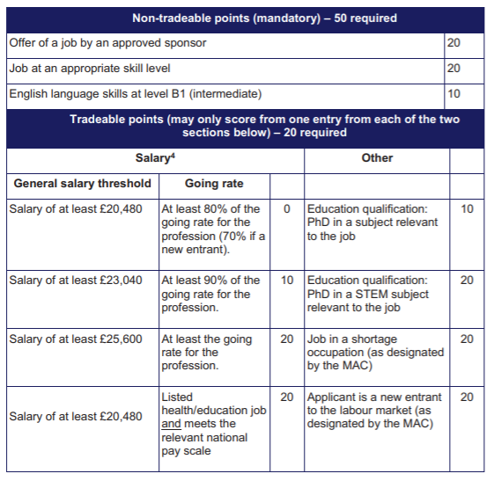
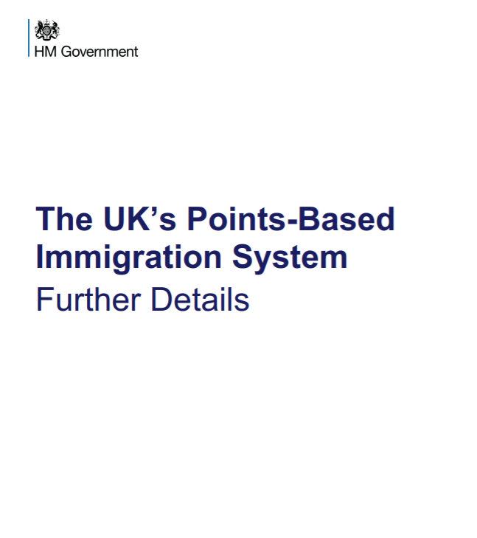
Immigration System
@NewAngliaLEP
Notes:
From 1 January 2021, EU citizens are treated the same as those from the rest of the world through the introduction of the new points-based immigration system.
How does the scheme work: meeting the mandatory criteria will earn the applicant 50 points (the offer of a job by an approved sponsor (20pts); job at an appropriate skills level (20pts); and English language skills at level B1 (10pts).
They must obtain a further 20 “tradeable” points through a combination of points for their salary, a job in a shortage occupation or a relevant PhD.
Sponsorship: a sponsorship requirement will apply to the Skilled Worker route, to the Health and Care Visa and to the student route, as well as to some specialised worker routes. This applies to both EU and non-EU citizens who come on these routes. Although specific requirements vary by route, for most work routes, sponsors must undergo checks to demonstrate they are a genuine business, are solvent, and that the roles they wish to recruit into are credible and meet the salary and skills requirements. The costs for employers sponsoring EEA nationals (from overseas) will significantly increase from January 2021. Employers with experience in sponsoring non-EEA workers are already familiar with the fee levels, however they may come as a surprise to those employers who have not previously had to pay them.
Sectors: There is a fast-track entry system for doctors, nurses, and other healthcare professionals. Most care workers will not be covered by the scheme though. Those eligible for this visa will pay reduced fees and be supported through the application process.
Sectors such as social care and construction could face increasing skills shortages as a result of the coming changes. Other exposed sectors include food manufacturing, accommodation, hospitality and manufacturing.
The technology sector, which brings in numbers of highly qualified, well-paid staff from India, the US, and other non-EEA countries, is one of the most obvious beneficiaries. Other sectors include financial services, insurance and research and development.
Seasonal Workers Scheme: expanded to 30,000 workers in 2021. Government will seek to build on the Pick for Britain campaign and retain more domestic seasonal workers. Farmers are still concerned about staff shortages this year. A big question mark hangs over the scheme’s future, with the agriculture industry pushing for the pilot to be made permanent.
EU Settlement Scheme: EEA citizens and their families already living in the UK by 31 December 2020, are not required to go through the new system. Instead, they can apply to the EU Settlement Scheme, and have until 30 June 2021, to do so. If the applicants are successful, they will be able to remain in the United Kingdom and claim benefits similar to UK citizens, if they become unemployed. Irish citizens do not need to apply under the EU Settlement scheme and will not require permission to come to the United Kingdom, as the UK and Ireland are both part of a common travel area.
UK citizens working in the EU: From 1 January 2021, UK citizens will no longer have an automatic right to live or work in the EU, so if they are looking to do this, they will need to check an individual country's immigration rules. If they have any professional qualifications in the UK, they will also want to check whether they are recognised where they plan to work.
Work visas may be required for work travel, although in most cases it will be possible to undertake some business related activities – such as business meetings – without a work visa. The rules around what activities will be permitted on short term business trips and visa requirements vary between member states, with country-by-country guidance available from the government. The deal limits these short term business trips to 90 days in any 180 day period (although how this time period is calculated varies between member states). Might be able to apply for an EU Blue Card, which gives highly qualified workers from outside the EU the right to live and work in an EU country.

Slide 6
How the deal affects sectors
@NewAngliaLEP
Notes:
Agri-Food: Successfully maintained access for meat, dairy and organic products, all of which are vitally important to farm businesses in the region. For example, 70% of poultry meat exports go to the EU, a trade worth £192m in 2019. Last year, almost 90% of our barley exports, worth £230m, went to the EU. In all, the EU market for UK agri-food exports is worth £14.5bn.
However, not all agri-food products have been included in the terms of the deal, such as seed potatoes.
The EU will immediately implement tough new checks on agri-food products, with no grace period.
There will also be restrictions on exports of some animal products, including fresh pork mince and sausages.
Defra has listed a long list of guidance on its website on changes to country of origin labels, EU health and identification marks, organic logos and much more. For example, food from GB must not be labelled as ‘origin EU’.
While food and farming businesses welcomed the deal, they warned that leaving the customs union and single market would still disrupt the food supply chain with new requirements, paperwork, checks, restrictions, increased costs, complexities, and potential delays at ports. This trade friction is could squeeze the already tight margins within the supply chain. AHDB analysis estimates these costs range from 5% to 8% for livestock products and 2% to 5% for crops, with farmers likely to ‘bear the brunt of these additional costs’. These estimates do not include the cost of potential delays at port, which may result in a further loss of value of perishable loads.
Energy: The energy provisions support and strengthen the UK and the EU’s respective energy and climate ambitions. This includes the way in which the parties trade electricity and gas over interconnectors, work together on security of supply, integrate renewables into our respective markets and cooperate to develop opportunities in the North Sea.
The energy chapter expires on 30 June 2026, unless both the EU and the UK agree to extend the arrangement on an annual basis. So while the 2020 agreement negotiations may be over, the ones for 2026 are just beginning.
The UK is now out of the EU’s internal energy market, which means it no longer has access to day-ahead or intraday trading tools that make the exchanges quicker and cheaper. Consumers will face power bills that are expected to be 2 to 5 percent more expensive, while energy traders will need to deal with new paperwork for each exchange made.
The UK is also out of the European Network of Transmission System Operators for Electricity and Gas (ENTSO-E and ENTSO-G) — the main venue in which transmission systems operators interact — and the European Union Agency for the Cooperation of Energy Regulators (ACER), which oversees the EU’s energy and gas markets. This ultimately leaves consumers exposed to measures on power trading set in rooms from which the UK is not present. The UK is expected to try to get back in and have an arrangement similar to the one the Swiss and Norwegians have with both organizations.
The UK has also left the EU’s Emissions Trading System. The UK has created a domestic version, but linking the systems is supported on both sides of the Channel in order to beef up the mechanism used to crack down on greenhouse gas emissions.
The Agreement commits both Parties to develop and implement new, efficient trading arrangements by April 2022. These will ensure that capacity on the interconnectors is maximised and that there is implicit trading in how this capacity is allocated (i.e. capacity and electricity are sold together). This will help integrate renewables and other clean technologies onto the grid in line with domestic commitments to net zero emissions. Whilst this system is being implemented, alternative trading arrangements will be in place for electricity. We have also agreed arrangements that will ensure we continue to trade gas efficiently via the PRISMA platform.
The UK and EU have agreed to enhance cooperation on renewable energy, including in the North Sea. This will facilitate the development of hybrid projects that combine interconnectors and offshore windfarms and opens up the potential for a North Sea grid.
Separate to the TCA, the UK and Euratom signed a Nuclear Cooperation Agreement which gives a legal underpinning to civil nuclear cooperation, including safeguards, safety, and security.
The Agreement provides for a new set of arrangements for extensive technical cooperation between the respective regulators and system operators, particularly with regard to security of supply, market abuse and network development.
The Agreement supports trade and investment in energy goods and raw materials between the UK and EU. These will help facilitate open and competitive markets, removing unnecessary barriers to trade.
ICT/Digital: These provisions will promote trade in digital services and facilitate new forms of trade in goods and services. The Agreement ensures cooperation on digital trade issues in future, including emerging technologies. The provision helps to facilitate the cross-border flow of data by prohibiting requirements to store or process data in a certain location.
The Agreement includes commitments including zero custom duties on electronic transmissions; keeping source code safe; online consumer protection; and anti-spam provisions giving consumers strong protections when buying from businesses in either the UK or the EU.
The Agreement provides a legal framework for common e-signature and trust services.
It is vital for the sector, and many others, that the Commission reaches a data adequacy decision for the UK. It is positive that the temporary arrangement has been put in place to allow data to continue being transferred from the EU to the UK from 1 January for 4-6 months until a decision is made.
Financial Services: Not covered comprehensively in the full trade agreement. Both sides have committed to setting out a “framework” for regulatory cooperation in financial services by March 2021 and will discuss the equivalence decisions which the EU has yet to make. The cooperation agreement is not expected to be legally binding or open up free trade in financial services, but merely to provide a framework for future discussion between rule makers.
The focus for financial services firms now will be on what can be achieved through trade deals and regulatory cooperation with key financial services hubs across the world. For many financial services firms - which operate digitally and employ significant numbers of people - the agreements on data and migration will be as important as the detail of the agreements on financial services itself.
The EU found the UK equivalent on a time-limited basis in two areas: clearing and transaction settlement, while the UK gave the EU some 17 findings that enable EU firms to do business in the UK more easily. Ahead of even considering further findings, the EU has said it wants “clarifications” on the UK’s plans to change its regulations. Meanwhile, the UK is at the very beginning of this process, meaning that any decisions on either side are at least months away.
A lack of equivalence decisions would increase the cost of doing business for financial services firms and the clients they serve. This would impact market efficiencies and the global competitiveness of financial services businesses operating both in the EU and the UK.
The financial sector has already implemented plans to continue working with EU clients without equivalence findings, by gaining regulatory licenses in EU jurisdictions and moving certain operating functions there. Some 7,000 jobs have shifted from the UK to the EU in support of these arrangements, according to the Bank of England.
For the time being, financial firms have to carry on with business as best they can. With the EU yet to recognise the UK’s market rules, EU traders have been forced to shift some London trading of continental and Irish stocks onto exchanges in the bloc. It remains to be seen if that is a permanent move, or if some investment houses — always on the hunt for the best prices and easiest trading — find a workaround.
Manufacturing: The UK manufacturing sector welcomed the fact tariffs had been avoided that risked wiping out profits in the sector but warned that companies still faced border delays and the loss of mutual conformity assessment.
This could mean two lots of certification and testing to meet both EU and UK standards, according to Make UK. This would add significant complexity and cost, for a sector that operates on fine margins.
A so-called ‘trusted trader scheme’ — where qualified companies could speed through customs — was also welcomed, although companies said they would need to see details, given the costs of participating in the system.
Far fewer companies in the UK have this “authorised economic operator” status than in Europe, given the costs, which means that it may end up benefiting larger groups with in-house experts over smaller operators.
The lack of recognition of professional qualifications has been cited as challenging news for manufacturers wanting to send engineers to the EU.
Six year phase-in on rules of origin for electric cars is positive for electric car industry.
The Trade agreement delivers on duty and quota free trade, only so long as exports meet stringent local content requirements. The lack of inclusion of allowing imported non-EU parts to count towards the agreement’s rules of origin thresholds, which determine whether a product can be traded tariff-free or not, will provide complications for UK business and could quickly lead to punitive tariffs being placed on UK business.
According to Make UK the TCA has done nothing to resolve the significant paperwork filling that businesses will have to get used to – an estimated up to 400 million new forms. The cost to business from this will be significant and even after all systems have bedded in and the queues at our ports have normalised, we would still expect each delivery to take longer than it did before this deal. In today’s optimised supply chains, this could impact operations in the UK in the longer term and will impact integrated supply chains.
Having dual bodies now in the UK and the EU to certify products containing chemicals. It will create significantly more cost and increased bureaucracy, without any obvious advantage.
Health and Social Care: While the deal includes an agreement on mutual recognition of good manufacturing practice inspections, that is as far it goes. The UK has separately agreed to accept batch testing of medicines done in the EU, but the EU has not done the same. Companies have prepared for this by ensuring that all batch testing can take place in the EU, but there are concerns about the capacity for this and whether everyone will be ready.
More broadly, the UK’s Medicines and Healthcare products Regulatory Agency (MHRA) is now responsible for medicines approvals, but it is unclear what relationship, if any, the MHRA will have with the European Medicines Agency.
There is also concern about a possible increase in shortages of medicines as hauliers prefer longer alternatives to the Dover-Calais route to avoid customs delays. We are unlikely to know for certain for a month or so whether this shifting will lead to an increase in medicine shortages according to experts.
The effect of new immigration laws are also expected to impact the health and social care sectors, both of which have significant numbers of EU nationals in their ranks. There is a specific health-worker visa already in place that requires a minimum salary of £20,480 per year. However, care workers are not included in the scheme and the sector, which has been significantly hit by the Covid-19 pandemic, may face difficulties recruiting sufficient staff from within the UK.
Logistics: For UK hauliers the deal contained mixed blessings. The two sides recognised the validity of each other’s licences and permits and included full transit rights, allowing drivers to cross multiple countries in order to drop a load. This will enable Irish lorries to use the UK as a “landbridge” to deliver goods into the EU.
However, the agreement limits UK hauliers to a single drop-off and a single pick-up from inside an EU member state and two pick-ups and drop-offs when crossing EU member states - this is a downgrade from EU membership, under which drivers could do three pick-ups inside an EU country before returning home.
Bus and coach companies can continue to operate to, from and through the EU.
Aviation: The deal allows flying rights between the EU and UK to continue, but UK carriers will not be able to fly between two points within the EU. This was expected, and airlines on both sides have set up foreign subsidiaries to continue current routes.
Creative Industries: Disappointments for the sector include confirmation the UK will not be part of Erasmus+ scheme and there will be no more automatic recognition of professional qualifications (e.g. architecture).
Vital for the sector that key arrangements such as data adequacy and the ease of movement (e.g. touring) are found moving forward. There are fears the clauses (90 in 180 days) will severely curtail the ability of performers to go on tour in Europe and will hamper the recovery of the arts after the devastating impact of the pandemic. This would affect tens of thousands of people in the UK’s creative industries, including film-makers, technicians, and models as well as performers.
Commitments to protect intellectual property rights to a very high level.
Fisheries: EU fishing fleets will have a five and a half-year transition period with guaranteed access to UK water – including the 6 to 12 mile zone from the UK coast. After that, access will depend on annual negotiations.
During the transition, EU fishing rights in UK waters — currently worth about €650m per year — will be reduced by one quarter, with British quotas increased by a corresponding amount. The shift will boost UK boats’ current share of fishing rights in British waters from about a half to two-thirds.
After the transition, access to waters will depend on annual negotiations, such as those the EU already has with Norway. But the EU will have some leverage: should the UK revoke access, it will be able to take compensatory measures, including hitting UK fish exports with tariffs, and even shutting the UK out of its energy market.

Slide 7
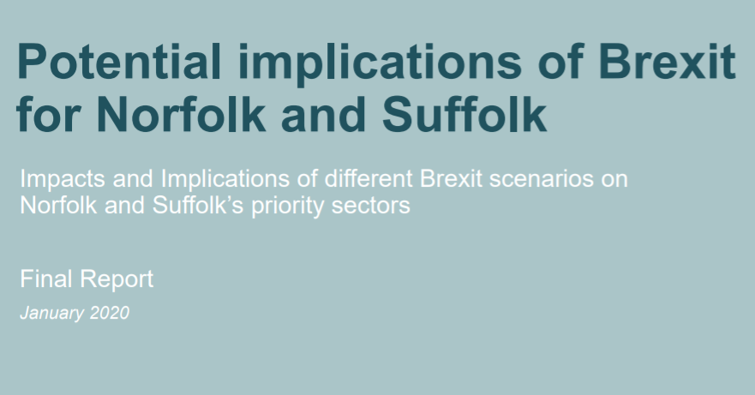
Potential Economic Impact
@NewAngliaLEP
 | Deal Agreed | No Deal Exit
National GDP in 2030 | Average reduction of 3.5% | Average reduction of 5-6%
Norfolk and Suffolk GDP in 2030 | Average reduction of 4% | Average reduction of 6%
National Income per Capita | Average reduction of 2.5% p.a. | Average reduction of 3.3% p.a.
Workforce / Free Movement | End of free movement within the EU Areas with relatively low skilled workforces are likely to face disruptions while adjusting to the Withdrawal Agreement’s effects due to the requirement to retrain and reskill workers. Workers in high-skilled occupations are less likely to be affected. | End of free movement within the EU Significant decline in EU migration; a possible rise in non-EU migration. Overall net migration expected to decline. Short-term UK-EU migration flows are likely to be very low, squeezing business’ access to labour
Value of Sterling (Trade) | Expected devaluation of the Pound will make UK exports more competitive but make imports more expensive, which will affect trade flows | Expected devaluation of the Pound will make UK exports more competitive but make imports more expensive, which will affect trade flows
*This analysis was published in January 2020 and does not take into account the impact of the Covid-19 pandemic.
Notes:
Back in January 2020 Metro Dynamics’ produced a report on the Potential Implications of Brexit for Norfolk and Suffolk which was presented to the LEP Board. This focused around the potential impact on the key areas of trade, regulation, workforce and funding and investment based on two scenarios – deal or no deal.
The prediction was that if a deal were secured, Norfolk and Suffolk’s GDP would face an average reduction of 4% by 2030 and the UK an average reduction of 3.5%. We believe that this impact upon the economy is still likely to remain true.
We could see in the coming months and years a varied impact across sectors and even sub-sectors as the realities of the new trading relationship and state aid rules come to fruition.
At this current moment in time, it is very difficult to say what the combined impact will be of the Brexit deal and the Covid-19 pandemic. We are currently in a national lockdown for the majority of Q1 2021 with uncertainty beyond. A great deal does rest on the vaccine and vaccination programme.
Intelligence suggests that we are likely to see redundancies and insolvencies coming through as a result towards the end of Q1.
Tourism, Leisure and Hospitality – the evidence does not suggest that these sectors will be adversely affected by the Brexit deal, but we are cognisant of the fact that Covid-19 has had a detrimental impact on these sectors and continues to see a great deal of uncertainty through the rest of 2021.

Slide 8
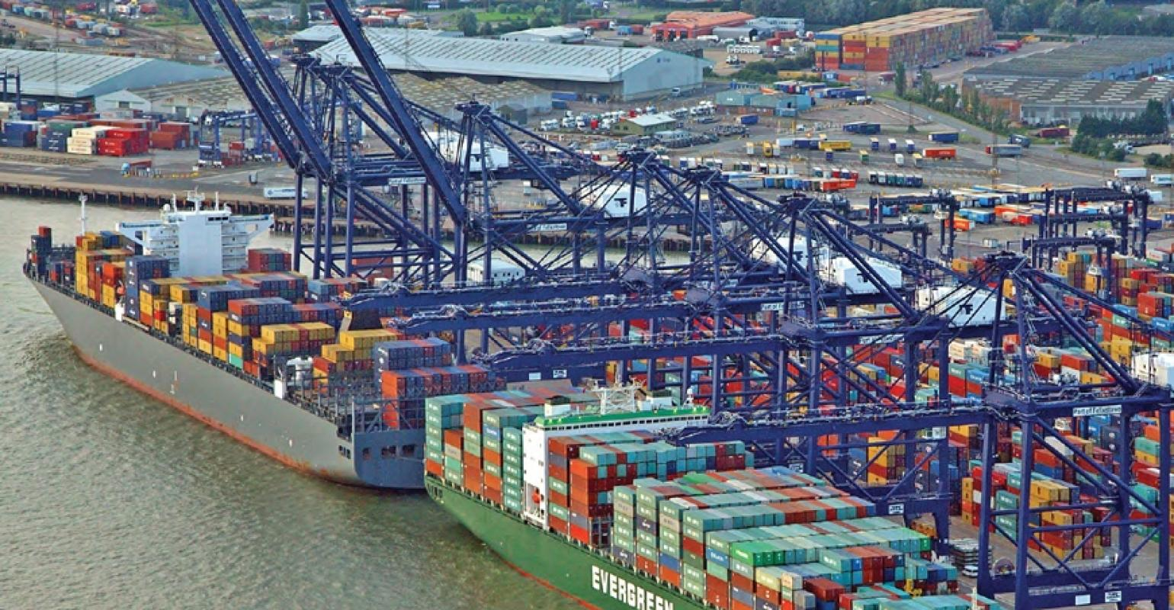
Emerging Challenges
@NewAngliaLEP
Notes:
A temporary arrangement has been secured on transfer of personal data whilst the Commission makes its data adequacy decision. It is vital for a wide range of sectors that the Commission provides a positive data adequacy decision.
It is anticipated that the full impact is still to come for borders. Stockpiling ahead of the end of the transition period and Christmas has lightened the load so far, while concern over new procedures and requirements for Covid tests have made some companies reluctant to send trucks right now.
Companies from the retail, delivery and chilled transport and storage sectors have highlighted emerging problems at the border regardless of the traffic being relatively low. We will continue to monitor how companies fare with the new phased-in border operating model.
Some sectors, such as retail and food and drink, have raised concerns around the rules of origin chapter given how interdependent supply chains are. Under the deal, businesses could face tariffs on goods imported from the continent for processing at British distribution hubs which are then re-exported to member states. For example, Marks and Spencer have highlighted concerns around Percy Pigs which are manufactured in Germany, brought to the UK before then being re-exported to M&S stores in the EU – Ireland, France and Czech Republic as this journey would now face tariffs.
The current provisions around services could throw up challenges for service providers to the EU with mutual recognition of professional qualifications potentially on a country- by-country basis and financial services awaits further details around equivalency.
There are fears the clauses around ease of movement in the EU (90 in 180 days) will severely curtail the ability of performers to go on tour in Europe and will hamper the recovery of the arts and creative sector after the devastating impact of the pandemic.
The EU Settlement Scheme ends on 30 June 2021 for EEA nationals (and their families) working in the UK up until 31 December 2020. Many workers are furloughed who need to fill this information in, so there could be challenges.
Pig farmers have highlighted the impact on the cull sow trade – whose main customers are in Germany for cured meat and salami - as UK slaughterhouses are currently not buying former breeding sows due to fears over the cost of sending shipments which could be rejected. UK supermarkets do not have sow meats in their sausages. There are concerns that they might be squeezed out of their well-established trading partnerships in Germany.
Cycle shops have highlighted that shipping costs are through the roof. Some of their bicycle suppliers are based in Europe - the likes of Bianchi and Ridley - but they are either suspending shipping until the middle of January, when more is known about how the new tariffs will work or factoring in 5% to 10% price increases to cover the extra costs. Anticipating massive shortages of bicycles later in the year.
A studio which regularly sells posters to customers in Europe, but those customers are now facing additional taxes (brokerage charges and sales tax) which is likely to put them off buying from small independent UK businesses.
Many firms had delayed considering issues until the dust had settled on this issue but have now been hit by the fallout from the Covid-19 pandemic. There will be some unknown issues (opportunities and challenges) that were not foreseen, and these will be monitored as they come through.

Slide 9
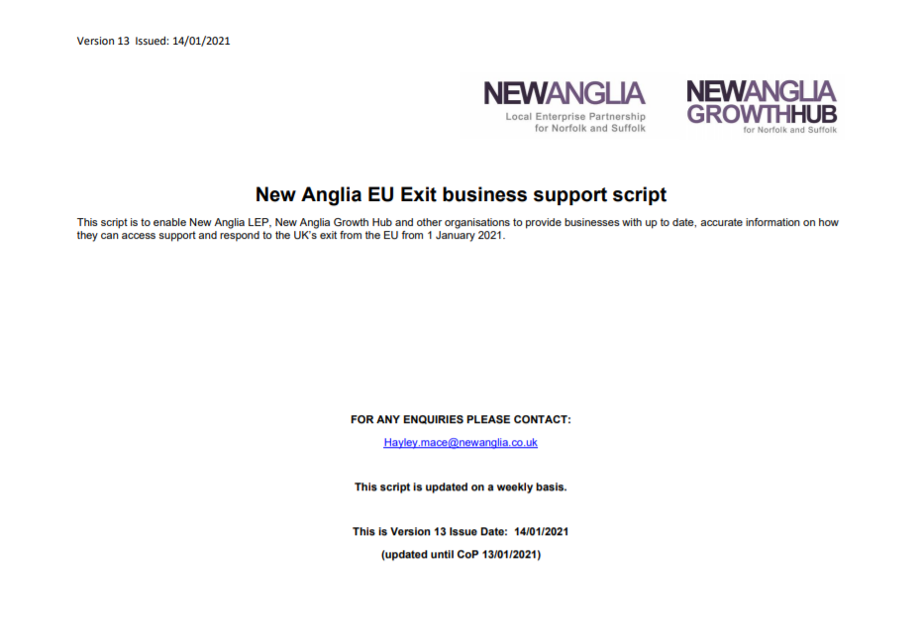
LEP & Growth Hub Activity
@NewAngliaLEP
Notes:
Communications: The LEP is regularly updating its business script for Growth Hub business advisers and partners engaging with businesses. This includes all of government’s most up to date technical notices and guidance for businesses following the deal and offers a local flavour for conversations. This script is updated weekly and circulated to 80 recipients across the LEP, Growth Hub, local authorities, and other business support organisations.
The business-facing information from the script is also on the LEP’s EU exit website pages, including details of upcoming local and national webinars and useful downloads.
Growth Hub Support: The Growth Hub continues to run, collectively with partners in our Ox-Cam Arc Growth Hub cluster, a series of webinars for businesses which continue to March 2021, providing businesses with updates on key issues. Events held so far have reached c.40 businesses at a time on issues such as the new trading landscape; importing and exporting; border changes; developing overseas markets; and effective supply chain management.
In comparison to Covid-19, business enquiries to the Growth Hub have been very low in recent weeks. We expect to see this demand increase significantly in the coming weeks and months now that the trading relationship with the EU has been established and businesses seek local guidance and support.
Outreach Support: Following the BEIS funding secured before the end of 2020, New Anglia LEP has undertaken a tendering process to outsource the delivery of outbound telephone and email contact with businesses, to secure the required capacity and expertise from V4 Services.
The contract is valued at £110,000 and made up of the £54,000 allocated for “Advisors for Outreach and Advice” activity, as well as £56,000 for “Specialist & General Advisors”. Under the contract, the provider will contact and proactively engage with at least 3,500 business across Norfolk and Suffolk, providing them with a greater awareness of the steps they need to take following the deal. To count as an output, the support must last at least ten minutes and provide the business with EU Exit help and advice from a list of agreed of subjects outlined in the tender specification, which is in line with our agreement with BEIS. The contract holder will also provide specialist advice to at least 100 businesses from a list of agreed of subjects outlined in the tender specification, which is in line with our agreement with BEIS. To count as an output, the specialist advice must be of at least three hours in duration.
In terms of operation, the support service will be branded Brexit4Business and will target SMEs that are more likely to be impacted by the UK leaving the EU, through a rolling target list of SMEs for V4 Services to contact each week. V4 Services will provide the LEP with a weekly business intelligence report that will be used to feed into the LEP’s weekly report as well as inform the targeting process, which can be fine-tuned each week. The service will also be used by the Growth Hub as a way of providing enquires with specialist EU Exit help and advice, alongside the work that Suffolk Trade Advisors are also providing.
The contract runs from the 11th January 2021 to the 31st March 2021. The relationship between the Growth Hub and V4 Services will be seamless and both will have copies of the business scripts so that businesses receive the most up to date and informed advice locally.
Business Intelligence: The LEP continues to share weekly business intelligence returns with central government, local government and MPs capturing intelligence around the UK’s new trading relationship with the EU and Covid-19. This will capture the proactive outreach work of V4 services.
From the BEIS funding, there is £14.5k allocated for intelligence and reporting. This will inform both our intelligence returns, but also our investment plan and the longer-term economic recovery plans, so that we can take advantage of opportunities present in the future trading relationship with the EU and the rest of the world and support businesses with their economic recovery from the pandemic.
The information that we capture in the coming weeks, months and year(s) is key to assess how the introduction of the new relationship, immigration system, border controls and state aid rules impacts businesses, and we can flag this in the returns and adapt our support locally.

Slide 10
@NewAngliaLEP
Any Questions?

