Slide 1
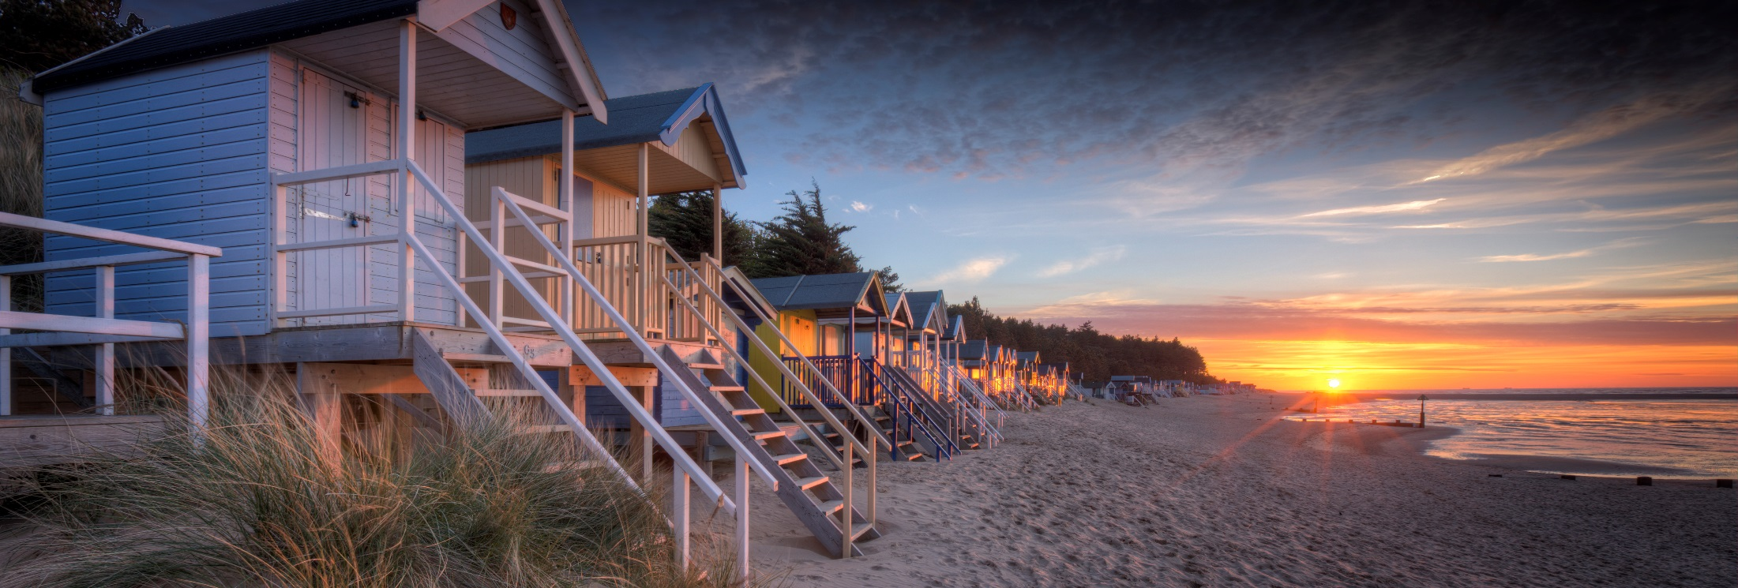
Where to now?
Overview on the visitor economy
Pete Waters
Executive Director, Visit East of England

Slide 2
Who are we?
We were Visit East Anglia
We’ve operated Visit Norfolk and Visit Suffolk since 2012
We work with all DMOs in the two counties, plus LAs
Now Visit East of England
VEE is the New Anglia LEP Visit Economy Sector Group
Notes:
Created in 2012 when the RDAs were abolished.
Group of private sector businesses.
There was no representation at national level.

Slide 3
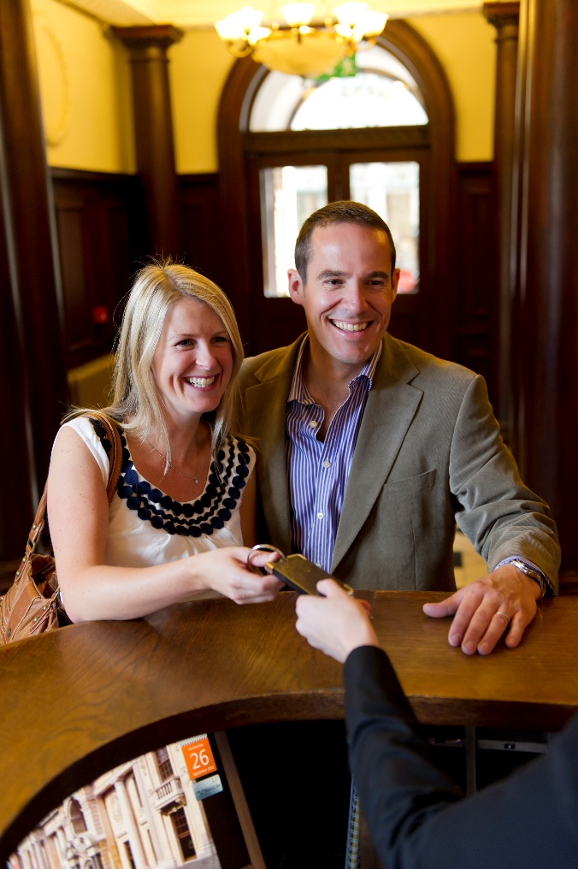
Tourism in Norfolk and Suffolk
Combined value = £5.4bn
Tourism-related employment = 110k
Percentage of all employment = approx. 16%
Day trips volume = 83m
Staying trips = 4.8m
Number of nights = 19.1m
Notes:
Norfolk alone is £3.3bn – more than Cornwall
Across the 4 counties it’s £10bn – which is more than Yorkshire with its large cities and two National Parks
Largest employer
That goes up to 40% in Great Yarmouth

Slide 4
The challenges
Poor perception – low-paid, low-skilled, seasonal
Improve productivity – digital innovation
Database not updated since demise of TICs
Sector can’t communicate with itself
OTAs dominate accommodation market
Region isn’t top of mind with Visit Britain
Region isn’t top of mind with consumers
Working together as a region
Notes:
1 Like it or not…
2 We’re open 12 months of the year, not 12 weeks – and we need to stop taking about ‘the season’ and ‘tourism’.
3 They were our Eyes and Ears
4 More than 15,000 SMEs.
5 They’re the biggest advertisers with Google, they hoover money and take it away...
6 We disppeared from the radar in 2011
7 Cornwall, Dorset, Devon... VisitBritain research suggests that of people wanting to go away in 2020, top destination is the South West.
8 Because what’s the alternative? Watching other regions get further ahead than us?
Have I forgotten anything?

Slide 5
Oh, yeh…
Notes:
Not going to dwell too much on the impact of Covid-19 on the industry – suffice to say it’s devastating at the moment, and could be catastrophic if it continues into the Autumn.
And it’s a rapidly changing situation – July 4 we’re not sure will happen yet.

Slide 6
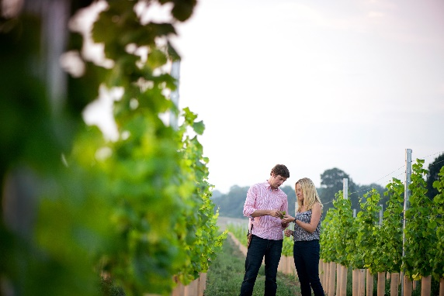
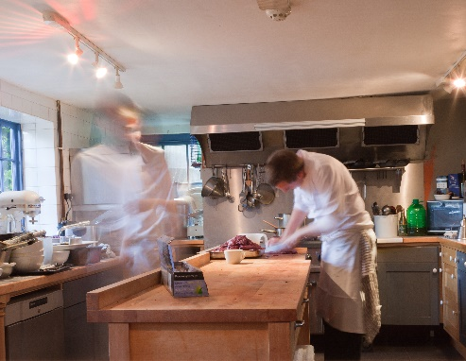
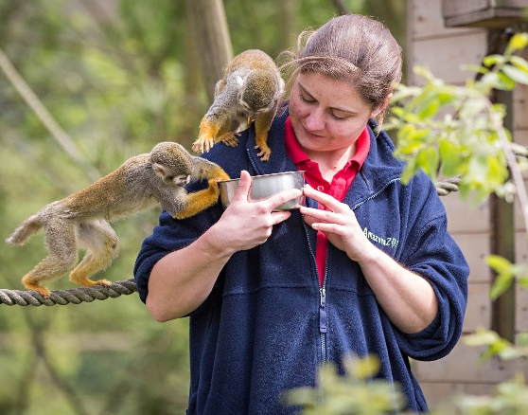
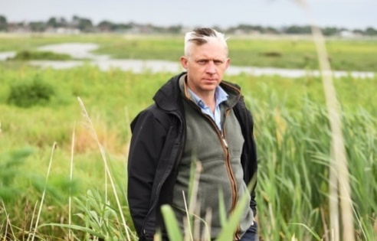
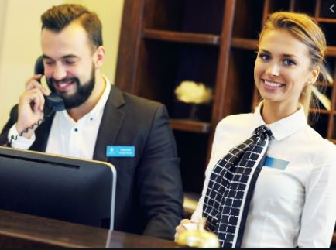
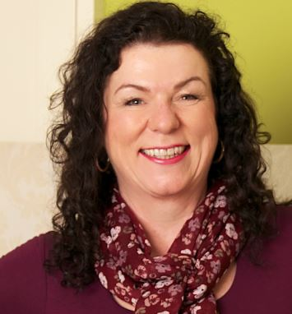
Sector skills
Working with New Anglia LEP and stakeholders
Year-round visitor economy will encourage investment in upskilling, training and employment
Change the mindset
Notes:
Let’s be honest, perception of tourism is a part-time role for a youngster before getting a real job.
So we need to rewrite the narrative.
It’s such a disparate sector, there are an infinite number of roles and positions.
With opportunities for people with all kinds of skills and interests – but it helps if you like working with people.

Slide 7
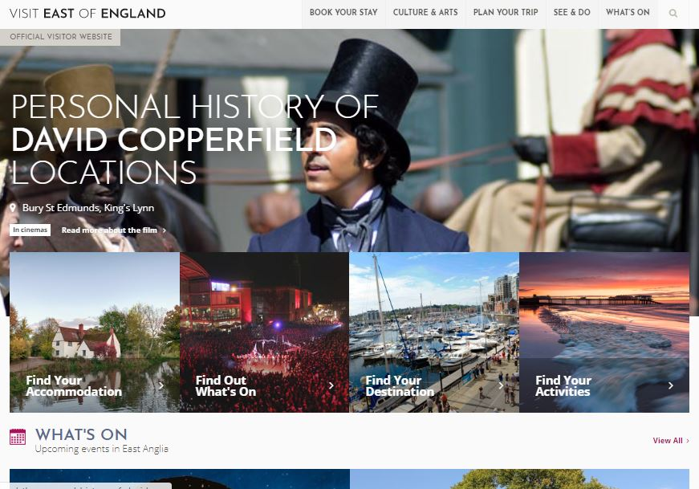
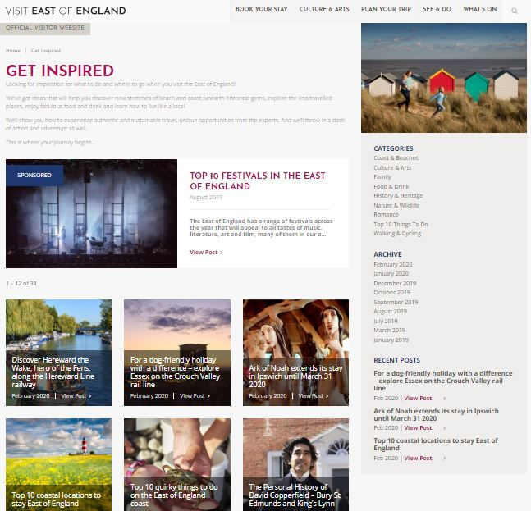
New VEE website
Free listings
Free booking mechanic with Staylists
10% commission for hotels – unlike OTAs
Create bookable itineraries
Build skills hub
Coronavirus update

Slide 8
Not ‘top of mind’
Reinvented ourselves as Visit East of England
Re-engage with VisitBritain and VisitEngland
VEE now the conduit for VB/VE to reach this region
Digital workshop for DMOs in Bury St Edmunds
Sector Deal and Tourism Zones
Notes:
Got tired of seeing other regions hoover up government money
We just get white noise out of East of England
VB website – East of England not recognised and Cambridge and Southwold in the South East!

Slide 9
VisitBritain Consumer Survey
Published weekly since June 1
Only 23% think things will be normal from Oct-Dec. 22% Jan-March 2021
Young people believe it will return to normal quicker
People want countryside and coast
42% want outdoor areas, 24% outdoor leisure
57% planning a break from October
Where do they want to go?

Slide 10
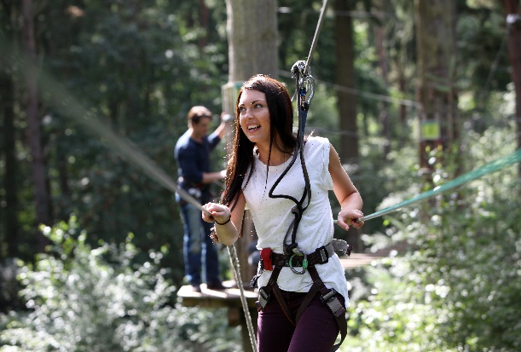
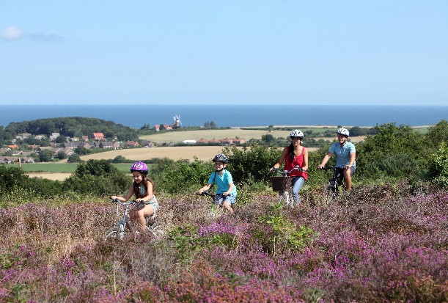
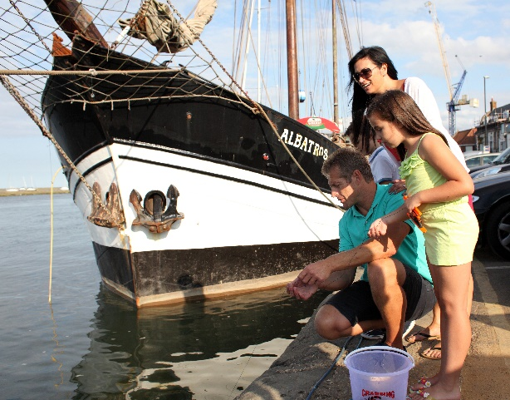
VB Industry standard
‘Know Before You Go’
‘We’re Good To Go’ Industry Standard for all SMEs
VB engaged with 63 industry bodies
74% of 500 tested said they’d be reassured
Hoping for No 10 approval this week
Free online self-assessment questionnaire

Slide 11
Working together as a region
Notes:
It’s been a catastrophe, but it’s highlighted the need to work together…

Slide 12
East of England Tourism Recovery Plan
776 businesses surveyed
Umbrella framework for all stakeholders
Reimagine what the landscape will be
Create networking opportunities
Digital innovation is key
Sustainable, environmentally-friendly tourism
Develop year-round economy
Leads to a Tourism Zone bid

Slide 13
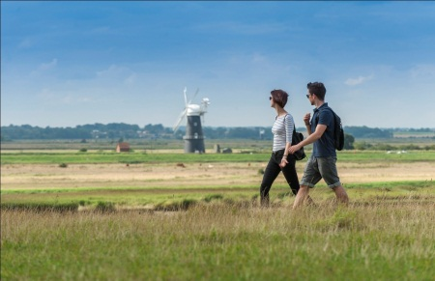
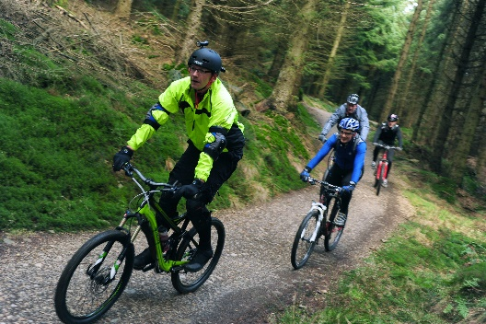
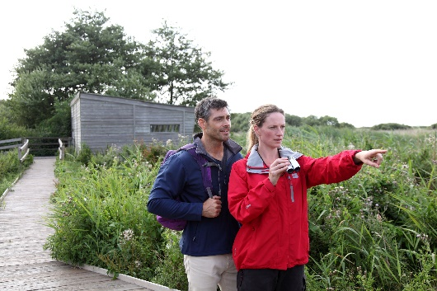
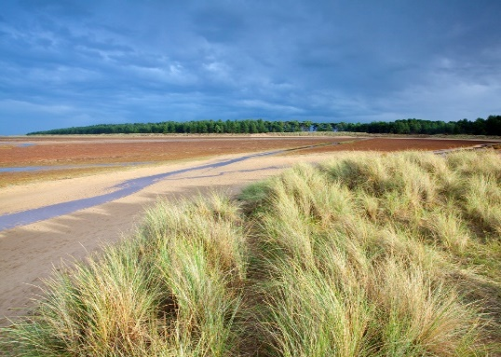
‘Unexplored England’ activity
Companion piece to Tourism Recovery Plan
Aligned to Visit Britain ‘We’re Good To Go’
Staged approach – not ‘Come now!’
1 - Early recovery – plan your visit
2 - Reassurance – travel when it’s safer
3 - Build demand for late year and 2020
Notes:
Reassurance campaign – all about safe visiting
If we get a second spike then that’s tourism done for 2020.
Avoid the honeypots; we have over 9000 square kms of coast and countryside
We can give visitors great experiences in Autumn and Winter
We have the best overall climate in the UK

Slide 14
Out of crisis…
Will come opportunity

