Slide 1
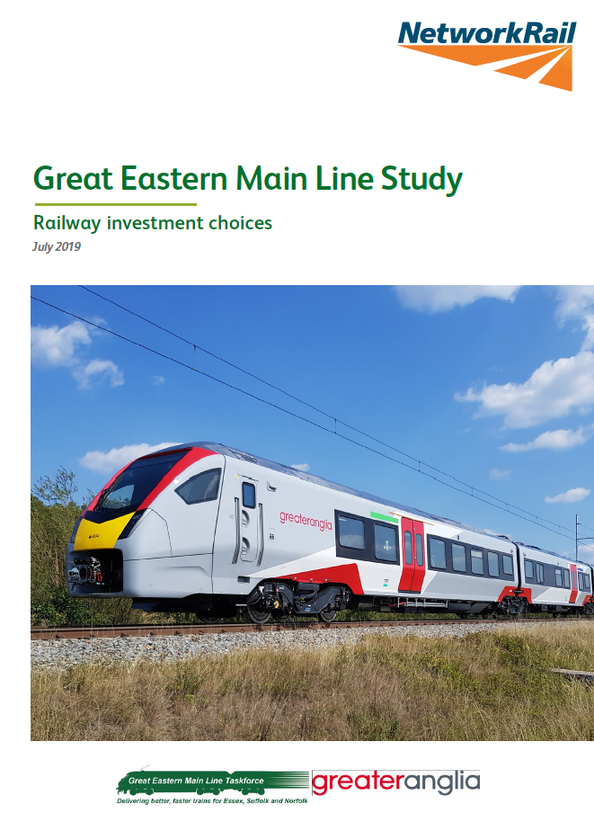
Great Eastern Mainline
Capacity Study

Slide 2
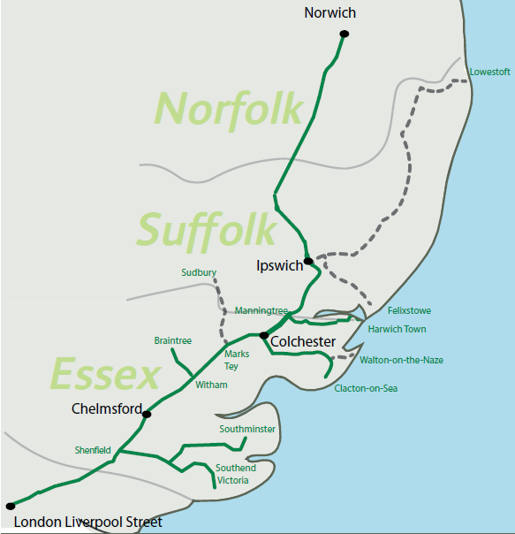
The GEML today
Headlines
East of England journeys increased 30% in the last 10 years
GEML stations in 2017-18 were involved in 90m journeys
Passenger demand in East Anglia has increased by 50% in the last 10 years

Slide 3
Growth
Baseline growth summary
Uses Government models and follows industry forecasting guidance
Considers 4 key centres on the route
Historic growth: typically 1.5-2% per year 2007-18
Forecast growth: typically 2-2.5% per year to 2033
Higher growth summary
Uses Government models and follows industry forecasting guidance with the inclusion of data provided by stakeholders
Supporting evidence: Delivering Economic Growth in Chelmsford to 2036 and Future Transport Network; List of Future Jobs in Essex New housing plans for East of England region; Local Plan data.
Forecast growth: approximately 3.2% per year to 2033

Slide 4
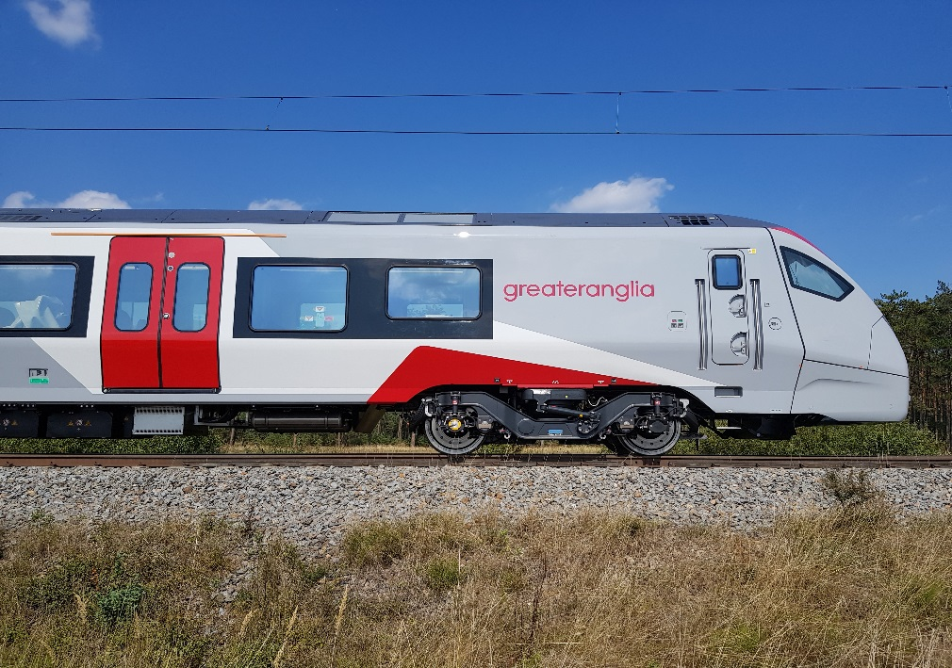
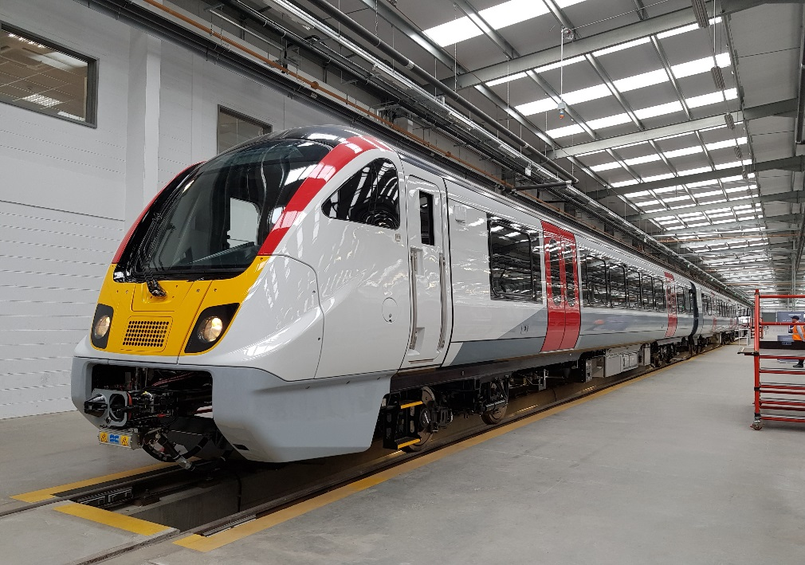
New rolling stock
Stadler inter-city
Bombardier suburban
Percentage change in seating between old and new stock
Suburban | 17% - 36% increase in seating | 164 – 305 extra seats
Inter-city | 22% increase in seating | 139 extra seats

Slide 5
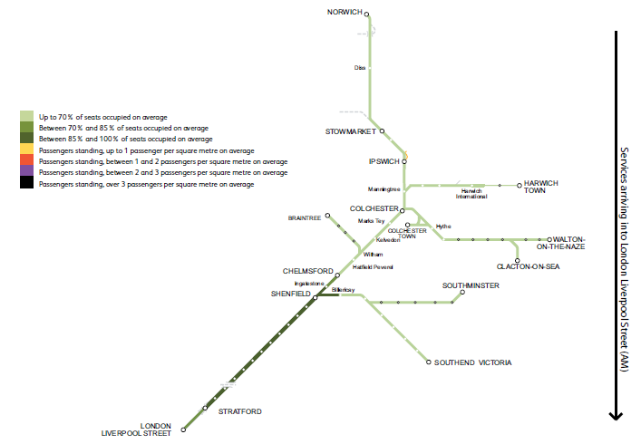
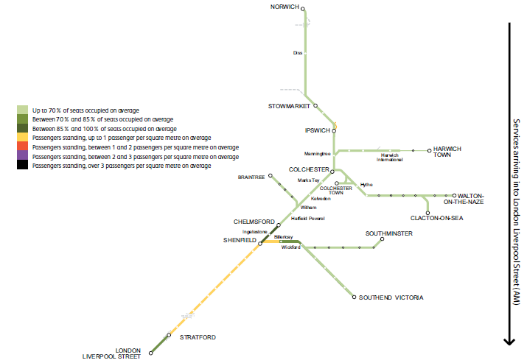
Impact of growth
Baseline scenario 2033
Baseline scenario 2043
Shows passenger load factors are predicted to on average be 85-100%, pressure shown between Billericay and Shenfield towards London.
Shows passengers standing is increasing, the levels of crowding on some services arriving at London Liverpool Street in the AM peak hour will be much higher as this only shows the average.

Slide 6
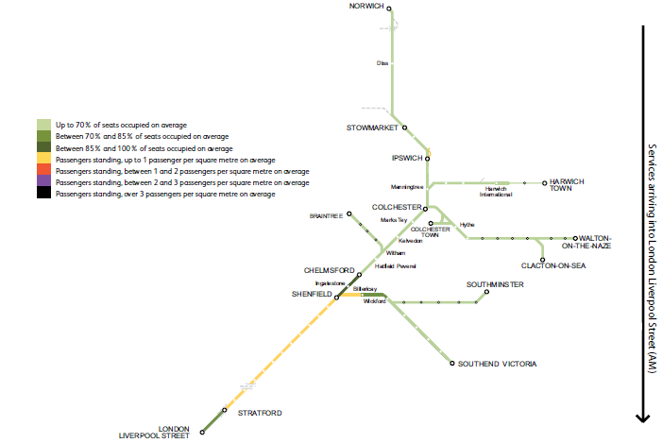
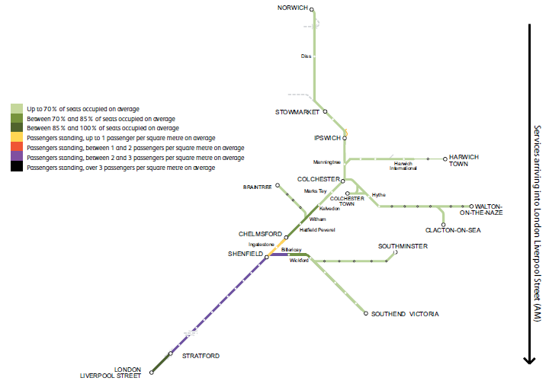
Impact of growth
Higher scenario 2033
Higher scenario 2043
Shows passenger are standing on all trains, pressure shown between Billericay and Shenfield towards London.
Shows passengers standing is increasing at a higher density between Chelmsford and Billericay towards London. The levels of crowding on some services arriving at London Liverpool Street in the AM peak hour will be much higher as this only shows the average.

Slide 7
Future services
A conditional output in the study was for ‘services to maintain existing train journey time’ Expected frequency required to meet this conditional output
GEML service frequency required to and from London Liverpool Street in High peak
Direction and growth scenario in high peak hour | Current frequency | 2024 | 2029 | 2033 | 2043
Arriving at London Liverpool Street (Baseline) | 22 | 23 | 23 | 26 | 27
Departing London Liverpool Street (Baseline) | 20 | 20 | 21 | 21 | 22
Arriving at London Liverpool Street (Higher) | 22 | 23 | 25 | 26 | 27
Departing London Liverpool Street (Higher) | 20 | 20 | 21 | 22 | 24

Slide 8
Accommodating future services
Future enhancement options that may be required for the GEML | Driver for scheme
Bow Junction remodelling | To provide any additional peak hour services into London Liverpool Street
Passing loops between Chelmsford and Witham (Beaulieu Station scheme option) | Additional services to Colchester and beyond
Haughley Junction doubling | Increased capacity for forecasted rail freight and increase the performance and reliability of passenger services
Passing loops south of Colchester, & Shenfield – Colchester headway reduction accompanied by 3 or 4 tracking solution between Chelmsford and Shenfield | Additional services to Colchester and beyond
Ipswich to Haughley Junction – 3 or 4 track solution | Hourly 90 minutes service between London and Norwich and increased reliability of passenger and freight services.
Trowse Bridge, Norwich | To support the potential increased services to Ely and Cambridge and to improve the reliability and resilience of existing services to and from Norwich

Slide 9
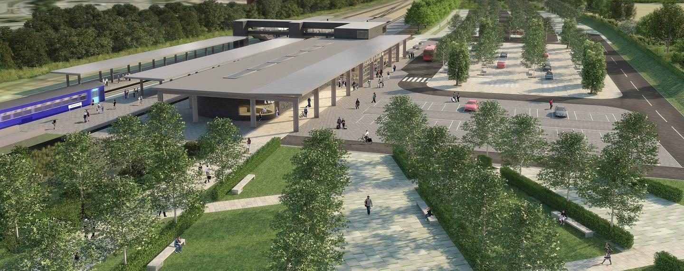
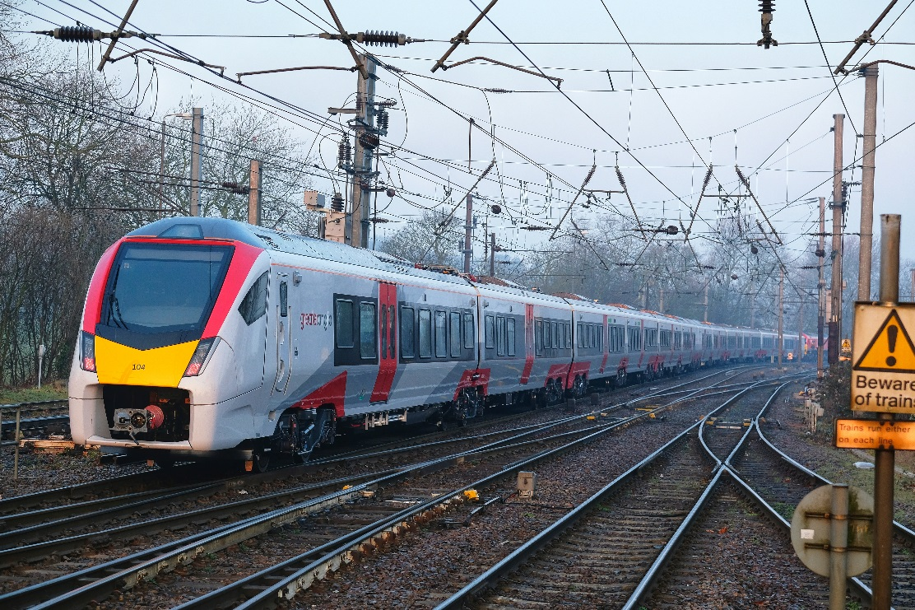
Development of options
Timetable assessments of Shenfield to Colchester options
Review of performance of new trains and potential further capacity benefits
Progression of Liverpool Street station and Haughley Junction schemes
Early development of schemes and establishment of costs

Slide 10
Thank You

