Slide 1
GEML SOBC GEML Rail Conference July 2019

Slide 2
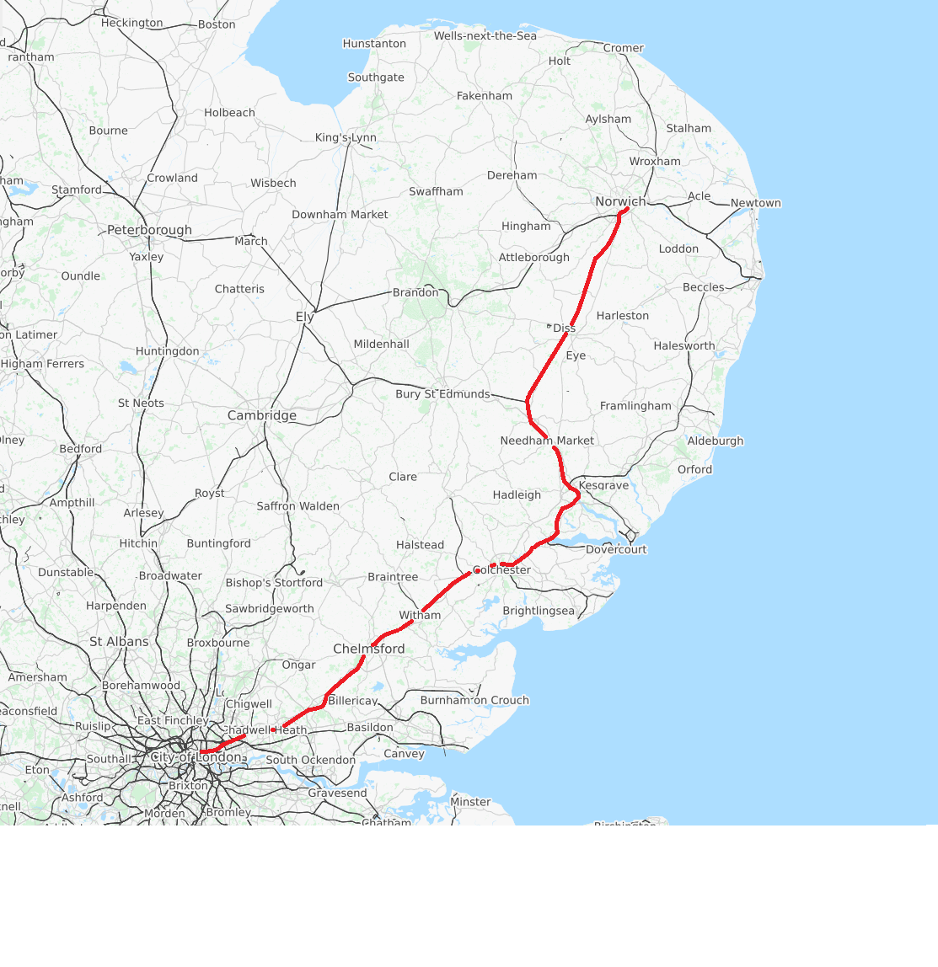
Introduction / Background to GEML SOBC
GEML Taskforce set up with a clear agenda for rail improvements on GEML
New fleet
Some Norwich in 90 services
Case to be made for infrastructure enhancements
A number of studies undertaken in recent years (including a previous business case in 2014, previous line speed studies, as well as the NR capacity study)
SOBC intended to be informed by the valuable work already done.
Notes:
GEML Taskforce set up with clear agenda for GEML rail improvements: development of a compelling business case for investment in GEML.
A new fleet is already being rolled out by Abellio over the next 18 months……., with capacity improvements, quality improvements and journey time savings.
Why do you need to know about this?
It is required to facilitate economic growth throughout the East Anglia region…..as the business case is developed consultation will become increasingly important and support / buy-in from MPs in region and local stakeholders will be a key part of the process.

Slide 3
Rail Network Enhancement Pipeline
RNEP is a new approach to Rail Infrastructure improvements
Applies to all rail “enhancements”
Pipeline process intended to aid prioritisation for investment
Notes:
Introduced by DfT / NR in 2018. Applies to enhancements tho no routine maintenance.
The first three stages, “Determine”, “Develop” and “Design” require increasing levels of detail and understanding. The final two stages are “Deliver” and “Deploy”. By the time these latter stages are reached, all investment decisions have been taken and the focus is on building and operating the Enhancement and realising the benefits that are anticipated.
SOBC is a fundamental component of the submission, taking a project from ‘Determine’ to ‘Develop’ stage. SOBC must conform to DfT 5-case structure (Strategic, Economic, Financial, Commercial, and Management Case.
Significant emphasis is placed on the Strategic Case at this stage of the process!

Slide 4
Strategic Aims
We have identified four Strategic Aims for the project which we believe articulate the wider goals of delivering improvements in journey times and capacity:
Support jobs and balanced economic growth
Support the growing population and the delivery of new housing
Connect Communities
Support the growth of the freight industry
These align well with wider national, regional and local strategic aims which is essential for the Strategic Case. We will also demonstrate how the project will deliver on these fronts.
Notes:
We have agreed these with the Taskforce.
Support jobs and balanced economic growth
Support the economies along the length of the GEML by delivering faster journeys for more people.
Support existing jobs and new jobs.
Support inward investment in the region including foreign direct investment (FDI)
Prevent the expected growth in demand from exacerbating the crowding on services.
Allow realistic timetables to be implemented successfully without the reliability problems caused by asking too much of the exiting infrastructure.
Improve the productivity of the existing economies.
Support the growing population and the delivery of new housing
Deliver the capacity to handle the expected regional population growth.
Relieve capacity on the road network by providing attractive rail alternatives.
Deliver increased service provision to the areas where new housing will mean drastic increases in population.
Support the delivery of additional housing developments (as yet uncommitted) through the provision of adequate rail services.
Connect Communities
Facilitate more people travelling more quickly between more places along the route.
Ensure that branch line stations also benefit from improvements to the mainline.
Movement between the cities is important for the local economy but also for access to more remote parts of East Anglia.
Support the growth of the freight industry
Deliver improvements that protect the necessary freight paths (in line with the growth expectations) to use the GEML and wider rail network, without affecting passenger services.

Slide 5
Problem Identification
An important part of the Strategic Case is clearly communication the problems and why they need addressing.
The evidence shows that congestions and crowding are already affecting the quality of service on the GEML – action is needed soon;
There is a clear trend of growing passenger demand that the current timetable (including the new trains) will not be able to cater for in the near future;
Journeys on the GEML take longer than on similar rail networks in the UK, giving other places a competitive advantage in attracting investment;
The full potential of new rolling stock will not be realise without further investment in the infrastructure;
There is conflict between freight and passenger services which requires one to be prioritised over the other.
Notes:
People in excess of standing arriving at Liverpool Street is already one of the highest levels of major stations in London.

Slide 6
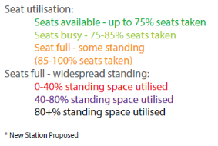
Network Rail’s crowding forecast for GEML

Slide 7
The Impact of Doing Nothing
As well as the current problems we need to consider the impact of not taking action.
As demand for rail travel becomes further constrained it will put increased pressure on the already congested road network therefore slowing all connections;
New housing will not be feasible beyond a certain point given the lack of transport options which will constrain the labour supply and in tern restrict economic growth;
The area served by the GEML has a high concertation industries identified by UK government as being essential for solving ‘The Grand Challenges’ – the whole country will suffer if these industries are affected;
Businesses in the area will start to consider relocation to areas with better transport links;
Communities will become more isolated.
Notes:
The Grand Challenges – are identified in the UK Government in the industrial Strategy (May 2019) - Artificial Intelligence and data, Ageing society, Clean growth, Future of mobility

Slide 8
Scheme Options for Appraisal
Capacity Infrastructure Enhancements
Bow Junction remodelling
Resignalling Shenfield – Colchester
Beaulieu Park Loops
Marks Tey loops
Capacity Option
Up to 4 additional peak hour services to London
Line Speed Infrastructure Enhancements
Programme of line speed enhancement works South of Colchester
1 tph Norwich in 90
Ipswich in 60
Colchester in 40
Line Speed Option
Notes:
Capacity option is a basket of schemes that permit operation of up to four additional services into Liverpool Street in the peak hour (20% capacity increase)
Line speed options will permit 1tph to run to Norwich In 90. Reference for infrastructure works required is the 2014 NR paper on 110mph line-speeds.
DfT have stipulated additionally that an appraisal needs to undertaken as part of the SOBC of the current franchise committed services or which no funding is currently committed.

