Slide 1


Delivering the North East Chelmsford Growth Ambition
GEML Conference
11th July 2019
Stuart Graham, Chelmsford City Council
Chris Stevenson, Essex County Council

Slide 2
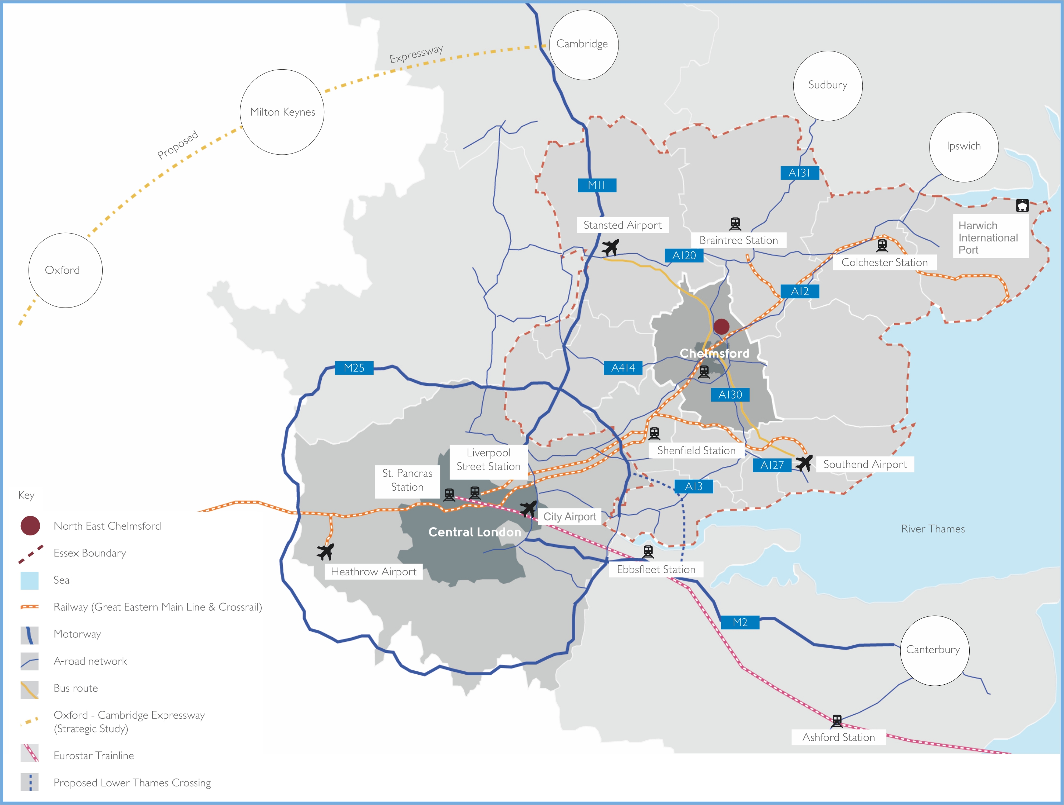

Slide 3
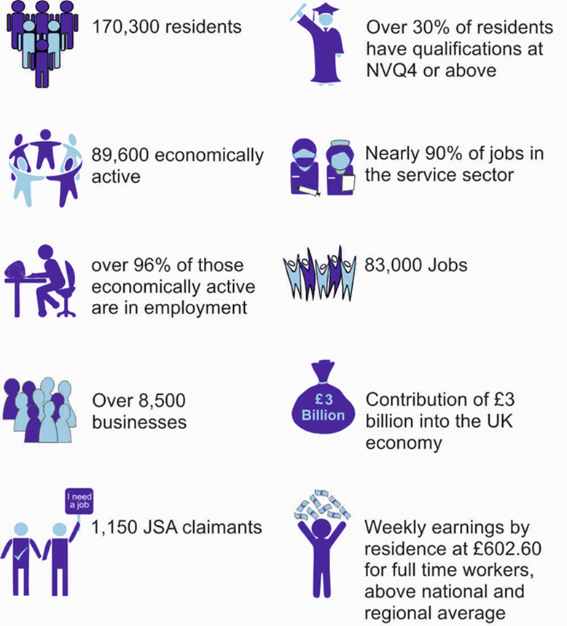

Slide 4
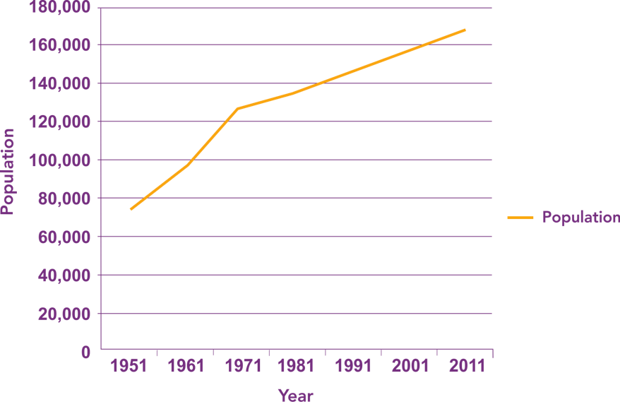

Slide 5
Projected Need: 18,515 homes (805 pa)
Supply: 22,043 homes (958 pa)
Projected Need: 65,000 sqm (725 jobs pa)
Supply: 55,000 sqm new + existing allocations/permissions

Slide 6
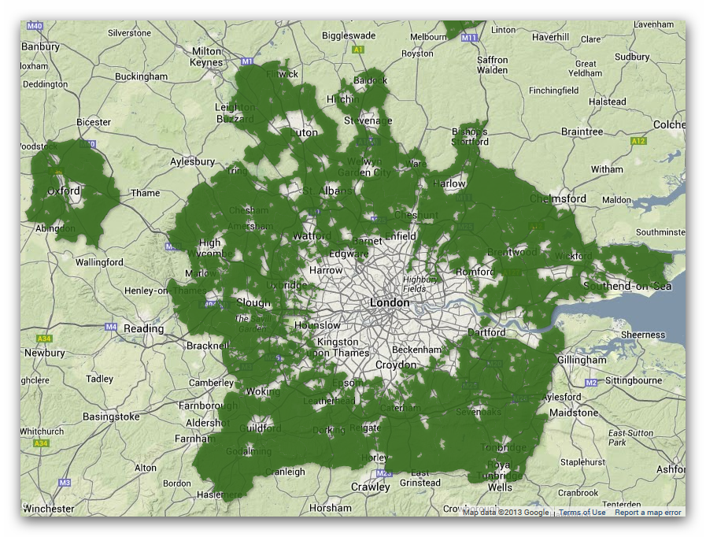

Slide 7
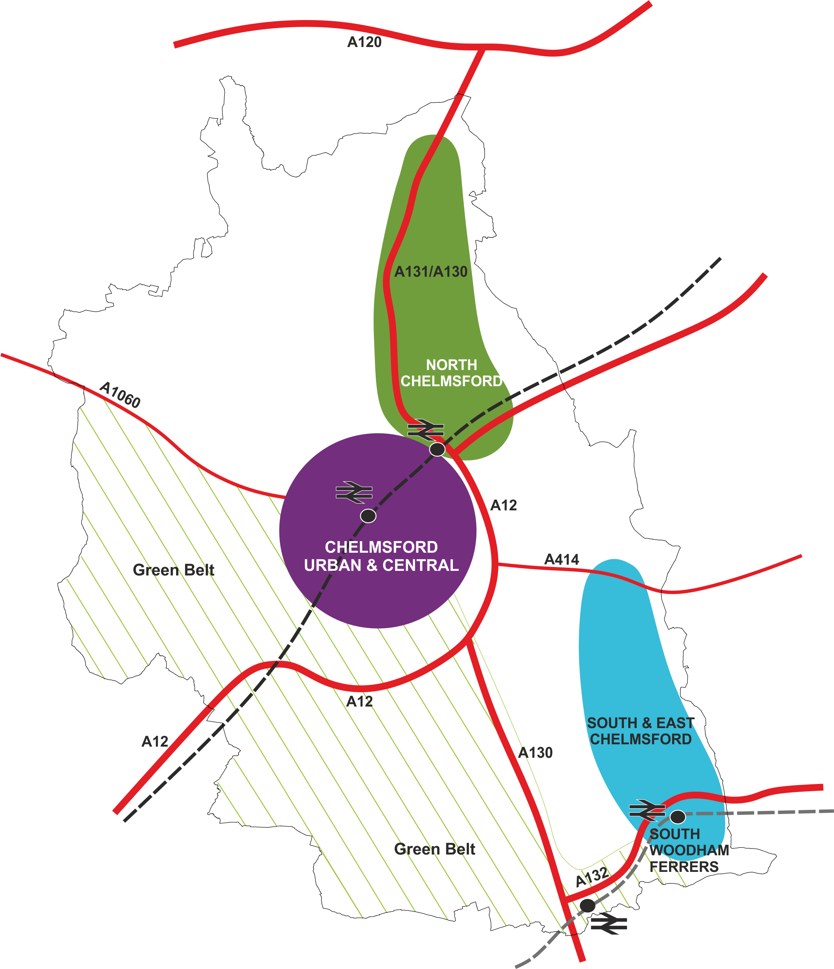

Slide 8
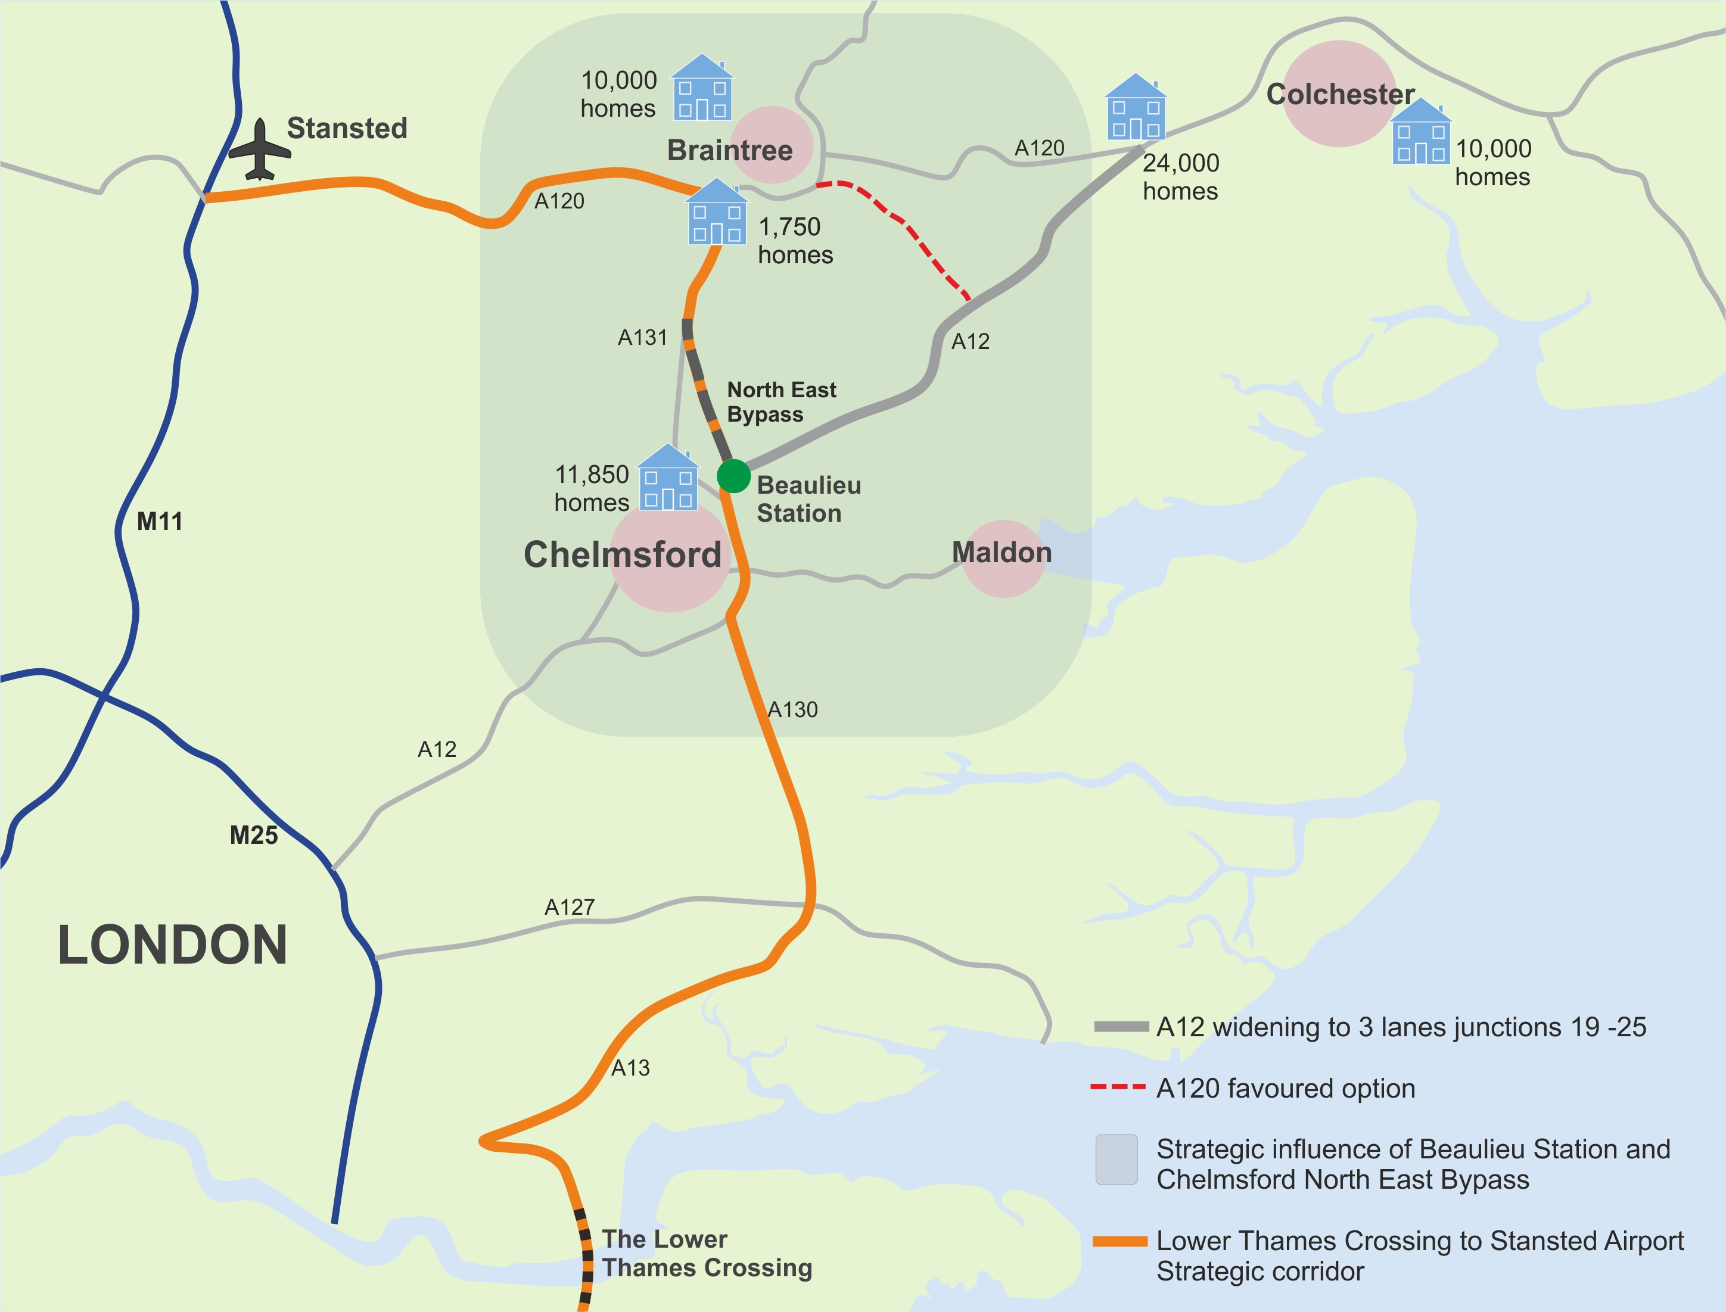

Slide 10
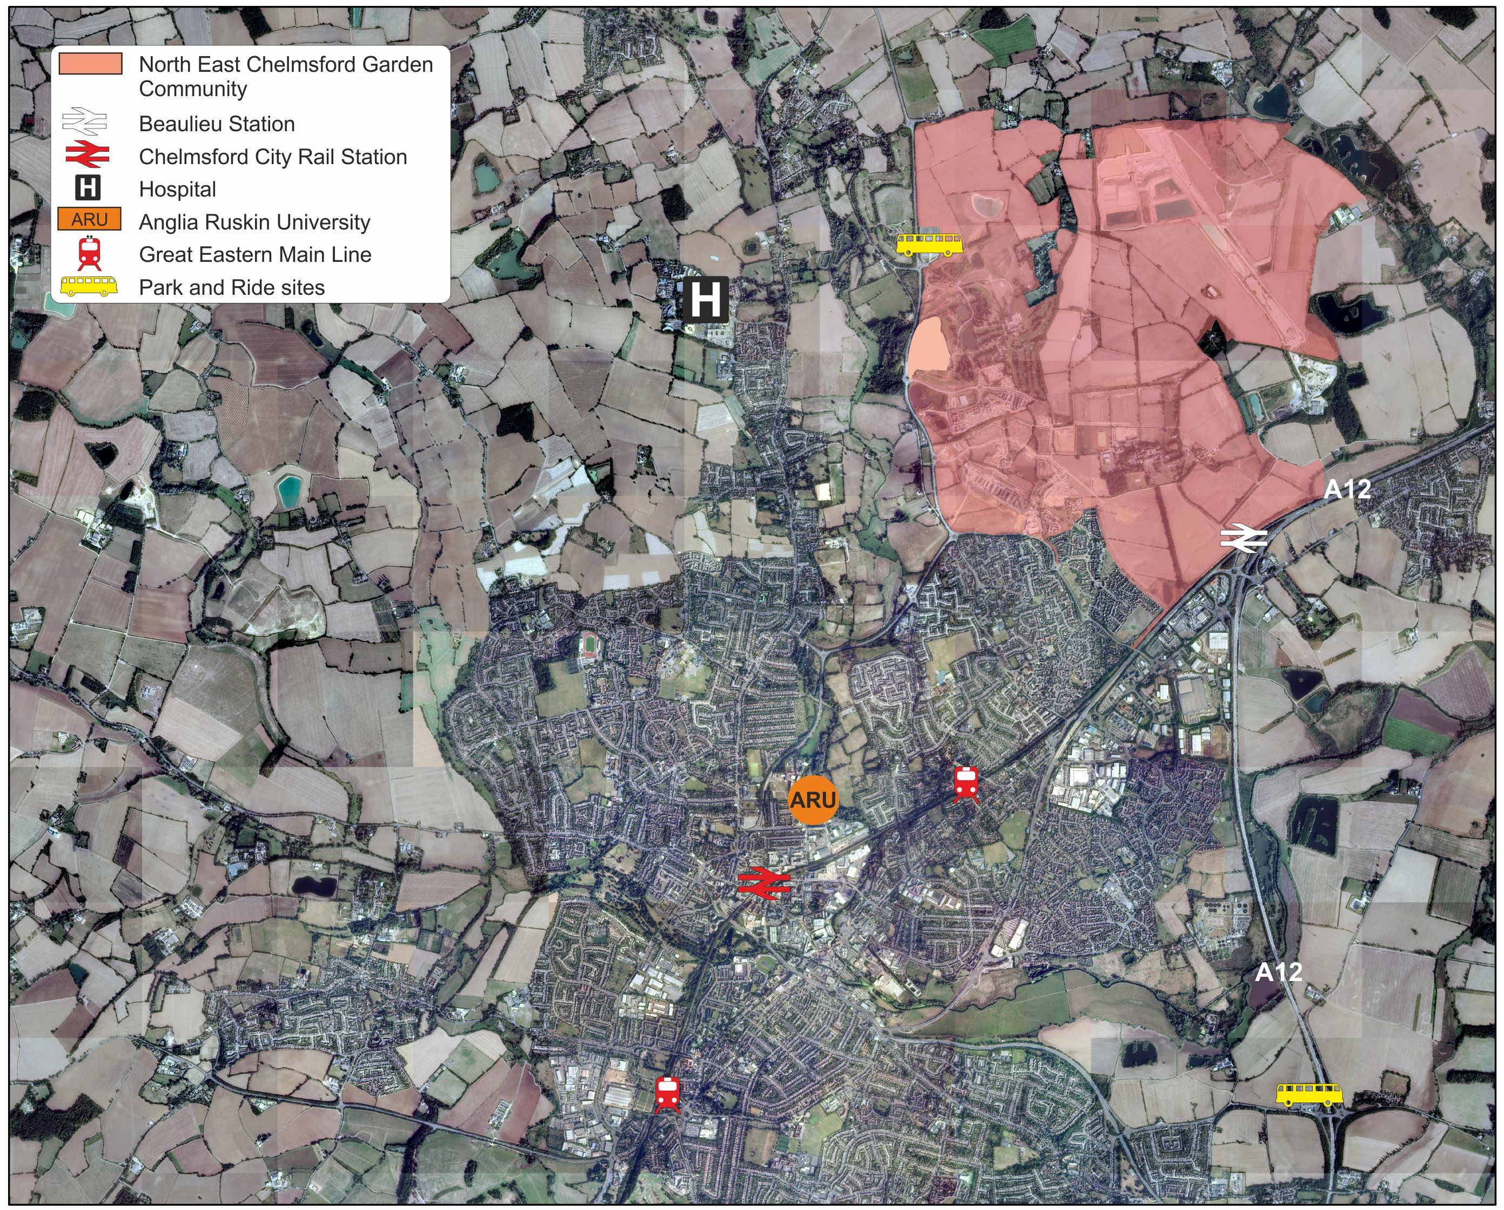

Slide 11
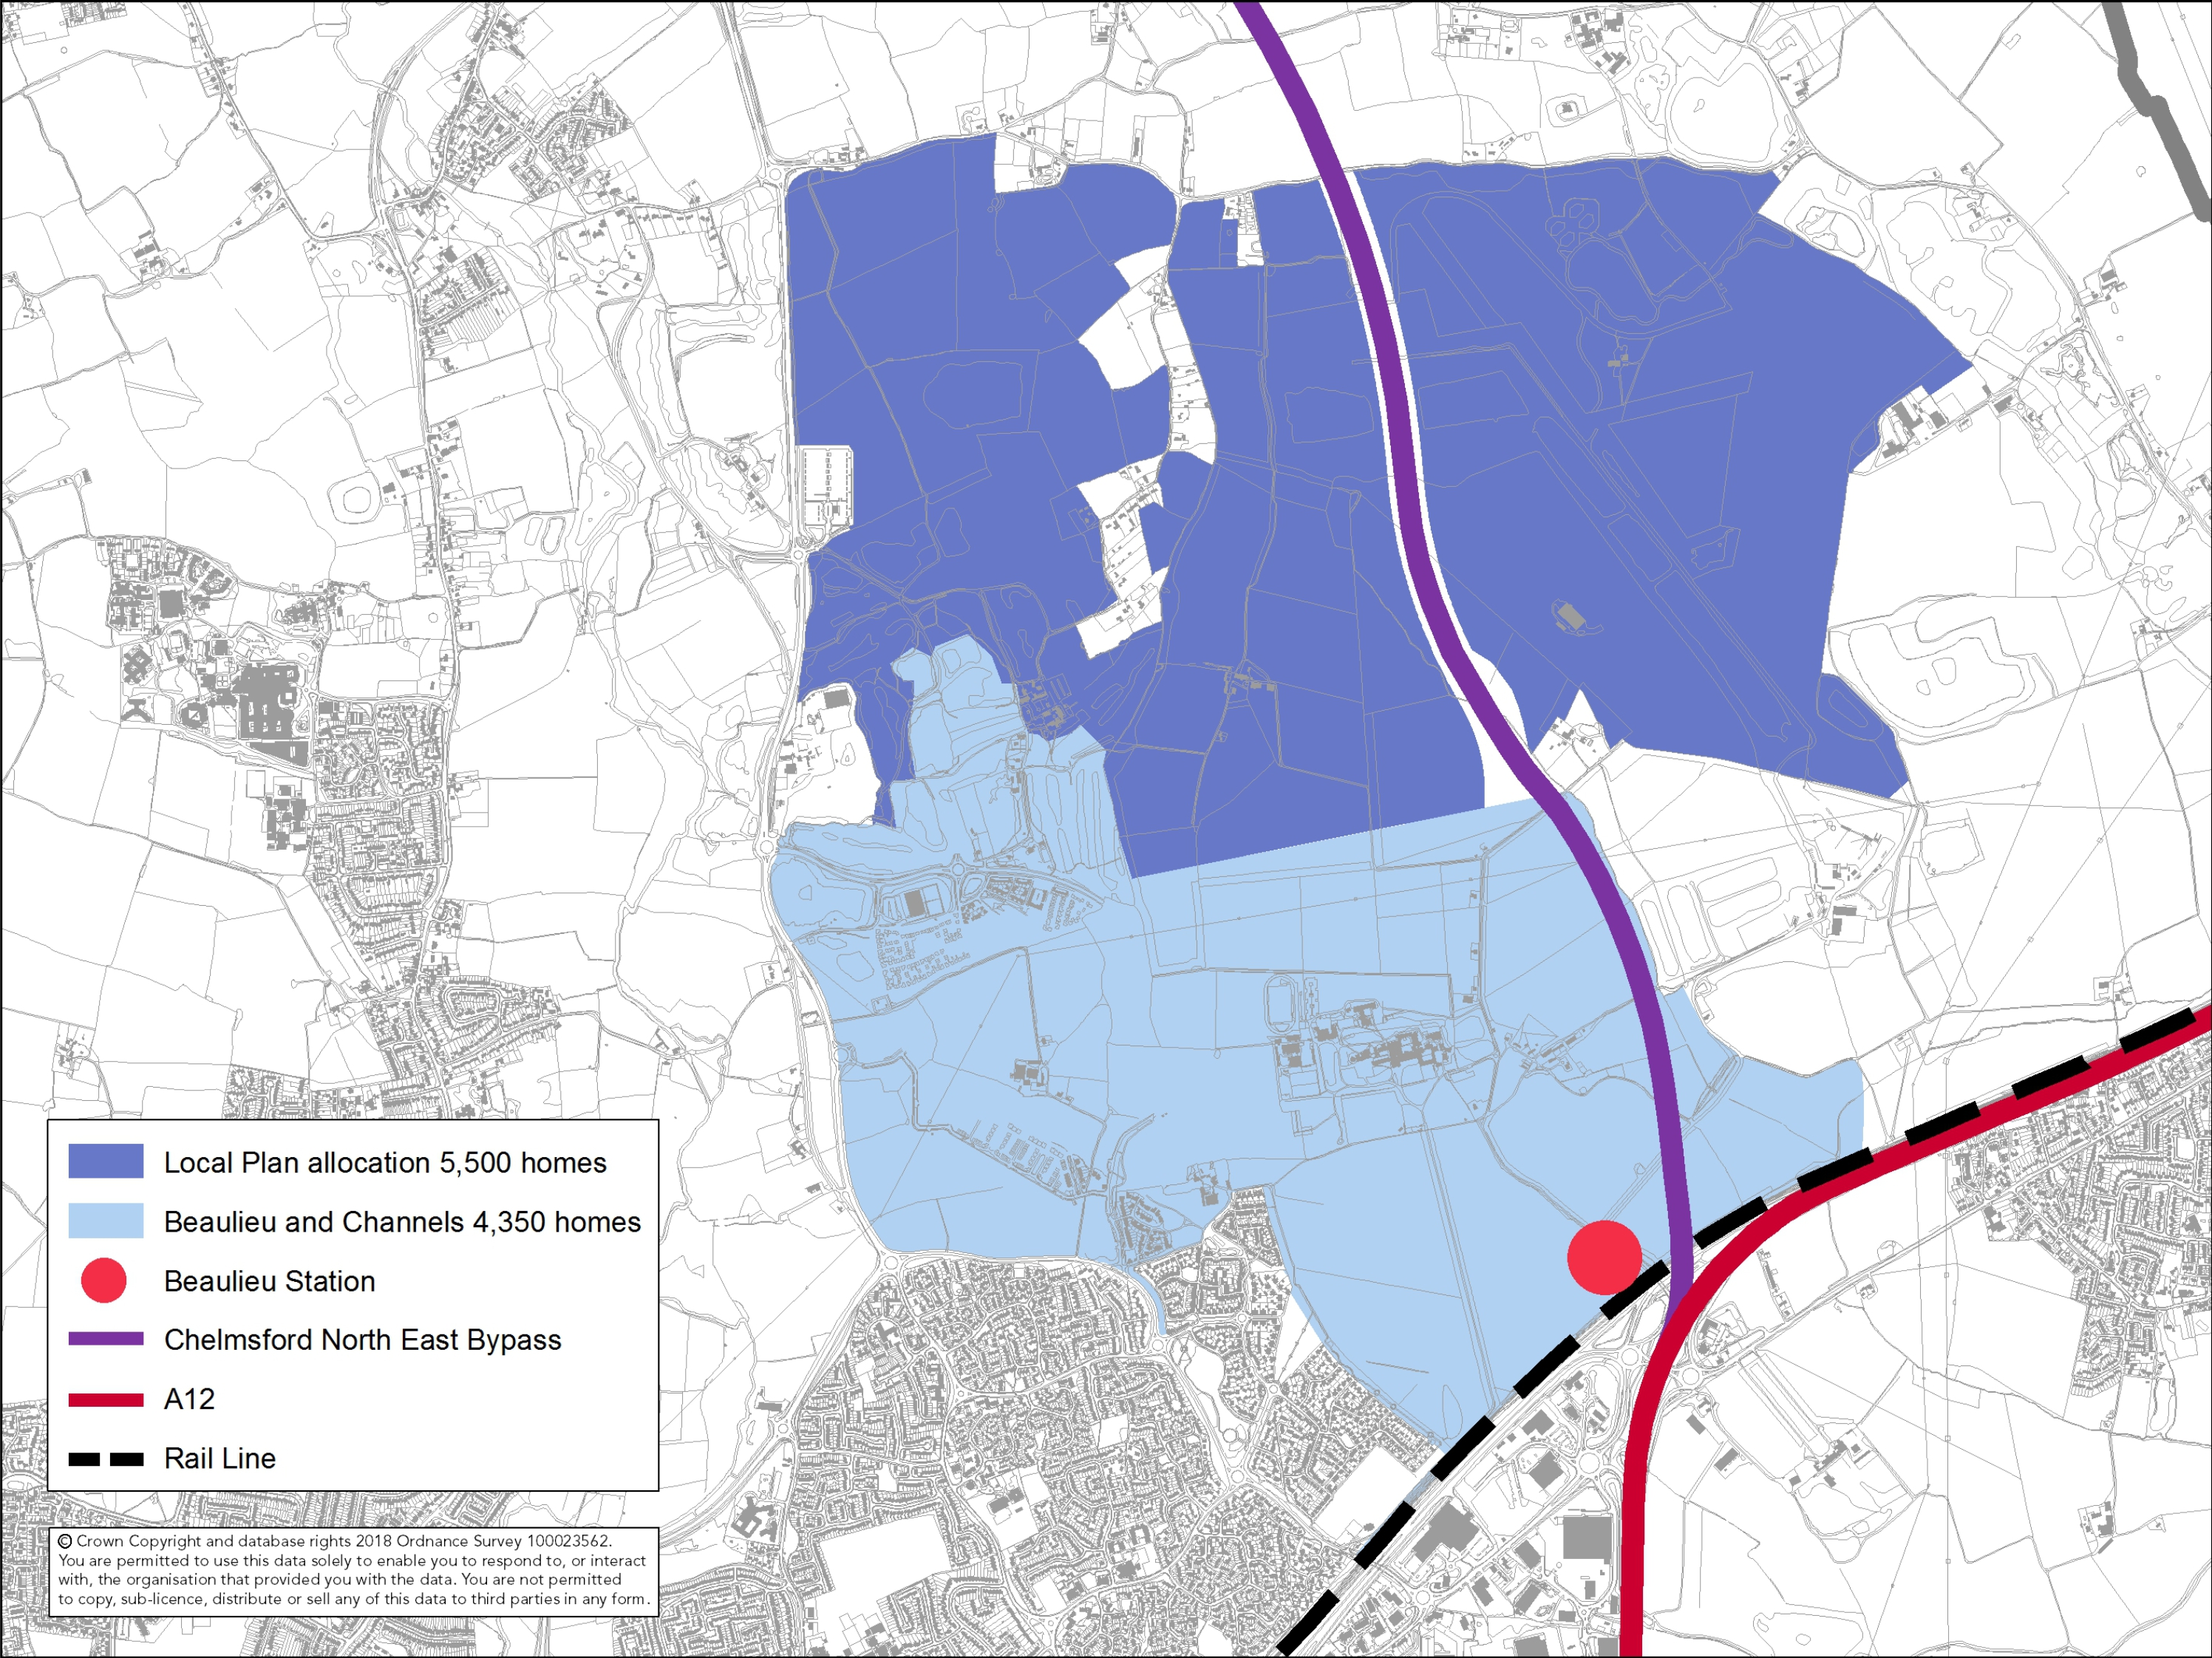

Slide 13
Chelmsford’s transport strategy and the role of Beaulieu Station

Slide 14



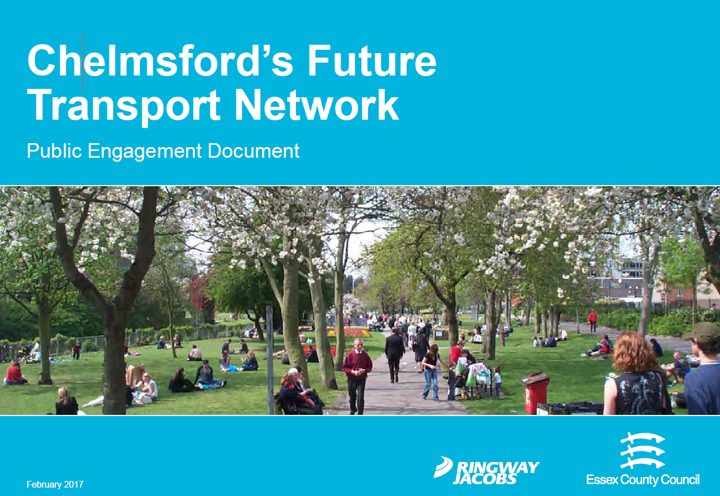
Political Context
Supported by Essex MP’s and MP’s directly affected by GEML. Regular updates provided by Chelmsford City Council.
Active Steering Group with Memorandum of Understanding between:
  Chelmsford City Council
  Essex County Council
  Network Rail
  Countryside Zest
Greater Anglia fully engaged with the project.
Chelmsford City Council have regular liaison with rail user groups.
Notes:
Chris Stevenson. The station has been subject of a PMQ by Vicky Ford (March 20th 2019)

Slide 15
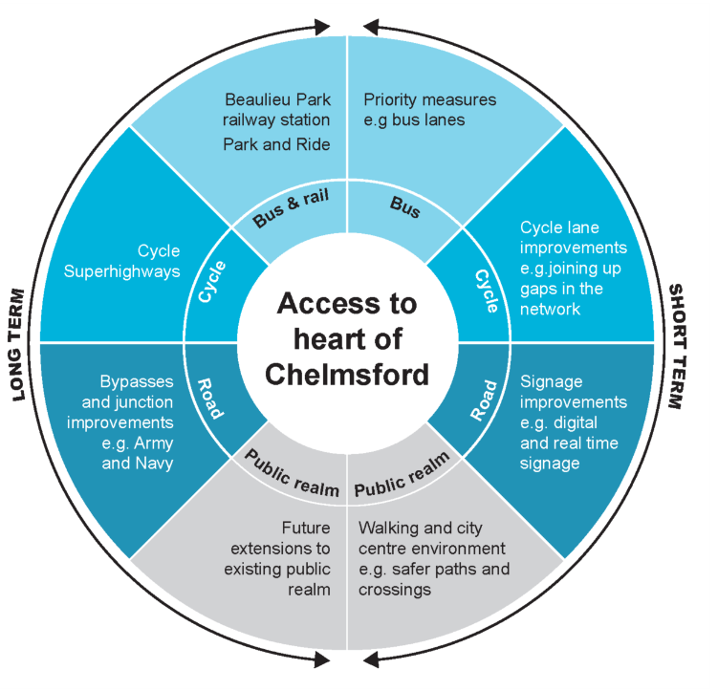

General Economic Benefits: Chelmsford Transport Strategy
Growing City, delivering close to 1,000 new homes and 700 jobs per year
One of the busiest rail stations outside of London at 8.5 million passenger trips per annum
City Centre Network has only 4% capacity at peak times
Sustainability at heart of Chelmsford’s transport strategy – public transport, cycling/walking, park and ride, congestion management
Chelmsford City Transport package will address some key issues via a £15m funding package
Longer term – reduction in car travel and congestion will remain a key priority
Chelmsford Station is a significant contributor to trips and journeys
Beaulieu Station is a key part of the City’s future transport and growth strategy to facilitate sustainable housing and economic growth
Notes:
Stuart Graham – Moving into Chelmsford Strategy. Try to major on traffic reduction strategies.

Slide 16
Beaulieu Station development and funding

Slide 17
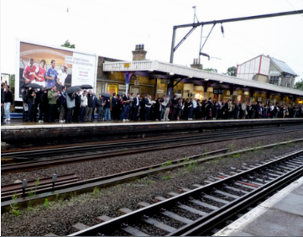

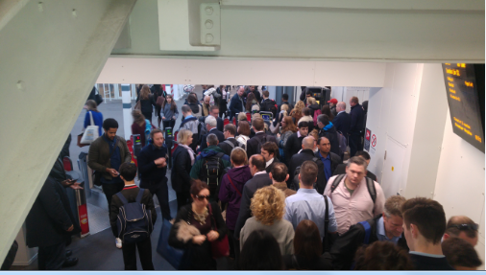
Project Development
Existing station is a Victorian station on top of a viaduct – some recent and very valuable improvements to ticket hall but little hope of viable expansion
New Railway Station on GEML 3 miles north of Chelmsford
Forms part of long term vision for Growth of Chelmsford – England’s newest City
Included in NR’s Anglia Route Study – March 2016
NR retained as Project Delivery Partner – Currently at GRIP 3
Outline Planning Permission granted 2014
Delivery being implemented by Steering Group of Chelmsford City Council, Essex County Council, Network Rail, Countryside Zest. MoU signed December 2015
Congestion in AM Peak – Chelmsford Station
Notes:
Stuart Graham – Highlight the inadequacies of the current station. Little/no room to expand the existing station. Recent station developments whilst improving the station is some respects has done nothing to ease overcrowding at peak periods. With anticipated growth in Chelmsford and with the BP development it is reasonable to expected growing numbers needing to use the station. These numbers can be expected to be substantial.

Slide 18
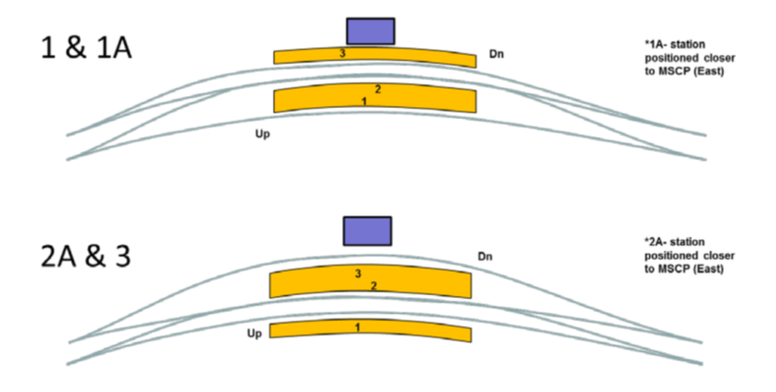
GRIP 3: 2018-2020
Study developed by WSP on behalf of Network Rail
A key objective for both Network Rail and the TOC, Greater Anglia is to ensure that the new station does not cause capacity issues on the GEML, particularly prejudicing faster journey times.
This is consistent with the GEML Taskforce Vision
The identified station options are configured with a central passing loop (or turnback) requiring 3 platforms.
These options that are now being developed further through GRIP stage 3
This will result in a preferred option for the station layout being selected.
Simultaneously ECC has completed the development of an access strategy for the station covering car parking, bus, taxi, cycling and walking routes and facilities.

Slide 19
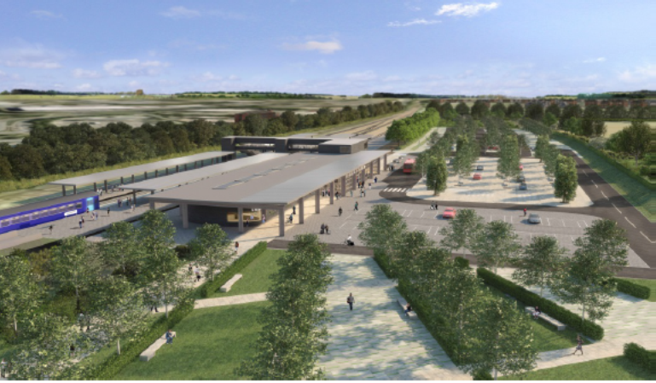
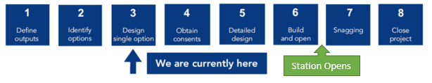
Current Status of Design Development
Notes:
Stuart Graham – Start of Part 2.
Station Opening

Slide 20
Beaulieu Station Delivery Milestones
Target Delivery Milestones – agreed by Steering Group
Complete GRIP 3 (AIP Outline Design) – 2 March 2020
Complete GRIP 4-5 (Consents and Detailed Design)– March 2023
Commence GRIP 6 (Construction) – March 2023 (including enabling works)
Complete HIF spend by March 2024
Target Station Fully Operational for timetable change – December 2025
Notes:
Chris

Slide 21
Funding
£34m secured through SELEP and S106
Housing Infrastructure Fund made available for infrastructure projects that deliver significant numbers of new homes. £218M total bid, £124.5M for the station
The planned new station at Beaulieu Park is important for the construction of 4,000 new homes currently being built, a further 3,000 planned for the future, and the potential for 2500 more home in the long term.
Development of Evidence Base – including wider economic impacts and understanding of scheme benefits.
Submission of Chelmsford bid covering both Beaulieu station and Chelmsford North East Bypass in March 2022
Currently working through ‘due diligence’ stage and await announcement

Slide 22
The benefits of the station – operational and economic

Slide 23
Operational Benefits
Central Loop allows Chelmsford Starters to Move to Beaulieu Park.
Provision of Loop removes need for infrastructure intervention at Chelmsford.
Delivery of the station supports delivery of capacity improvements in the area of Chelmsford.
Reliability benefits on the Great Eastern Mainline as a result of the introduction of the passing loops.
Reduction in Crowding at Chelmsford Railway Station.
Reduction in Traffic Congestion within Chelmsford as a result of the abstraction of car journeys.
Reduction in Traffic Congestion on the A12 South of the Boreham
Interchange as a result of the provision of a railway station more easily accessible from the Highway Network.
Notes:
Chris Stevenson – Note

Slide 24
