Slide 1
Great Eastern Main Line Taskforce
Conference – 11 July 2019
Greater Anglia business update
Jamie Burles
Managing Director
Greater Anglia

Slide 2
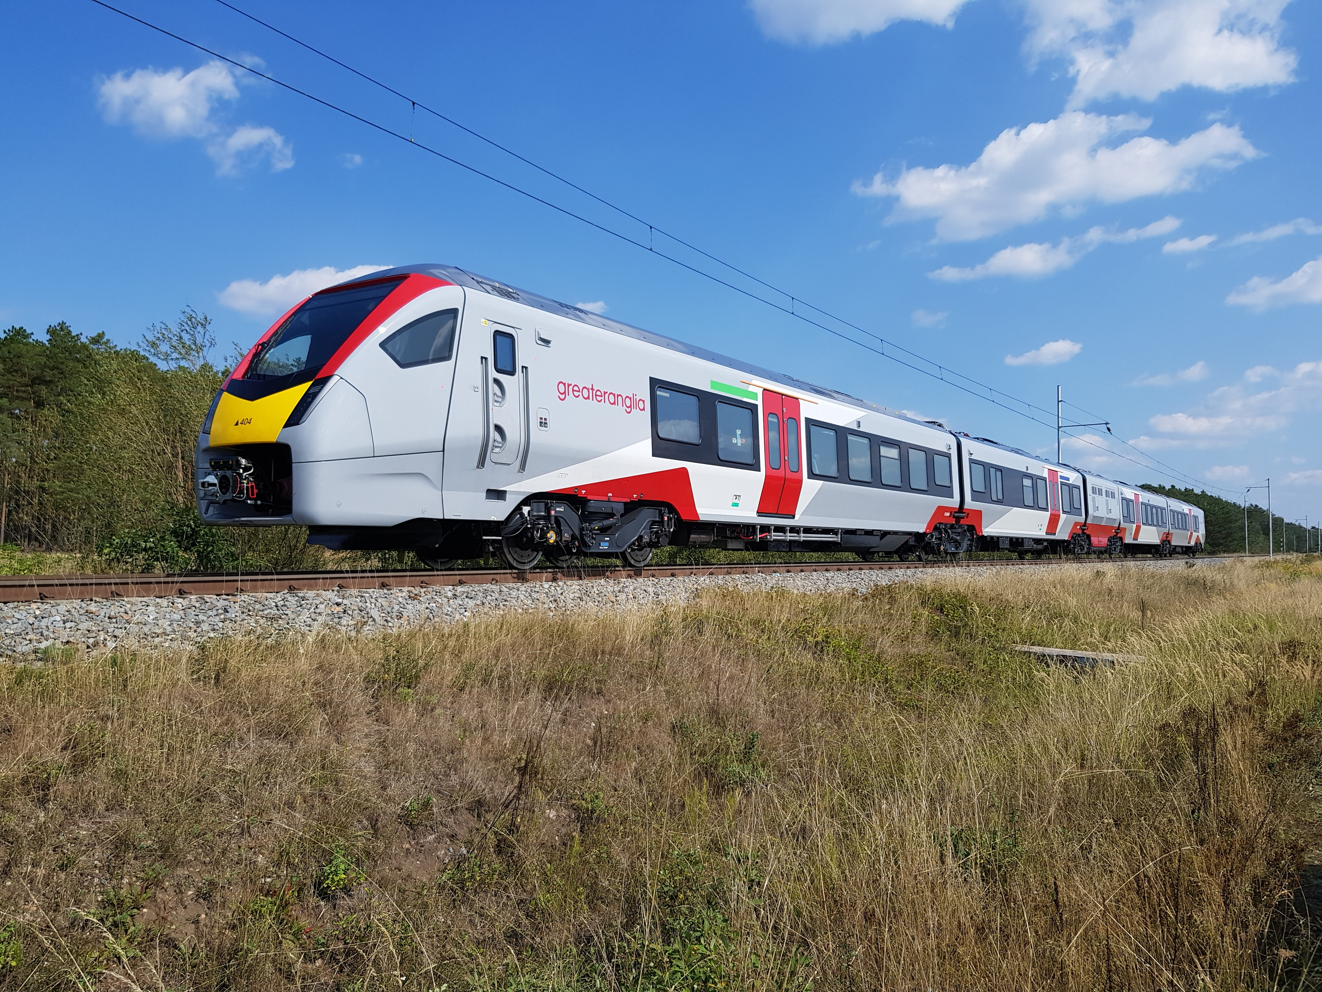
Agenda
Excellent performance progress
Franchise commitments delivered
Other improvements implemented
New trains programme on course

Slide 3
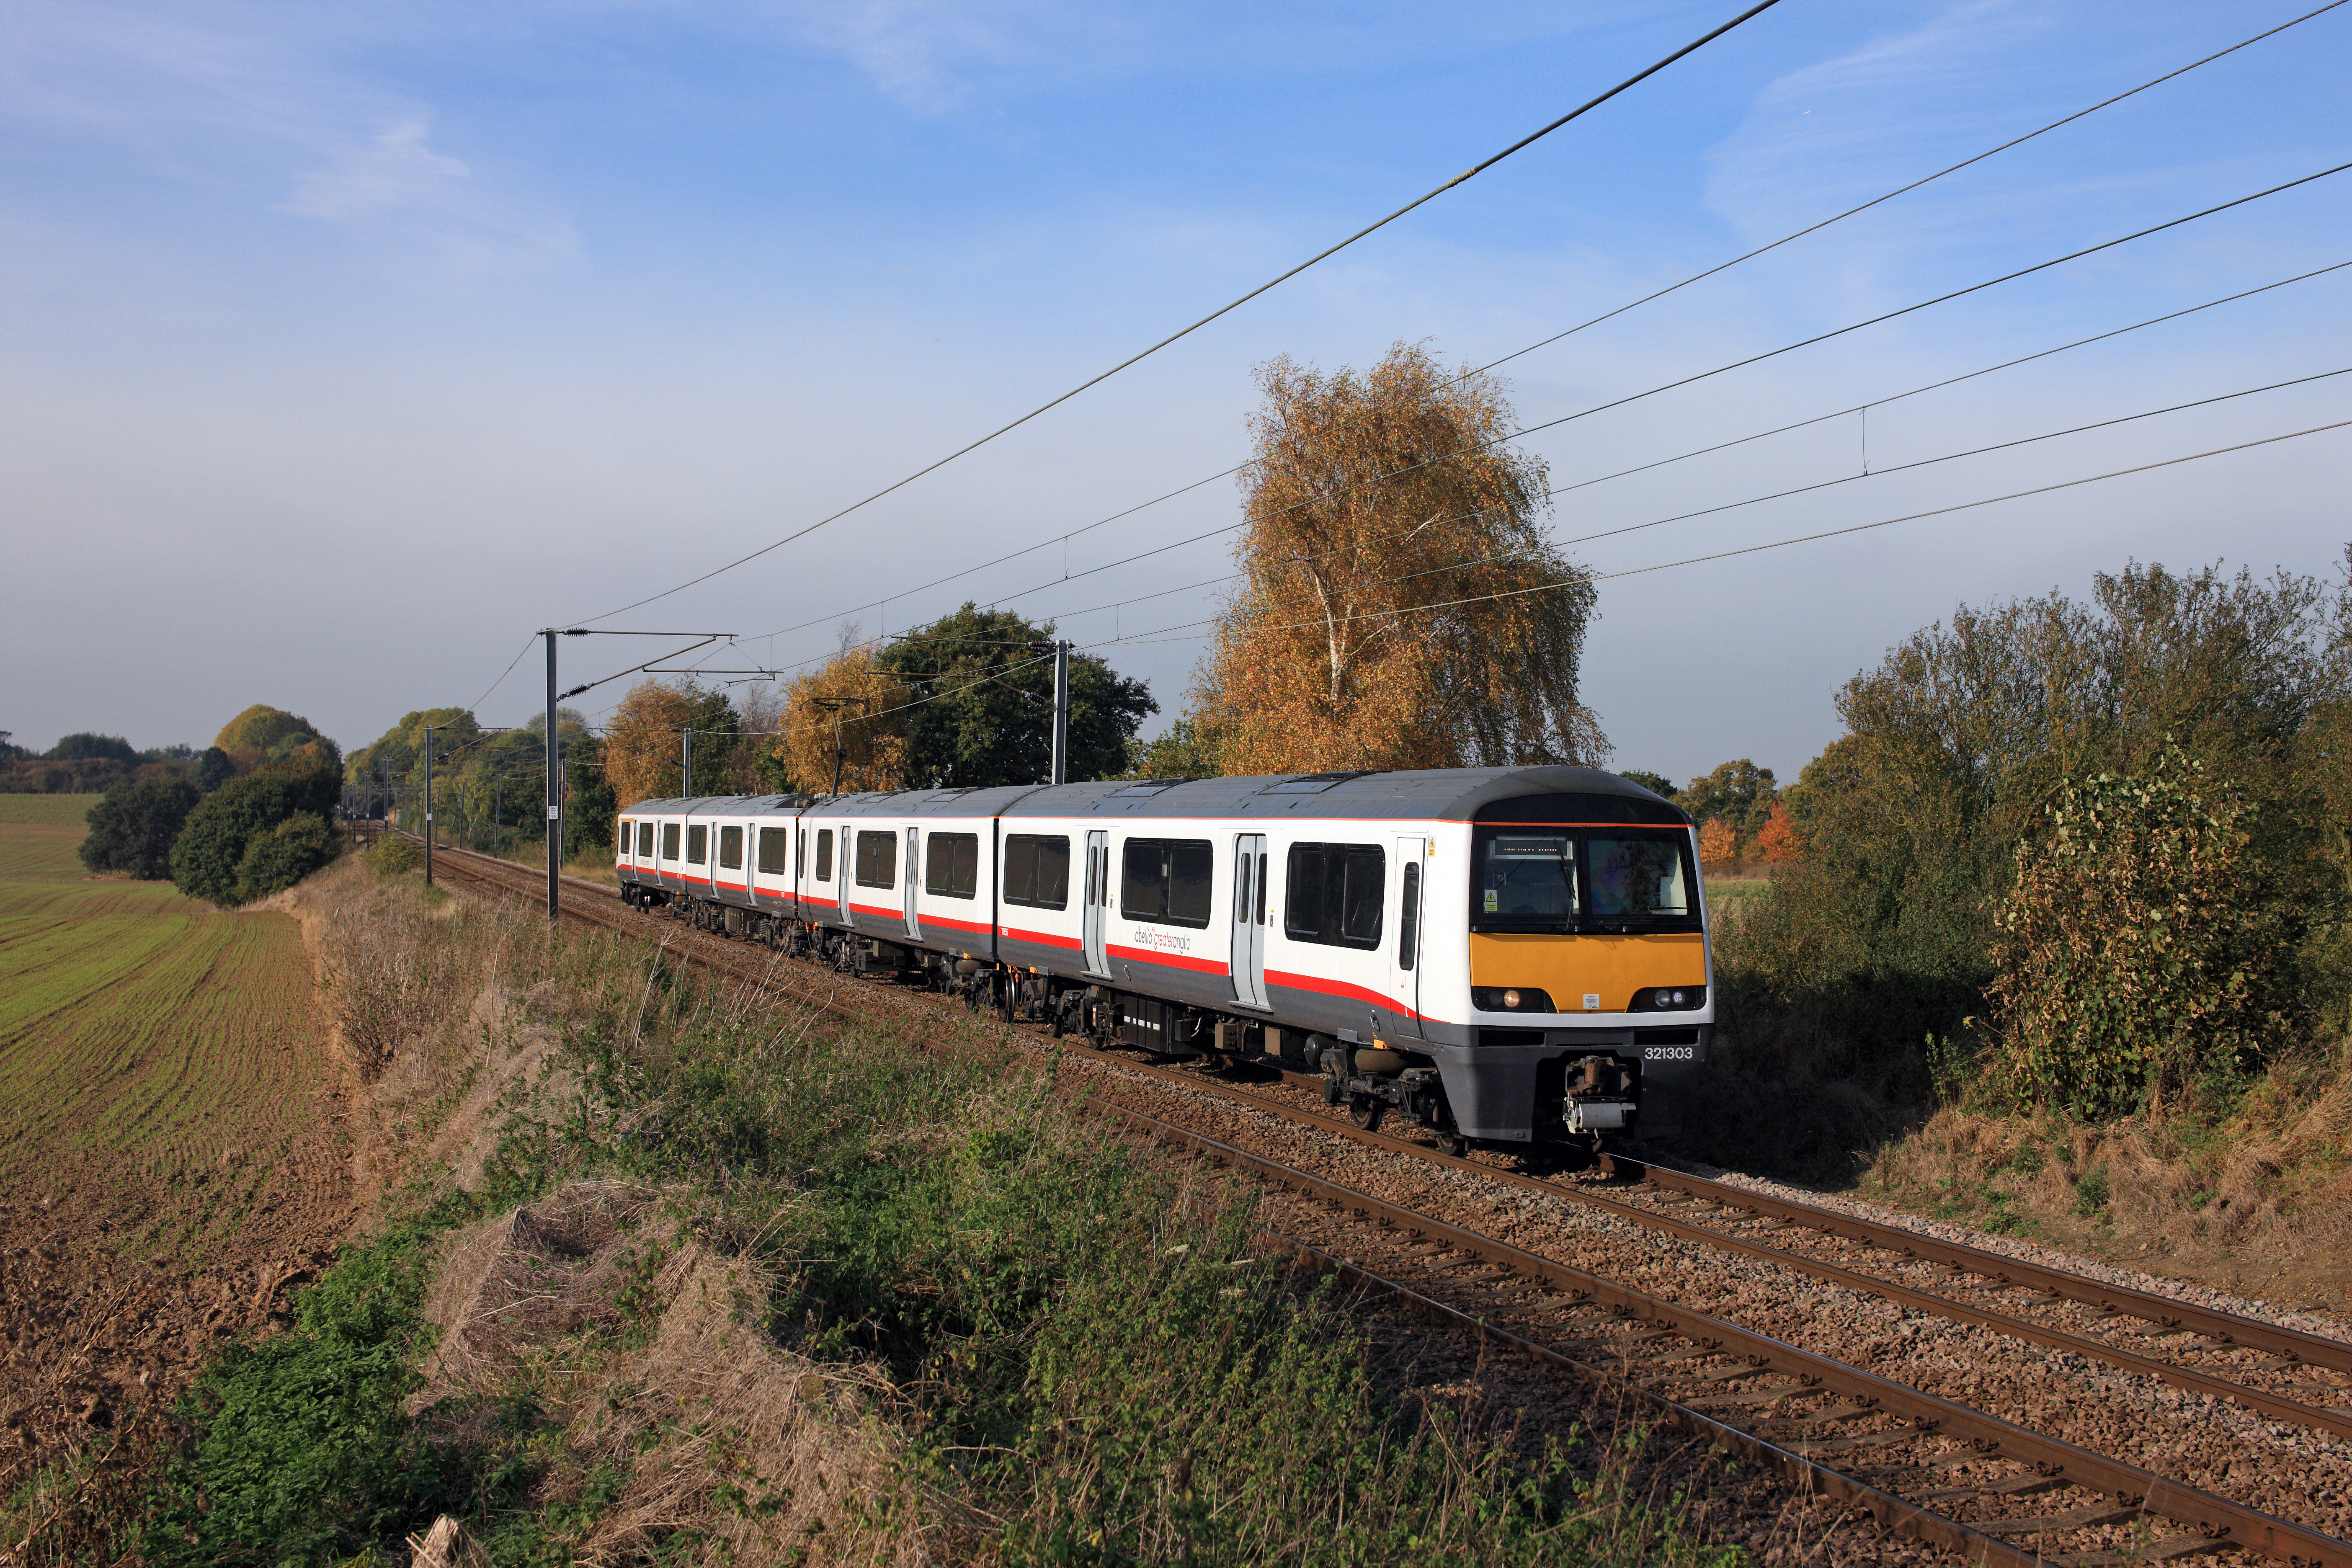
Excellent performance
Record GEML performance
4 successive periods over 94.7%
94.78%, 95.83%, 95.51% & 95.79%
Follows GA-Network Rail performance summit
Fleet reliability initiatives working well
Network Rail improving too
Committed to maintaining positive trends

Slide 4
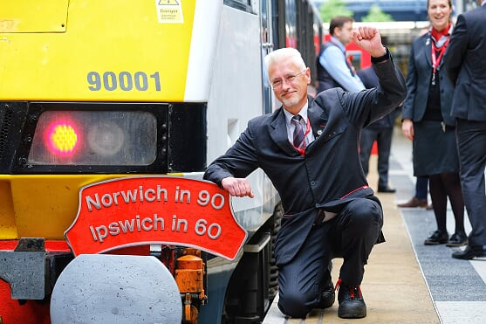
Franchise commitments delivered
Norwich in 90/Ipswich in 60 services delivered as scheduled from Monday 20 May 2019
Extra capacity provided on GEML suburban train services from 2017 onwards by hiring additional trains
Smart ticketing roll out making ticketing more convenient and flexible (UK rail industry leader)
Wi-fi now fitted to all electric trains
Station upgrades – more seats, platform and car park re-surfacing, re-painting, new lighting, new customer information systems

Slide 5
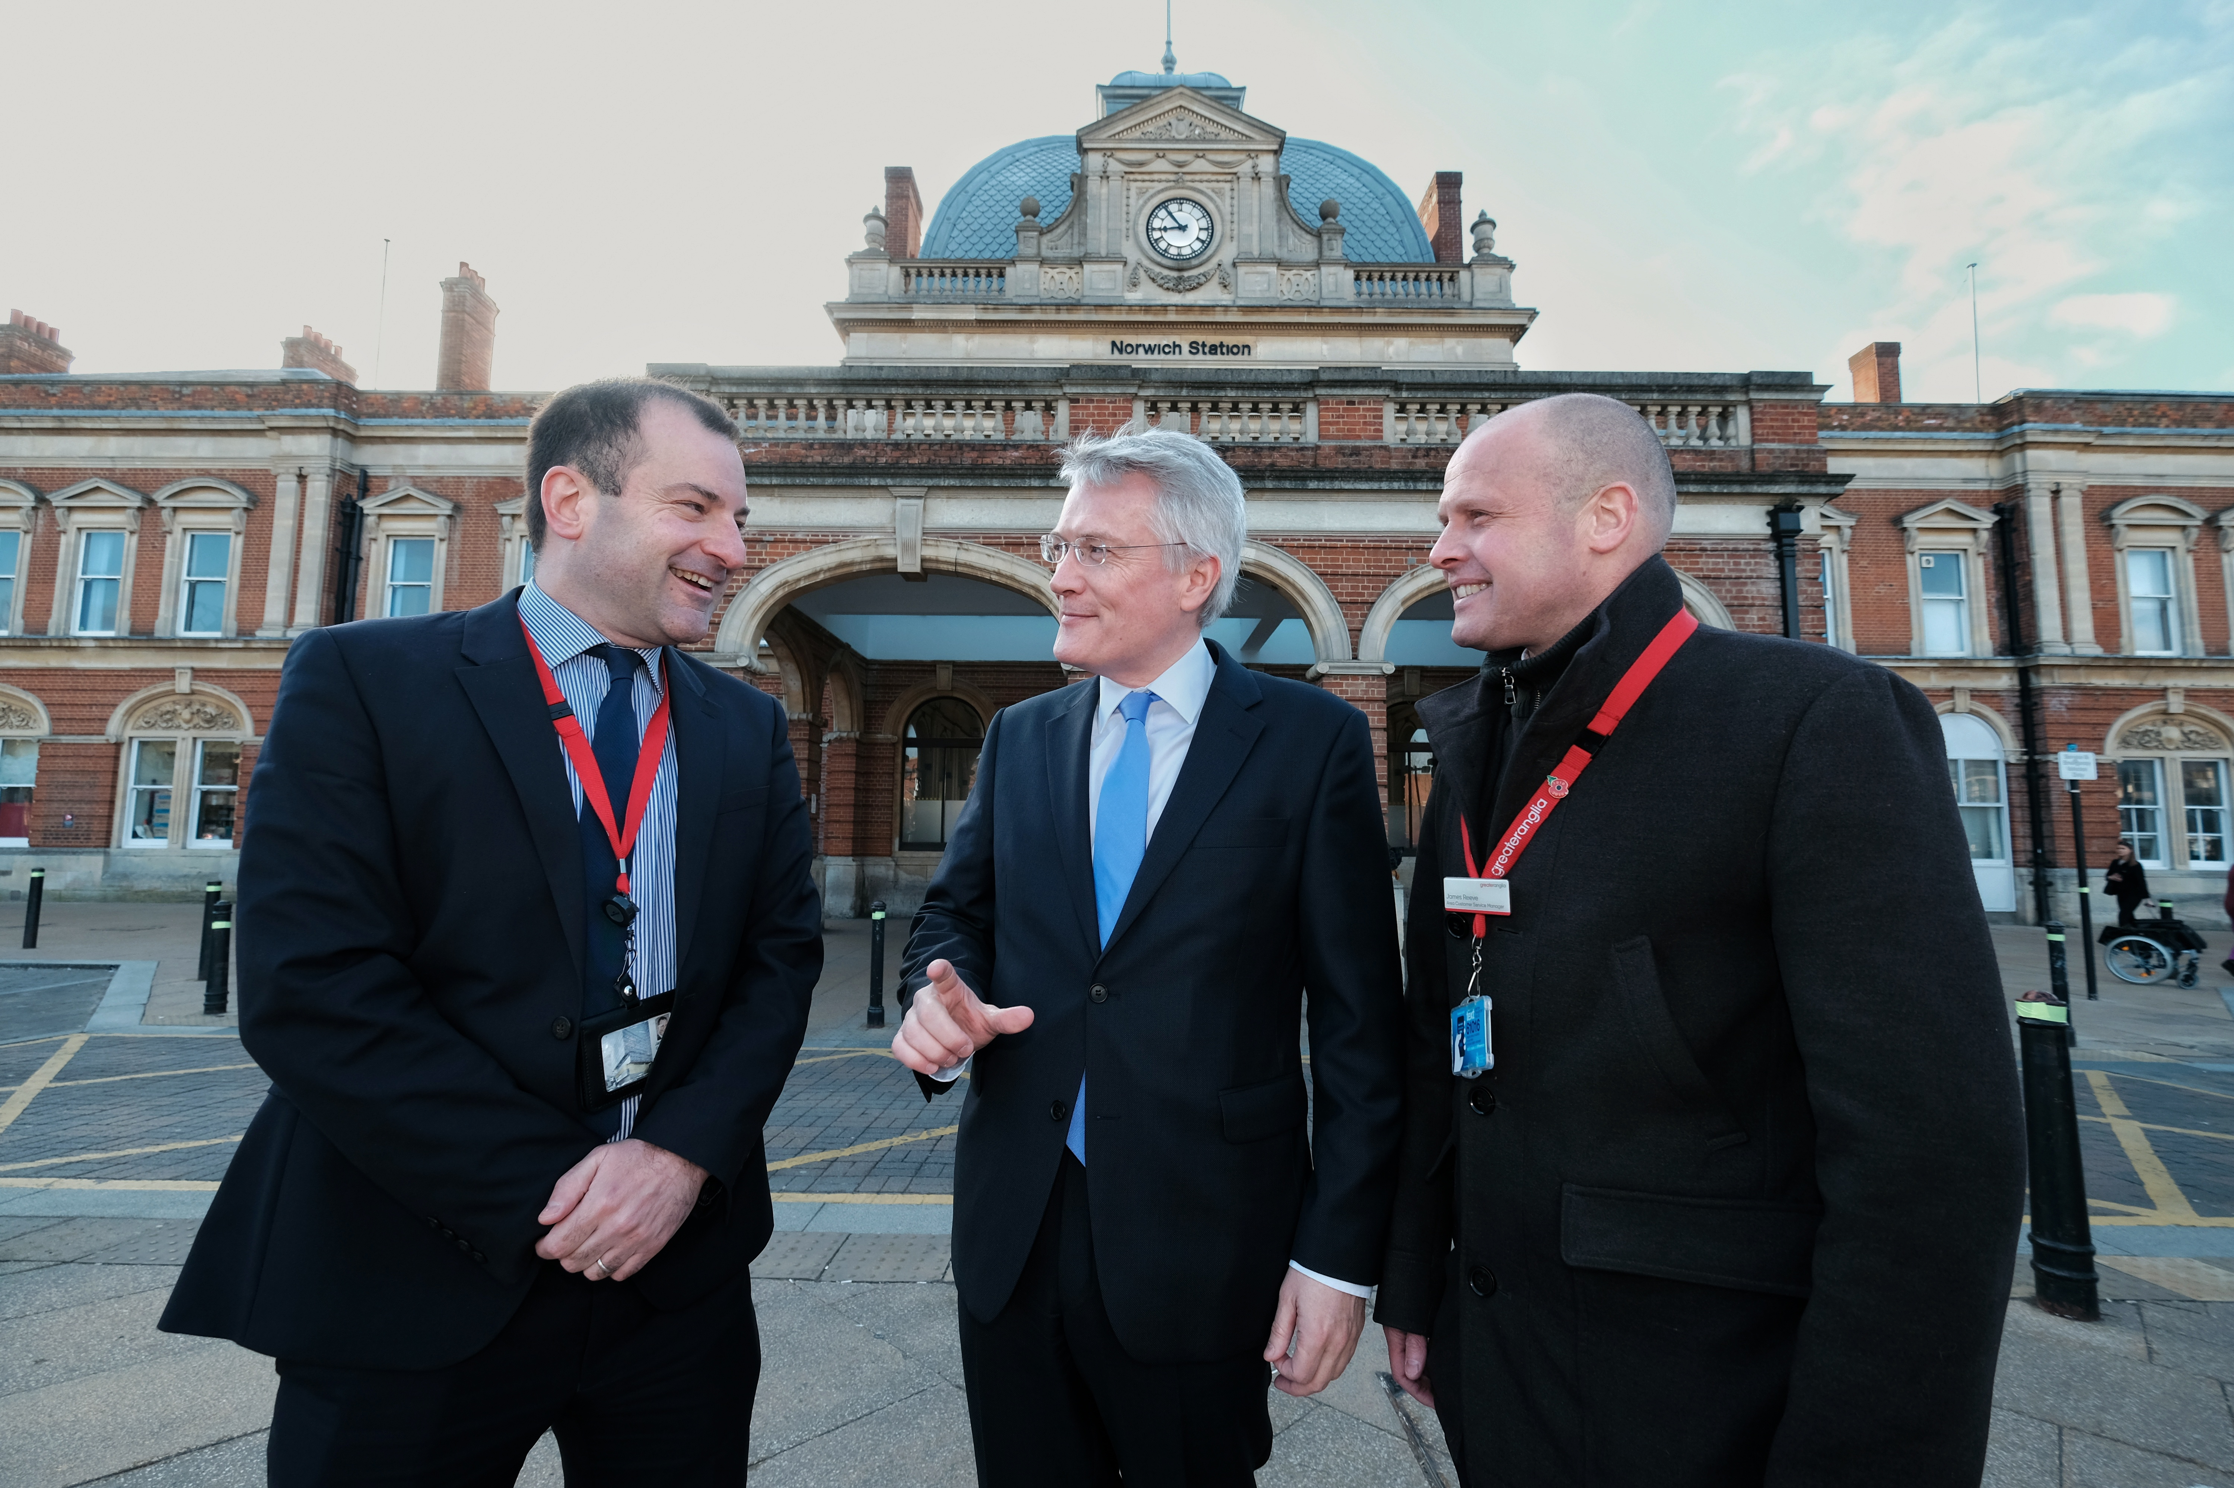
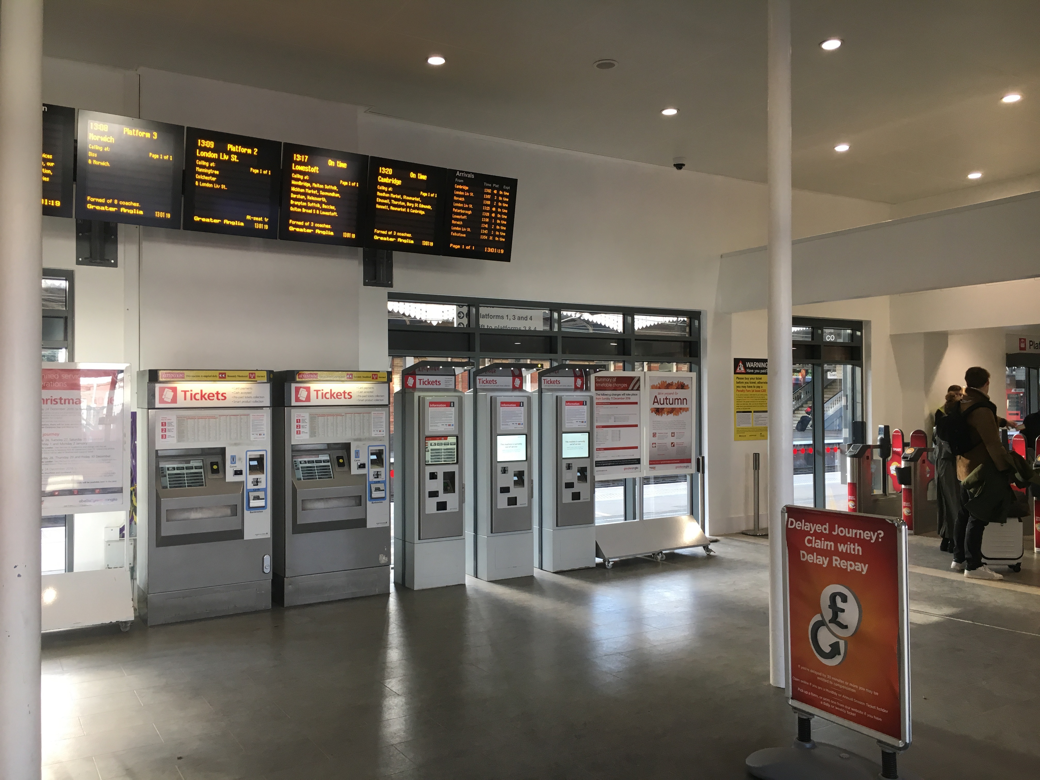
Other improvements
Delay Repay 15 launched earlier than expected (April 2019) despite it not being a franchise commitment
Over £108 million investment in stations and depots in the last two years
£25 million investment in car park upgrades with ANPR, CCTV, re-surfacing, more spaces and easier payment options
Water fountains at Chelmsford, Colchester, Ipswich and Norwich
Most routes free of engineering work for the summer

Slide 6
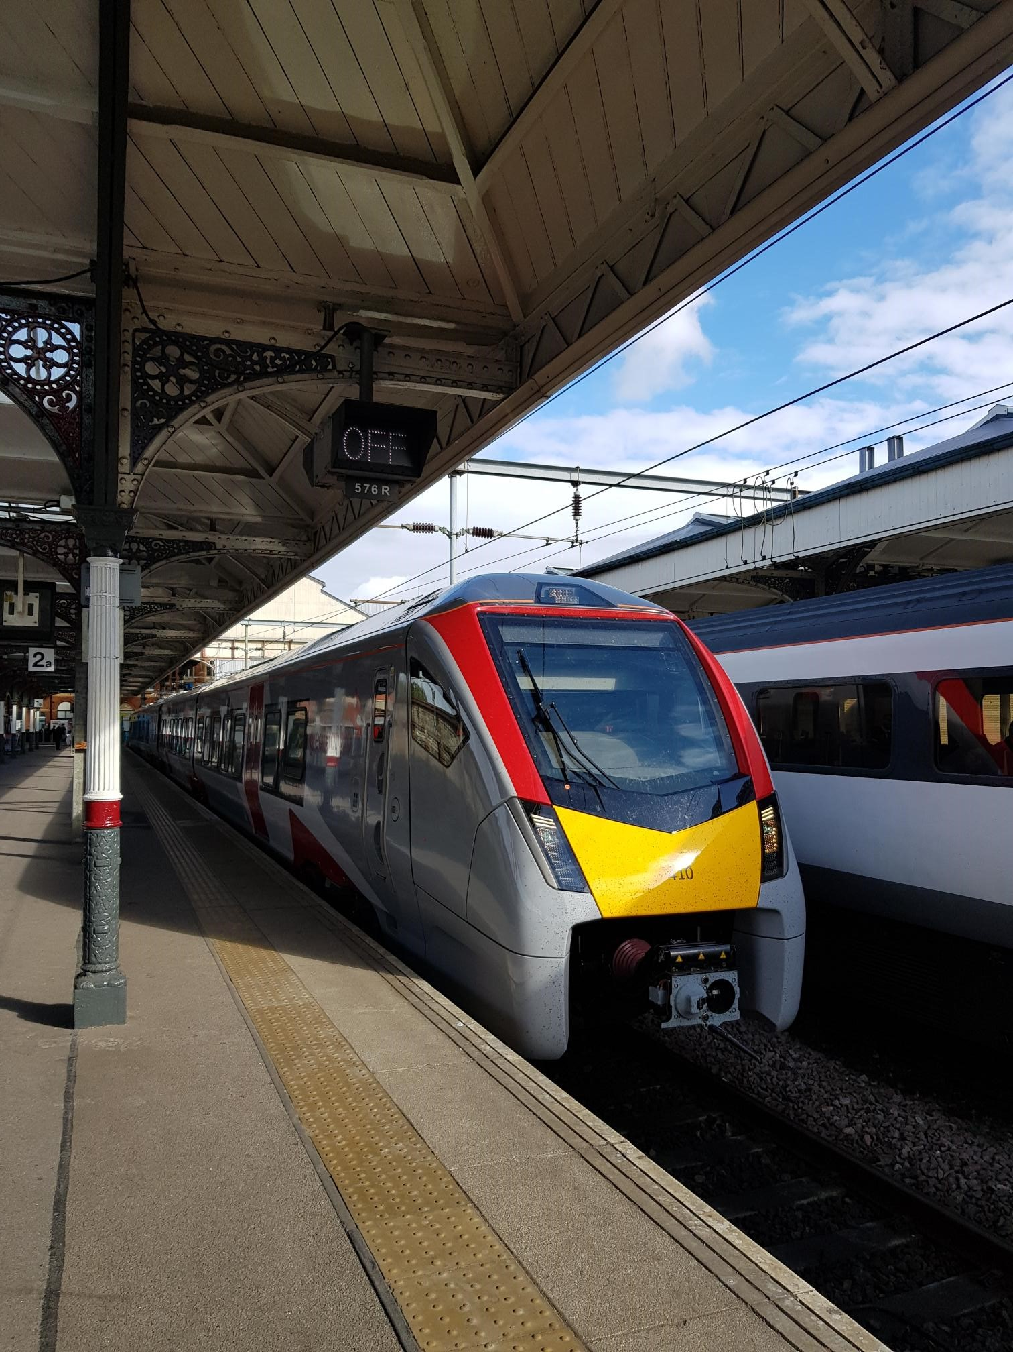
New trains (1) - Stadler
Already have 24 of 58 trains here in the UK
19 bi-modes, 3 Intercity, 2 Stansted Express
Testing and commissioning going well
High quality trains
More seats, more comfort,
Air conditioning, wifi, plug points, USB ports
Better accessibility
24 x 4-car bi-modes, 14 x 3-car bi-modes
10 x 12-car intercity, 10 x 12-car Stansted Express
First ones in service later in the summer

Slide 7
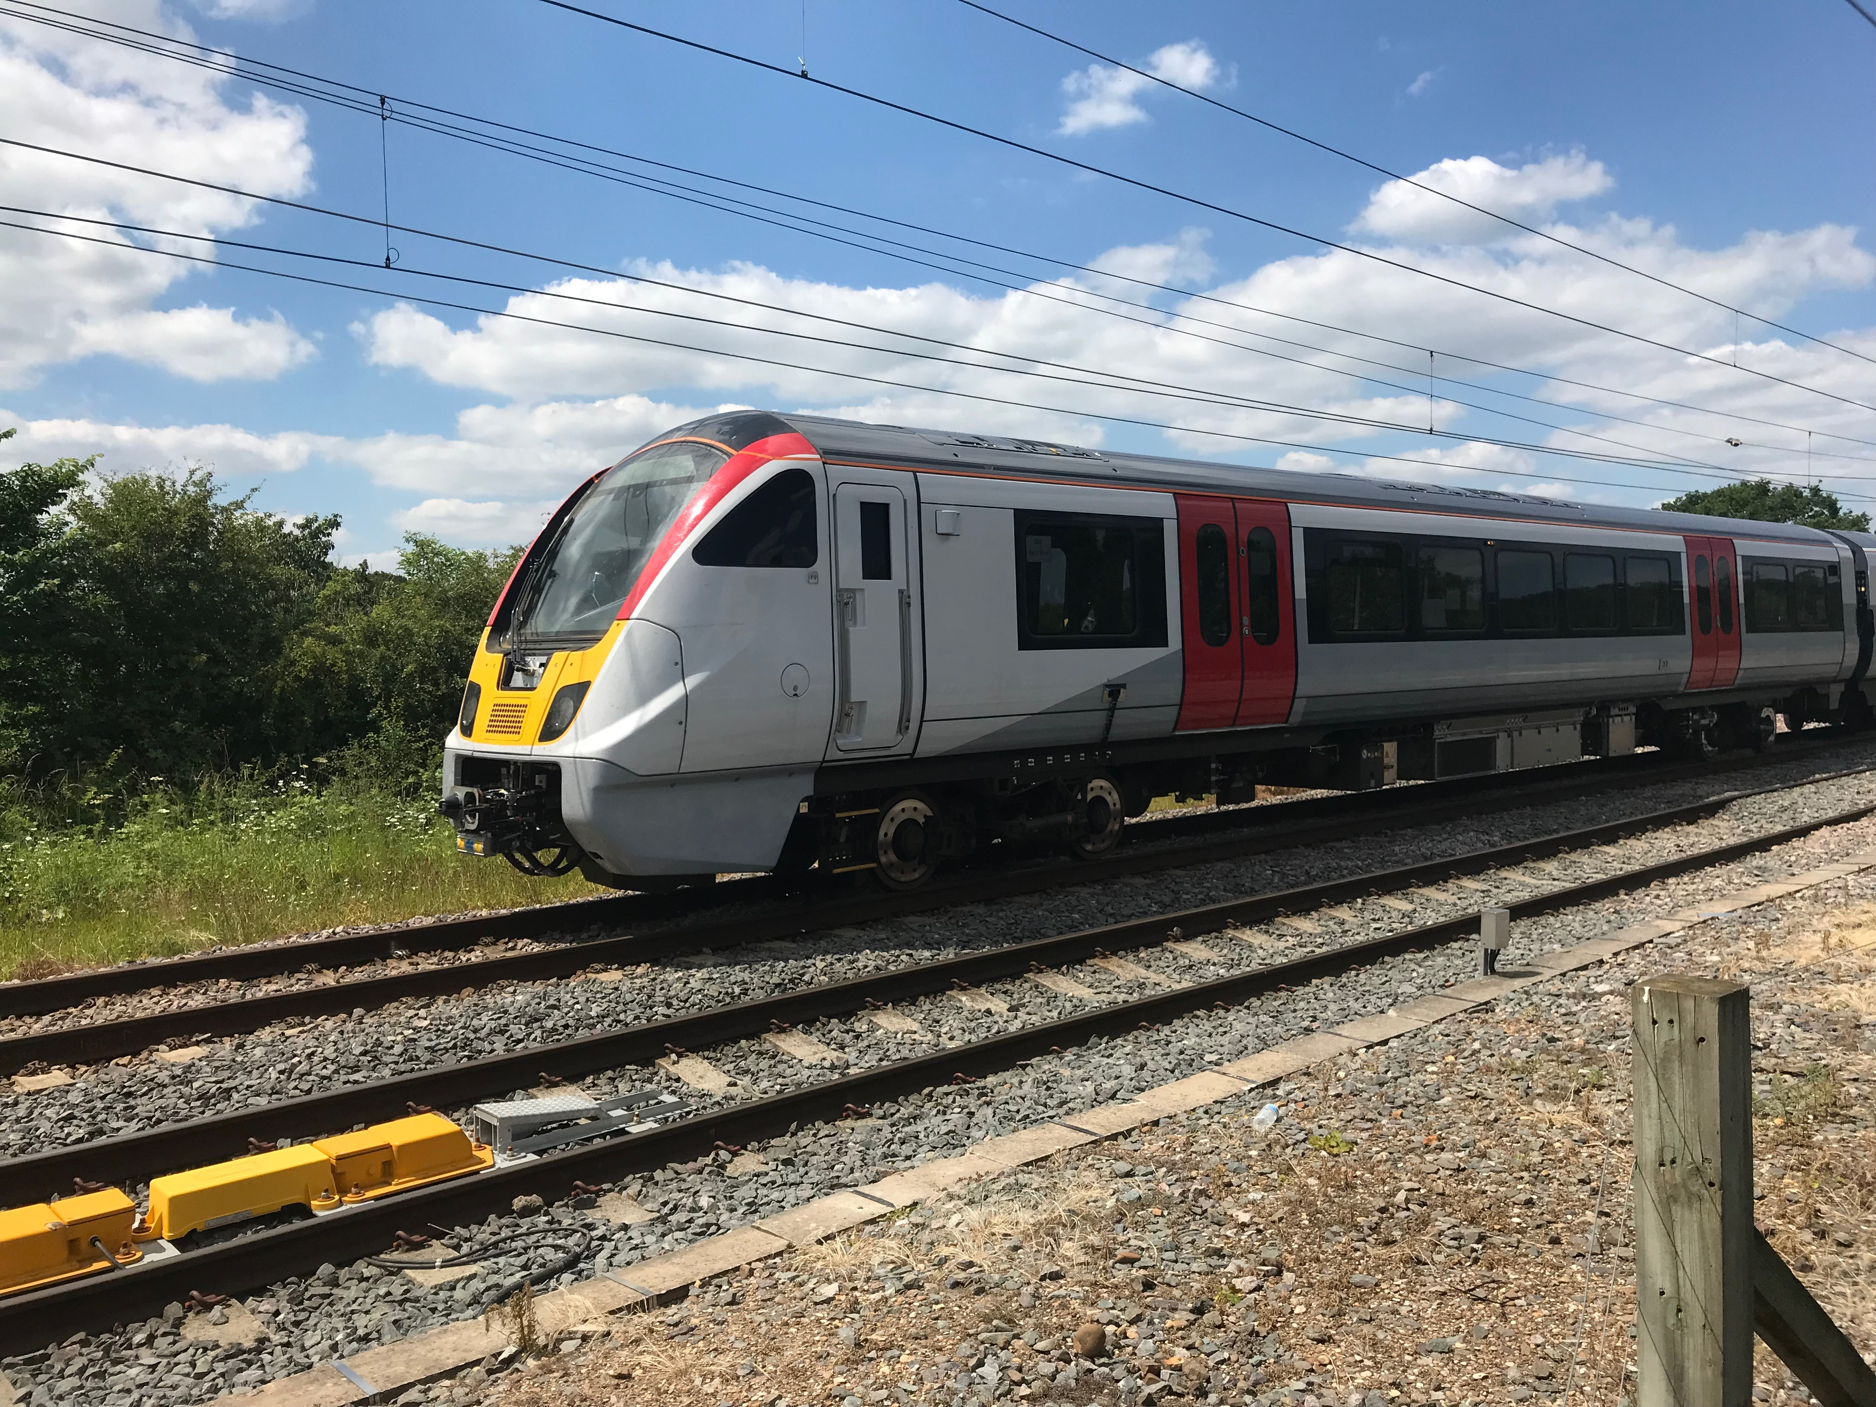
New trains (2) - Bombardier
First train on test at Old Dalby
Testing and commissioning at Derby
Also very good trains
More seats, more comfort,
Air conditioning, wifi, plug points, USB ports
Better accessibility
89 x 5-car trains, 22 x 10-car trains
First train due in service in the autumn

Slide 8
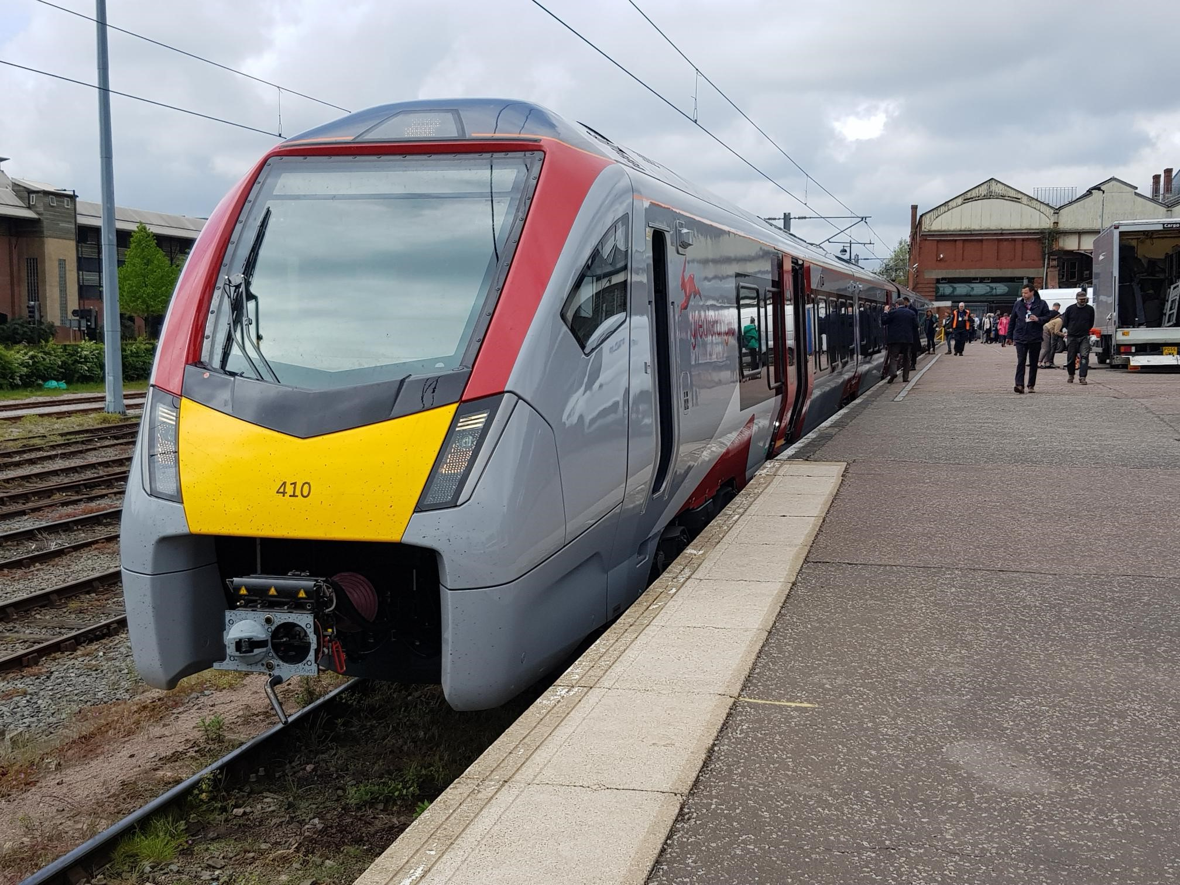
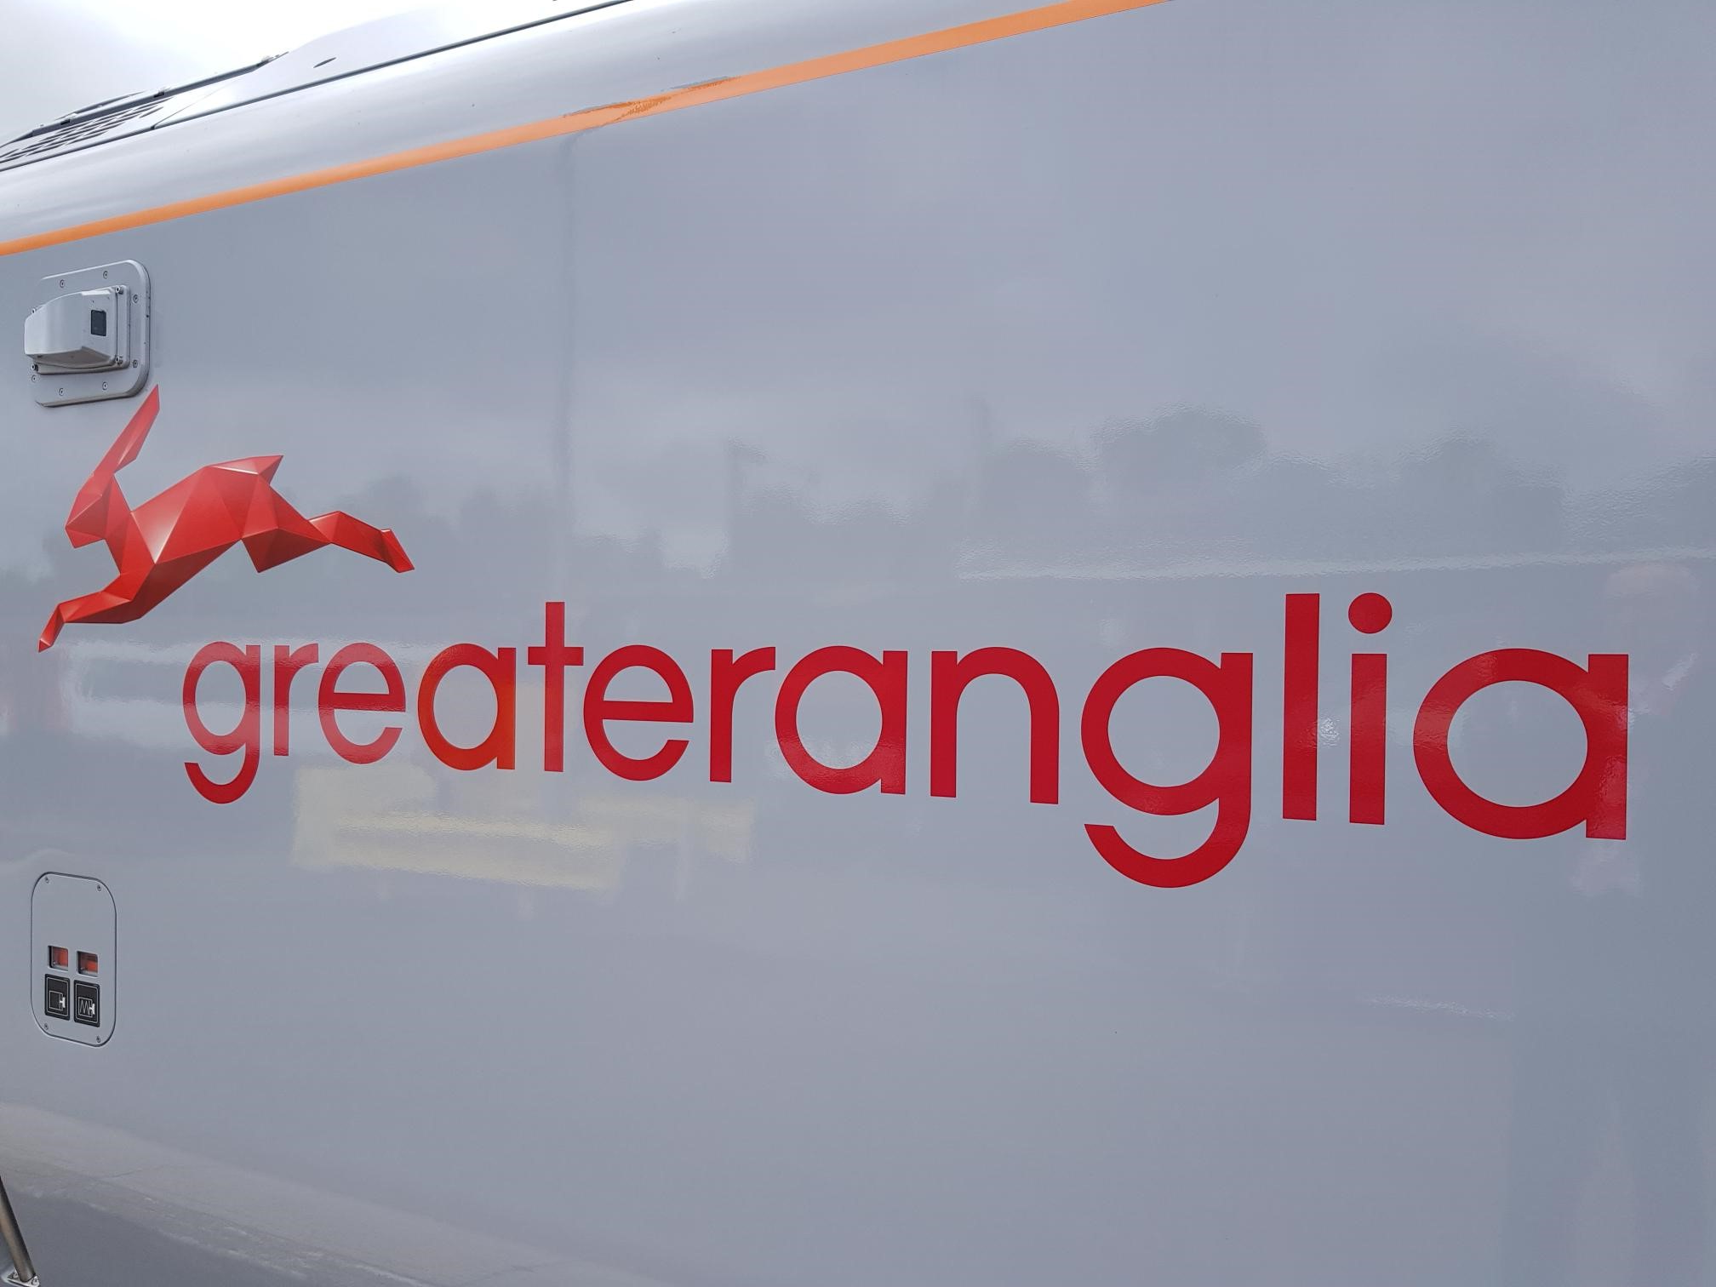
New trains

Slide 9
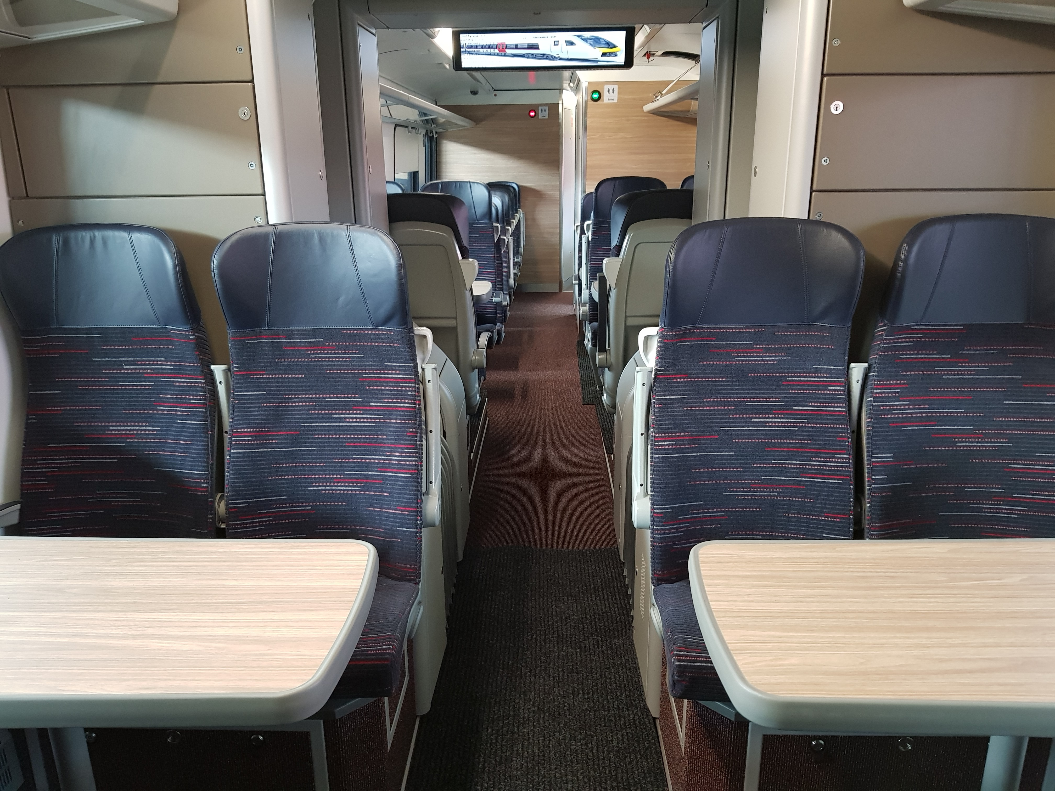
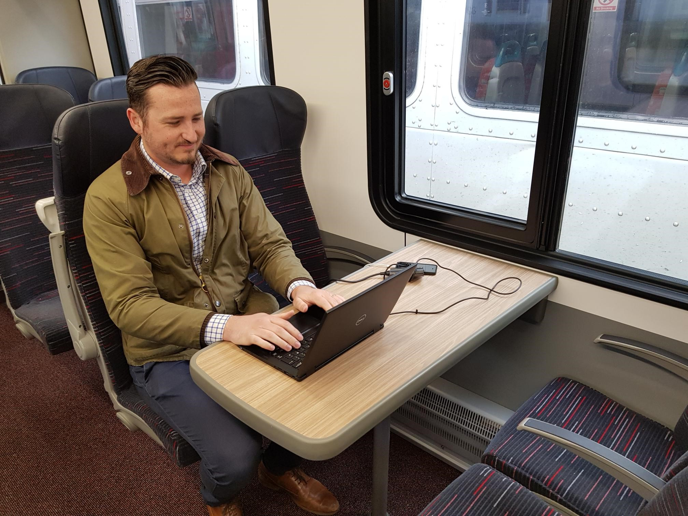
New trains (Intercity/regional/Stansted Express)

Slide 10
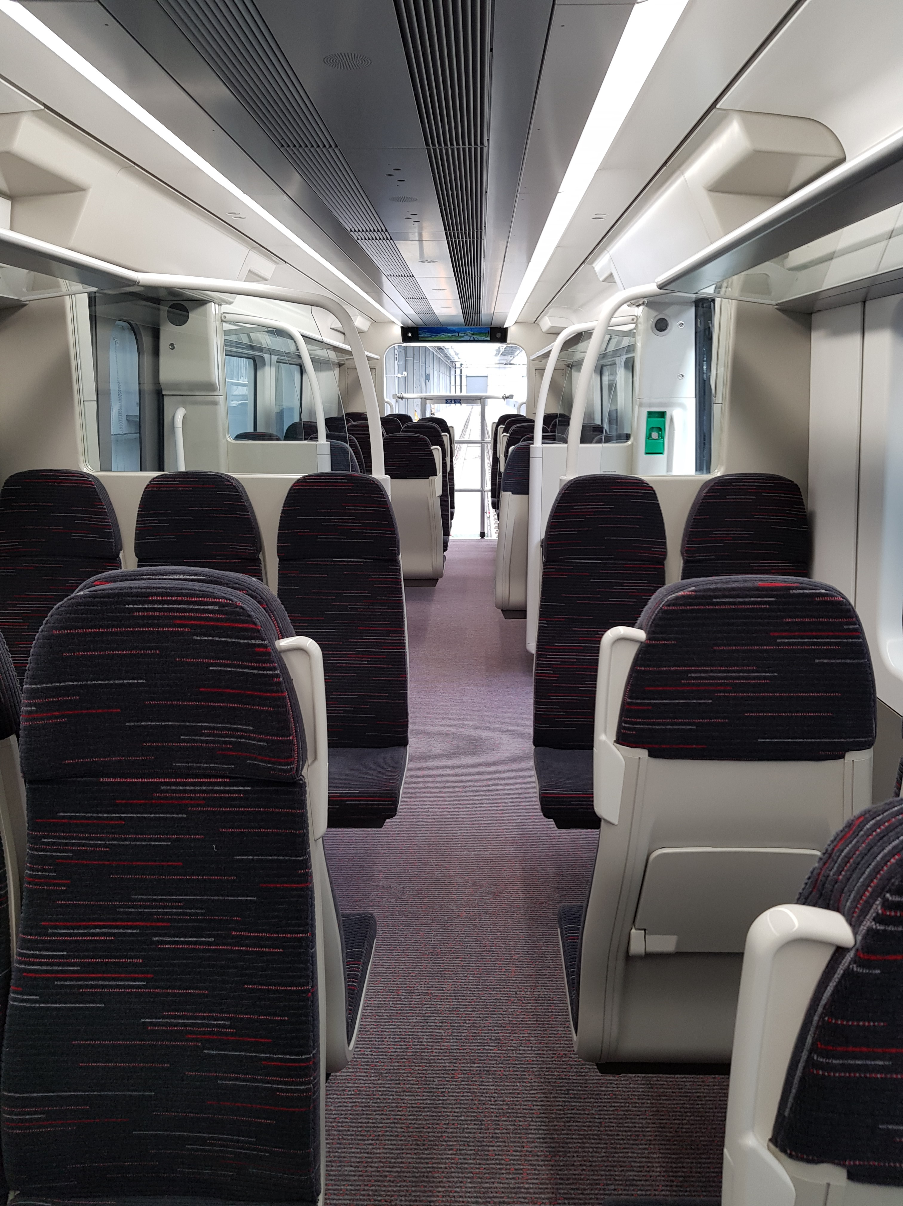
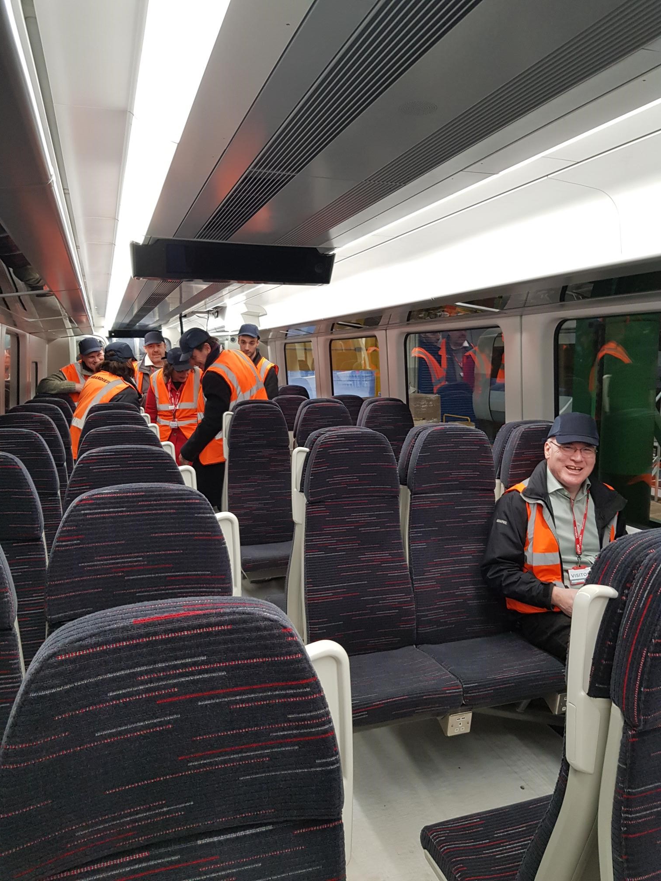
New trains (Suburban)

Slide 11
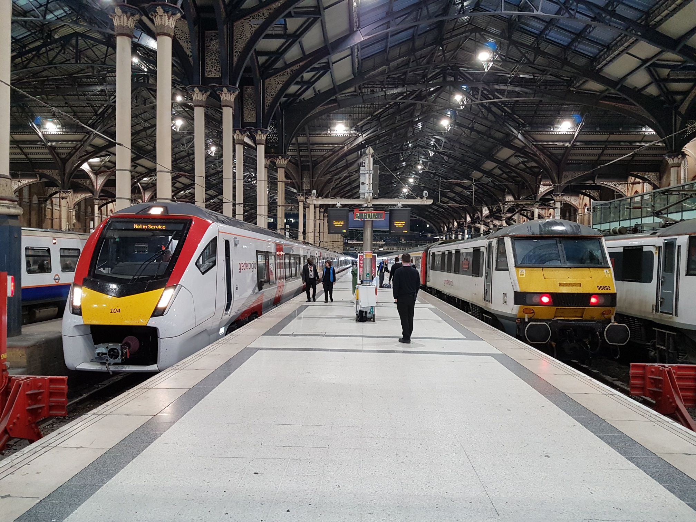
Looking forward
New train roll out begins shortly – 18 month transformation with phased service introduction
New marketing and PR campaign, plus new uniforms
Most Stadler trains due in service by the end of 2019
Other timetable improvements to be phased in
Continued stakeholder campaign with the GEML Taskforce to secure the rail infrastructure investment and improvements that will enable us to maximise the impact of the new trains and the benefits for customers and communities all along the route

Slide 12
Thank you

