Slide 1
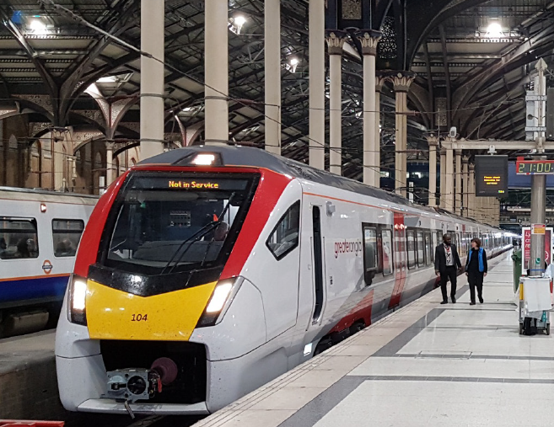
GEML Wider Economic Benefits Study Overview of approach Presentation by Ciaran Gunne-Jones, Senior Director 11 July 2019

Slide 2
Introduction
Parallel study to complement and inform the SOBC
Update previous assessment prepared in 2014
Consider the wider economic benefits to unlocking growth across Essex, Suffolk and Norfolk
Focusing on the key locations of Chelmsford, Colchester, Ipswich and Norwich
Garden community proposals and additional housing growth in Southend will be presented as a sensitivity test reflecting their longer-term nature and emerging planning status
Reflect updated service patterns and latest economic growth assumptions for key settlements along the route

Slide 3
Scope of works
Capital investment & construction impacts: impacts of planned capital investment on construction employment and associated income generation and economic output
Permanent employment impacts: operational jobs created directly and indirectly in the local areas arising from the enhanced development potential as a result of the investment, and associated economic output
Resident impacts: local expenditure and jobs supported, as well as the potential role of the capacity enhancements in improving access of residents to services and employment, in turn helping reduce worklessness

Slide 4
Scope of works
Fiscal benefits: the benefits that development would bring in terms of local authority financial receipts from New Homes Bonus, business rates and Council Tax
Development and property impacts: impacts on demand for property in the local areas along the route, in terms of residential and commercial uses and land value uplift
User and operator benefits: benefits linked to journey time savings for residents and business users along the route, improved connectivity, and environmental benefits
Other qualitative benefits: local competitiveness and business location perceptions

Slide 5
Next steps
Scenario input information from the SOBC (via Jacobs) during July
Prepare the scenario development followed by economic modelling in August
Draft WEB study report to be issued in early September

Slide 6
This publication has been written in general terms and cannot be relied on to cover specific situations. We recommend that you obtain professional advice before acting or refraining from acting on any of the contents of this publication. Lichfields accepts no duty of care or liability for any loss occasioned to any person acting or refraining from acting as a result of any material in this publication. Lichfields is the trading name of Nathaniel Lichfield & Partners Limited. Registered in England, no.2778116. Registered office: 14 Regent's Wharf, All Saints Street, London N1 9RL © Nathaniel Lichfield & Partners Ltd 2019. All rights reserved.

